Slide 1
An Analytic Framework to Support Open Collaboration Needs Assessment
^{ENGAGING MINDS,} ^{EXCHANGING IDEAS}
Dr Justin Lee
Research Fellow
Institute of Policy Studies
Lee Kuan Yew School of Public Policy
National University of Singapore
Engaging Minds, Exchanging Ideas

Slide 2
Context: From Participatory Needs Assessment to Open Collaboration Needs Assessment
Needs assessment – (focus on client type)
Open collaboration – e.g. Wikipedia
Benefits of open collaboration needs assessment
From incremental to exponential growth
From proprietary to public knowledge

Slide 3
Objective
Can and should needs assessments be done via open collaboration?
Yes, it can and it should. And this is how we might do it.

Slide 4
Background
Developed while in National Council of Social Services
Help bureaucrats without technical training hit the ground running without luxury of extensive training
Analytic framework developed and tested, tentative plans to implement it

Slide 5
Some projects we started
Financially Vulnerable Seniors
End of Life
Ex-offenders and their Families
People with Disabilities

Slide 6
Requirements for Open Collaboration Needs Assessment
Analytic Framework
Knowledge base that is ‘contributable to’
Facilitate collective sense-making
Social Participation
Buy-in and commitment
Right ethos of working together
ICT Infrastructure
Magnify the reach and ease collaboration on the web

Slide 7
Components of the Analytic Framework
Environmental Scanning Strategy
Catalogue of Information
Sense-Making Template
Report & Share

Slide 8
Sense-Making Template
A) Problem Definition & Scope
Target client group & inclusion criteria
Conceptualize the desired or ideal outcomes
Size and consequence of problem
How is the problem likely to change
B) Client profile & client system
Demographic characteristics
Client segments
Client system: those at risk or vulnerable; those indirectly affected or can contribute to resolution
Distribution of the problem
C) Needs & Gaps Matrix

Slide 9
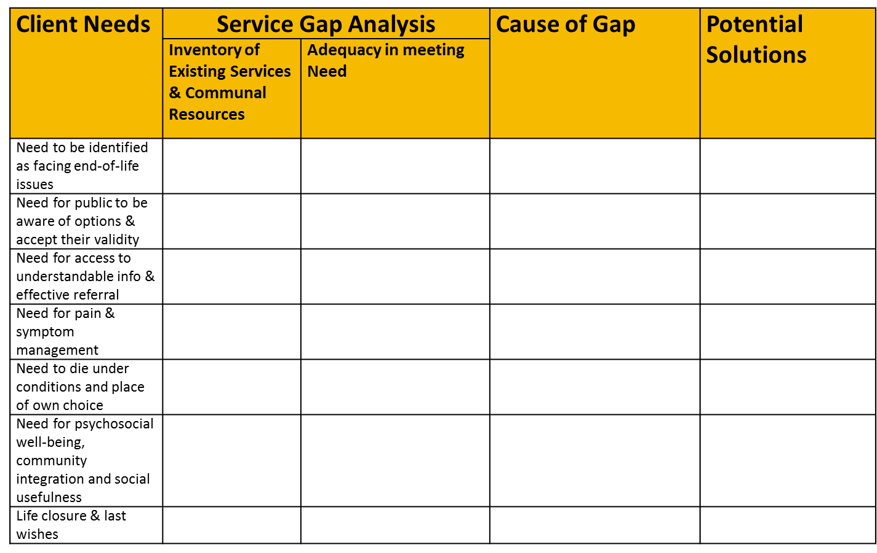
End of Life Example

Slide 10
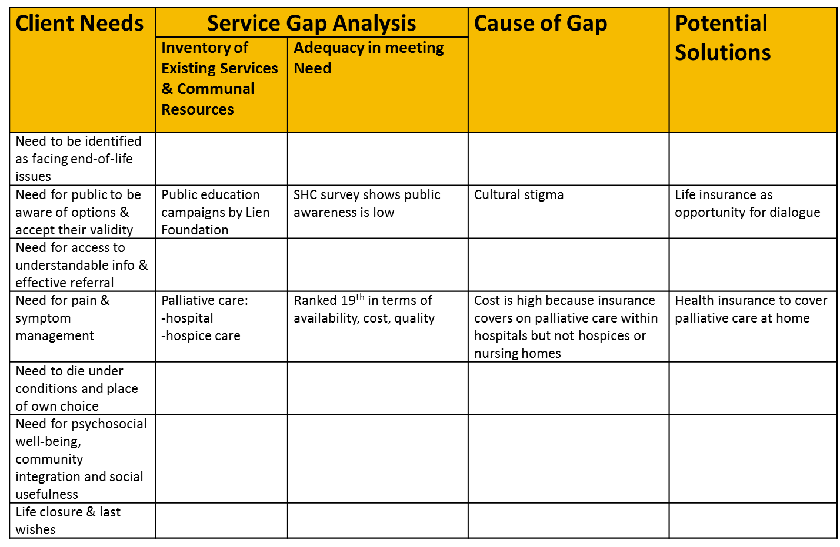
End of Life Example
Resource directory
Story you can tell by looking across

Slide 11
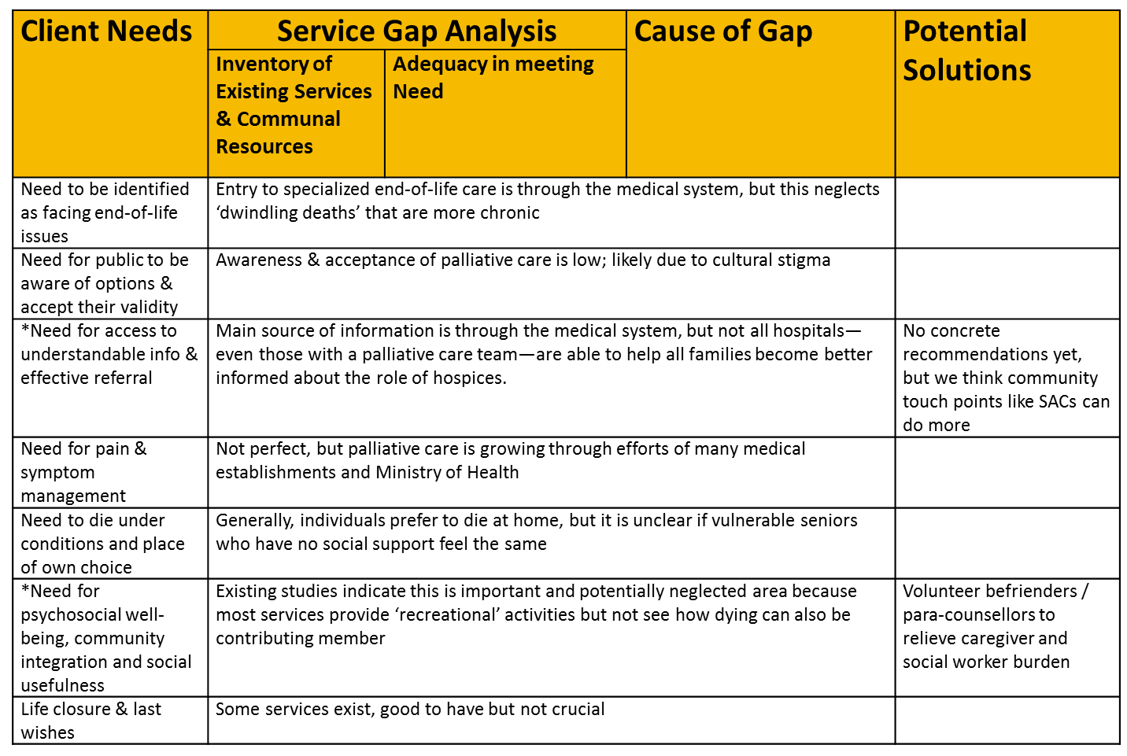
End of Life Example

Slide 12
Guidance on categories of needs
Client Needs | Service Gap Analysis |  | Cause of Gap | Potential Solutions
 | Inventory of Existing Services & Communal Resources | Adequacy in meeting Need
SCREENING, DETECTION & DIAGNOSIS
PUBLIC AWARENESS, INFORMATION & REFERRAL
TREATMENT & INTERVENTIONS
‘AFTERCARE’
CLIENT SYSTEM SUPPORT
CAPABILITY SUPPORT/MISC

Slide 13
Analytic Payoffs of the Framework
simplicity without reduction in sophistication
comprehensive, coherent and holistic
accumulative and ‘contributable to’
allows prioritization of knowledge gaps for more strategic data collection
ability to be kept updated: needs & gaps reports can be generated every year
(sometimes, I even use the template as an interview guide)

Slide 14
Strategic and Planning Benefits of the Framework
allows people to calibrate their degree of participation
overcome fragmented efforts and turf issues
changes the ethos (being transparent about ignorance)
exponential growth instead of incremental growth of knowledge base
ability to mobilize community to contribute, and lead to actionable insights for solutioning

Slide 15
Implementation?
Analytic framework is central to the process – but requires participation from a core group who should manage and oversee the process
Decide on ICT platform later

Slide 16
Thank You!
Email:
justin.lee@nus.edu.sg

