Slide 1
Challenges to evaluate the implementation of an affirmative action project: The Color of Culture
Ana Paula Brandão, Mônica Pinto
Rosalina Soares, Geraldine Silva and
Thomaz Chianca
Roberto Marinho Foundation - Brazil
Presentation at the AEA’14 conference
Denver, CO., USA - October 2014

Slide 2
Roberto Marinho Foundation
Non-governmental organization founded in 1977 in Brazil
A partnership-based organization: governments, NGOs and private companies
Focus on education using communication technologies
Target: youth and adults
Areas: education, heritage, environment and communication

Slide 3
Futura Channel:
A project managed by Roberto Marinho Foundation
A public social communication and educational project
24 hour channel . 46 million viewers
Different strategies to distribute education contents through outreach work
Sponsored by the private initiative and the non profit organization
A hub, building up partnerships to work with the principal social causes

Slide 4
Basic Education in Brazil
Universalization of education > 1990’s
But
Brazilian students with low performance in OECD’s PISA* test compared to students from other countries
*Programme for International Student Assessment

Slide 5
Basic Education in Brazil
Some numbers
50 million students: (kindergarten, primary, secondary and professional)
141,260 primary schools
27,450 secondary schools
Multiethnic population (primary schools and secondary schools)
Source: Mec/Inep/DEED/2013
 | Not declared | White | Black | Brown | Oriental | Indigenous | Total
primary school | 9.239.916 | 8.683.132 | 929.987 | 9.912.055 | 116.438 | 187.753 | 29.069.281
 | 31,79% | 29,87% | 3,20% | 34,10% | 0,40% | 0,65% | 100,00%
secondary school | 3.450.388 | 2.186.453 | 226.455 | 2.383.055 | 38.977 | 27.487 | 8.312.815
 | 41,5% | 26,3% | 2,7% | 28,7% | 0,5% | 0,3% | 100,0%
Total (ES+HS) | 12.690.304 | 10.869.585 | 1.156.442 | 12.295.110 | 155.415 | 215.240 | 37.382.096
 | 33,9% | 29,1% | 3,1% | 32,9% | 0,4% | 0,6% | 100,0%

Slide 6
Inequities of learning by color/race
National assessment of performance in Reading and Math evidence lower performance for students who self-declared blacks
Differences in Portuguese Language proficiency scores according to students’ color/race (2003)
Level | Brown - White | Black - White | Brown - Black
4ª primary | -9,9 | -30,5 | -20,6
8ª primary | -15,0 | -29,3 | -14,3
3ª secondary | -19,8 | -34,2 | -14,4
Source: Andrade, 2008 / Thesis

Slide 7
Inequities of learning by color/race
Difference between average proficiency in Mathematics according to the classification of color/race of students (2003)
Level | Brown - White | Black - White | Brown - Black
4ª primary | -11,3 | -30,5 | -19,2
8ª primary | -20,3 | -34,5 | -14,2
3ª secondary | -28,8 | -41,1 | -12,3
Source: Andrade, 2008 / Thesis

Slide 8
No Equity
African-Brazilians and
the poorest students have worst performance
when compared to the white and less poor students
Numerous situations of racism and
prejudice in everyday school life

Slide 9
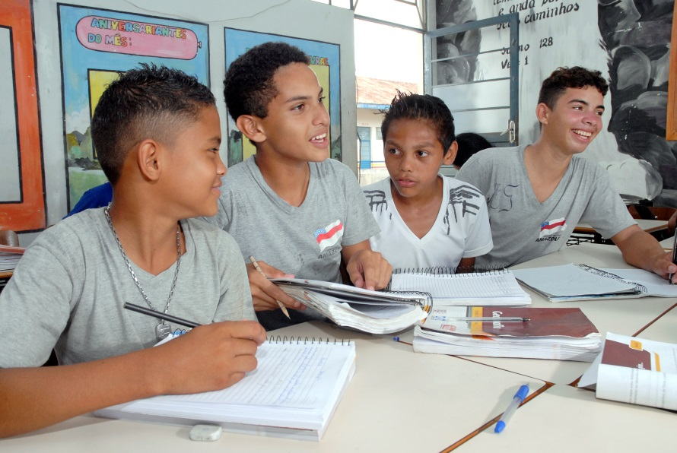
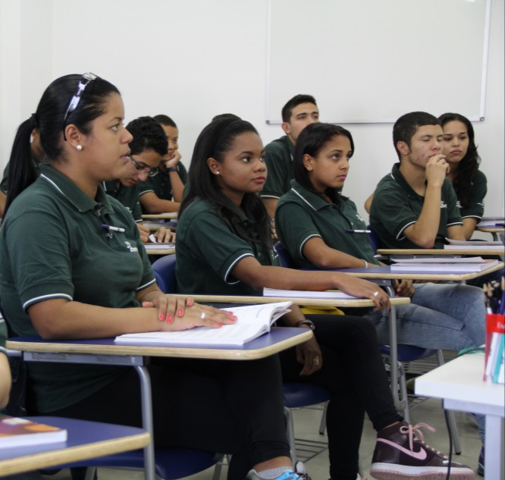
10.639/03 Federal Law
WHAT IS IT?
A Law implemented in 2003 that turned the teaching of African and Afro-Brazilian history and culture mandatory in schools in Brazil

Slide 10
A Cor da Cultura (ACDC)
“The Color of Culture”
WHAT IS IT?
HOW?
It is a social project of Roberto Marinho Foundation and partners to promote the African-Brazilian cultural heritage, and to support the implementation of the 10.639 Law in Brazil
Institutional Articulation (NGOs, universities)
Initial and continuing training
Materials (videos, books, games)
M & E
History and Afro-Brazilian Culture in School Curriculum
Government Federal Law 10,639 / 03 changes the LDB / 96
The Color Of Culture
Local Initiatives

Slide 11
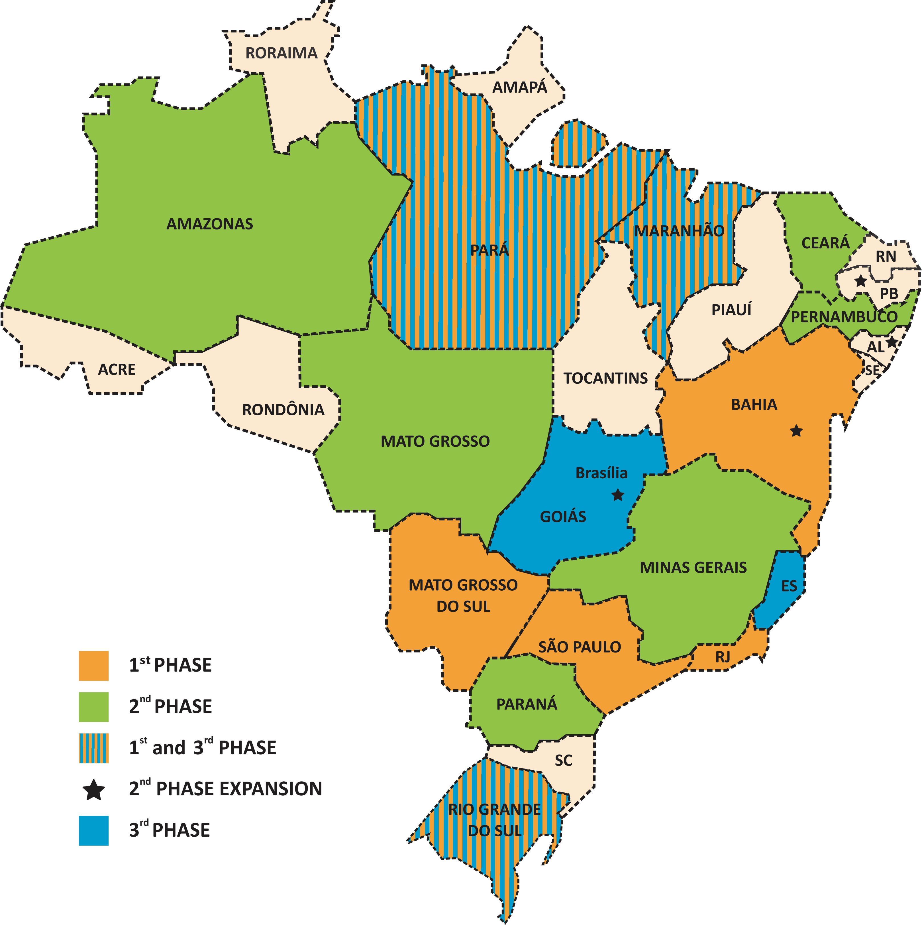
The Color of Culture
WHERE? HOW MUCH?
17 STATES
117 MUNICIPALITIES
302 NGOs
71.577 TEACHERS TRAINED
HOW?
SINCE WHEN?
2004/2006 → 1st phase
2008/2010 → 2nd phase
2012/2014 → 3rd phase

Slide 12
How to evaluate the ACDC?
Negotiation of interests and values ​​of different stakeholders is a key factor in any assessment, and especially in an equity focused project
Rubrics Methodology
. Brought together stakeholders
. Evaluative questions
. Creating rubrics: outstanding, good, regular and bad performance
. Evidences
. Discussing findings

Slide 13
Rubrics methodology
Evaluation design
negotiating values
Developing big evaluative questions related to all values of the project
Combining different evidence (quanti and quali) to define the project’s quality and values
Evaluation throughout the implementation cycle
Provision of frequent feedback to support decision making
Evaluative conclusion

Slide 14
Rubrics methodology
Evaluative Questions:
How well did the different key components of the Project’s methodology contribute to strengthening the implementation of Law 10.639/03?
What is the probability that positive changes brought by the Project may persist after the implementation is complete?
Where, to whom, and why did the project succeeded in producing relevant results?
Notes:
Itens ou Numeração?

Slide 15
Rubrics methodology
Evaluative question: How well did the different key components of the Project’s methodology contribute to strengthening the implementation of Law 10.639 / 03?
Criteria | Evidence | Sources
The training offered (initial, continuing and transfer) and the educational kit ACDC contributed significantly to the implementation of Law 10.639 / 03 in schools | 1. The participants’ perception of the quality training 2. Proportion of participants who effectively applied the acquired knowledge in their professional practice 3. Others 4. (...) | 1. Survey with managers and teachers 2. Interviews with universities, NGOs and public educational local departments 3. Focus Groups with teachers and students

Slide 16
Lessons learned
Listening and engaging different stakeholders, especially the ones that are usually “invisible” in evaluations (civil society, managers, students, educational trainers, teachers)
Values → criteria → consistent evidences → consistent reports
More sensitive tools to the reality under assessment

Slide 17
Sustainability and equity
Evaluation can help broadening the understanding of different dimensions and necessary conditions to implement the project
It can also contribute to the social innovation in the field of inequities of color/race issues in Brazil

Slide 18
Thank you!
anapaula@frm.org.br
monicap@frm.org.br

Slide 19
How to evaluate the ACDC?
The ideal scenario of any evaluation process has to involve the Stakeholders in its formulation
ACDC project deals with the implementation of a set of civilizing values​​, working in a perspective of affirmative action to ensure fairness in a very unequal social and educational context -> this involvement becomes even more important
Observing the past implementations of the project, there are a number of conflicts, values ​​and different interests that often undermine its plenty success

Slide 20
ACDC project Challenges
Provide training to almost 2 million teachers
Promote access to pedagogical materials based on the content of the Federal Law (10.639/03)
Strengthen Education Network and local partners (civil society institutions that have been working with the cause)

