Slide 1
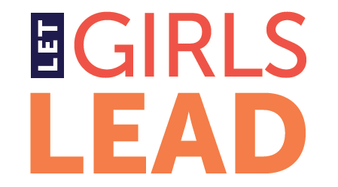
Assessing Change and Contribution in a Multi-country Advocacy Program: Evaluating the Adolescent Girls’ Advocacy & Leadership Initiative (AGALI)
Carlisle J. Levine, Ph.D.
BLE Solutions, LLC
For the American Evaluation Association 2013 Conference
Washington, DC, October 19, 2013

Slide 2
The Adolescent Girls’ Advocacy & Leadership Initiative (AGALI)
Notes:
The Adolescent Girls’ Advocacy and Leadership Initiative (AGALI) increases girls’ access to education, health services, and economic opportunity through girl-centered advocacy. AGALI is the advocacy program of Let Girls Lead, which is based at the Public Health Institute.
AGALI focuses its work primarily in Guatemala, Honduras, Liberia and Malawi. Its strategy is to improve girls’ lives by empowering leaders, organizations and adolescent girls themselves to advocate for girl-friendly laws, policies, and funding. AGALI selects Fellows from among national leaders dedicated to adolescent girls, and provides them with advocacy capacity building and institutional strengthening workshops, seed grants and ongoing technical assistance and communications.
As AGALI reached the end of its first five years, its primary donor, the UN Foundation, and the Public Health Institute commissioned an external evaluation to assess the initiative’s effectiveness, capture part of AGALI’s story, and provide guidance for AGALI and other organizations working to support advocacy initiatives aimed at benefiting adolescent girls.

Slide 3
AGALI’s Sphere of Influence
Interest
Control
Influence
Develop Capacity
Change Policies and Practice
Improve Lives
Advocate
AGALI
Fellows/ Organizations
Policy makers
External factors
Notes:
The evaluation addressed three questions:
AGALI’s contribution to the advocacy capacity development of its Fellows, their organizations and AGALI-supported networks;
AGALI’s contribution to key advocacy and policy results aimed at improving adolescent girls’ health, education, livelihoods and human rights; and
AGALI’s contribution to changes in the lives of adolescent girls who have been involved in the initiative.
As we know, AGALI has the most control over its primary program components - the workshops, technical assistance and grants it offers to its Fellows and their organizations, and the least control over changes in adolescent girls’ lives. The challenge of this evaluation was to capture changes in advocacy capacity, policies, practices and lives, and to link those changes back, in part, to AGALI.

Slide 4
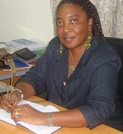
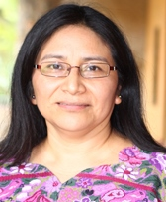
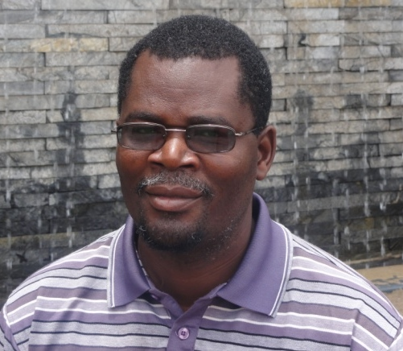
Working with National Evaluators
Notes:
To address these questions, as a first step, I chose to put together a team of national evaluators. Since I did not know evaluators in Guatemala, Honduras, Liberia or Malawi, I relied on my network. In the end, the three national evaluators I selected (one covered Guatemala and Honduras), I identified with the help of AGALI and the Public Health Institute.
I anticipated that national evaluators would offer the following benefits:
Greater familiarity with context
Better access to key stakeholders
Language facility
Greater mobility
This turned out to be true.
Franklin was able to provide sensitive insights into some of the obstacles to eliminating child marriage in Malawi. He was also able to relatively easily travel to remote places and, given his language facility, talk directly with village leaders, adolescent girls and other key stakeholders.
In all cases, the national evaluators were able to gather rich stories from adolescent girls and boys. I hypothesize that this richness may have resulted from their language facility and because, although outsiders in the eyes of the adolescents, they were less outsiders than an evaluator from another country or region might have been.
Annie in Liberia and Marta Julia in Guatemala and Honduras, due to their connections and persistence, were able to overcome one of the most significant challenges for advocacy evaluators: they were able to interview policymakers.
The choice to include national evaluators on our evaluation team faced a number of challenges.
We had to build a remote team. I budgeted time for that and ensured steady communication.
The national evaluators were not familiar with the methods I wanted to use. I budgeted time for developing their capacities to use those methods through both training and ongoing technical assistance.
As the evaluation team lead, I had to consolidate four reports into one. Again, budgeting time for this was critical. I was also glad that I was able to bring in another team member who could help with the evaluation design and pulling all the pieces together.
Most importantly, we had to ensure the independence of the national evaluators, given their connections to the Public Health Institute or AGALI country representatives, Fellows and trainers. On this last point, the information and analysis that they shared with me during our calls made it clear that they felt comfortable offering a critical eye. This reinforced for me the thought that “external” and “independent” are not synonymous. I hypothesize that their greater familiarity with context and key stakeholders allowed them to more quickly establish trust, which led to receiving more complete information about AGALI and its effectiveness. I also hypothesize that their greater familiarity with context and key stakeholders allowed them to provide deeper insights than someone less familiar with the settings would have been able to provide.
A final point to make is about evaluation as intervention, especially in the case of advocacy evaluation. When our evaluation team talked with policymakers about the issue about which AGALI grantees were advocating, their interview became one more intervention in which the advocacy issue was raised. At the very least, this caused the stakeholders to think about the issue one more time. In two cases, one of our evaluators chose to cross the line between evaluator and intervener: because of her expertise and connections, she was able to respond to two challenges presented, thus, further advancing progress toward successful policy implementation.

Slide 5
Develop capacity and advocate
Notes:
To assess AGALI’s effectiveness helping Fellows, their organizations and networks develop and use their advocacy and leadership capacities, I surveyed all AGALI Fellows in the four focus countries and interviewed 32 key stakeholders, including AGALI Fellows, country representatives, trainers and donor staff members.
The information I collected via survey and via interviews for the most part reinforced each other.
Generally speaking, AGALI Fellows and other stakeholders reported that, as a result of their participation in AGALI, Fellows increased their advocacy capacity and used their new capacities to advance their advocacy efforts with and for adolescent girls.
Of the 80 Fellows who received an electronic survey, 50 responded. I attribute this high response rate to the cash prizes we offered (4 prizes of US$50 each), AGALI’s follow-up e-mails and phone calls, and to Fellows’ commitment to AGALI. Those who responded had, on average, been involved with AGALI for more years than the group of Fellows as a whole, and they had, on average, been more likely to receive an AGALI seed grant than the group of Fellows as a whole. I took this into consideration in analyzing the survey responses.
The survey emphasized questions about changes in Fellows’ behavior, although there were also some questions about their perceptions of changes in their capacities.
The biggest challenge in analyzing the survey results was knowing how to interpret the surprising differences between the responses of Latin American (primarily Guatemalan) and African Fellows. While both tended to respond positively to the questions posed, the African Fellows’ responses were consistently notably more positive than those of their Latin American counterparts. Absent time to go back and interview a select group about these differences, we could only guess in our interpretation and recommend further research. A lesson learned was to always allow sufficient time post-survey data collection for some additional interviews.

Slide 6
Change Policies/Practices
Notes:
To assess the policy changes that AGALI, its Fellows and their organizations reported, and to draw linkages between those changes and the work of AGALI’s Fellows and AGALI, we used contribution analysis.
Together with AGALI, we selected six illustrative cases. These covered the four focus countries and took place at the national and sub-national level. They were among the most significant policy changes to which AGALI and its Fellows reported to have contributed. In all of the cases, the evaluators were able to identify strong evidence – either in the form of official documents or interviews – of the AGALI grantees’ contributions.
In Liberia, AGALI Fellows contributed to the passage of the national Children’s Law.
In Malawi, they contributed to the adoption of local bylaws prohibiting child marriage and helped advance advocacy aimed at raising the marriage age nationally.
In Guatemala, they contributed to the development and implementation of two national protocols aimed at preventing and responding to sexual violence. They also influenced the creation of a municipal commission and the opening and funding of a municipal office aimed at protecting the rights and serving the needs of children and adolescents.
In Honduras, they contributed to the Ministry of Health’s implementation of the National Strategy for the Prevention of Adolescent Pregnancies.
For our contribution analysis, we undertook a document review, and the national evaluators interviewed AGALI Fellows, their organizations, allies and policymakers. Where applicable, they also made site visits.
In our interviews with the AGALI Fellows, we worked with them to describe their theories of change as to how their efforts contributed to the desired change in policy. We also asked them about AGALI’s contribution to their ability to successfully undertake their advocacy effort in order to be able to link the outcomes of their efforts back to AGALI.
In interviewing external stakeholders – others involved in the advocacy effort and policymakers, we took the policy change as our starting point in our interviews and then found out whether or not the external stakeholders mentioned the AGALI grantee. Insofar as was possible, with external stakeholders, we tried not to mention our AGALI affiliation at the beginning of the interview.
A strength of our approach was that in 4 out of 6 cases, the evaluators were able to talk with policymakers.
The evaluation team faced two challenges:
Due to time and budget constraints, our team could not always undertake as many interviews as we would have liked to in order to fully understand AGALI’s grantees’ contributions to the advocacy outcomes or their contributions as compared to the contributions of others. While it is clear that AGALI’s grantees contributed to these policy changes, in at least two of the cases, more interviews would have helped us better understand the nature of that contribution and how it fit into the broader effort to influence a policy change.
In at least two cases, we had to be careful to ensure that our access to policymakers was not seen as too obviously through AGALI grantees, since being seen as affiliated with AGALI grantees could influence the information that the policymakers were providing.

Slide 7
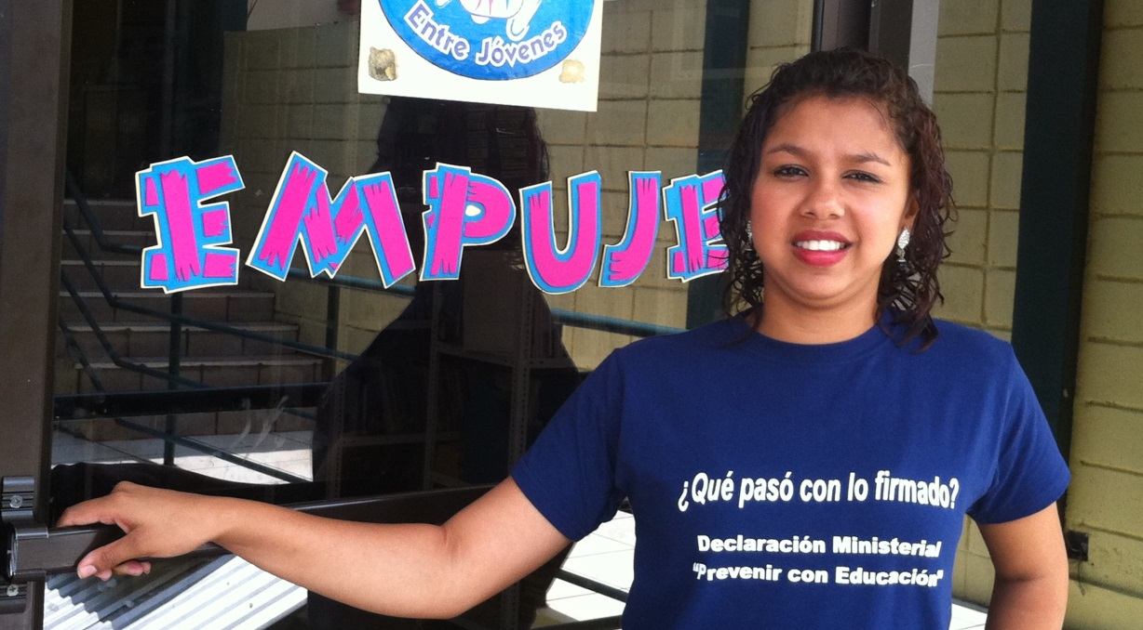
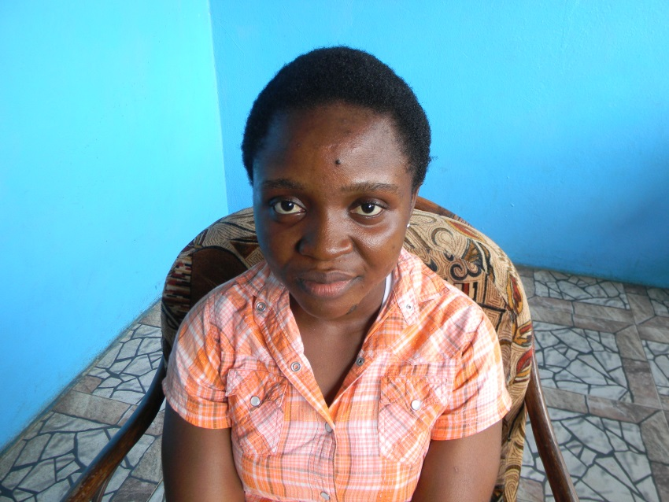
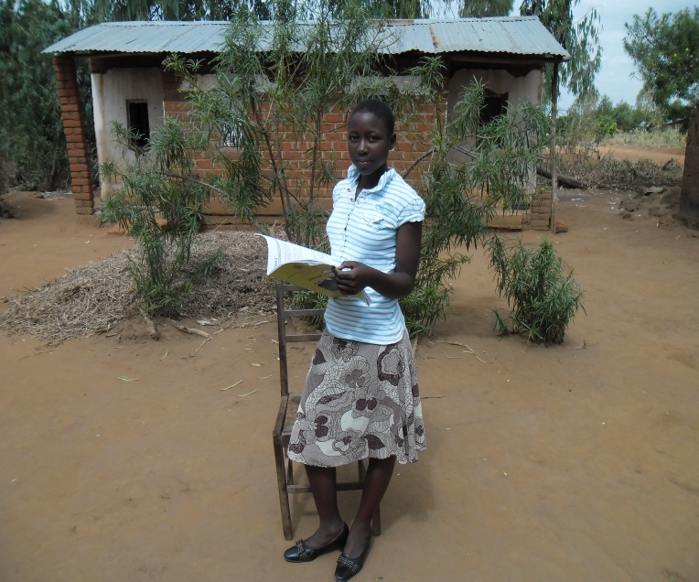
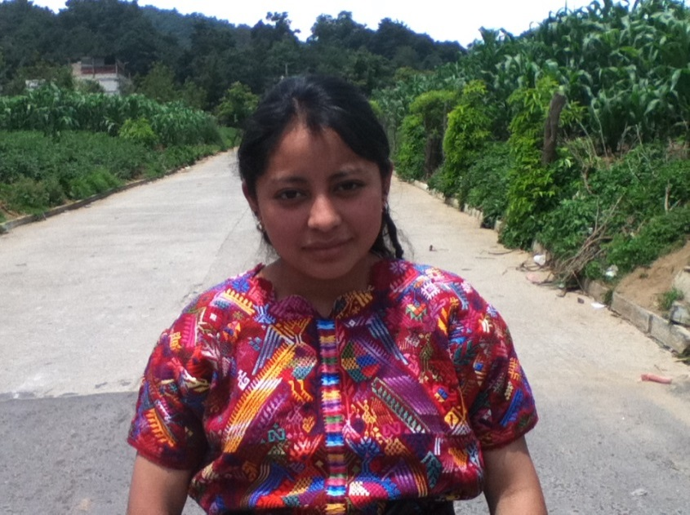
Improve lives
Notes:
It was too early in the life of AGALI to try to assess changes in adolescent girls’ lives resulting from the policy changes that AGALI grantees influenced, and nor did we have the time or resources to try to undertake such an analysis.
However, we could begin to find out how AGALI-supported advocacy efforts had affected the lives of adolescent girls and boys who have participated in them. We were also able to ask those adolescents about changes they saw in their families and communities as a result of their participation and as a result of the policy change for which they had been advocating.
We gathered Most Significant Change stories to look for these early indications or perceptions of impact. The Most Significant Change approach is an inductive, story-telling approach that begins with a basic question about changes in a person’s life (or family or community, etc.) over the past specified time period or as a result of participation in an intervention. The story collector then asks the storyteller to identify the most significant change among those that he or she has listed and for an explanation of its choice. In this way, one can gather participants’ perceptions of change resulting from an intervention, as well as information about how they value that change. Through a meta-analysis of the 35 stories we collected, we identified emerging themes that point to areas where further investigation is required.
The adolescents talked about their increased self-confidence and self-esteem, as well as their personal development. In Liberia, a number of adolescents described decreases in physical punishment as a result of the passage of the Children’s Law. In Malawi, all of the adolescents described girls leaving marriages and returning to school. They also reported that the local bylaws prohibiting child marriage were indeed discouraging the practice – a report that was confirmed by local officials. In Guatemala, almost all of the girls interviewed reported greater respect for children’s and especially girls’ rights, as a result of their advocacy. The adolescents in Honduras reported that officials are now offering classes and creating centers that respond to their demands.
While the findings emerging from these stories are promising, the evaluation team recognized that there is more work to do. Given the time and budget constraints of the evaluation, the availability of the youths determined whose stories were captured. Thus, the number and composition of youths interviewed were not necessarily representative of the group as a whole. For example, in Liberia, the majority of youth who were most involved in advocating for the passage of the Children’s Law live in counties far from Monrovia. Gathering their stories could provide additional helpful insights into the effects of participating in the advocacy effort and the passage of the Children’s Law from their perspectives.
Of course, these stories capture personal perceptions. We were glad that we were able to triangulate some of their emerging findings with those of other interviews we collected.

Slide 8
Main Takeaways
Challenge of establishing contribution across areas of control, influence and interest
Value of teaming with national evaluators
Importance of using mixed methods for interpreting survey results
Utility but challenges of contribution analysis for credibly establishing contribution
Utility of the Most Significant Change approach for gathering early indications or perceptions of impact
Notes:
Main Takeaways
Challenge of identifying linkages between client and changes in people’s lives when the client is building advocates’ capacities. Challenge of identifying those linkages across areas of control, influence and interest
Value of teaming with national evaluators because of their access, knowledge of context and (hopefully) cultural sensitivity
Importance of using mixed methods for interpreting survey results
Utility but challenges of contribution analysis for credibly establishing contribution. Challenges were mainly related to having enough time and budget to ensure we could undertake all of the interviews we needed to undertake to sufficiently triangulate what we heard from the grantees.
Utility of the Most Significant Change approach for gathering early indications or perceptions of impact. MSC captures early indications of impact from the perspectives of those who are intended to benefit from the policy change. Themes emerge through meta-analysis, pointing to areas for further research.

