Slide 1
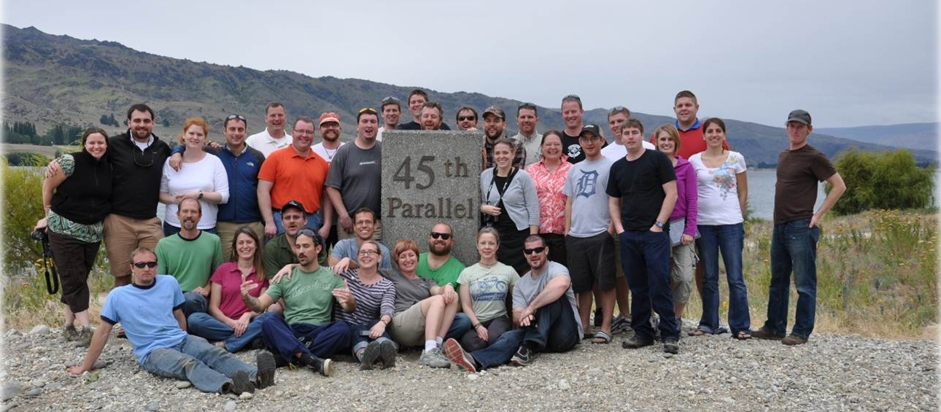
New FARM Program of Northwest Michigan
Farmer Assistance & Resource Management Program
in New Zealand at the “other” 45th parallel
Three years of data to reach intermediate outcomes and nobody will read the reports!
Dr. Cheryl Peters, Evaluation Specialist

Slide 2
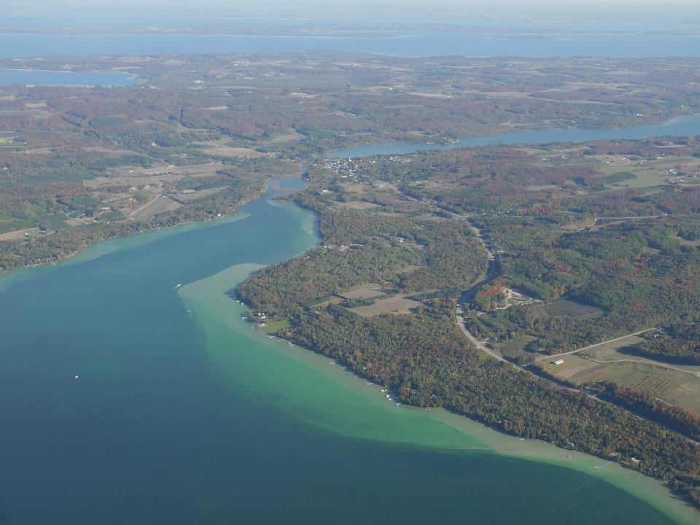
Situation: land is disappearing
Between 1982-2002, Michigan lost 2 million acres of farmland
Could lose 25% of fruit growing land next 40yrs
Farmland conversion in northern Michigan
Prime fruit growing acreage in MI located on highly valued property near Lake Michigan
Our 45th parallel
Notes:
Between 1982 & 2002, Michigan lost 2 million acres of farmland (17 %)
Could lose 25% of fruit growing land next 40yrs
Why Farmland conversion in northern Michigan?
development pressure & growing population; inflates land prices, elevated worth, complicates farmers to offer or purchase acreage at market value
Coincidentally, prime fruit growing acreage in Michigan located on highly valued property near Lake Michigan.

Slide 3
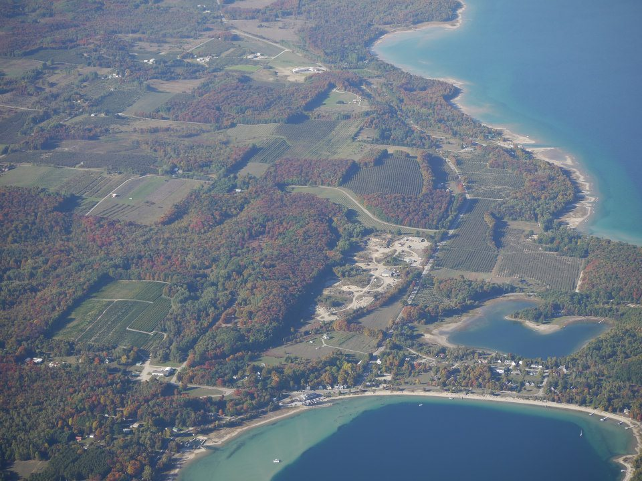
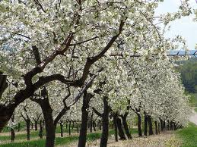
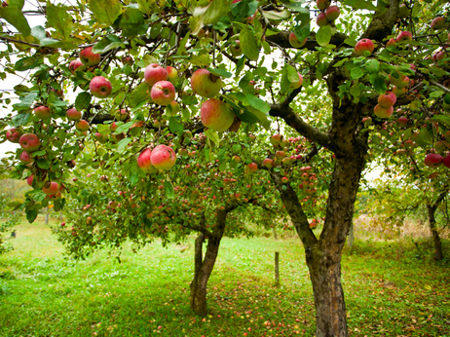
New FARM Program Goals
Omena Point, Leelanau County, Michigan
Develop and hone leadership, decision-making, facilitation, communication, team-work, and problem-solving skills
Gain an understanding of agricultural production strategies that enhance sustainability and environmental stewardship
Decipher challenges and opportunities related to agricultural commodities, marketing strategies, profitability, and impacts of local, state, national, & international economies

Slide 4
Goals, cont.
Develop a better understanding of public policy, estate planning, and inter-generational farm transfer
Navigate changing social, economic, and political environment as they impact agriculture and rural communities
RESULT: A tight-knit, regional network of
agricultural leaders that will help make
informed, long-term decisions that
positively shape NW Michigan's communities

Slide 5
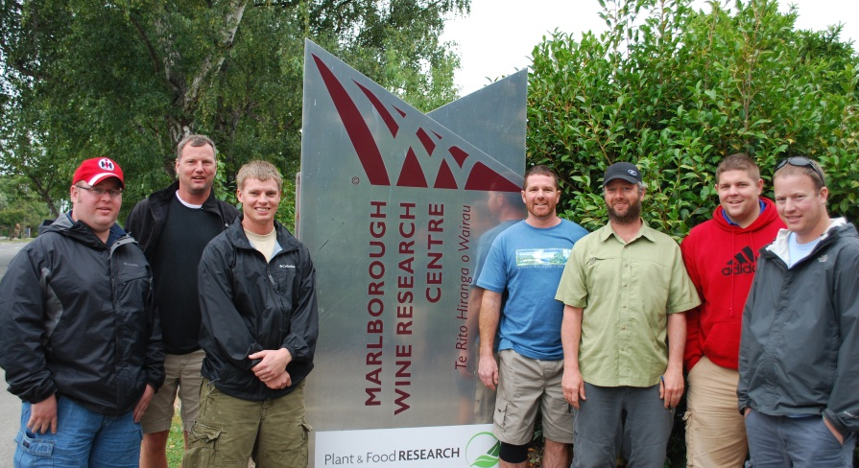
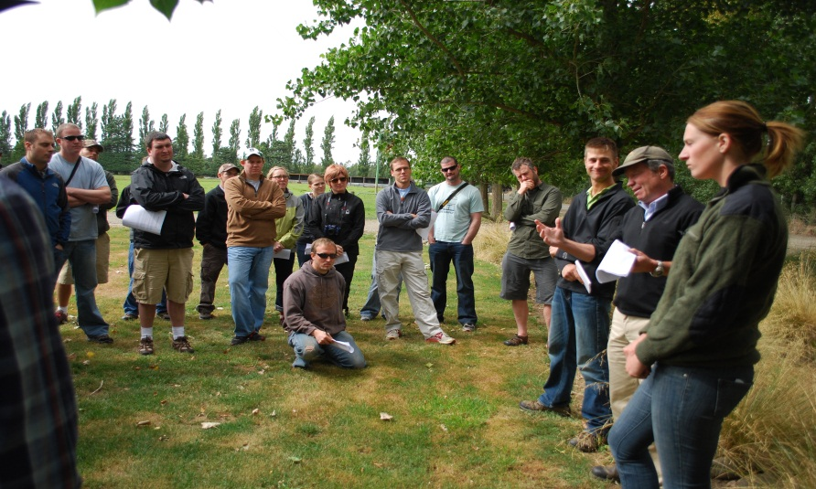
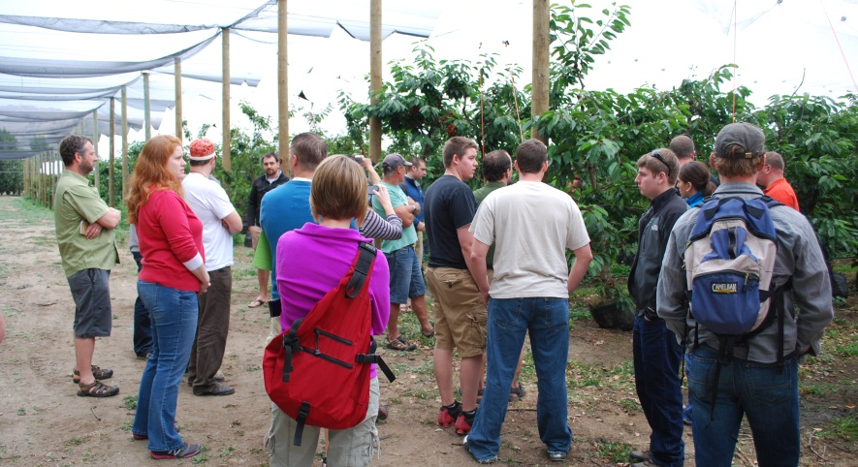
New FARM Program
30 month program
Nov 2009 to Apr 2012
20 unique learning events
42 participants, + 4 PI’s
Most under age 40
9 women
2 limited resource; vulnerable
U.S. growing region
Notes:
The New FARM program began as a small-scale series of courses to address the needs of new members of the Grand Traverse agricultural community. Organizers originally applied for a USDA Grant but did not receive funding in 2009. With no funding but overwhelming interest from emerging farmers, the New FARM Program launched on a limited budget with 30 participants. New FARM coordinators were able to initiate the Program from local organization support and participant fees ($10,000). In 2009, Rotary Charities’ administrators attended a New FARM Financial Literacy session to provide information on grant writing, and as a result, New FARMers collaborated to develop a proposal to advance the Program’s efforts. Once we received Rotary Charities’ funding, we re-submitted a proposal to USDA and leveraged the dollars, as well as demonstrated local support for the program and received $138,000.
As a result, we had several funding and programming partners over the course of 30 months. 20 unique learning opportunities took place, with hiatus during growing season summer months. The program expanded to 42 members and had 4 organizers early career professionals all from MSU Extension. The program demographics were young, white, rural, 20% women, and 10% socially disadvantaged or limited resources. However, the 5 county region program participants represented has a rich agricultural legacy currently pressured by trends in agriculture showing a clear shift towards older growers and fewer acres of production. Further – land is disappearing. Between 1982 and 2002, Michigan lost nearly 2 million acres of farmland or roughly 17 %. Conversion is affecting prime farmland at a rate 2-4 times that of more traditional agricultural land. Michigan is expected to lose 25% of its fruit growing land in the next 40 years. The foremost reason for farmland conversion in northern Michigan is high property costs due to development pressure and a quickly growing population. Development pressure inflates land prices, and this elevated worth makes it complicated for farmers to offer or purchase acreage at market value. Coincidentally, prime fruit growing acreage in Michigan are located on the same highly sought and highly valued property near Lake Michigan.

Slide 6
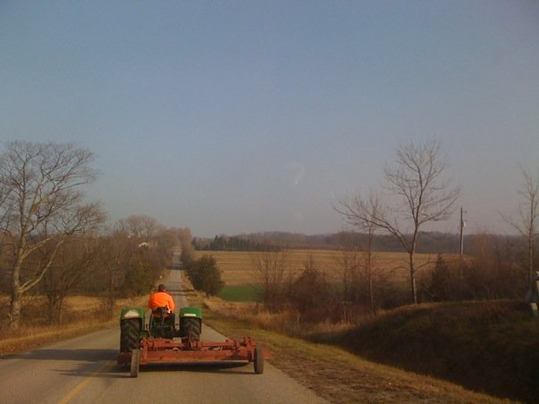
Michigan hops grower drives his tractor down the road.
Year One Activities
Classroom study of public speaking, media relations, crisis management, building/ owning a business, marketing, estate/tax planning.
Time developing professional relationships between program individuals and guest speakers/MSU staff.
Attendance at an international fruit conference.
Meeting with local legislators/ policymakers in state capitol.
Tours of farms, packing houses/ processing plants, and retail operations to understand whole food chain.
Communication with veteran farmers/industry leaders about MI's agriculture industries.
Year Two Activities
Classroom study of labor issues, environmental stewardship, public policy, communication, and agritourism.
Touring the Great Lakes region to view value-added agricultural opportunities.
Taking an international tour of an agriculture region to better understand global food systems.

Slide 7
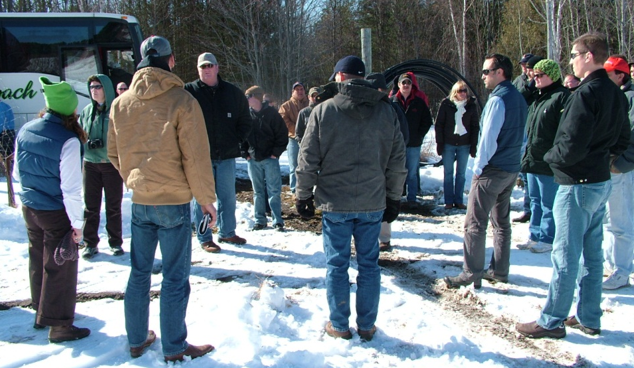
New FARM Program Timeline
Nov, 2009 Introduction to New FARM Program
Dec, 2009 Great Lakes Fruit and Vegetable Expo “Serving on a Board”
Jan, 2010 Economics/Financial Literacy Session
Feb, 2010 Managing Public Relations and media
Mar, 2010 IFTA Meeting and NW MI Post-tour
Apr, 2010 Building a Sustainable Business
Sept, 2010 Alternative Marketing Strategies
Oct, 2010 Planning for Farm Succession
Nov, 2010 Meet the Lawmakers & State Policy
Dec, 2010 Business Etiquette
Jan, 2011 Farm Bill, Federal Farm Policy w/ Senator Debbie Stabenow
Feb, 2011 Environmental Stewardship
Mar, 2011 Agriculture Labor Management
Apr, 2011 Federal Marketing Order tour
Oct, 2011 New FARM Member Farm Tours
Nov, 2011 Certifications and Branding
Dec, 2011 Great Lakes EXPO
Jan, 2012 Planning for Educational Trip
Feb, 2012 Final Educational Trip New Zealand, South Island
Mar, 2012 Graduation and Evaluation

Slide 8
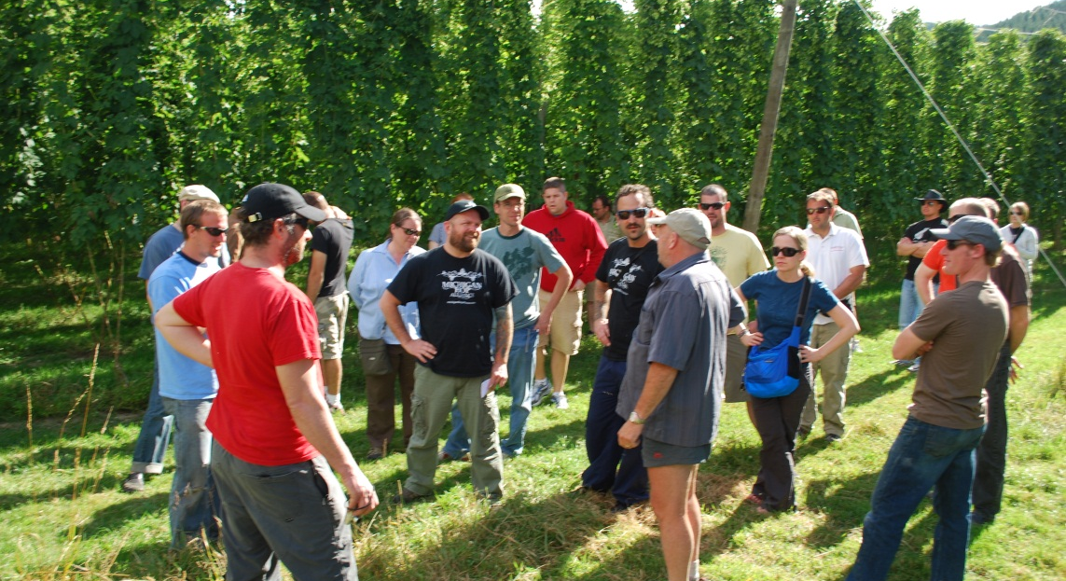
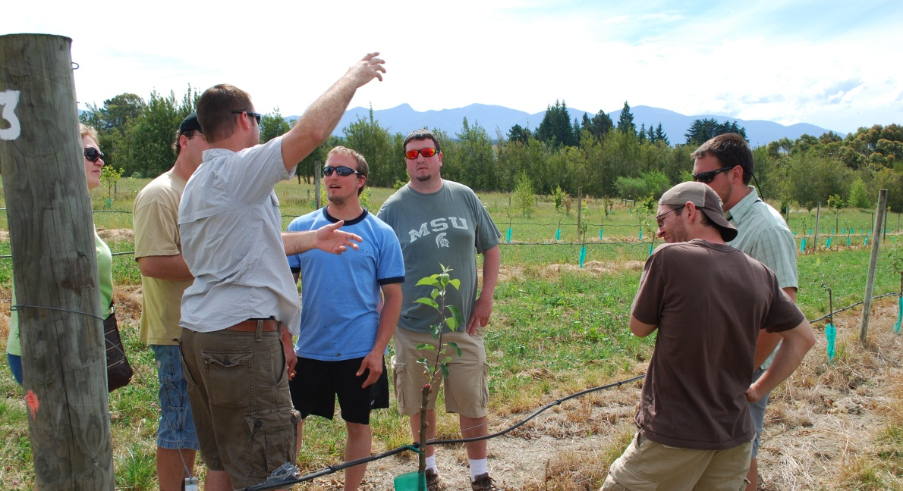
This project was supported by the Beginning Farmer & Rancher Development Program of the National Institute of Food and Agriculture, USDA, Grant #2010-49400-21734. $138,524 Rotary Charities of Traverse City $47,720 The Leelanau Conservancy & The Leelanau Horticultural Society Grand Traverse Fruit Growers’ Council Cherry Marketing Institute Northwest Michigan Horticultural Research Station Foundation Board Participants of the New FARM program (fees)
Total Project Funding ~ $222,000

Slide 9
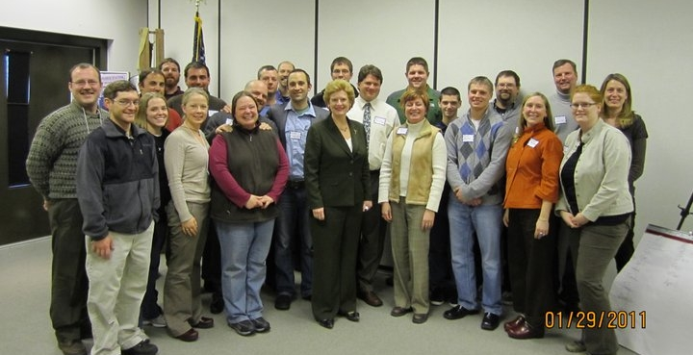
New FARM Program Cultivating Farmers; Growing Communities
New FARM Group with Senator Debbie Stabenow – Chairwoman of the Senate Committee on Agriculture, Nutrition, and Forestry.

Slide 10
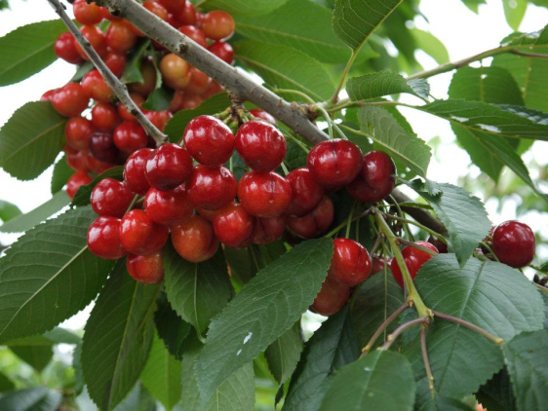
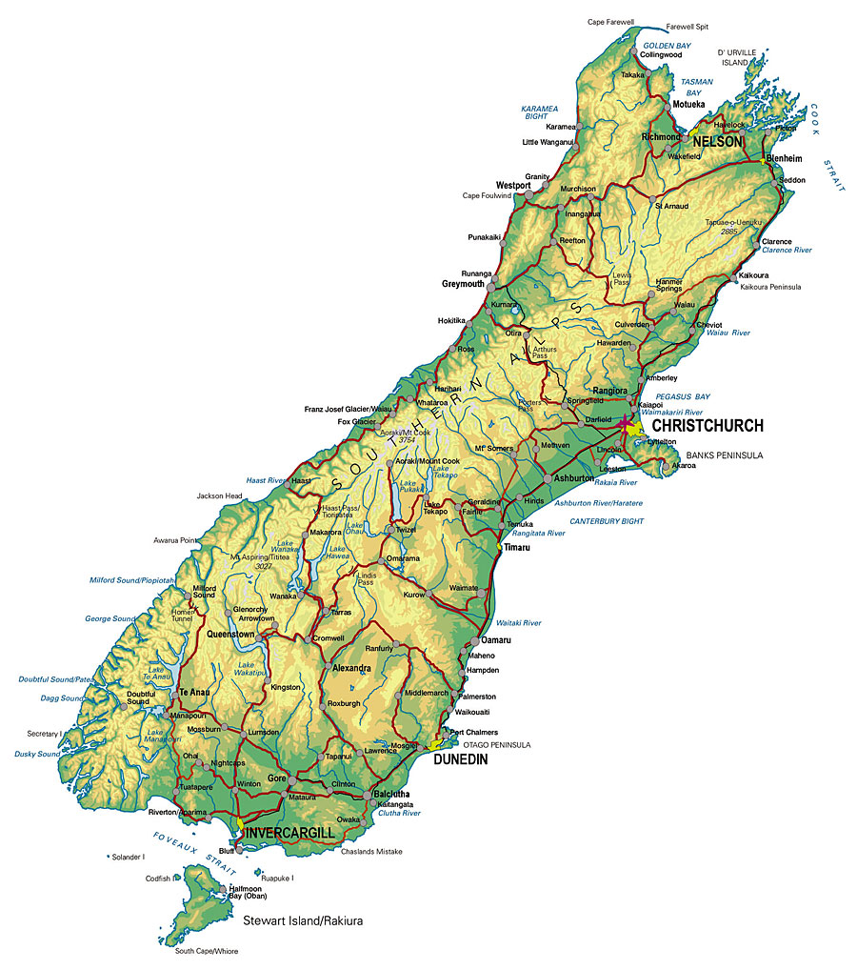
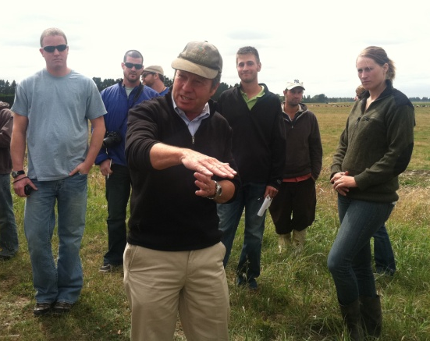
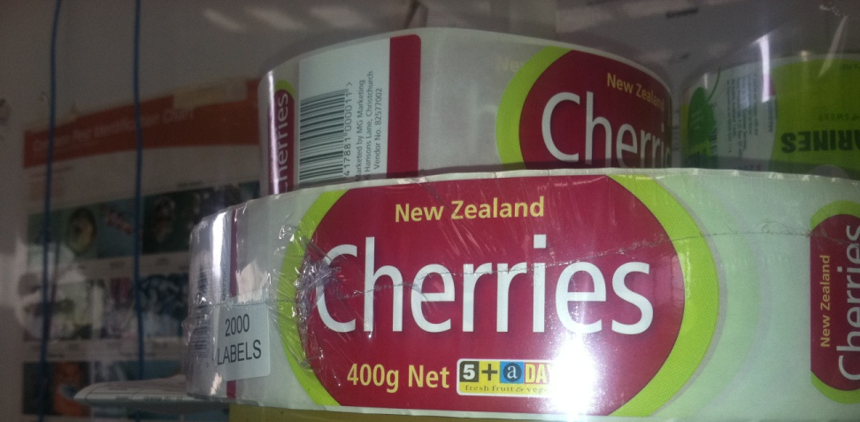
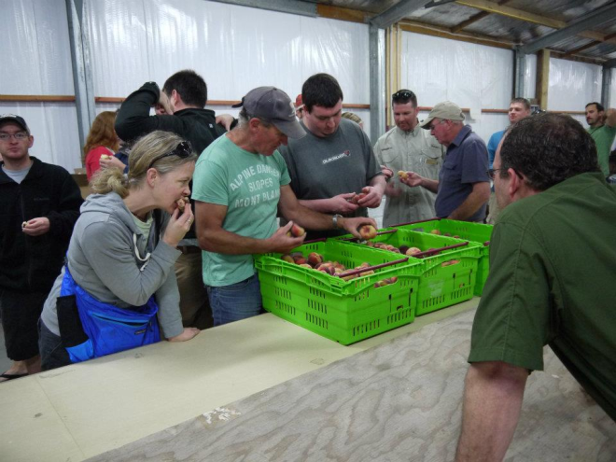
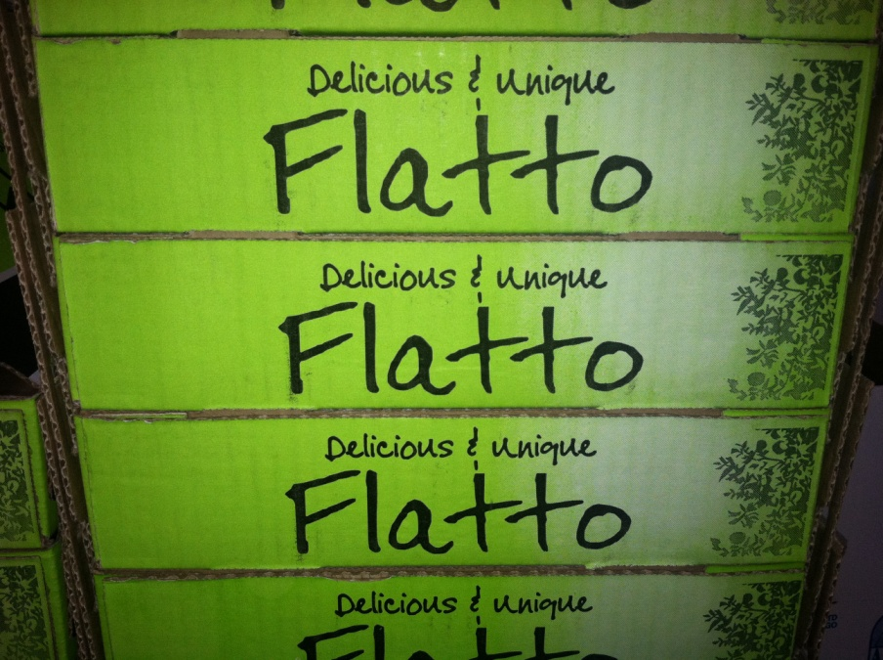
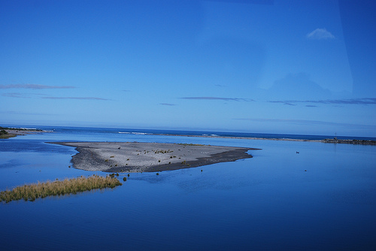
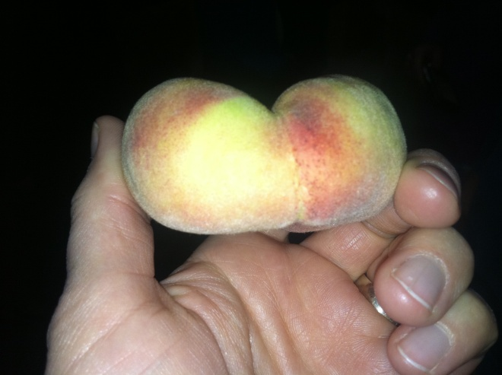
the South Island,
New Zealand

Slide 11
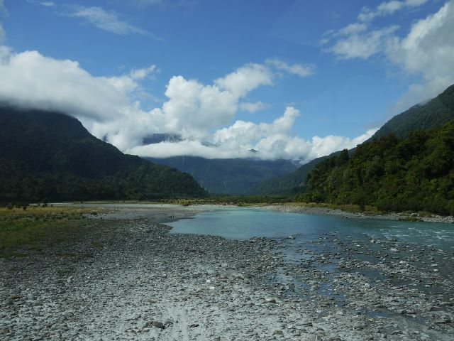
Themes from Reflective Essays on New Zealand Trip
Exposure to New Zealand communities = innovative ideas to Michigan.
International travel created a shared experience that tightened the group.
Cultural observations during the trip that could impact local food movements, farmland preservation, environmental stewardship, or the economy in Michigan.

Slide 12
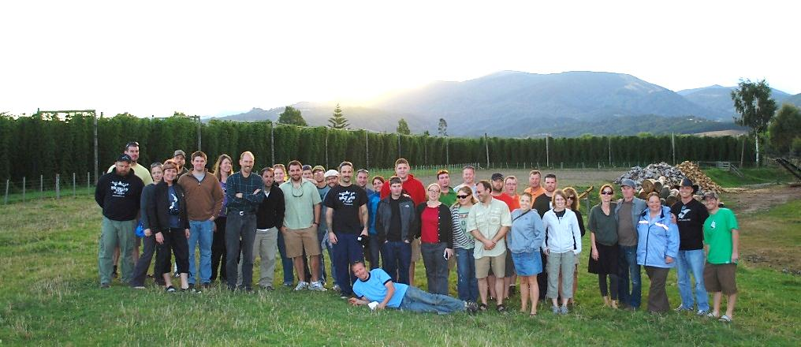
Winter 2011 Mid-Term Evaluation
100% Changed marketing practices. Program expanded networking and therefore awareness of local marketing strategies and outlets.
Benefit of the program –NETWORKING!!!! buying services/goods
61% Changed farming/ growing operations or land management practices. Examples: trying high density apples, making plans related to farm transfers, taking out new loans for land, building a chemical building, trying a farm stand, investing in goats.
43% Developed or revised a farm plan. Diversification in crops or business practices like adding agritourism.
30% Started farming and 0% stopped farming. 5 new farmers.
26% Changed business practices. Examples: farm transfer plans and farmland preservation efforts.

Slide 13
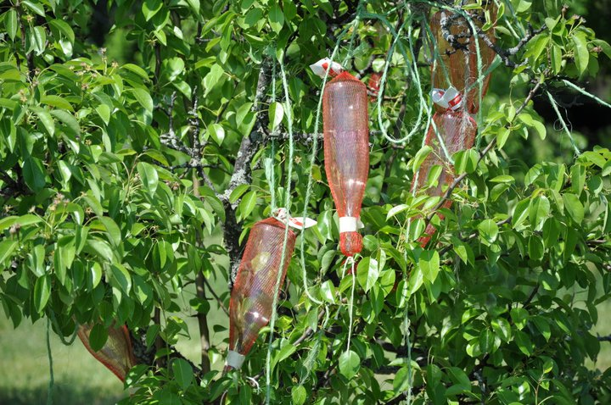
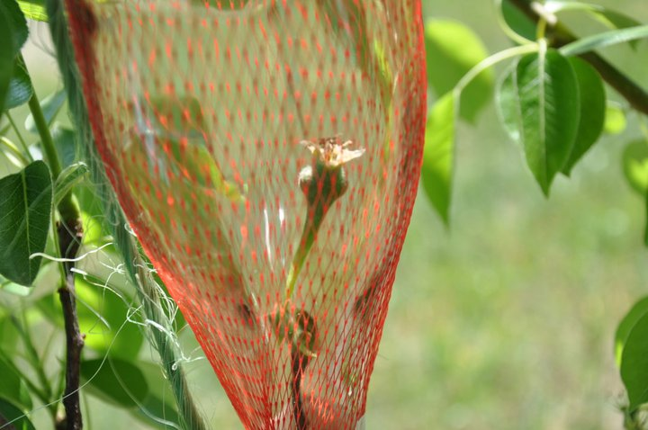
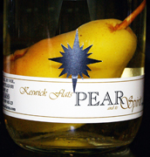
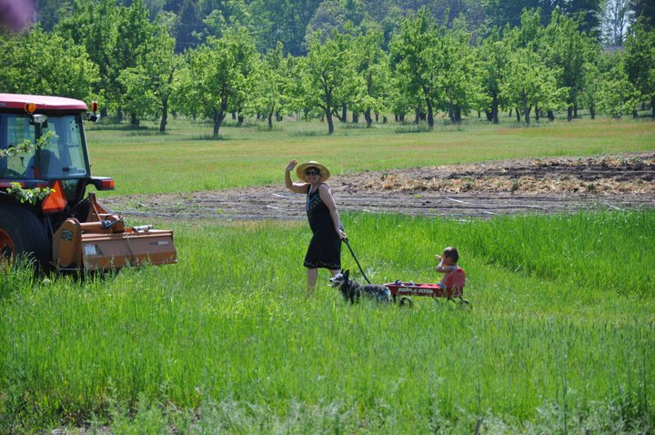
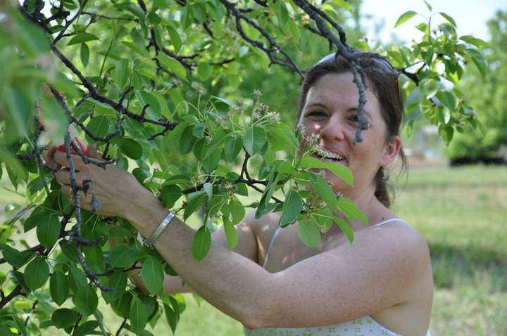

Slide 14
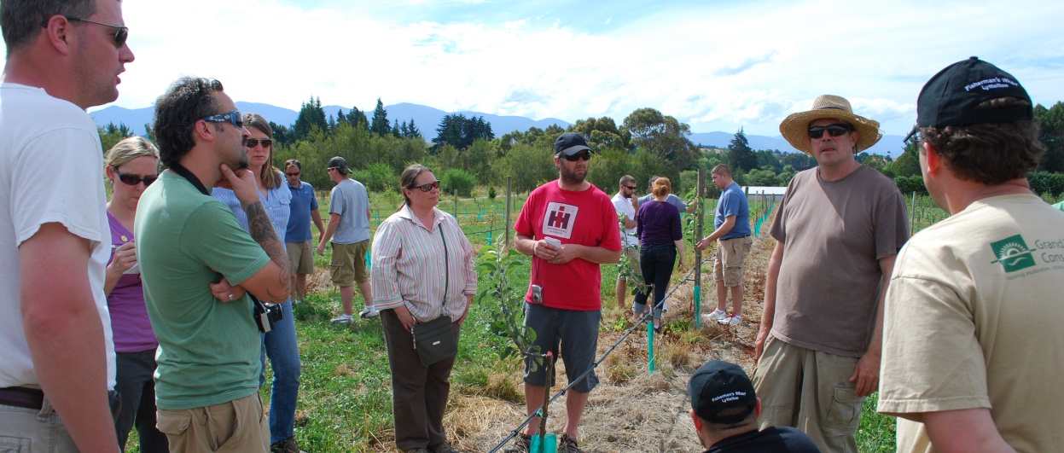
End-of-Program (2012 Final Evaluation)
89% improved their management or leadership roles on-the-farm.
89% applied practical knowledge to improve the sustainability of their farming.
86% plan to seek a leadership position in the agricultural in the future; 50% had assumed a leadership position.
57% modified or expanded current marketing practices to begin producing value-added crops.
57% increased local food sales.
50% acted on land stewardship.
43% had purchased, leased, or taken over family farming operations.
48% reported an increase in the amount of food produced.
38% experienced an increase in farm revenue.
Notes:
End-of-Program (2012 Final Evaluation)
89% improved their management or leadership roles on-the-farm because of what they learned being part of the New FARM program.
89% applied practical knowledge to improve the sustainability of their farming operations because of what they learned in the New FARM program.
86% plan to seek a leadership position in the agricultural industry or NW Michigan community in the future; 50% assumed a leadership position had assumed a position since the beginning of the New FARM program.
57% modified or expanded current marketing practices to begin producing value-added crops since the beginning of the New FARM program.
57% increased local food sales, since the start of the New FARM program, which they believe was connected to their participation. Examples included gaining new customers, joining local farmer markets, participating in farm-to-school programs, selling jams and other food products locally, and securing new direct sales to brewers (hops) or fermentation viticulture scientists (grapes). Two members had their pork production increase 300%.
50% acted on land stewardship practices through MAEAP or NRCS programs.
43% had purchased, leased, or taken over family farming operations.
48% reported an increase in the amount of food produced by the farm or growing operation, since the start of the New FARM program, which they believe was connected to their participation. Examples included noticeable improvements in soil fertility for improved crops (cherries), an expanded fruit stand for direct sales, and adding pork to the current operation. Two industries represented in the program are hops production for breweries and apple growing for cider production. These crops are grown and distributed for creation of a product. New FARM members representing this industry also reported improved production including better IPM (Integrated Pest Management), increase in acres planted, and a 40% increase in cider production.
38% experienced an increase in farm revenue, since the start of the New FARM program, they believe was connected to their participation. Examples included increasing CSA (community supported agriculture) income, increasing pasture-based poultry, adding a hop processor facility, and selling merchandise. Three members (14%) started new agricultural enterprises or started farming.

Slide 15
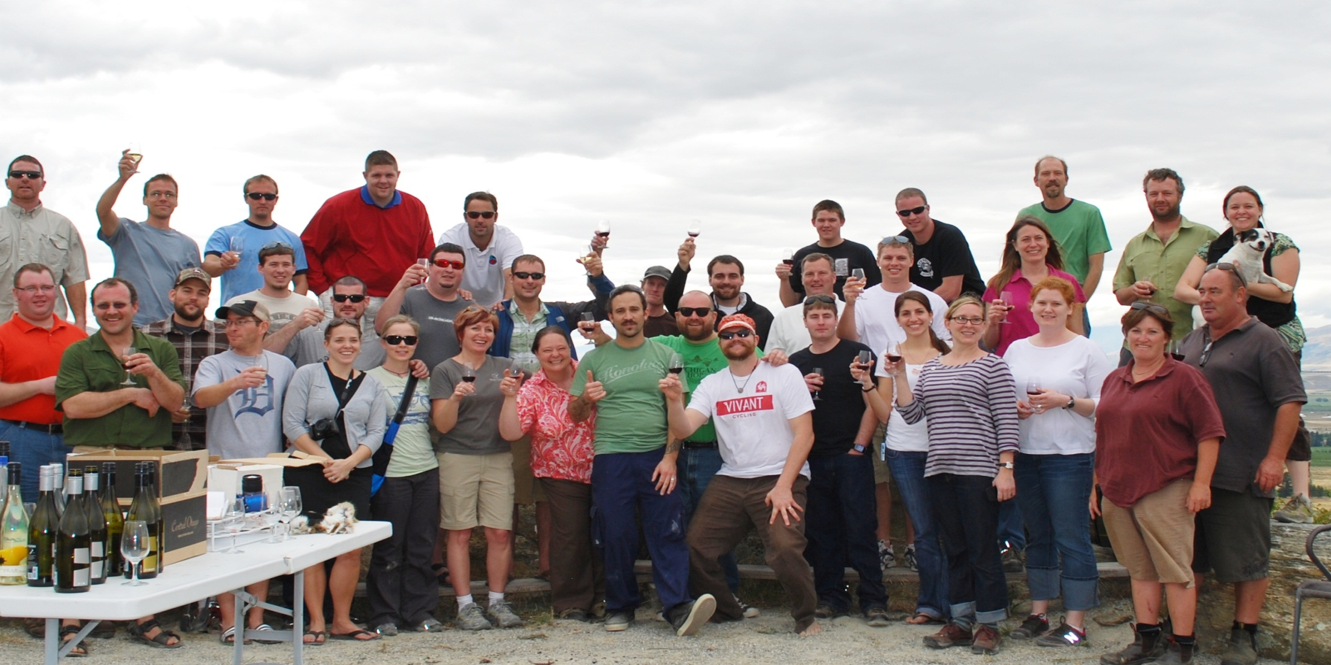
Longer Term Outcomes?

Slide 16
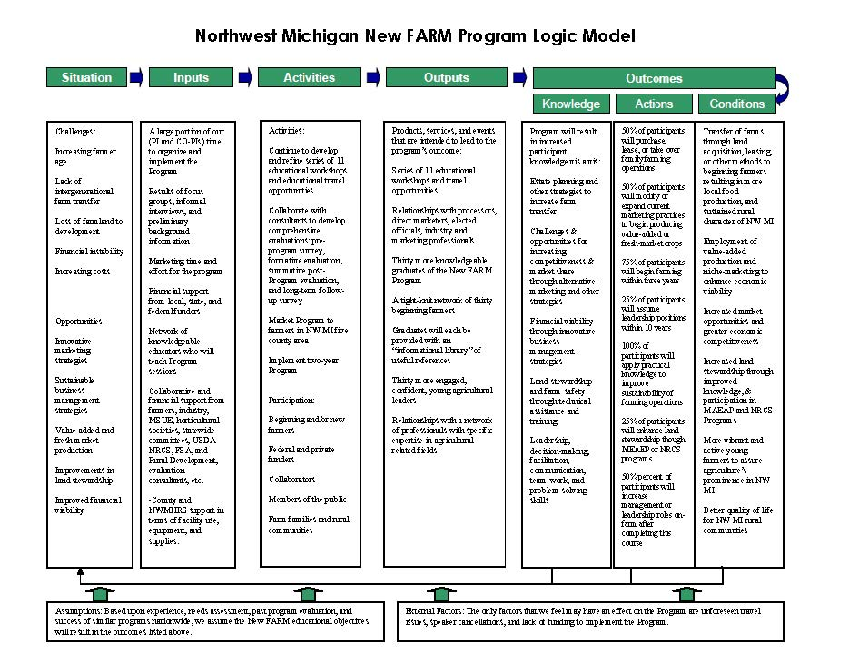
One Evaluator’s Frustration…
Reached intermediate outcomes within 3-5 years of the program
Found expected impacts PLUS unexpected positive changes
Completed funder’s reports, public and private presentations, mass media

Slide 17
…what’s next?
Data utilization
Stakeholders care about, understand, and use program results

