Slide 1
Women and Wisdom: Changing CVD Risk
Tim Feuser
Alabama WISEWOMAN (ALWW) Epidemiologist/Evaluator

Slide 2
Talking Points
Overview
Evaluation of ALWW Impact on Cardiovascular Health

Slide 3
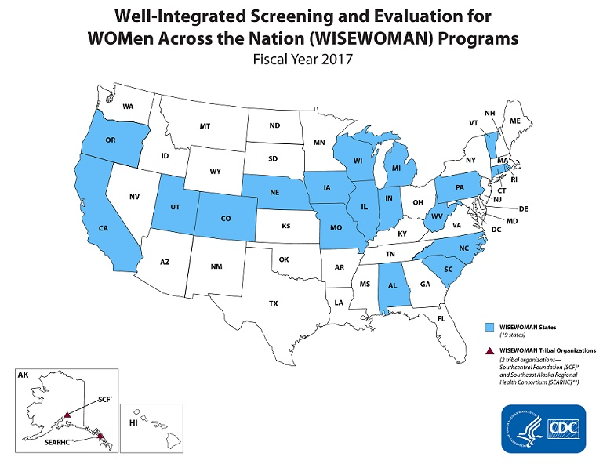

Slide 4
ALWW Target Group
Age: 40-64 years
Income: Below 250% FPL
Insurance: Uninsured or Underinsured

Slide 5
ALWW Active Provider Counties

Slide 6
What ALWW Offers

Slide 7
Baseline Demographics, n=2941 (February 2014-December 2017)

Slide 8
Qualitative Data Sources
Participant Satisfaction Surveys
Home Blood Pressure Monitor Surveys
Support Group Surveys

Slide 9
Participant Satisfaction Survey Requirements
Complete Three Sessions

Slide 10
Survey Results on Tools’ Usefulness (n=405)
Stretch Band
Home BP Monitor
Gym Membership
86%
89%
73%
79%
86%
83%
Pillbox
“My Plate”
Resource Book

Slide 11
Survey Results on Positive Lifestyle Changes (n=405)
Ate More
Fruits
Ate More
Vegetables
Drank
More Water
Lowered Sugar
Intake
82%
88%
91%
85%
88%
76%
71%
76%
Lowered Salt
Intake
Checked Food
Labels
Increased
Exercise
Lowered
BP

Slide 12
Home Blood Pressure Monitor Survey Requirements
Have BP Monitor for at least a Month

Slide 13
Home BP Monitor Survey Results on Positive Lifestyle Changes (n=241)
96%
BP Monitor Use At Least Weekly
89%
Medication Adherence
96%
BP Awareness
79%
Increased Physical Activity
66%
Smoking Reduction
85%
Change Diet

Slide 14
Support Group Survey Requirements
Completed After Monthly Support Group

Slide 15
Support Group Survey Results on Positive Lifestyle Changes (n=366)
Increased Exercise
Lowered BP
Weight Loss
65%
48%
43%
68%
Eating Healthier
Notes:
These surveys asked how they improved their physical activity, weight, blood pressure, and diet.

Slide 16
Quantitative Data Procedure
Total Clients who Met the Three Criteria (n=370)
Hypertensive Diagnosis at Baseline Visit
BP Measured Obtained at
Least 30 Days After Baseline
Completed at Least Three HC Sessions

Slide 17
Quantitative Data Results

Slide 18
AL WISEWOMAN TEAM
ALWW Data Analysis Team
Tim Feuser Kumari Seetala
Phone (334)-206-3039 Phone (334)-206-7034
Email: tim.feuser@adph.state.al.us Email:kumari.seetala@adph.state.al.us
ALWW Program Manager
Rhonda Hollon
Phone (334)-206-2005
Email: rhonda.hollon@adph.state.al.us
Director, Cancer Prevention and Control Division
Nancy Wright
Phone (334)-206-5851
Email: nancy.wright@adph.state.al.us
Nurse Supervisor, Cancer Prevention and Control Division
Katherine Norris
Phone (334)-206-6227
Email: katherine.norris@adph.state.al.us

