Slide 1
Support and Preparation in Computer Science for Black Female Scholars: Black Girls for Computing in Alabama (aka Legacy)
Kathy Haynie, PhD, Haynie Research and Evaluation
Martha Escobar, PhD, Oakland University
Mohammad Qazi, PhD, Tuskegee University
Jeff Gray, University of Alabama
American Evaluation Association
November 14, 2019

Slide 2
The Legacy Rationale
Lack of “preparatory privilege”

Slide 3
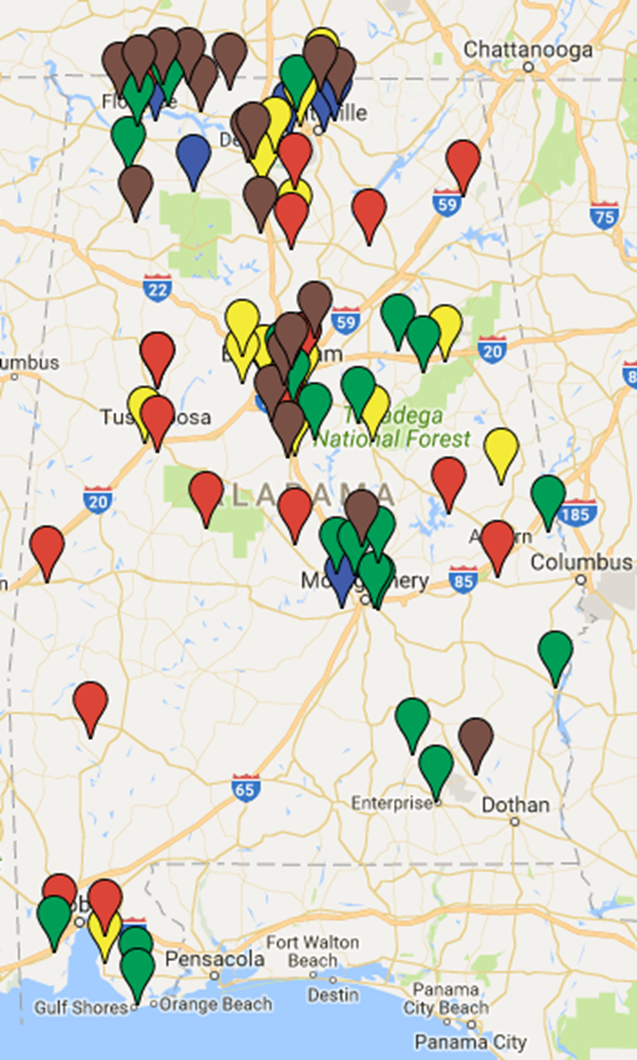
Context: Alabama PD for AP CSP Teachers!
Six cohorts of teachers, 2013-2018

Slide 4
Alabama AP CS Participation
 | TOTAL EXAMS | FEMALE | BLACK | FEMALE & BLACK
AP CS A 2007 | 27
AP CSP 2017 | 1249 | 32.7% 408 | 11.4% 143 | 4.5% 56
Statewide Parity | 1249 | 48.7% 608 | 33.9% 423 | 16.5% 206

Slide 5
Alabama AP CS Participation
 | TOTAL EXAMS | FEMALE | BLACK | FEMALE & BLACK
AP CS A 2007 | 27
AP CSP 2017 | 1249 | 32.7% 408 | 11.4% 143 | 4.5% 56
Statewide Parity | 1249 | 48.7% 608 | 33.9% 423 | 16.5% 206

Slide 6
Alabama AP CS Participation
 | TOTAL EXAMS | FEMALE | BLACK | FEMALE & BLACK
AP CS A 2007 | 27
AP CSP 2017 | 1249 | 32.7% 408 | 11.4% 143 | 4.5% 56
Statewide Parity | 1249 | 48.7% 608 | 33.9% 423 | 16.5% 206

Slide 7
Alabama AP CS Participation
 | TOTAL EXAMS | FEMALE | BLACK | BLACK FEMALE
AP CS A 2007 | 27
AP CSP 2017 | 1249 | 32.7% 408 | 11.4% 143 | 4.5% 56
Statewide Parity | 1249 | 48.7% 608 | 33.9% 423 | 16.5% 206

Slide 8
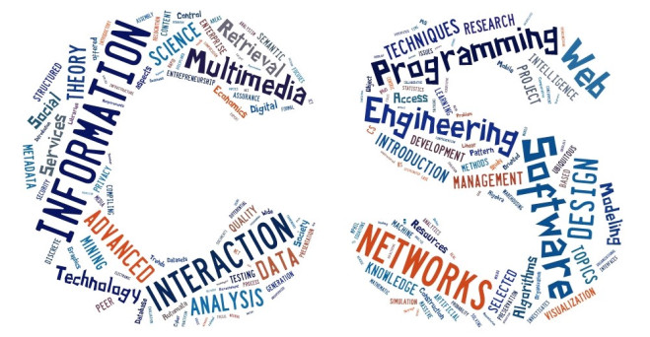
The Focus of Legacy
AP Computer
Science Principles
(AP CSP)
PEER LEARNING COMMUNITY
Career Awareness

Slide 9
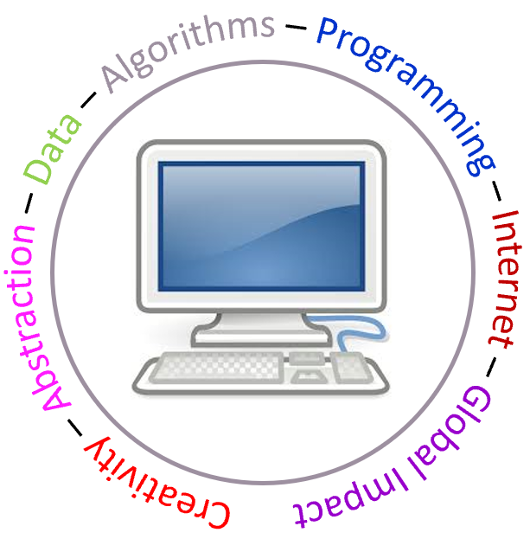
About AP CS Principles
Intro college-level CS course developed to broaden participation
Culturally responsive curriculum, instruction
End of course exam (60%) Explore & Create PTs (40%)
Biggest launch ever! 126,000 exams 2017+2018

Slide 10
Legacy Leadership
University of Alabama
Oakland University
Haynie Research & Evaluation
Tuskegee University

Slide 11
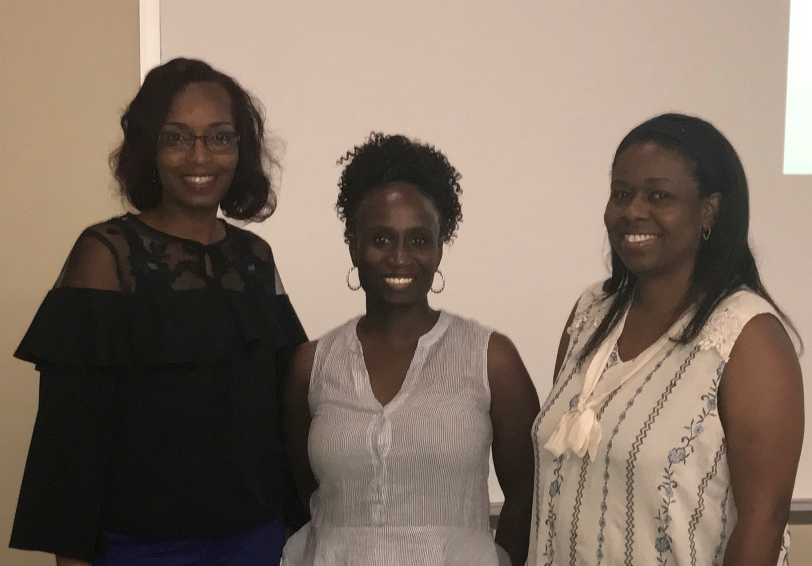
Legacy Teacher Leaders
Donnita Tucker
Pam McClendon
Wendy Johnson

Slide 12
Legacy Participants
Black Female Students selected each year
40 each in 2019, 2020, 2021
120 total students
Higher achieving
Enrolled in fall AP CSP course
Undergraduate Peer Mentors

Slide 13
LEGACY - Logic Model
INPUTS
OUTPUTS
Activities Outputs
OUTCOMES IMPACTS
Short-term Intermediate Long-term
• Project PIs w/ K-12 CS research, outreach, and culturally responsive teaching experience
• 3 black female AP CSP Teacher Leaders
• Pool of 105 AP CSP teachers in Alabama
• Near peer mentors
• Laptops, Kajeet kits, exam costs provided for students with needs demonstrated;
• Travel and $2K stipends for all students
• University Partners
• ALSDE
• Industry Partners
• Researchers/Evaluator experienced in assessing AP CSP, broadening STEM participation
• Recruit and select 120 young black high school women from Alabama, grades 10-12, rural, urban
• Residential: participate in Summer Institute and Interim (online project-based)
• Home-based: utilize home-base resources to support CS activities
• School-based:
AP CSP courses, Career Education, Saturday sessions
• Learning community/ network is established, including peer mentoring
• 120 students complete summer training and are prepared to be peer experts in AP CSP courses
• Home "work" accomplished, including Piazza posts
• All students attend required hangouts, Saturday sessions
• All student take AP CSP exam
• Social and cultural barriers to young black women's CS/STEM participation are reduced
• Students serve as Peer Experts
in AP CSP courses
• Students gain in interest, belongingness, intent to persist
• Students gain in self-efficacy, content knowledge, college preparedness
• Social and cultural barriers to young black women's CS/STEM participation are reduced
• Students serve as Community Ambassadors, encouraging peers and younger girls to explore CS
• Students' interest in STEM careers is increased
• Students successfully enter college, choose STEM majors
• Social and cultural barriers to young black women's CS/STEM participation are reduced
• Three cohorts of black female students move through Alabama CS/STEM pipeline, reducing privilege gap
• Program contributes to diverse workforce in STEM
• Students attain college degrees, majoring in STEM fields
Priorities:
Young women of color in Alabama succeeding in AP CS Principles, computing, and STEM careers
EVALUATION and RESEARCH
Project activities are implemented as planned; Quantity and quality of participation; Expectations, structures, practices established for community;
Assess self-efficacy, content knowledge, belongingness, intent to persist, college preparedness, career interest;
Assess interest, career interest, persistence in CS/STEM, college choices

Slide 14
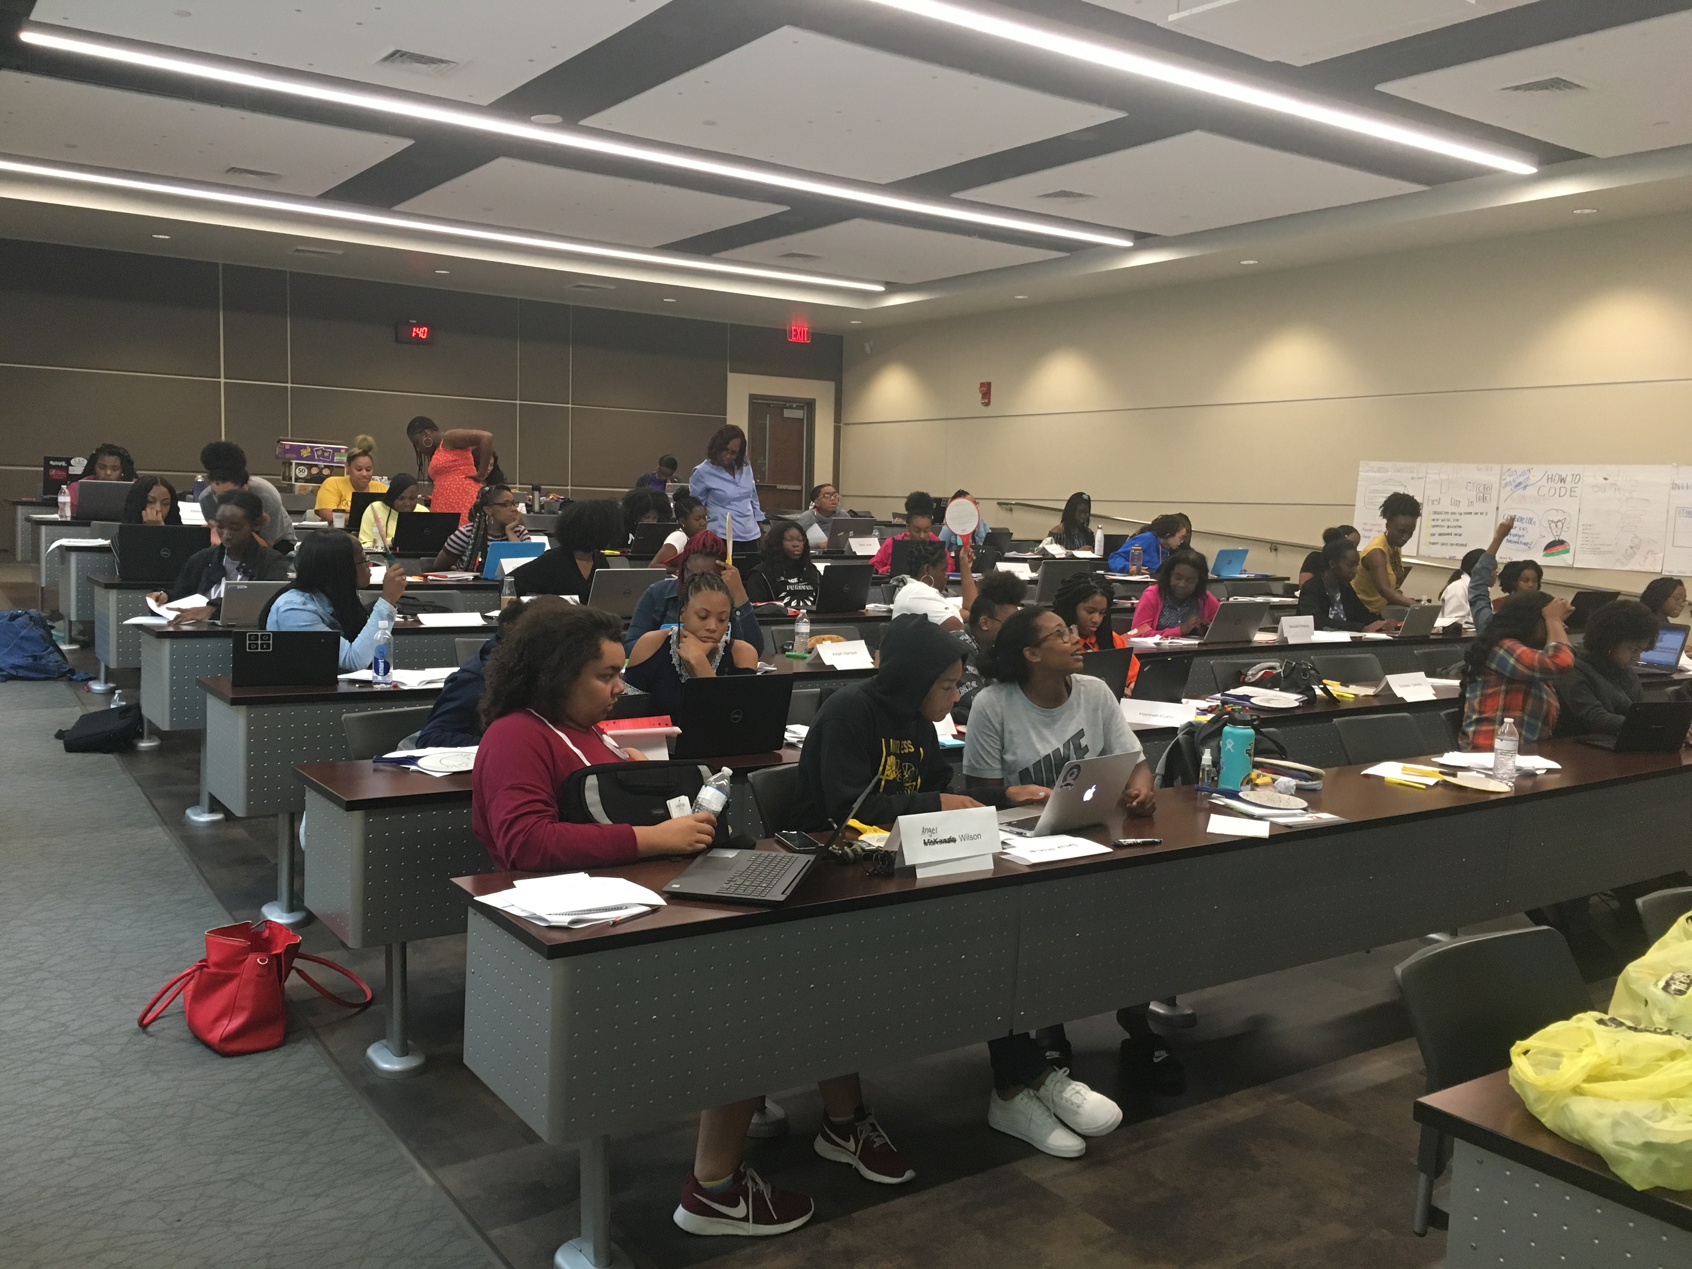
June 2019 Summer Institute
-------------------------------------------
30 hours of AP CSP curriculum
Create Performance Tasks
CS Career Awareness
Our First Summer
Summer 2019 Interim --------------------------------
Students work on PTs
Up to 50 hours
Synchronous virtual meetings
July 2019 Summer Institute
-------------------------------------------
12 hours of class-time
Students present Performance Tasks
Students ready for AP CSP course

Slide 15
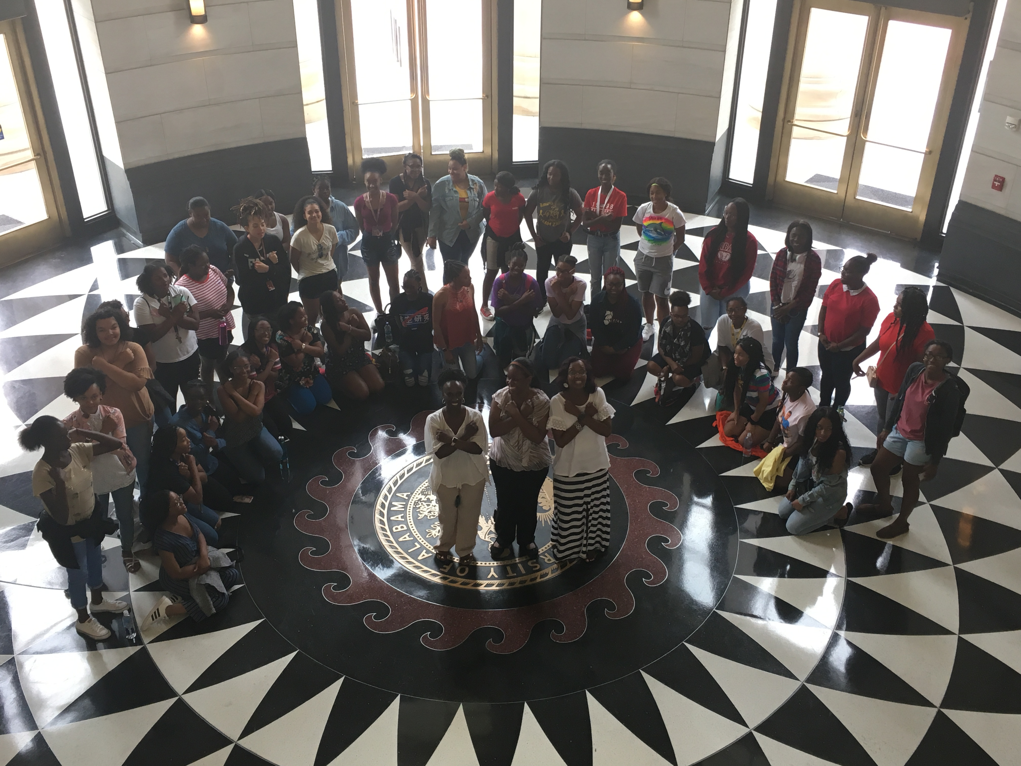

Slide 16
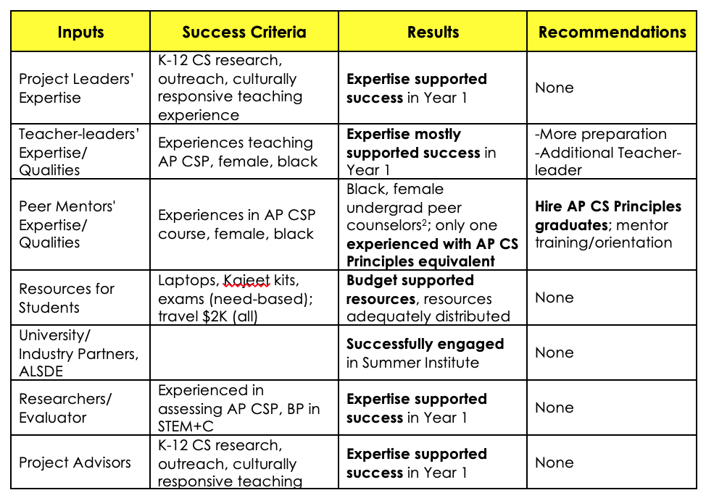
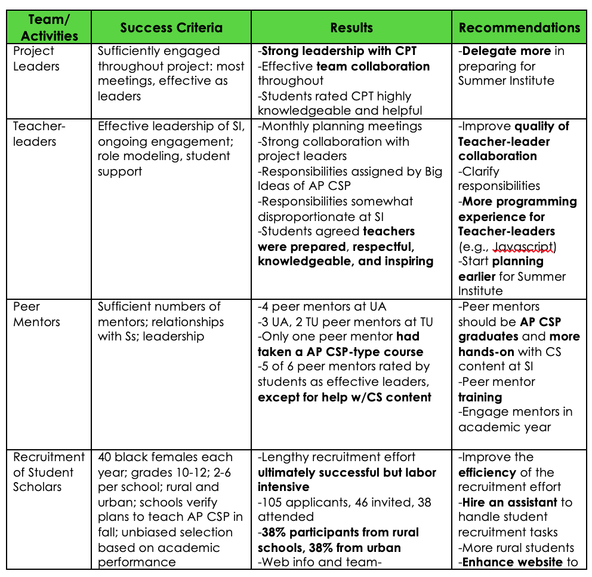
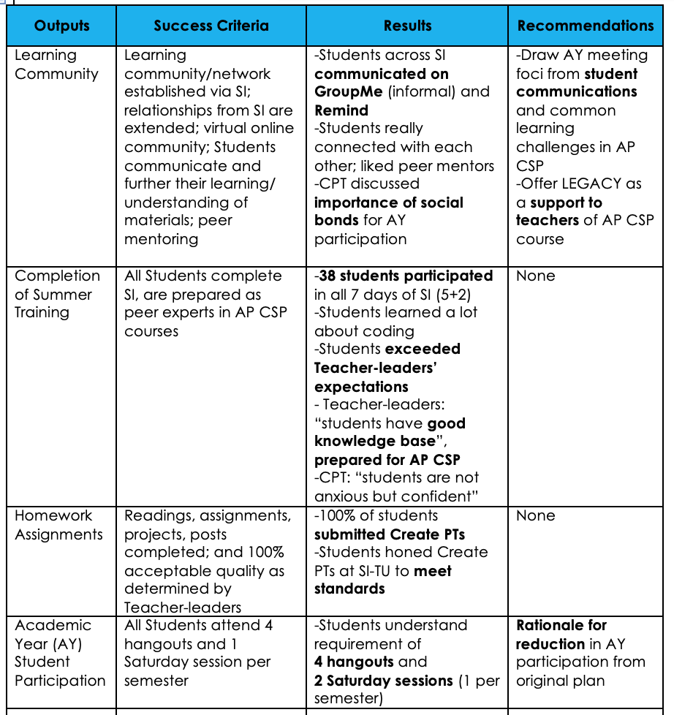
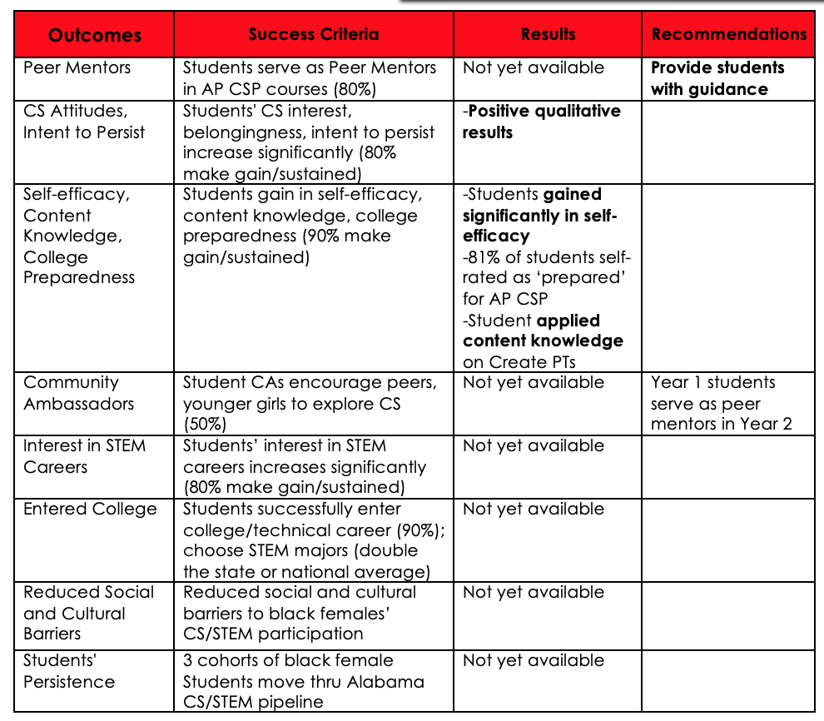
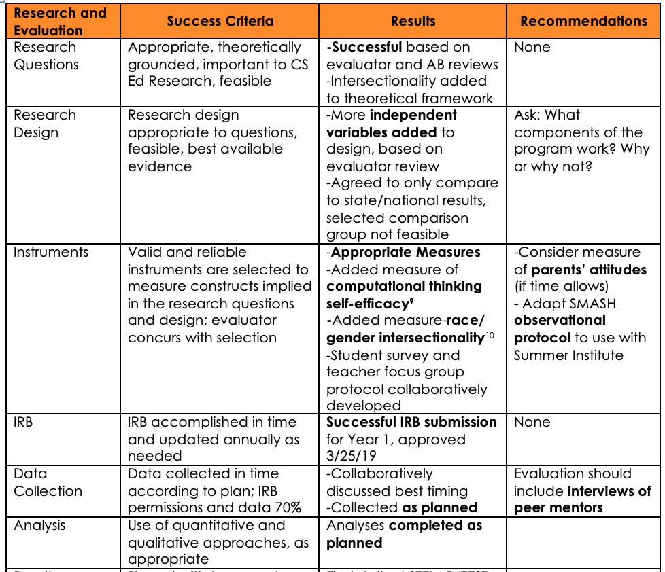
Evaluation: Success Criteria, Results, Recommendations

Slide 17
Our Students Shared…
Being able to meet so many black girls, such as myself, from different backgrounds and walks of life. You never get that experience at home.
It changed my life for the better.
I LOVEDDD the fact that this was for only black girls who wanted to learn more about CS.
All 3 teachers would be getting off-topic by talking to us about all of the AMAZING things about computers and the joy on their faces…
whenever we were all able to just BOND
were my personal favorite.
I would say that it was
a life changing experience.
Actually Being the Majority in an area and experience friendship with those who
look like me.
I came in knowing literally NOTHING about coding and now I'm independently developing my own pseudo-code and algorithms.
It gave me a head start on what I will doing for the school year and how I need to do it.
The knowledge I obtained about coding and computer science [was my favorite]. I am now reconsidering my anticipated major. I also enjoyed meeting my peers and the environment our grown connections created.
African American girls learning more and more about CS to change the world in the future.
.
Everyone was so different and
we helped each other out the entire time.
Meeting new people and making friends because I didn't know that other girls like me would be doing the same thing I am doing.
.
The people and the college experience, because…it is a once in a lifetime kind of thing.

Slide 18
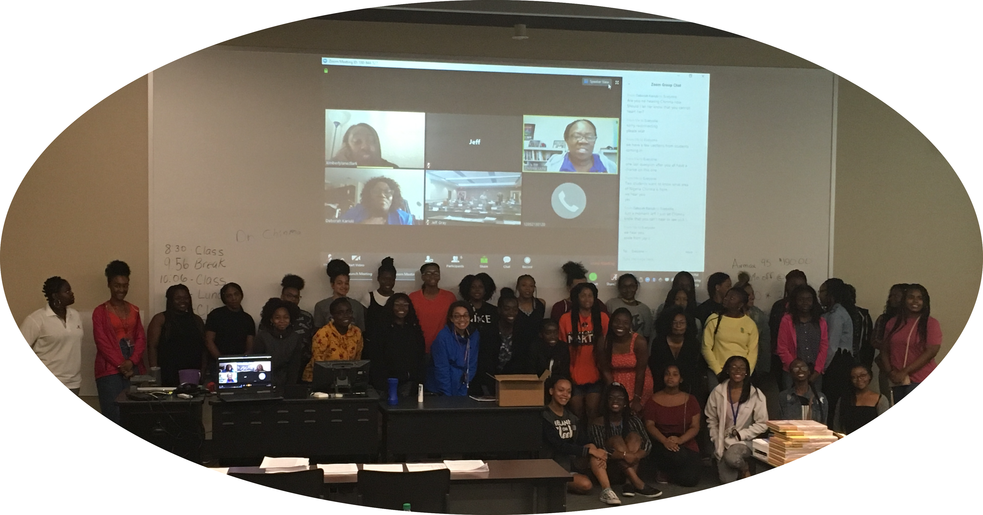
Thank You!
This material is based upon work supported by the National Science Foundation under Grant Nos. DRL-1759421, DRL - 1759197 and DRL - 1759262.

