Slide 1
Assessing Program Fidelity Across Multiple Contexts: The Fidelity Index, Part II Session # 814 Joel Philp, Krista Collins, and Karyl Askew The Evaluation Group
American Evaluation Association Annual Conference
October 13-18 2014
Denver, CO

Slide 2
For Today
Introductions – Joel, Krista, and Karyl
Review – Steps in Creating a Fidelity Index (Joel - 15 minutes)
Applications and lessons learned in different education contexts across different phases of fidelity assessment:
Designing (Karyl –i3 STEM - 15 minutes)
Monitoring and Adaptation (Krista – RTT-D Blended Learning - 15 minutes)
Reporting (Joel – i3 College prep - 15 minutes)
Answer questions and hear your comments (20-30 minutes)

Slide 3
Background
TEG has evaluated over 150 education-based programs over the last 20 years
Most are multi-year, multi-component programs
Most have some type of fidelity assessment, but little guidance exists
Ex., What Works Clearinghouse is explicit on impact evaluation, silent on implementation evaluation
Notes:
Most guidance focused on impact evaluation, but no clear remarks about what is a good implementation evaluation. Fidelity assessment is an under-developed area. There is no right or wrong way, this is just one attempt that we have put into practice.

Slide 4
Review: What is a Fidelity Index?
Fidelity Index:
“A quantitative assessment of the extent to which a multi-component intervention has been implemented as intended across the program.”
Computing a Fidelity Index requires us to “roll-up” scores:
Program-Level
Component-Level
Individual-Level
(see handout)
Notes:
Summative number of implementation – program wide. Series of cascading roll-ups

Slide 5
Review: 8 Key Criteria for Assessing the Implementation of any One Program Component (Durlak and DuPre, 2008)
Individual Level | Program Level
Adherence | Reach
Dosage | Differentiation
Quality | Contrast
Responsiveness | Adaptation
Notes:
Focused on 4 that can be measured on individual level.
Other four – either hasn’t been a whole lot done in that area, or it’s more of a program level than individual level
Quality is most abstract/undefined – not many standards exist. Use empirical evidence to determine quality, information in proposal or narrative – WANT TO DEFINE A PRIORI, don’t want to rig the game, probably won’t be an exhaustive list, but can identify critical components
Don’t need to include all of them – maybe some are more relevant that others

Slide 6
Review: A Simple Example
School-based program for 100 at-risk students
Mentoring
Case Management
Higher grades, motivation
Enroll in college
College Prep Workshops
Notes:
Multicomponent Program:
45 minutes
Mentoring
Case Management – work with kids to monitor grades and goals, check-in quarterly
College Prep – complete college access documents

Slide 7
Review: Steps in Creating a Fidelity Index
Step #1: Identify Key Components
Decide what are the Key Components of your Multi-Component Program.
Everything can’t be a key component.
More key components you identify, the more complex the implementation assessment.
Tip: Stick to direct services as key components (not preparation or planning services)
Notes:
Which services are directly affecting outcomes – you could argue for everything to be a key component, but that just makes your index more complex, best to stick to direct services to targeted audience
If you think of it as a living/fluid measure – you can modify it every year to reflect key components
Training, planning – preliminary and important, but not a direct service for participants. But say planning and training were the only components done in Year 1, then it is reasonable to identify them as key components.

Slide 8
Review: Steps in Creating a Fidelity Index
More from Karyl
Step #2: Determine your criteria
Select 1 key component and decide the criteria you will use to assess its implementation
Some criteria are more difficult to measure than others (ex., Quality)
You don’t need to use all criteria!
In the example, we will use the first 4 criteria with MENTORING, all of which can be measured at the individual-level
Criteria
Adherence
Dosage
Quality
Responsiveness
Notes:
Once you identify key component – drill down using criteria
Can use any one or combination of criteria most relevant to your program

Slide 9
Review: Steps in Creating a Fidelity Index
Step #3: Operationalize your criteria
Define the criteria and plan for data collection
Criteria | MENTORING Operationalized Criteria
Adherence | 3 Core ingredients: Mentor must be: an Adult; received training; and be the same gender as his/her mentee. Method: Student survey
Dosage | Weekly 1-1 meetings, minimum of 45 minutes each: Method: School Sign-in/out sheets
Quality | Three standards of quality Mentoring: Mentor is on-time; reviews previous meeting; listens/ask questions: Method: student survey
Responsiveness | Students rate their satisfaction with mentoring on a 1-5 scale. Method: student survey
Notes:
Go back to grant narrative, proposal, program materials, best practices, program history to define criteria

Slide 10
Review: Steps in Creating a Fidelity Index
Step #4: Determine Levels and Thresholds
Define the # of levels of implementation
Can have any number of levels, but 2-3
seems best. For example:
Adequate/not adequate
Poor/satisfactory/exemplary
Below expectations/meets expectations/exceeds expectations
Notes:
Need to set threshold or target – can have any number of levels, but fewer is less complex
More than three you get finer level of measurement, but can become difficult to interpret

Slide 11
Review: Steps in Creating a Fidelity Index
Step #4: Determine Levels and Thresholds
Define the thresholds (i.e., targets) for each level
Thresholds and criteria are set a priori from:
Discussions with program staff
Review of program model or grant narrative
Known best practices cited in the literature
Historical program evidence
Notes:
Need to set threshold or target – can have any number of levels, but fewer is less complex
More than three you get finer level of measurement, but can become difficult to interpret

Slide 12
Review: Steps in Creating a Fidelity Index
Levels (3)
Mentoring Component
Criteria | Poor | Adequate | Exemplary
Adherence | 1 of 3 core ingredients | 2 of 3 core ingredients | 3 of 3 core ingredients
Dosage | 1/month or less | 2-3 month | 4+ per month
Quality | Meets 1 of 3 mentoring standards | Meets 2 of 3 mentoring standards | Meets all 3 mentoring standards
Responsiveness | Rating of 1-2 | Rating of 3-4 | Rating of 5
Thresholds
Notes:
Need to do this all a priori

Slide 13
Review: Steps in Creating a Fidelity Index
Step #5: Assign scores to each level; compute the range
Here, scores range from 4 (all criteria scored ‘1’) to 12 (all criteria scored a ‘3’)
Criteria | Poor (1) | Adequate (2) | Exemplary (3)
Adherence | 1 of 3 core ingredients | 2 of 3 core ingredients | 3 core ingredients
Dosage | 1/month or less | 2-3 month | 4+ per month
Quality | Meets 1 of 3 mentoring standards | Meets 2 of 3 mentoring standards | Meets all 3 mentoring standards
Responsiveness | Rating of 1-2 | Rating of 3-4 | Rating of 5

Slide 14
Review: Steps in Creating a Fidelity Index
Step #6: Define implementation at the Individual level
Determine the range of summed scores that will define poor, adequate, and exemplary implementation
For example:
4-6 = poor implementation
7-9 = adequate implementation
10-12 = exemplary implementation
Notes:
Need to roll-up individual scores

Slide 15
Review: Steps in Creating a Fidelity Index
Step #7: Define implementation at the Component level
Determine a priori the range of summed scores that will define poor, adequate, and exemplary implementation at the component level, and assign a score to that level:
If 50% or fewer score between 10-12 = Poor implementation = score of 1
If 51-74% score between 10-12 = Adequate implementation = score of 2
If 75% or more score between 10-12 = Exemplary implementation = score of 3

Slide 16
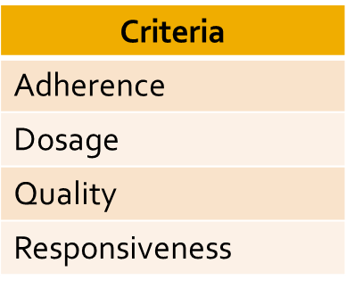
Review: Steps in Creating a Fidelity Index
Step #8: Repeat steps 2-7 for each of your identified key components
Mentoring
Case Management
College Prep Workshops

Slide 17
Review: Steps in Creating a Fidelity Index
Step #9: Define Implementation at the program level
Determine a priori the range of summed scores that will define poor, adequate, and exemplary implementation for ALL component at the PROGRAM level, and assign a score to that level:
Ex.: With 3 components, each with same scoring = range of 3-9:
Poor implementation = Combined score of 4 out of 9 (44% or less) or less summed across all components
Adequate Implementation = Combined score of 5-7 out of 9 (55 -77%) summed across all components
Exemplary implementation = Combined score of 8-9 out of 9 summed across all components (78% or higher)

Slide 18
Review: Steps in Creating a Fidelity Index
Step #10 : Score each component at the predetermined time.
Mentoring Component
Criteria | Poor (1) | Adequate (2) | Exemplary (3)
Adherence | 1 of 3 core ingredients Score =1 | 2 of 3 core ingredients | 3 core ingredients
Dosage | Ave 1/month or less | Ave 2-3 month Score = 2 | Ave 4+ per month
Quality | Meets 1 of 3 mentoring standards | Meets 2 of 3 mentoring standards Score = 2 | Meets all 3 mentoring standards
Responsiveness | Rating of 1-2 | Rating of 3-4 | Rating of 5 Score = 3
Summed Score = 8 (adequate)

Slide 19
Review: Steps in Creating a Fidelity Index
Step #11: Roll–up across components and entire program
Score | N | %
4-6 | 15 | 15%
7-9 | 20 | 20%
10-12 | 65 | 65%
Mentoring
Score
2/3
Score | N | %
4-6 | 10 | 10%
7-9 | 12 | 12%
10-12 | 78 | 78%
Fidelity Index
6/9, 66% or Adequate Implementation
Score
3/3
Case Management
Score | N | %
4-6 | 25 | 25%
7-9 | 45 | 45%
10-12 | 30 | 30%
Score
1/3
College Prep Workshops

Slide 20
Design: INSPIRE – An US DOE i3 Grant
K-12 STEM pipeline approach for STEM course content and instructional design.
Year 1 of a four-year i3 grant that mandated studies of impact and fidelity of implementation.
Target Sample
1 School District
4 Schools (2 Elementary , 1 Middle, 1 High)
2085 K – 12 Students
95 K – 12 Teachers
Notes:
For this portion of the discussion I will walk you through the initial design of a fidelity index for INSPIRE.
INSPIRE stands for (Infusing Innovative STEM Practices Into Rigorous Education)
It is a USDOE Investing in Innovation Development Grant designed to test a k-12 STEM pipeline approach.
The underlying rationale of INSPIRE is that training teachers across levels to implement high-quality STEM PBL will significantly increase student interest and engagement in STEM, leading to higher achievement in math and science.
We are in the first year of a four year grant that mandated studies of impact and implementation.
INSPIRE operates in 4 schools in one NC school district with a populations of 2085 students and 95 teachers.

Slide 21
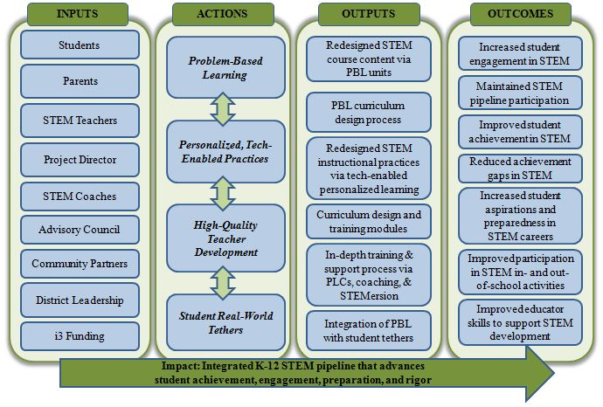
Design: INSPIRE Logic Model - Components
Notes:
The first step in designing a fidelity index is to identify the key ingredients of the intervention. We were fortunate to began with a program logic model that was predefined during the grant application.
Logic models come in all forms, but typically we want to focus on elements of the logic model labeled as activities/actions/outputs to signal important services or categories of services. This logic model signaled four strategies or types of services that could serve as the basis for a fidelity index.
During initial discovery meetings with our client a goal was to verify that what was represented in the logic was still their plan.

Slide 22
Design: INSPIRE Fidelity Index - Components
1. STEM problem-based and project-based learning (PBL) INSTRUCTION |  | 2. PERSONALIZED, TECH-ENABLED INSTRUCTION
3. TEACHER PROFESSIONAL DEVELOPMENT AND SUPPORT |  | 4. STUDENT REAL-WORLD STEM TETHERS
Notes:
With confirmation from the client, we specified four components of the INSPIRE fidelity index.
Development and Implementation of STEM PBL content and instruction
Integrations of adaptive digital course content to provide real-time feedback on student learning
Sustained year-round teacher professional development and instructional support facilitated by school-based STEM coaches
Integration of real-world tethers that connect to and extend the STEM course content

Slide 23
Design: INSPIRE Fidelity Index – Criteria Identified
1. STEM problem-based and project-based learning (PBL) INSTRUCTION # of PBL lessons developed (A) % of PBL lessons that are interdisciplinary (A) % of PBL lessons meeting quality criteria (Q) % of teachers implementing PBL lessons (A/D) % of students reporting favorable opinions (Rs) % of teachers reporting favorable opinions (Rs) |  | 2. PERSONALIZED, TECH-ENABLED INSTRUCTION % of PBL lessons incorporating technology (A) % of STEM teachers rating experiences as “good” or “excellent” (Rs) % of STEM students reporting weekly use of technology with adaptive content (R/D) % of STEM students rating experiences as “good” or “excellent” (Rs)
3. TEACHER PROFESSIONAL DEVELOPMENT AND SUPPORT # of INSPIRE trainings and institutes offered (A) % STEM teachers completing 10 hours of STEM PD per year (R/D) % of teachers utilizing on-site STEM coaches per month (D) #, % of teachers participating in STEM Professional Learning Communities (PLCs) per month (D) % STEM teachers demonstrating increased PBL proficiency (Q) |  | 4. STUDENT REAL-WORLD STEM TETHERS % of STEM students participating in school-sponsored STEM events by level per year (D) % of STEM students who participate in NASA summer camps per year (R) % of STEM students who report STEM-related career aspirations (Q) % of STEM students rating experiences as “good” or “excellent” (Rs)
Legend
A=Adherence; D=Dosage; R=Reach; Q=Quality; Rs=Responsiveness
Notes:
From the grant application, document reviews, and evaluation planning meetings with client, we began to identify criteria for assessing the implementation of each component.
Let’s pick one to focus on…student real-world tethers…activities such as STEM-focused clubs, camps, or competitions design to increase students’ exposure and interest in STEM.

Slide 24
Design: INSPIRE Fidelity Index – Criteria Defined
A_{ES}. % of K-5 STEM students who participate in at least 2 school-sponsored STEM events (D). Measure: School administrative records and permission slips.
B. % of NASA summer camp slots filled (R). Measure: NASA Camp daily attendance records.
C. % of STEM events achieving an average effectiveness rating of 3.0. Measure: STEM Event Teacher Survey quality subscale.
D. % of STEM students rating experiences as “good” or “excellent” (Rs). Measure: INSPIRE Year-End Student Survey.
4. STUDENT REAL-WORLD STEM TETHERS % of STEM students participating in school-sponsored STEM events by level per year (D) % of STEM students who participate in NASA summer camps per year (R) % of STEM students who report STEM-related career aspirations (Q) % of STEM students rating experiences as “good” or “excellent” (Rs)
Legend
A=Adherence; D=Dosage; R=Reach; Q=Quality; Rs=Responsiveness
Notes:
For this component we identified four criteria. Again drawing from the grant application, document reviews, and evaluation planning meetings with client.
Then we moved to defining or operationalizing each criteria.
4A. Our first criteria…became operationalized as…and we created one indicator for each grade level because of different activities and expectation for each level (after-school clubs for ES, science fair for MS, mandatory senior projects for HS). We also thought of this indicator as both adherence to the plan of 2 per year and dosage per student.
4B. Operationalized as % of slots filled vs % of student who participate because of capacity constraints,
4C. We began thinking of this in terms of outcomes…but it is more appropriate for the fidelity index to think of in terms factors the program has more direct control like quality of the event experience, particularly in year 1.
4D. However, the final one does incorporated student reactions.

Slide 25
Design: INSPIRE Fidelity Index – Thresholds
Criteria & Measure | Year 1 Threshold
A_{ES}. % of K-5 STEM students who participate in at least 2 school-sponsored STEM events (D; PM 4.4). Measure: School administrative records and permission slips. | 733 of 1466 (50%) STEM elementary school students
B. % of NASA summer camp slots filled (R). Measure: NASA Camp daily attendance records. | 240 of 300 (85%) NASA camp slots
C. % of STEM events achieving an average effectiveness rating of 3.0. Measure: STEM Event Teacher Survey quality subscale. | 60% of STEM Events
D. % of STEM students rating experiences as “good” or “excellent” (Rs). Measure: INSPIRE Year-End Student Survey. | 1563 of 2085 (75%) Targeted STEM students
Notes:
Next we moved to setting year 1 thresholds.
For A we began with the project-specific performance measures predefined in the grant.
For B - D, we referenced the grant narrative and project budget and the evaluation team set what we thought was a reasonable goal of 85%.
We repeated this process for each component. Once a draft was completed we incorporated into our evaluation plan, submitted it to the client with specific instructions to guide their review of criteria, and scheduled a meeting to focus just on the fidelity index.
The goal of this meeting was to introduce the client to implementation fidelity in a concrete way and invite their input in the development process. We were seeking agreement that what we proposed was appropriate, reasonable, and ambitious. The conversation focused on measurement and thresholds.
Questions to ask during that meeting where:
How many events do you plan to offer? How many student/teachers do you expect will attend/engage? What has this looked like for your schools in the past? Is that threshold realistic given where you are in the phase of program implementation? Is this the right measure to use for the indicator? What types of data do you already collected on this activity?

Slide 26
Design: Tips and Takehomes
Begin with a logic model to identify key components.
Engage stakeholders in an iterative process to determine the appropriate criteria and thresholds.
Collaboration and communication can help to ease/calm stakeholders’ anxiety and increase commitment to data collection.

Slide 27
Monitoring: IMPACT – An US DOE Race to the Top District (RTT-D) Grant
1 School District
9,526 students
616 teachers
-9 middle schools
-4 high schools
-2 alternative schools
Individualized Student Learning
Student Transition Activities
Blended Learning Implementation
Student College and Career Readiness
Professional Development
Data Driven Decision Making
Teacher Effectiveness
Sustainability
Notes:
IMPACT: Innovative Methods for Personalizing Academics, Complemented by Technology
2012-2016 four year grant – just completed year 1 and beginning year 2 of the project/evaluation
Requires both an impact and implementation evaluation – embedded a fidelity index to support implementation evaluation
Outcomes
Blended Learning Implementation
Student Outcomes – Academic Achievement, College and Career Readiness
Teacher Effectiveness
Sustainability

Slide 28
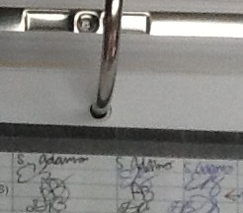
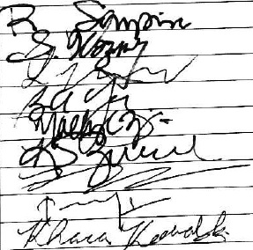
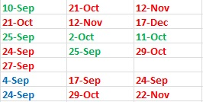
Monitoring: Oversee Data for Fidelity Index
Is the necessary data available?
How is the data being collected?
Are the targets set being met?
Notes:
Need to constantly monitor data to assure that the data produced can be used to measure fidelity indicators of interest, as well as can be reported in the format desired (percentage, mean, etc.) Also need to check that data has been measured consistently across all sites
We had to modify our index and reduce indices to the lowest consistent measure (what teachers received v. what staff provided)

Slide 29
Adaptation: Initial Fidelity Index
Individualized Student Learning
Blended Learning
Demonstration Classrooms
Student Transition Activities
Summer Transition Camp
College Readiness Institute
Professional Development
Teacher PD
Self-Assessment
Data Driven Decision Making
Personalized Learning Communities
Individualized Coaching
Notes:
These are the key components of our fidelity index – and the indicators that make up each component
Thinking long-term, wanted to be certain that the key components were always being measured to some degree

Slide 30
Adaptation: Adapt FI to Align with Current Program Focus: End of Year 1
Individualized Student Learning
Blended Learning
Demonstration Classrooms
Student Transition Activities
Summer Transition Camp
College Readiness Institute
Professional Development
Teacher PD
Self-Assessment
Data Driven Decision Making
Personalized Learning Communities
Technology
Individualized Coaching
Admin PD
Notes:
Green – were added in retrospect
Black – removed from fidelity index

Slide 31
Adaptation: Adapt FI to Align with Current Program Focus: Thinking Ahead
Individualized Student Learning
Blended Learning
Demonstration Classrooms
Student Transition Activities
Summer Transition Camp
College Readiness Institute
Professional Development
Teacher PD
Self-Assessment
Data Driven Decision Making
Personalized Learning Communities
Technology
Individualized Coaching
Admin PD
Sustainability
Notes:
Thinking ahead
Green – Demonstration Classrooms and Sustainability will become important features of the index
Grey – we’ll still measure technology and teacher/admin PD, but they will become less important
Important to note that throughout data collection the same key components are always being measured

Slide 32
Adaptation: Revise Targets Annually
Summer Transition Camp
Measure | Year 1: 2013-2014 |  |  |  | Year 2: 2014-2015
 | Target | Actual | Weight | Total | Target | Weight
Dosage: % of participating students attending all days | 60% | 87.1% | .40 | .58 | 70% | .50
Reach: % of targeted students attending | 30% | 17.9% | .20 | .12 | 30% | .20
Responsiveness: % of students who rated the STC as “useful” to “very useful” | 60% | 95.7% | .40 | .64 | 70% | .20
Quality: % of best practices implemented | N/A | N/A | N/A | N/A | 60% | .10
INDIVIDUAL ACTIVITY FIDELITY: |  |  |  | 1.34 | Fidelity in Place
Notes:
Dosage: target set low, but weighted heavy – strongly exceeded target, so target increased for year 2 and weight increased
Reach: target set low and weighted low, because unsure of what to expect with new program – didn’t meet target, so maintain target and weight for year 2
Responsiveness: target set high and weighted high because satisfaction scores are often high (likely in their favor), increased target but decreased weight for year 2 – because not as important
Quality: were not certain of “best practices” at onset of program so left out of fidelity index, set target but low weight for year 2

Slide 33
Monitoring and Adaptation: Tips and Takehomes
Monitor the data for the fidelity index
Establish the format for all data collection tools
Developing a fidelity index is an iterative process
Adapt fidelity index to align with current program goals and performance levels
Reconfirm that fidelity index will address longitudinal interests

Slide 34
Reporting
What are some ways of reporting fidelity?
Roll-up across key components to get a final program -wide score
Report implementation of each key component separately (# adequately implemented)

Slide 35
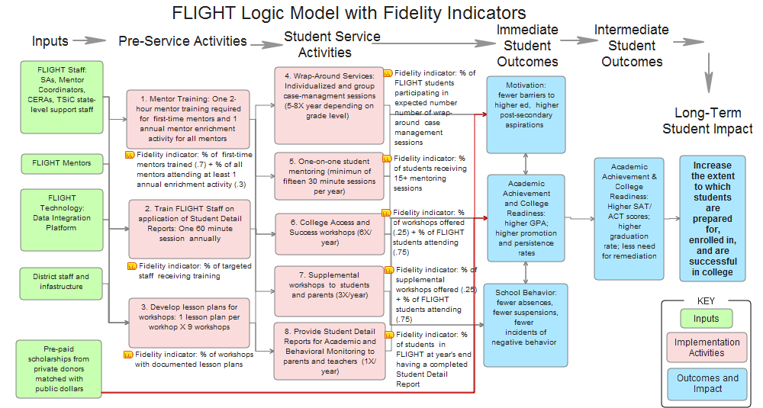
Reporting: Program Wide Fidelity Score

Slide 36
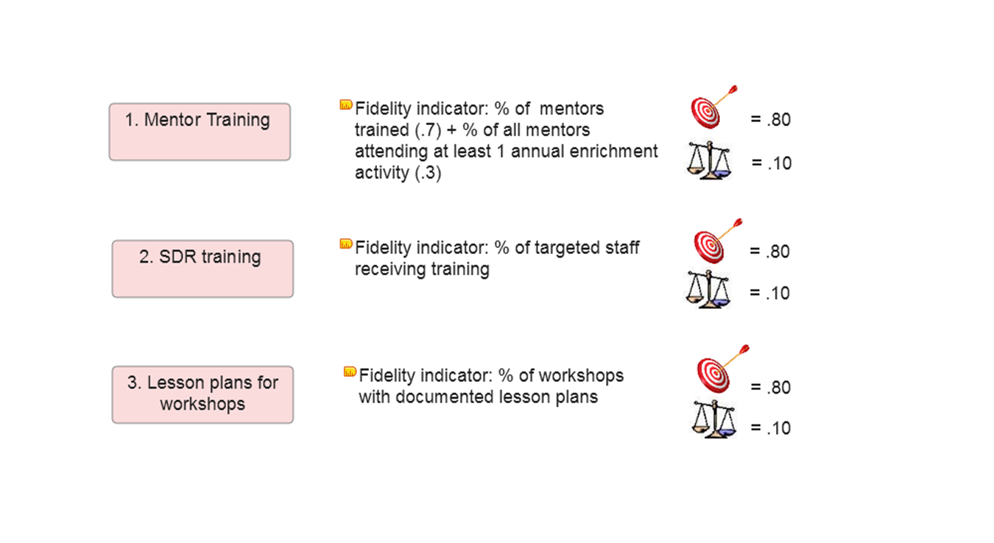
Reporting: Program Wide Fidelity Score

Slide 37
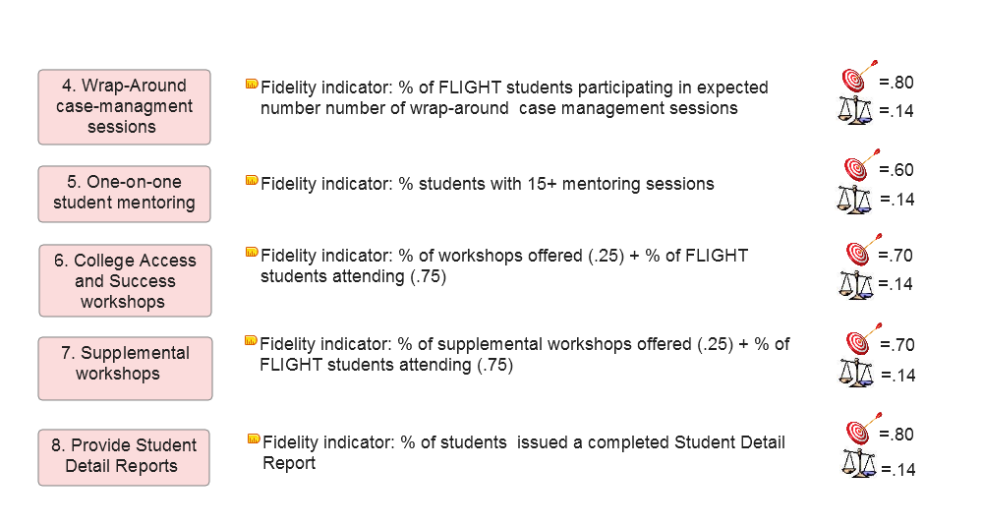
Reporting: Program Wide Fidelity Score

Slide 38
Reporting: Program Wide Fidelity Score
A program component score is the ratio between what was expected (the target) and what actually occurred
A score of 1.0 = perfect fidelity between what was expected and what was observed.
A rubric qualifies the range of fidelity scores
Weighting the scores and summing across all activities yields an overall weighted score for the entire project, aka the Fidelity Index

Slide 39
Reporting: Program Wide Fidelity Score
Fidelity Scores - 3 Level of Implementation
Fidelity Score | Level of Implementation | Descriptor
.80< | Below expectations | Actual implementation fell well below the expected level. Implementation of this core component needs to be improved upon.
Between .81-1.20 | Meets expectations | There is congruence between the actual level and expected level of implementation. The implementation of this core component is satisfactory.
1.21 > | Exceeds expectations | The actual level of implementation far exceeds the expected level of implementation. The implementation of this core component is outstanding.

Slide 40
Reporting: Program Wide Fidelity Score
Summary Table of Weighted Fidelity Scores Across All Services
Activity Description/Indicators | Target | Actual | Actual/ Target Ratio | Assigned Weight | Weighted Fidelity Score
Pre-Service Activities
Train mentors | 80 | 86 | 1.07 | .10 |  | .107
Train staff on Student Detail Reports | 80 | 100 | 1.25 | .10 |  | .125
Create instructional plans for workshops | 80 | 100 | 1.25 | .10 |  | .125
Pre-service activities |  |  |  |  |  | .362
Student Centered Activities
Case Management Meetings | 80 | 61 | .76 | .14 |  | .106
mentoring sessions | 60 | 57 | .95 | .14 |  | .133
College Access and Success Workshops | 70 | 64 | .91 | .14 |  | .127
Supplemental Student Workshops | 70 | .92 | 1.31 | .14 |  | .183
Issue Student Detail Report | 80 | 100 | 1.25 | .14 |  | .175
Student Centered Services |  |  |  |  |  | .724
Fidelity Index |  |  |  |  |  | 1.09

Slide 41
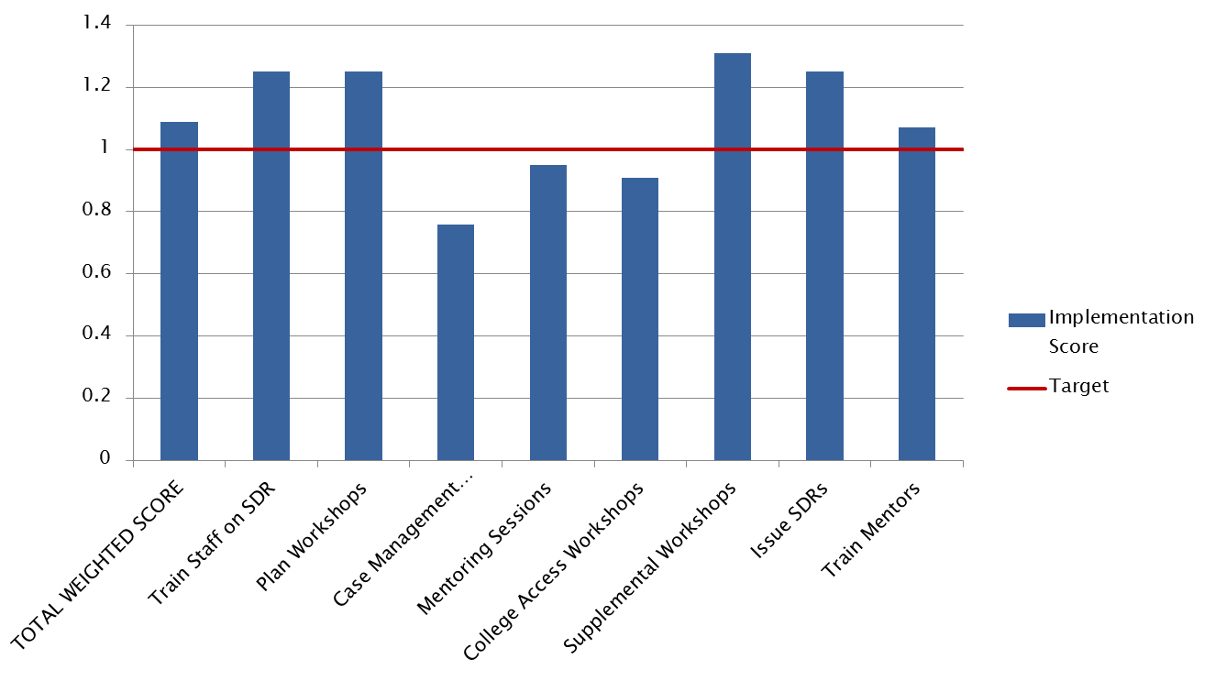
Reporting: Program Wide Fidelity Score

Slide 42
Reporting: # of Key Components Adequately Implemented
Just two levels - adequate and inadequate implementation
Defined a priori for each key component
If you report by components, you can always roll-up to the program level in the future (assuming performance levels were set a priori)

Slide 43
Reporting: # of Key Components Adequately Implemented
Key Component: College Prep Workshops (CPWs) Implementation of component = sum of implementation scores for 2 indicators (Range 0-4). 0 - Inadequate = score of 0-2 1 - Adequate = score of 3 -4
Indicator | Criteria | Operational Definition for Indicator | Data Source(s) for Measuring Indicator | Raw Scoring and Scoring Criteria for Fidelity
 |  |  |  | Implementation Criteria | Results (B=Broward; H=Highlands) | Impl. Score | Fidelity Rating
1 | Adherence: Students have an opportunity to participate in CPWSs | Number of CPWSs offered each year | Student workshop sign –in sheets; STAR database | 0 (low) = 1-3 CPWSs offered per year 1 (moderate) = 4-5 CPWSs offered per year students 2 (high) = 6 CPWSs offered per year | Broward Co. offered 5 CPWSs to 11th grade students ; H offered 2 CPWSs to 11th grade students ; The required number of CPWSs is 2 for 11th graders. | 2-High | Adequate
2 | Dosage: Students participate in CPWSs | % of targeted students participating in the required # of CPWSs offered each year | Student workshop sign –in sheet; STAR database | 0 (low) = 60% or fewer students attended the required number of CMMs 1 (moderate) = 61% – 74% of students attended the required number of CMMs 2 (high) = 75% or more of students attended he required number of CMMs | Of the 58 11th grade students, 36 (62%) attended at least 2 CPWSs. (B=32/46, 69%; H=4/12, 33%) | 1 - Moderate

Slide 44
Reporting: # of Key Components Adequately Implemented
Summary of Fidelity Ratings for Each Key Component.
Key Component | Rating | Comment
Train Mentors | Adequate | All (100%) of the 95 mentors working with FLIGHT students received the mentor training.
SDRTraining | Adequate | All 14 staff in Broward and Highlands were trained on the creation of the SDR.
Workshop Plans | Adequate | Plans were submitted for 10 student workshops plus one parent orientation workshop.
Case Management Meetings (CMMs): | Adequate | Ninety-eight percent of all active FLGHT students received the requisite number of case management meetings.
Mentoring | Inadequate | FLIGHT fell just short (14.6) of the target threshold of an average of 15 mentoring sessions per student, per year.
College Prep Workshops (CPWs) | Adequate | FLIGHT consistently offered CASWs to students; 62% of the 11th grade students attended the requisite two or more sessions.
Supplemental Student Workshops | Adequate | Most (89%) of the FLIGHT students participated in the requisite number of supplemental workshops.
Student Detail Report | Adequate | All study students in FLIGHT received a SDR.

Slide 45
Reporting: Tips and Takehomes
Reporting using a program-wide index may be appropriate:
With a stable, proven program
Important to monitor implementation across time
Want to differentially weight certain components
Reporting by key component may be appropriate when:
Key components are expected to change across time
Important to monitor implementation within time.

Slide 46
Discussion/Questions – 25 minutes

Slide 47
Contact Information
Joel Philp : Joel@evaluationgroup.com
Krista Collins: Krista@evaluationgroup.com
Karyl Askew: Karyl@evaluationgroup.com

