Slide 1
The Use of Text Mining and Data Visualization to Assist in Managing a Scientific Grants Portfolio
Elizabeth Ruben, Jerry Phelps, Kristianna Pettibone, and
Christina H. Drew
Program Analysis Branch Division of Extramural Research and Training
National Institute of Environmental Health Sciences
November 4, 2011
Notes:
Thank you for coming to the panel presentation. We’re excited to share some of our recent efforts using Omniviz to analyze our portfolio.
My name is Elizabeth Ruben and I’m from the National Institute of Environmental Health Sciences.

Slide 2
NIEHS Mission
Reduce the burden of human illness and disability by understanding how the environment influences the development and progression of human disease.
Notes:
The National Institute of Environmental Health Sciences is part of NIH. We are focused on how the environment influences health and disease.
I am in the extramural division, which funds research outside of our organization.

Slide 3
Purpose
To investigate the use of the text mining/data visualization tool OmniViz™ as a way to:
Help us understand patterns in our portfolio that could inform the management of science in a new way.
Visualize the assignment of grants to program officers.
Explore emerging areas of science.
Identify gaps in research.
3
Notes:
The purpose of our project was to see how visualization techniques in OmniViz would help us better analyze our research portfolios.
Our goal was to answer questions like:
Understand patterns in our portfolio that could inform the management of science in a new way.
Visualize the assignment of grants to program officers.
How can we use this tool to explore emerging areas of science and also to
Identify gaps in research
In this presentation, we will focus on the first two items.

Slide 4
What is OmniViz?
Software designed to find and display trends in large amounts of data.
Specifically designed for bio-medical, healthcare, pharmaceutical industries.
4
Notes:
OmniViz uses text mining algorithms to cluster/categorize gobs of data and then uses visual methods to help the analyst make sense of the results.

Slide 5
The Process:
Obtain our active grant portfolio data.
Limit our data set by grant type and program to focus on our Research Grant Program portfolio.
Import data into OmniViz.
Select text mining algorithm.
Identify words to eliminate in the text mining algorithm. (stop words)
Notes:
This slide lists the five broad steps we completed to define and refine our text mining algorithm. In reality, most of these had many sub-steps and iterations within them. I can’t emphasize how important these steps are, because the text mining process drives the results that are displayed. However, in the interest of time, I’m going to focus on the results, the visualization. If anyone is interested in the text mining process, please feel free to come up to me after the presentation.

Slide 6
Question 1: Can OmniViz help us understand patterns in a portfolio that could inform the management of science in a new way?
6
Notes:
Our first question was: Can OmniViz help us understand patterns in a portfolio that could inform the management of science in a new way?

Slide 7
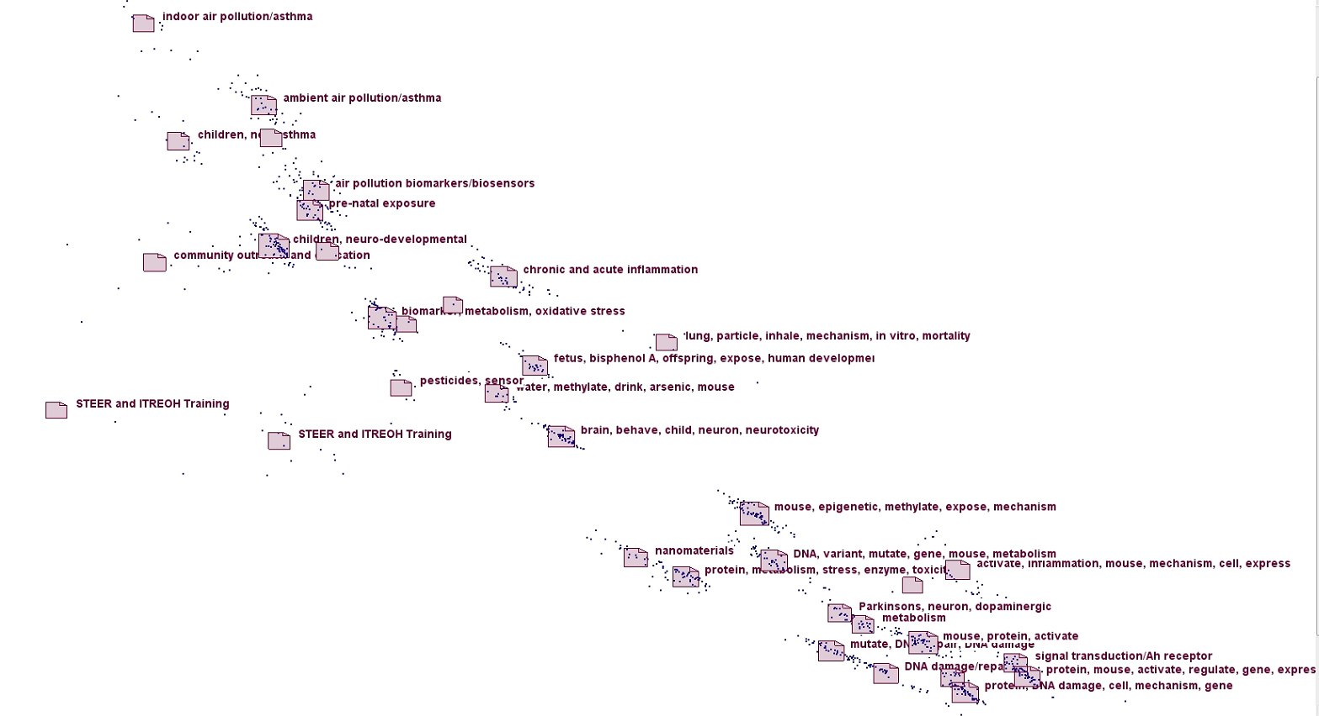
Galaxy: DERT Active Research Grants
Legend:
= Cluster of grants
. = One grant
Note: Labels are created by NIEHS; not the OmniViz default.
7
Notes:
Let me explain what you’re seeing:
We call it a galaxy view because that’s what Omniviz calls it. Each one of these little blue “stars” is a grant. It helps us understand the relationships of the records to each other. Each cluster is a similar to a pile of records, in this case grants, that are similar to each other.
Each grant is a point, or dot, on the visualization.
The “folder icon” associated with each cluster represents the mathematical center of the numeric representation for the records in that cluster. The proximity indicates relatedness. The more similar a point, the closer in proximity they are to each other. Likewise to clusters around each other – the more related they are to each other, the closer together they are. The less related, the farther away they are from each other. The location in the Galaxy provides the overall distribution of grants within the total portfolio. For example, a large number of grants in one area congregates around related subjects/topics.

Slide 8
Galaxy: DERT Active Research Grants
Legend:
= Cluster of grants
. = One grant
Note: Labels are created by NIEHS; not the OmniViz default.
8
Notes:
For our organization, the grants on the lower right side of the slide represent the most basic, cell-level, mechanism-level of research.

Slide 9
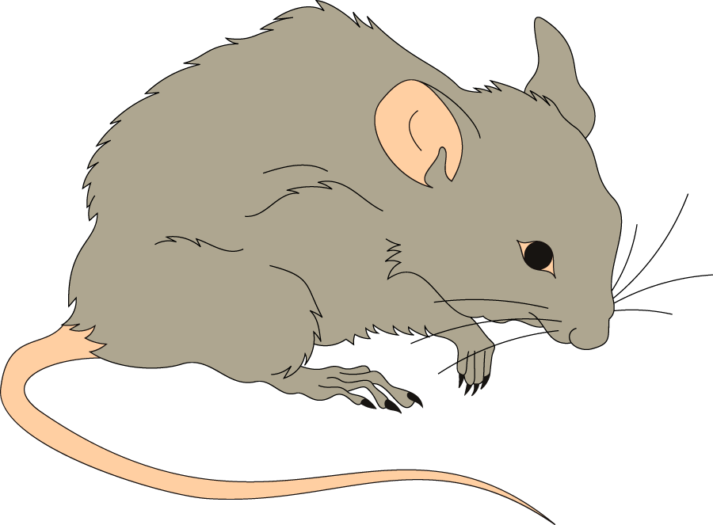
Galaxy: DERT Active Research Grants
Legend:
= Cluster of grants
. = One grant
Note: Labels are created by NIEHS; not the OmniViz default.
9
Notes:
As we move up and left, the research/organism moves from mechanism to cell to larger congregations of cells to mouse models and mechanisms.

Slide 10
Galaxy: DERT Active Research Grants
Legend:
= Cluster of grants
. = One grant
Note: Labels are created by NIEHS; not the OmniViz default.
10
Notes:
Farther up, we see human studies.

Slide 11
Galaxy: DERT Active Research Grants
Legend:
= Cluster of grants
. = One grant
Note: Labels are created by NIEHS; not the OmniViz default.
11
Notes:
And in the far upper left, we see population level activities.

Slide 12
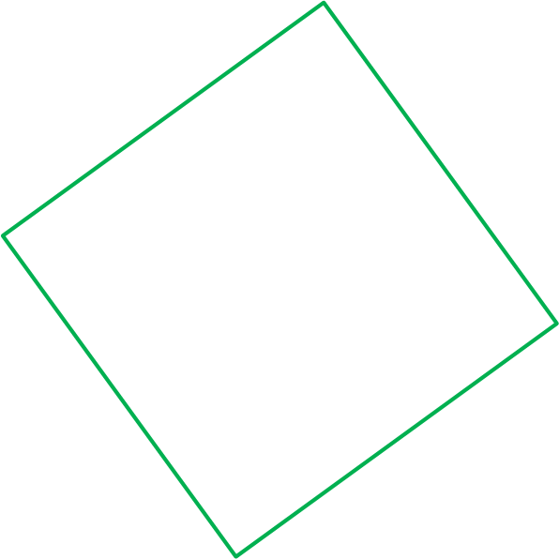
Initial View of Grant Clusters DERT Active Research Project Grant Portfolio
Human Studies
Transitional
Basic Science
Training/Education
Note: Labels are created by NIEHS; not the OmniViz default.
12
Notes:
Another way of thinking about it, we see four major categories of science: Basic science down here at the bottom right, human studies in the top left, a transitional category in between basic and human (and yes we chose that term deliberately, we did not want to use translational without looking more closely at what the individual studies are.
And the training and education grants.
The term translational is not well-defined across the Institutes and we deliberately avoided the term. We were looking for generic labels.

Slide 13
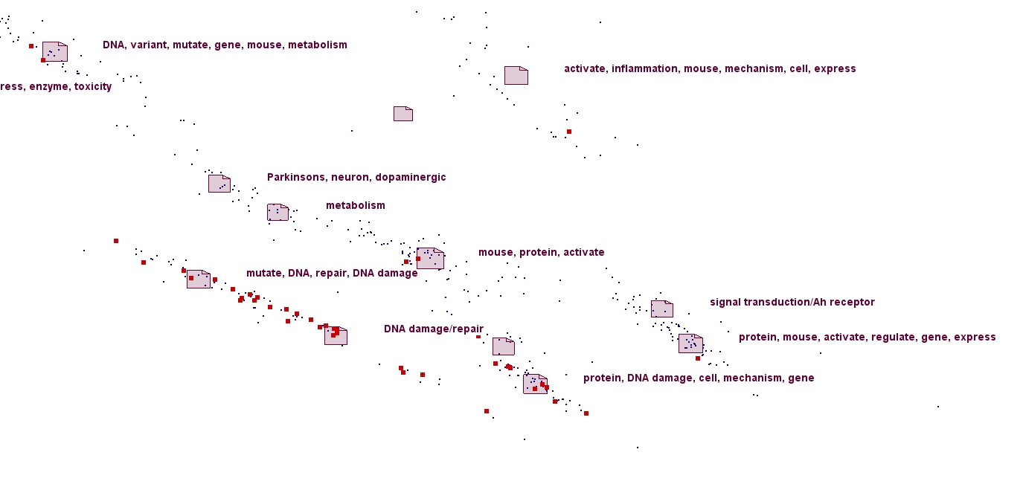
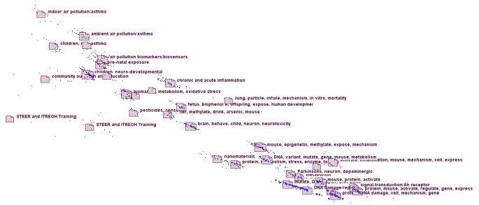
DNA Repair Grants
Program Officer | Number of DNA Repair Grants
Program Officer 1 | 39
Program Officer 2 | 2
Program Officer 3 | 1
Program Officer 4 | 1
Grand Total | 43
13
Notes:
Once we had a sense of the overall categories, we wanted to see where some groups of grants are displayed. As a test case, we looked at the distribution of grants in one of our programs: DNA repair. Because they are clustered quite tightly, the larger picture zooms in on the area. The map on the right shows the entire grant portfolio. The number of DNA Repair grants and the Program Officer assigned to them is displayed in the upper right.

Slide 14
Question 2: Understand Program Administrator Workload Distribution
Examples of individuals across galaxy visualization
Similar/Different
Branch Distribution
14
Notes:
Now, part of our motivation for starting this analysis in the first place was knowing that we were about to embark on a reorganization. It has been about ten years since we changed our organizational structure. So we wondered if looking at patterns in our portfolio could help us figure out how to group science in branches and whether it makes sense for us.

Slide 15
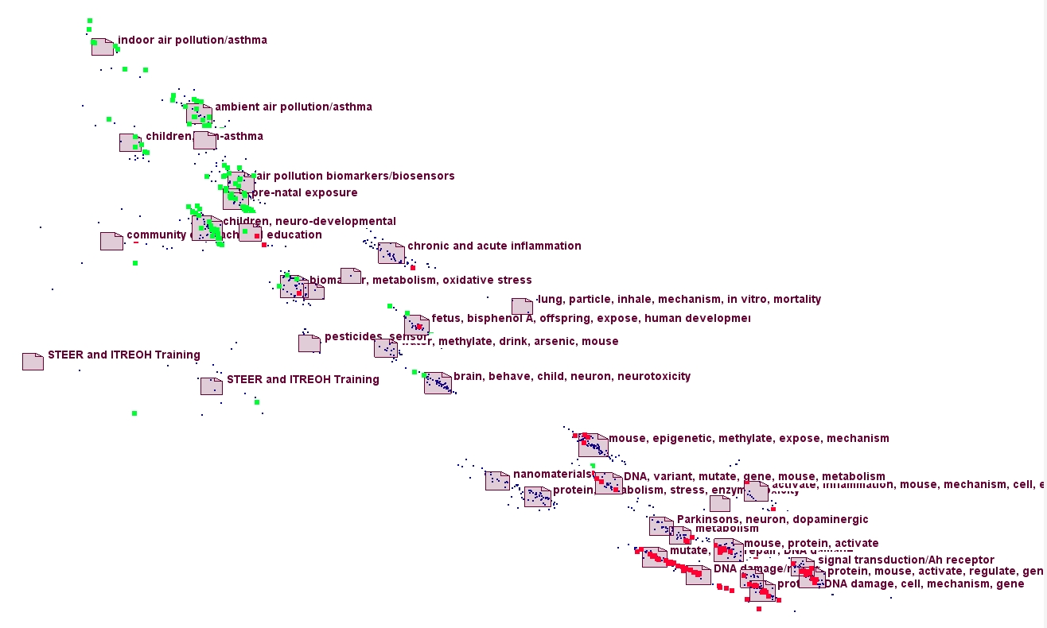
Portfolio Distribution Across Program Officers
Legend:
Program Officer 1
Program Officer 2
15
Notes:
To help us try to understand what we were seeing, we started by looking at two people in the same branch, but who we knew had very different portfolios.
We weren’t surprised by the results – that person 1 clusters up at the top, and person 2 clusters in the Basic area, with some in the “transitional” area.

Slide 16
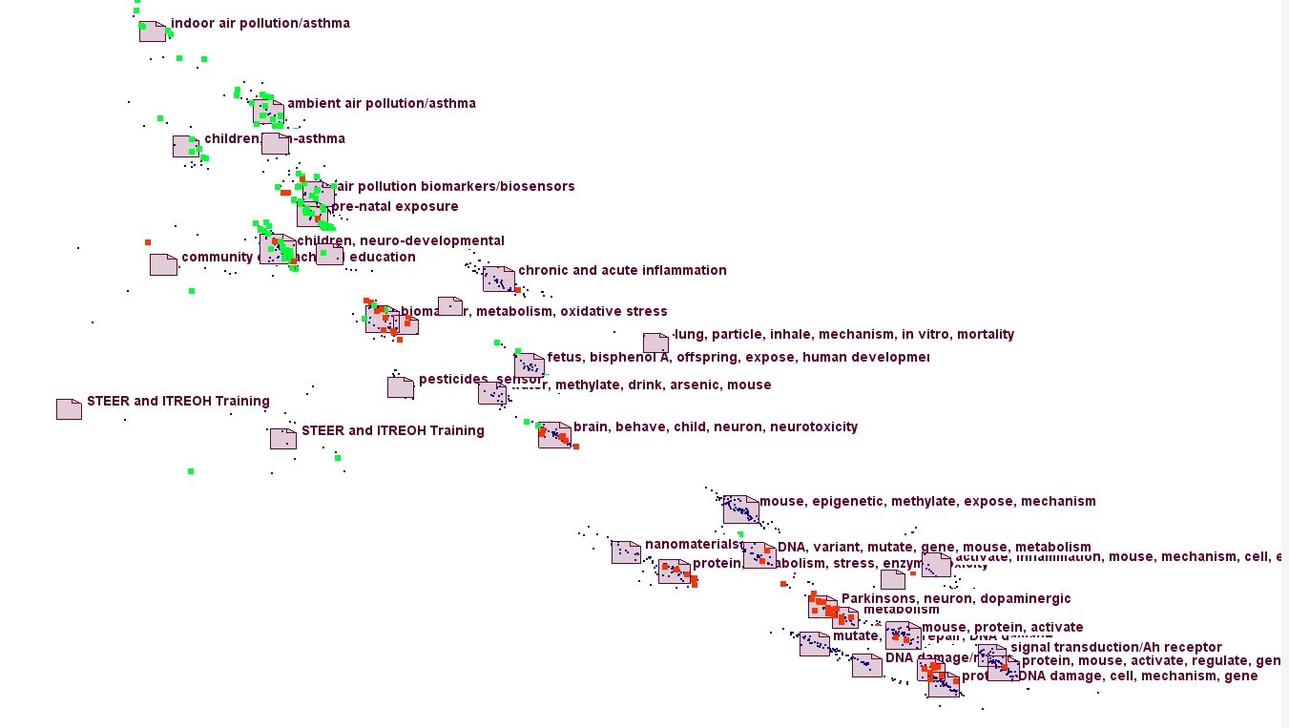
Portfolio Distribution Across Program Officers
Legend:
Program Officer 1
Program Officer 3
16
Notes:
Then, we examined portfolios of two people who are in different branches: Program Officers 1 and 3.
Again we see most of Program Officer 1 at the top, most of Program Officer 3’s at the bottom and some in the middle.

Slide 17
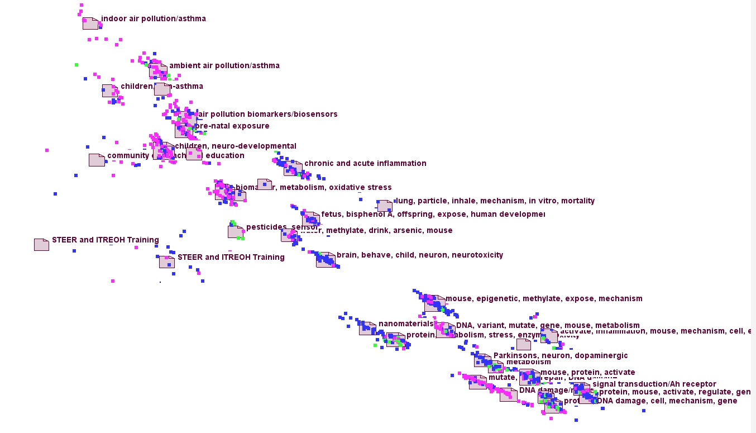
Portfolio Distribution Across Branches
Legend:
Branch A
Branch B
Branch C
17
Notes:
We were also interested in seeing the distribution across branches. This visualization shows that all three branches are fairly well distributed across the galaxy.

Slide 18
Galaxy: DERT Active Research Grants
Human Studies
Transitional
Basic Science
Training/Education
Note: Labels are created by NIEHS; not the OmniViz default.
18
Notes:
And for our final analysis – we wondered which program officers were associated with each of our four science categories.
We thought perhaps if could make sense to base branches based on these categories. A first step is to look at who the people are in each category.
Just as a reminder of our portfolio distribution: Here are the four science categories.

Slide 19
Program Officers by Category of Science
Program Officer | Human Studies | Transitional | Basic Science | Training and Education | Number of Categories
KG | X |  |  |  | 1
LO | X |  |  |  | 1
LC |  |  | X |  | 1
LR |  |  | X |  | 1
FT |  |  | X |  | 1
DC |  |  | X |  | 1
CT |  |  | X |  | 1
CD | X | X |  |  | 2
DB | X |  | X |  | 2
DS |  | X | X |  | 2
JH |  | X | X |  | 2
LM |  | X | X |  | 2
SN |  | X | X |  | 2
CL |  | X | X |  | 2
KM |  | X | X |  | 2
MH |  |  | X | X | 2
AK | X | X | X |  | 3
CS | X | X | X | X | 4
19
Notes:
What this slide shows is that a few people are highly distributed. Among the rest of the people, it’s split with Program Officer’s in one category or two. We also see that most of our Program Officers have more than 20% of their portfolio in Basic Science.
Our immediate take-home message is that organizing by these categories would not be useful
To bring it back to our first question: is the tool useful: I would say yes! Although we may not realign based on the galaxy, it has helped us see new patterns in the portfolio and provided new information for discussions. However, the cost has been pretty high.

Slide 20
Pros and Cons of Using This Tool
Pro | Con
Big picture view of our portfolio Output Novel way of doing pattern analysis Ability to identify outliers Cool factor is very high | Cost of software ($1,000 annually for education and federal government) Steep learning curve Transferring output to PowerPoint is challenging Difficult to interpret
20
Notes:
We wanted to lay out some of our lessons learned to help you decide if you might want to use OmniViz. So we made a list of pros and cons.
On the pro side,
Having a big picture view of our portfolio is extremely useful: This tool would be even more useful for ICs that are large because one of our issues is the small number of grants in our portfolio (1200).
In terms of Output: It’s the first time we have data and can visualize our portfolio on a high level.
Similarly, using Omniviz as a way of doing pattern analysis is very helpful and I think we just touched the surface of what we can do with it.
Outliers show up quite well on the galaxy visualization, which may helpful when we begin to think of mission boundaries.
Last, we can’t forget about the cool factor of doing something like this.
On the con side,
The cost of the software is, for education and the federal government, about $1,000 per year. So it’s definitely an investment.
And there is a steep learning curve. Plus we have found that it’s not something you can put down for several months and then pick back up again where you left off.
While there is an easy way to save the galaxy visualization to a *.jpg image, preparing them for PowerPoint is time-consuming.
It also takes some time to interpret the findings.

Slide 21
What questions could this method of analysis answer for you?
Strategic planning
Emerging areas of science
Gaps in research
Institute/Center niches/across all Institutes/Centers
21
Notes:
In summary, using OmniViz has helped us understand patterns in our portfolio that could inform the management of science in a new way, particularly in helping us with our reorganization. It has helped us visualize our grants and given us a big picture view of our portfolio to enable needed discussions around the topic of reorganization.
Here are some directions we are thinking of examining next, but I’d be very interested in hearing from you on what types of questions it could help you answer.

Slide 22
Contact Information
Elizabeth Ruben: elizabeth.ruben@nih.gov

