Slide 1
Engaging Youth: Not an Afterthought
American Evaluation Association 2018

Slide 2
Welcome!
Agenda
Introductions
Examples of ways to engage youth in evaluation
Reflections: Successes/challenges
Discussion
Notes:
Christen

Slide 3
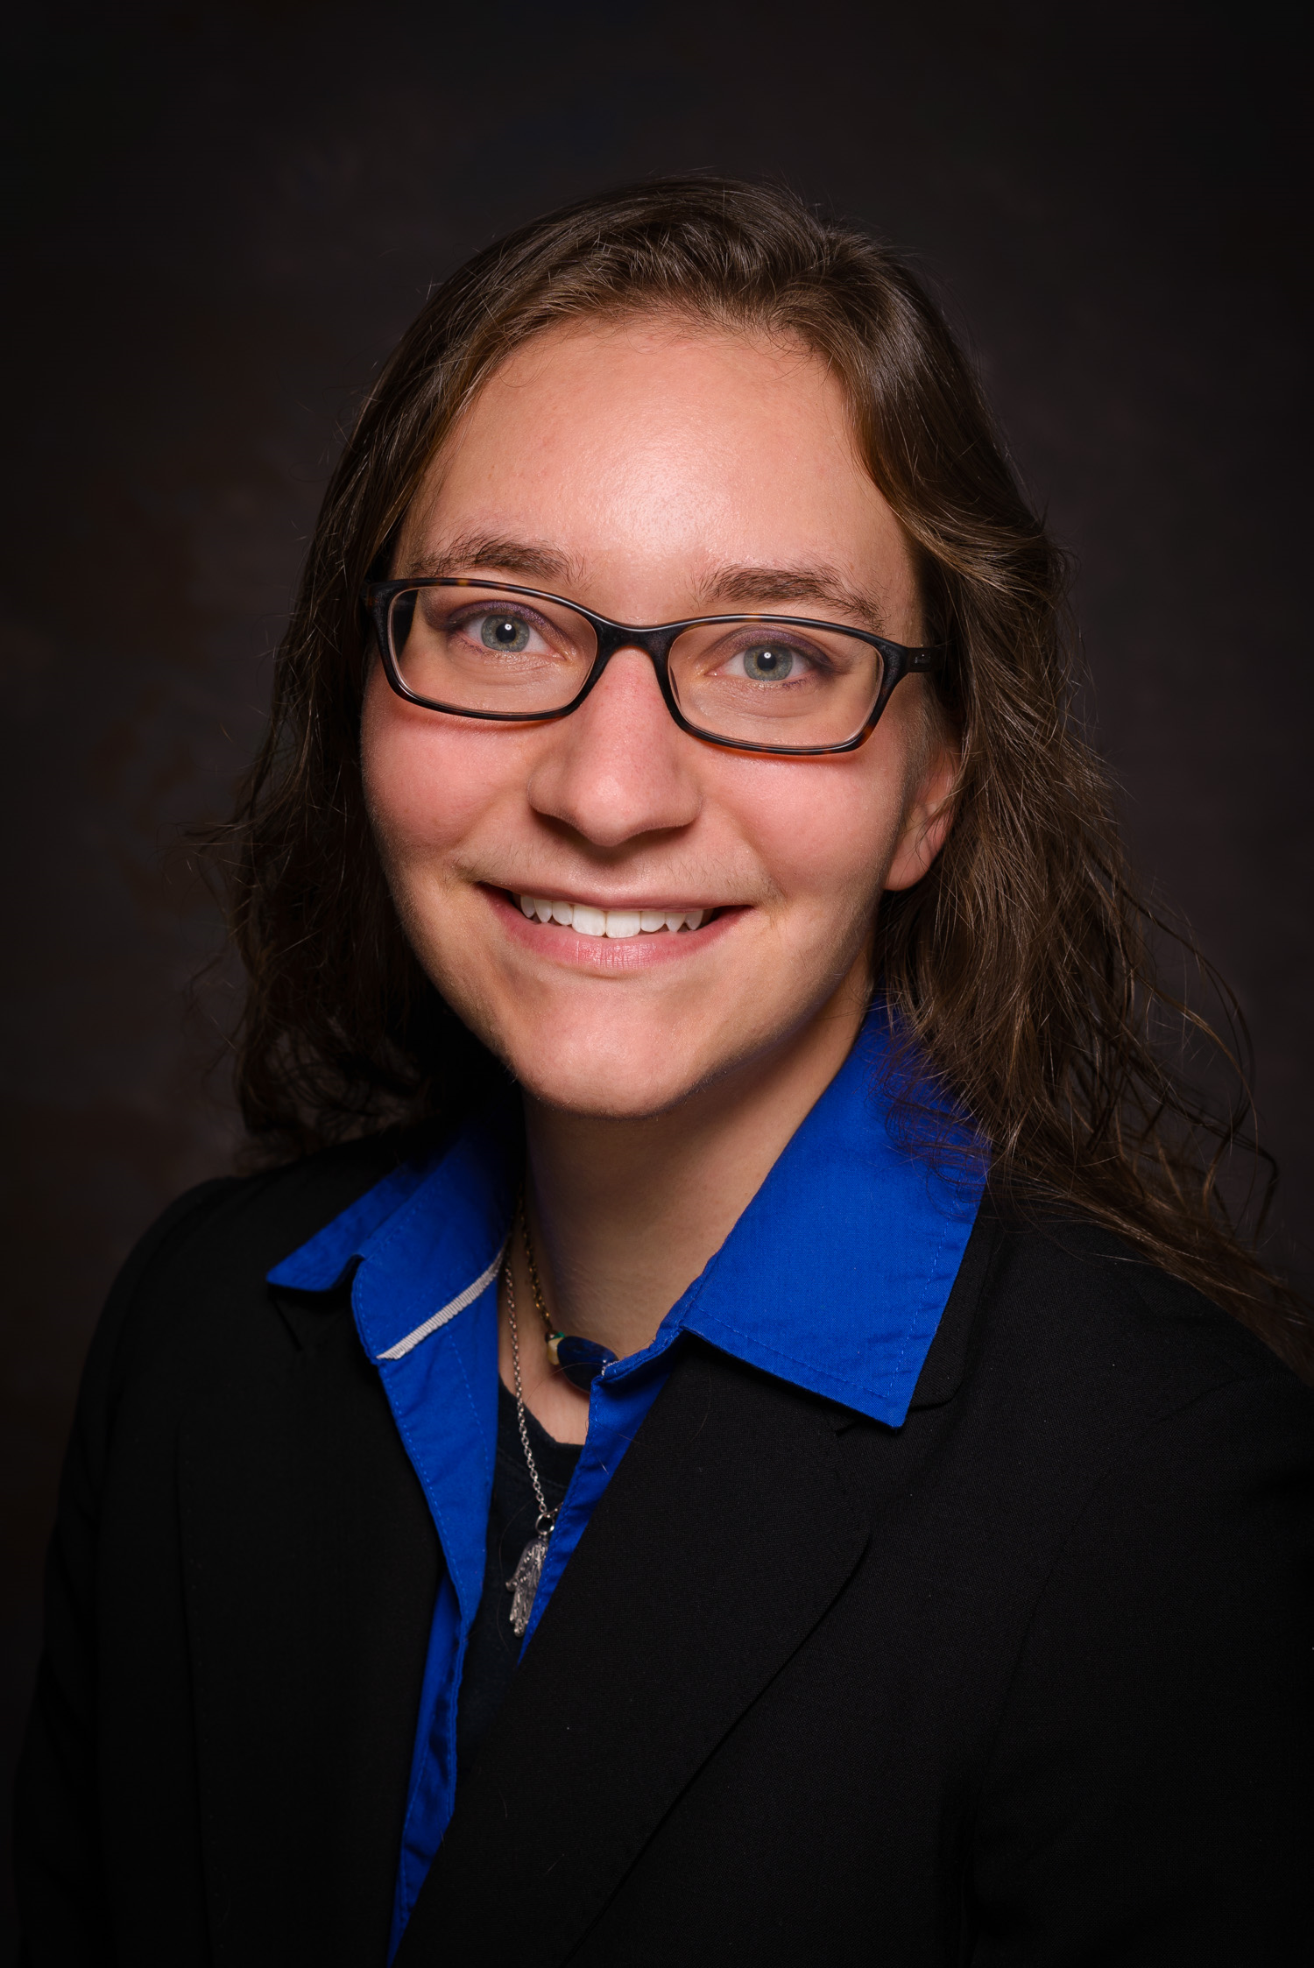
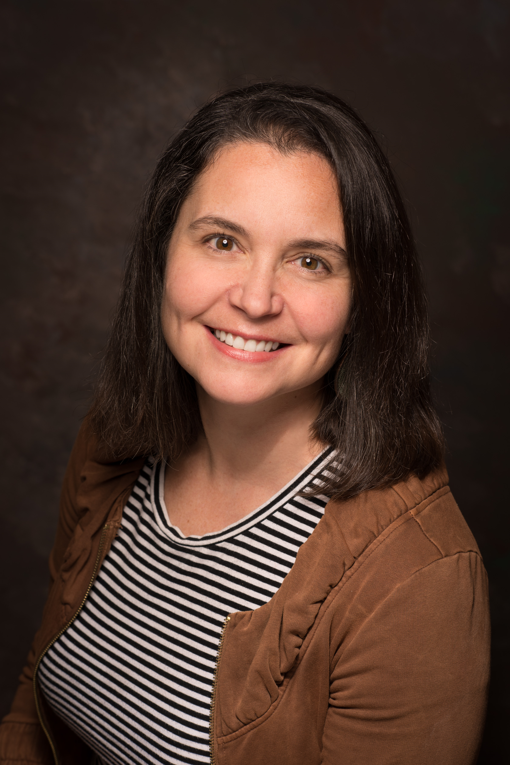
Panelists
Christen Pentek The Improve Group
Becky Stewart The Improve Group
You!
Notes:
Becky
About the Improve Group – who clients are, generalists, commitment to engaging people who are most affected by the programs and challenges in this world. This includes young people!

Slide 4
Fist to 5
How much experience do you have doing evaluation?
…Conducting evaluation projects with youth?
…Working with youth on evaluation/research in schools?
…Working with youth on evaluation/research outside schools?
Notes:
Christen

Slide 5
Example #1
Youth participatory action research (YPAR) involves young people constructing knowledge by identifying, researching, and addressing social problems through youth–adult partnerships.
Using an existing YPAR network
Anyon, Yolanda & Bender, Kimberly & Kennedy, Heather & DeChants, Jonah. (2018). A Systematic Review of Youth Participatory Action Research (YPAR) in the United States: Methodologies, Youth Outcomes, and Future Directions. Health Education & Behavior.
Notes:
Becky
Fortunate to have a network, funded by a local foundation, of sites and youth trained in and doing YPAR. Want to share this one because there are networks in many communities so considering a partnership may be a good opportunity for you.
A lot of overlap in skills needed for evaluation, seeing the value and potential impact of applied research.
Youth participatory action research (YPAR) involves young people constructing knowledge by identifying, researching, and addressing social problems through youth–adult partnerships (Cammarota & Fine, 2010; Checkoway & RichardsSchuster, 2003; Jacquez, Vaughn, & Wagner, 2013; Shamrova & Cummings, 2017).
Anyon, Yolanda & Bender, Kimberly & Kennedy, Heather & DeChants, Jonah. (2018). A Systematic Review of Youth Participatory Action Research (YPAR) in the United States: Methodologies, Youth Outcomes, and Future Directions. Health Education & Behavior. 109019811876935. 10.1177/1090198118769357.

Slide 6
Example #1
Project Description
Foundation environment assessment to inform fund planning
Youth interviews one of many data sources
Time frame of approximately 6 months
Local geographic focus
Youth Engagement
Involved in planning, data collection (peer interviews), and interpretation
Training in evaluation context
Funder interaction limited
Using an existing YPAR network
Notes:
Becky
Want to describe the “how” of this
Youth had an easier time focusing on how and what of data collection, Have had more success with engaging youth in participatory ways when focusing on an existing program.
Facilitated conversation about what they heard and what it means in this context gave most of the analysis meat.
Training, or more orientation, to what these phases are, what we are trying to do so they can see their role

Slide 7
Example #2
Project Description
Multi-year initiative
Many data sources
Goal = social workers in elementary and middle schools
Youth Engagement
One semester pilot
Goal = to hear from young people
the extent of need for services, and
how young people receive services
Model off of the Youthprise Northside Research Team
Social Worker in Schools Program
Notes:
Christen
, an independent, youth-led, action research team focused on using research justice (The Data Center & Public Science Project) to address disparities in North Minneapolis

Slide 8
Example(s) #3
Convened an advisory group of past program participants
Consulted with an existing advisory group
Youth serve on organizational boards
Voting opportunity = decisional power
Youth gain leadership experience
Keeps team focusing on clear language about purpose, scope, and organizational agenda
Youth as Positional Leaders
Advisory or Board role
Notes:
Becky then Christen
Convened – they advised on topics to include, language for tools and engagement strategies. They also helped with outreach.
Existing advisory board formed to advise client on their work in this area – advise on outreach (in what is primarily outreach project for longitudinal data collection – keep us cool, advise on outreach/social media. We are reporting results to them. https://mn.gov/dhs/people-we-serve/children-and-families/services/adolescent-services/programs-services/youth-leadership-councils.jsp
Christen: Youth on Boards Project….? Hosted interviews with adult board members and workshop with youth board members to validate and highlight recommendations that felt would work for them.
heARTS project: youth had board comprised of youth with equal decisional making process to adult board. Organization decided that any action items needed to be approved by both

Slide 9
Successes in Youth Participatory Evaluation
Opportunities for power sharing
Community Based Organizations as strategic partners to bridge geography
Young people may not ‘have it all together;’ that’s where the innovation is!
Group gains clarity -“Readers’ Digest” version
Youth provide skillsets that deepen evaluation
Multiple perspectives inform a fuller picture of what we should evaluate
Show clients or partners what can be possible
Training/orientation help introduce youth to the field, build new skills
Notes:
Christen then Becky
‘not have it all together’ - this is reference to the fact that brains not finished devleoping until age 26, so stereotype of risktaking (i.e. innovation) is one that can be strategically honed! Orgs seeking innovation often need people who are willing to push the boundaries and be able to sometimes set aside anticipated consequences to see & plan & do in ways that have not yet been.

Slide 10
Challenges in Youth Participatory Evaluation
Data collection strategies outside of school spaces
Working against decision-making process norms
Disagreement about youth-collaborative decisions
Fear of youth engaging in defining the problem
Youth compensation
Expected ‘professional’ culture of evaluation
Evaluation purpose may not align with YPAR frame
Differences between cultures
Notes:
Christen then Becky

Slide 11
Questions?

Slide 12
Discussion
What other examples or ways of doing this work would you like to share?
What makes you skeptical about engaging youth in an evaluation?
What are benefits of engaging youth in evaluation?
Notes:
Christen

Slide 13
Closing
Discuss in pairs:
What will you takeaway from this presentation?

Slide 14
Closing
What came up in your discussions?
Notes:
Becky
Popcorn sharing

Slide 15
Panelists
Christen Pentek The Improve Group
christenp@theimprovegroup.com
Becky Stewart The Improve Group
beckys@theimprovegroup.com
Notes:
Thank you for coming!

