Slide 1
Lessons Learned about How to Support Outcomes Measurement
Donna Spiker, Early Childhood Outcomes (ECO) Center at SRI International
Presented at
Annual Conference of the American Evaluation Association
Anaheim, CA, November 2011
Notes:
1

Slide 2
What will be covered….
Describe ECO Center’s role in assisting states with the implementation of high-quality outcome systems for EI and ECSE:
What activities and strategies are being used by the ECO Center to support states?
What has been learned about the factors that support or hinder states’ implementation of high-quality outcome measurement systems?

Slide 3
TA supports include….
Develop and manage a national web site
Use web site to collect and disseminate state-developed resources
Develop and disseminate guidance papers, documents, other resources
Coordinate state Communities of Practice
Plan and hold national conferences
Hold variety of dissemination events

Slide 4
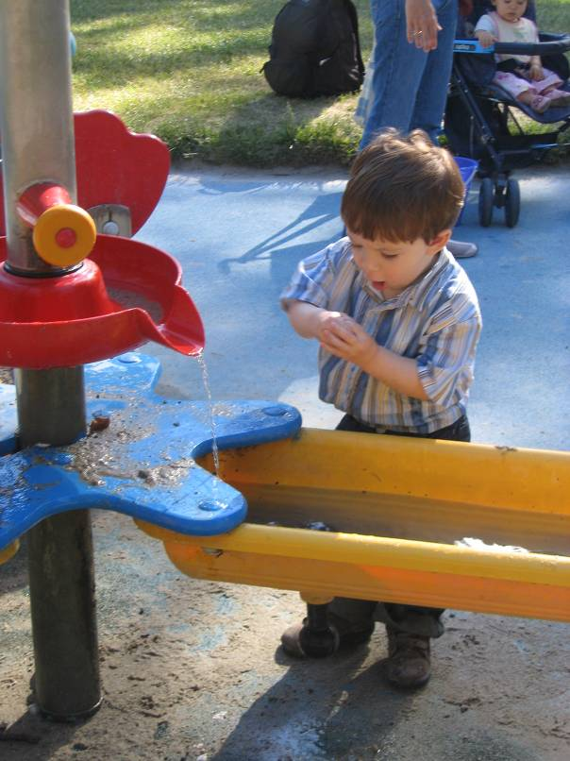
ECO Center Web site
Provides up-to-date information and resources for state and local administrators, technical assistance providers, teachers, other direct service providers, and families

Slide 6
ECO web site has links to state web sites…….

Slide 7
State-Developed Resources: Examples
Includes states’ written documents, PowerPoint presentations, videos, online modules, etc.:
Policy guidance (e.g., papers, manuals, videos)
Quality assurance & training materials
Informing families about outcomes (e.g. brochures, letters, fact sheets, FAQs)
Family outcomes (e.g., tools, analysis approaches, presentations)

Slide 9
Guidance Papers and Documents: Examples
Considerations in developing a child outcomes measurement system
Summary of child outcomes and the analyses
Setting targets for child outcomes
Guidance for measuring family outcomes
Tools about using data

Slide 10
One Example: A Framework for Child Outcomes Measurement System

Slide 11
Purpose of the Framework
Provide a common language for ECO and other TA providers to use in discussing COMSs with states.
Provide a organizing structure of categorizing resources and state examples related to implementation of a COMS.
Serve as the organizing structure for states to use as a self assessment of status of their COMS and for planning improvements

Slide 12
Framework and Self-Assessment
Framework
Set of components and quality indicators
Provides the structure for the self-assessment
Self- assessment
Scale that provides criteria for levels of implementation within each quality indicator
Value assigned based on level of implementation within each indicator

Slide 13
Process for Framework Development
Built off what we had learned from ECO work with states and previous ECO conceptual framework
Literature review
Repeated discussion and review internally and with 7 Partner States

Slide 14
COMS Framework Components
Purpose
Data Collection and Trans-mission
Analysis
Reporting
Using Data
Cross-system Coordination
Evaluation
Notes:
The difference between a data system and an outcomes measurement system.

Slide 15
7 Framework Components
PURPOSE: State has articulated purpose(s) of COMS.
DATA COLLECTION AND TRANSMISSION: The state has effective procedures for collecting, storing, and transmitting data to the state.
ANALYSIS: The state agency and local programs generate outcomes questions and analyze data for accountability and program improvement.

Slide 16
REPORTING: State has developed and implemented a plan for interpreting data, reporting, and communicating information about child outcomes.
USING DATA: The state agency and local programs use child outcomes data for accountability and program improvement .
EVALUATION: Evaluation of the COMS is in place to assure relevance and timeliness of procedures.
CROSS-SYSTEM COORDINATION: State coordinates child outcomes measurement and data use across EC systems.

Slide 17
Purpose of the Self Assessment
Provide guidance to states on what constitutes a high quality child outcomes measurement system.
Assist states in setting priorities for improving their COMS
Provide information to assist states in advocating for resources for systems development

Slide 18
The Scale for the Quality Indicators
1 = No or minimal implementation of the quality indicator
3 = Some implementation
5 = Substantial implementation
7 = Full implementation

Slide 20
Communities of Practice (CoP)
Via conference calls/Webinars, at national meetings, state members:
Share expertise and experiences that provides TA support to states
Showcase and share state resources, products, and/or data
Provide peer-to-peer support
Provide input to ECO staff about issues, challenges, and successes

Slide 21
National Conferences
Held annually since 2007
Participants include:
Part C (EI) and Section 619 (ECSE) staff who work on collecting, reporting, analyzing, and using child and family outcomes data
TA providers,
federal agency staff
university staff/others involved with outcome efforts and planning improvements in states

Slide 22
National Conferences: Purposes
Allow states to share strategies for measuring and improving child and family outcomes and learn from each other.
Provides national forum for ECO and OSEP to share the latest guidance with states
Provides states a forum to discuss common challenges and effective practices, strategies, and resources.

Slide 23
Other Dissemination and TA Events
Onsite state trainings
National or state webinairs
Individual state TA calls
Presentations at variety of meetings
Conference calls and meetings with stakeholder work groups
Think tank meetings and calls on key issues
Analyze and present state and national data

Slide 24
Lessons Learned about State Development of COMS
State leadership and commitment to importance of quality outcomes data
Some see it as a tool, others see it as a requirement only
Collaborative processes for convening stakeholder groups for consensus-building and development of procedures and resources – builds recognition of value of the data and its uses

Slide 25
Lessons Learned (cont)
State capacity and resources
Some are data savvy, some are not
Some have state-level analysis staff and resources, some do not, but most need to build capacity for analysis and use of data
States also need to build capacity for local programs so they can analyze, interpret, and use data
State personnel turnover can create problems

Slide 26
Lessons Learned (cont)
State and local needs for materials
Having a national TA center helped to provide states with resources
Having a national TA center helped to provide web site, conferences and other forums for states to share resources they developed

Slide 27
Lessons Learned (cont)
No additional funds for data collection
Develop ways to incorporate data collection into ongoing processes (e.g., build into IFSP/IEP process that already includes assessment)
Challenges are greater for large states with lots of children (e.g., early intervention numbers ranges from about 800 to nearly 31,000)

Slide 28
Lessons Learned (cont)
Many stakeholders with differing needs and perspectives about an outcomes system
Develop multiple formats to educate stakeholders (e.g, parent brochures, training for providers)
When local program data were posted publically, local staff became motivated to improve data quality

Slide 29
For more information & questions….
www.the-eco-center.org

