Slide 1
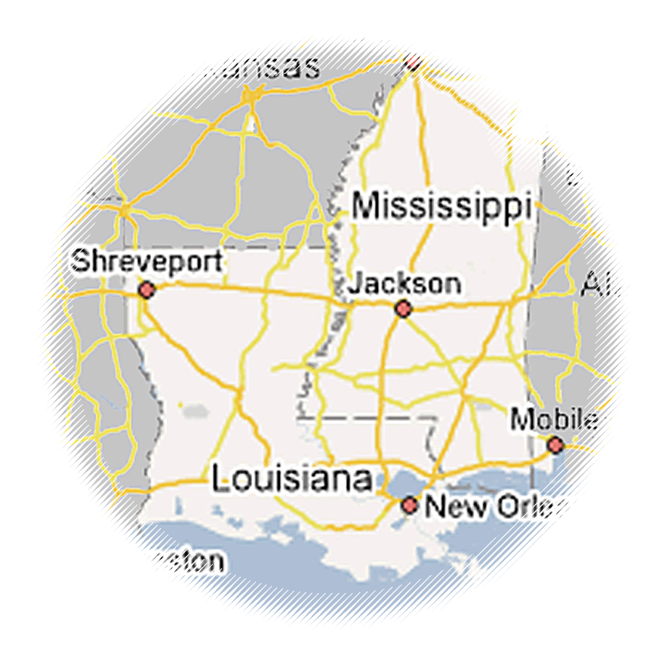
Lessons learned from evaluating a complex, multi-partner, multi-year, multi-site K-12 education intervention
EDC’s Center for Children & Technology
Elizabeth Pierson
Dr. Harouna Ba
Terri Meade

Slide 2
Presentation Outline
Cisco 21S Initiative
Evaluation challenges
Partnership management and research
Program impacts
Lessons learned

Slide 3
Cisco 21S Initiative
History
21S Initiative program description
Goals
Support
Partnerships

Slide 4
Unscrambling a partnership soup
21st Century Schools Initiative
High School Redesign
Promethean Boards
Harvard Wide World—Professional Development
Philip Schlechty—Professional Development
Wireless Generation
EDC
DOT Intern Program
IBM
Metiri
One Economy
Local Universities
Cisco

Slide 5
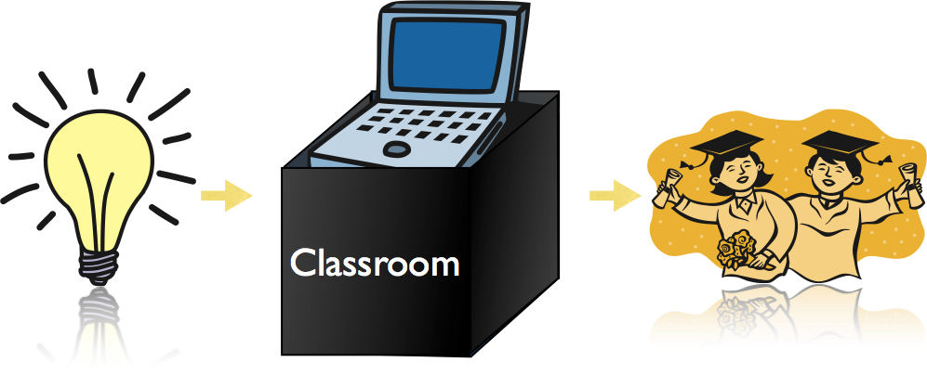
Unpacking the black box of implementation

Slide 6
Inputs and outcomes
Teacher training
Updating security equipment
Technology fairs
Attending leadership training
Increased student engagement
Installing software
Distributing teacher laptops
Reliable wireless internet
Increased technology use
Increased technology integration
Increased technology expertise
Purchasing Interactive Whiteboards
Increased parent involvement
Improved school websites

Slide 7
Implementation Framework
Connected Schools
Connected Learning
Connected Community
Updating security equipment
Purchasing Interactive Whiteboards
Distributing teacher laptops
Installing software
Increased technology integration
Reliable wireless internet
Adequate technical support
Teacher training
Attending leadership training
Increased technology use
Increased student engagement
Increased technology expertise
Technology fairs
Improved school websites
Increased parent involvement
Increased partnerships with the business community
Increased access to student and school information
Increased home-school communication

Slide 8
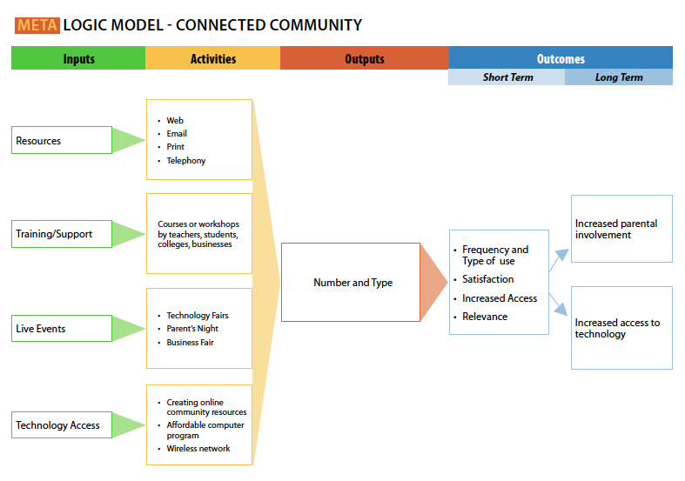
Connected Community: Meta Logic Model

Slide 9
Harvard Wide World—Professional Development
High School Redesign
Philip Schlechty—Professional Development
Wireless Generation
Promethean Boards
Digital Opportunity Trust (DOT)—Intern Program
EDC
Cisco
IBM
Metiri
One Economy
Local Universities

Slide 10
Data collection and partnership management
Logic model development and implementation study
Participation analysis
School level outcome analysis
Self-report surveys
School level case studies
Classroom observations
Individual interviews
Focus groups
Research capacity building at local universities

Slide 11
Program Impact
Increased technology hardware and software access for administrators, teachers and students
Increased technology expertise among teachers
Increase in student-centered instructional and assessment practices
Increased technology use among students
Increased classroom participation levels
Increased student engagement

Slide 12
Lessons Learned
An external evaluator is rarely
completely external!

Slide 13
Contact information
Elizabeth Pierson
EDC’s Center for Children & Technology
epierson@edc.org
Telephone: 212.807.4200
Website: cct.edc.org

