Slide 1
Complex Problems for a Complex Future: Evaluation of Violence Surveillance
Terra Wiens, Minnesota Department of Health
November 15, 2019

Slide 2
Presentation Outline
Purpose of intimate partner violence (IPV) surveillance in Minnesota
“What” and “why” of surveillance system evaluations
Main data sources for IPV surveillance in Minnesota
Evaluation and recommendations to improve IPV surveillance in Minnesota

Slide 3
Purpose of IPV Surveillance
The purpose of IPV surveillance in Minnesota is to monitor and describe trends in this type of violence and disseminate the information to stakeholders who work in IPV prevention.
how many Minnesotans are affected by IPV?
what are the characteristics of those affected?
what is the duration and frequency of incidents?
what are the consequences of IPV (including injuries, need for services, fear for safety, etc.)?
Notes:
Interviews with people inside and outside IVPS helped me define the purpose of IPV surveillance in Minnesota.
Information collected from surveillance can inform prevention and intervention work and direct resources.

Slide 4
Surveillance System Evaluations – an “Epi Tool”
Public health surveillance systems should be evaluated periodically to ensure that issues of public health importance are being monitored effectively and efficiently.
Using the CDC’s “Updated Guidelines for Evaluating Public Health Surveillance Systems”, IPV surveillance in Minnesota was evaluated and the following surveillance system attributes were assessed:
Usefulness
Simplicity
Flexibility
Data Quality
Acceptability
Timeliness
Stability
Source: Updated guidelines for evaluating public health surveillance systems: recommendations from the Guidelines Working Group. German RR et al. MMWR Recomm Rep. (2001) Available at: https://www.cdc.gov/mmwr/preview/mmwrhtml/rr5013a1.htm
Notes:
I developed recommendations for how to improve the surveillance system attributes I evaluated and there are 19 recommendations in the full report. For the purposes of this presentation I’ve selected four recommendations on which to focus.

Slide 5
Main Data Sources for IPV Surveillance in Minnesota
There is not one single data source for the surveillance of IPV, rather surveillance is conducted using data from multiple sources.
The main data sources used by IVPS to conduct IPV surveillance were identified by:
an examination of how IPV surveillance has historically been conducted by IVPS
key informant interviews
Notes:
Before getting into the evaluation and resulting recommendations, it’s important to understand where the data we use for surveillance comes from.

Slide 6
Main Data Sources for IPV Surveillance in Minnesota
The main data sources used for IPV surveillance in Minnesota describe three different aspects of IPV:
Hospital-treated IPV-related injuries
Minnesota hospital discharge data (HDD)
Fatal IPV
Minnesota Violent Death Reporting System (MNVDRS)
Femicide Report
Domestic violence homicide case reviews (case fatality reviews)
Self-reported IPV
Minnesota Student Survey (MSS)
Minnesota Crime Victimization Survey (MCVS)

Slide 7
Main Data Sources for IPV Surveillance in Minnesota
The main data sources used for IPV surveillance in Minnesota describe three different aspects of IPV:
Hospital-treated IPV-related injuries
Minnesota hospital discharge data (HDD)
Fatal IPV
Minnesota Violent Death Reporting System (MNVDRS)
Femicide Report
Domestic violence homicide case reviews (case fatality reviews)
Self-reported IPV
Minnesota Student Survey (MSS)
Minnesota Crime Victimization Survey (MCVS)

Slide 8
Recognized Challenges of IPV Surveillance
IPV can take many different forms; correspondingly, outcomes may look very different.
No single agency or data collection tool can collect all data related to the various aspects of IPV.
Current IPV surveillance in Minnesota lacks many data elements.
Many different sources contribute distinct pieces of knowledge.
Judgement is necessary for decisions about which data elements are absolutely necessary to IPV surveillance and those that can fill in gaps as needed.
All counts of IPV are likely underestimates.
Notes:
IPV is a complex and challenging public health issue to monitor. There are many different forms IPV can take, including physical, sexual, stalking and psychological aggression (including coercion). Correspondingly, the outcomes of these various forms of perpetration may look very different.
Due to the complex nature of IPV, no single agency or data collection tool can collect all data related to the various aspects of IPV. Limiting the use of only one source of data to conduct IPV surveillance would underestimate the extent of the problem, as well as show only one aspect of this public health issue.
Data elements lacking include: better understanding of sexual abuse within IPV
better information about perpetrators
data about children witnessing IPV and their trajectory later in life
economic challenges faced by survivors of IPV
county-level data
intersection of IPV and other forms of injury and violence
To avoid making a system too complex and overwhelming, epidemiologists and subject matter experts must work together to make difficult decisions about which sources and what variables are essential for inclusion in IPV surveillance.

Slide 9
Evaluation of IPV Surveillance in Minnesota
 | Usefulness | Simplicity | Flexibility | Data Quality | Acceptability | Timeliness | Stability
MN Violent Death Reporting System
Femicide Report
DV Homicide Case Reviews
Hospital Discharge Data
MN Student Survey
MN Crime Victimization Survey
Notes:
My first recommendation is to evaluate ICD-10-CM codes just as ICD-9-CM codes were evaluated.

Slide 10
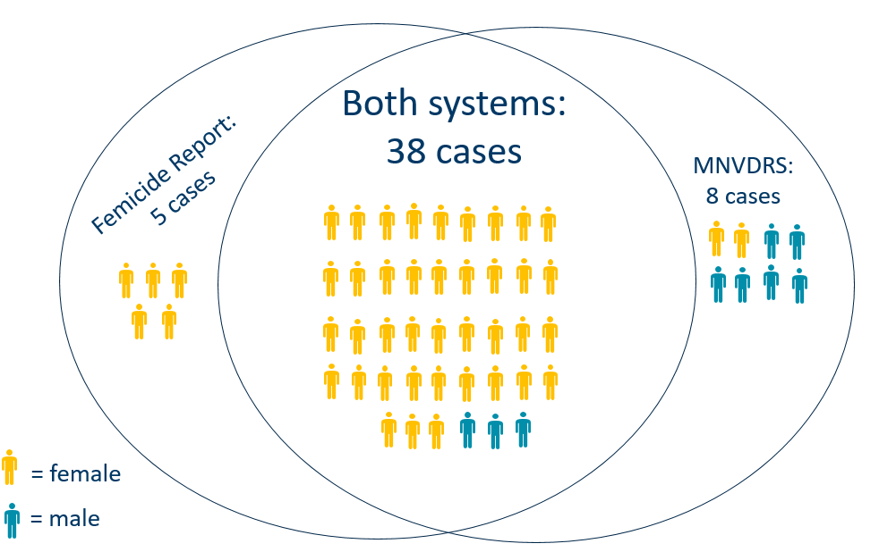
Usefulness: IPV Surveillance in Minnesota
Notes:
For the purposes of this surveillance evaluation, fatal IPV cases were compared between MNVDRS and the Femicide Reports for 2015 and 2016, and while the majority of cases were captured by both data systems, a few cases were missed by each system. In addition to each system missing a few cases, it is expected that a few cases went unidentified by both systems. This undercount was estimated by capture-recapture analysis, which estimated that one case was unidentified by both MNVDRS and the Femicide Report.

Slide 11
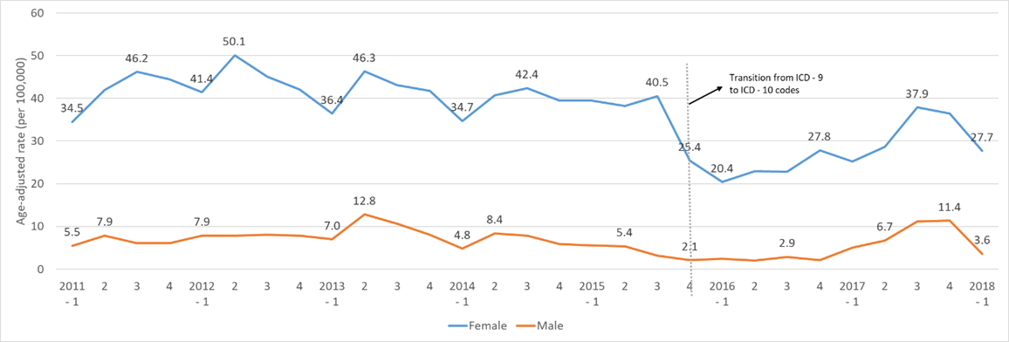
Data Quality: IPV Surveillance in Minnesota
Rate of hospital-treated patients for IPV in Minnesota, 2011 through the first quarter of 2018
Notes:
A recent analysis of hospital-treated IPV highlighted the issue of the quality of HDD after October 2015. This figure shows a drastic decline in the rate of IPV among females between the third quarter of 2015 and the first quarter of 2016 (January 2016 through March 2016). It is unlikely this decrease in rates was a representation of the true trend in hospital-treated IPV in Minnesota and more likely to be related to the transition from ICD-9-CM to ICD-10-CM.

Slide 12
Data Quality: IPV Surveillance in Minnesota
Hospital discharge data has low data quality for IPV surveillance
Recommendations:
Identify appropriate diagnosis codes to use for IPV surveillance
Conduct a statewide survey to measure IPV through self-report and use this data to validate hospital discharge data
Notes:
My first recommendation is to evaluate ICD-10-CM codes just as ICD-9-CM codes were evaluated.

Slide 13
Conclusion
Mixed-methods approach is possible
Key informant interviews are helpful to identify data sources, as well as strengths and limitations of data sources
This methodology can be applied to other violence surveillance systems

Slide 14
Thank you!
Terra Wiens
terra.wiens@state.mn.us
651-201-5449

