Slide 1
© UNICEF/UGDA02504/Hyun
Evaluating Social Cohesion: Lessons from UNICEF’s PBEA Program
October 2014

Slide 2
The Evolution of M&E Systems for Peacebuilding, Education and Advocacy (PBEA) Program
Bosun Jang
Education Specialist, PBEA M&E
UNICEF
bjang@unicef.org

Slide 3
PBEA program design
VISION / IMPACT
Strengthened resilience, social cohesion and human security in conflict-affected contexts
OUTCOMES
Policy
Peacebuilding and Education Integrated
Increased inclusion of education into peacebuilding and conflict reduction policies, analyses and implementation and vice versa.
Institution Building
Increased institutional (including UNICEF) capacities to supply conflict sensitive and peace education.
Individual Capacity Development
Increased capacity of children, parents, teachers and community members to prevent, reduce and cope with conflict and promote peace
Access to Conflict Sensitive Education
Increased access for children to quality, relevant education that contributes to peace, including education delivered as a peace dividend
Knowledge, Evidence and Advocacy
Adequate generation and use of evidence and knowledge in policies and programming on linkages between education, conflict and peacebuilding
TARGET COUNTRIES
East Asia & Pacific
Myanmar
East & Southern Africa
Burundi, Ethiopia, Somalia, South Sudan, Uganda
Middle East & North Africa
State of Palestine, Yemen
South Asia
Pakistan
West & Central Africa
Chad, Cote d’Ivoire, Democratic Republic of the Congo, Liberia, Sierra Leone

Slide 4
PBEA M&E operationalization
Global | Conflict driver | Theory of change | Activity | Output | Outcome
Impact
Strengthened resilience, social cohesion and human security in conflict-affected contexts
Country | Conflict driver | Theory of change | Activity | Output | Outcome
Partner | Conflict driver | Theory of change | Activity | Output | Outcome

Slide 5
PBEA Global Results Framework (GRF)
No. | Key characteristic | Advantage | Disadvantage
1st | Key performance indicators (KPIs) | Helped set targets and structure to a global program | Structure too rigid for meaningful, contextualized programming
2nd | Replaced KPIs with “menu” of indicators based on country-level indicators | Flexibility in logic models and work plans for contextualization | Too many unique indicators not amenable to aggregation
3rd | Indicators “bucketed” or coded for country-, regional-, and global-level aggregation and analysis | Bottom-up approach that enables flexibility in design as well as aggregation | Potential for misinterpretation of indicators in the coding process

Slide 6
Examples
Conflict driver
Theory of change
The acceptance of violence and social disruption as a norm has resulted in a deterioration of social cohesion within the Palestinian territory.
If government and civil society provides civil and capacity development opportunities for adolescents, then adolescents will participate more effectively in community as a sustainable alternative to violence.
Activity
Output
Outcome
Support capacity building of adolescents to led initiatives including community-based activities.
Adolescents have increased knowledge and skills to lead and participate in constructive initiatives in marginalized areas.
Adolescents constructively engage in their societies as agents of social transformation for advancing sustainable alternatives to social violence and discord.

Slide 7
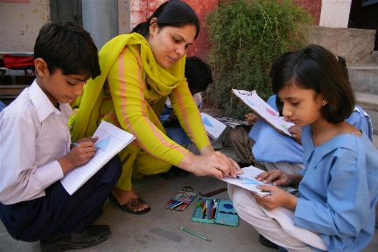
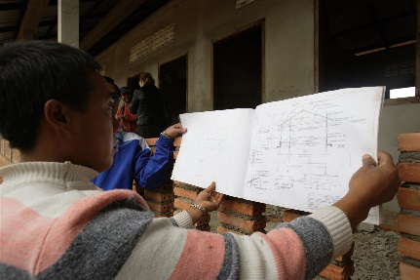
Going beyond performance monitoring
Output
Indicator
Result
Adolescents have increased knowledge and skills to lead and participate in constructive initiatives in marginalized areas.
# of adolescent who participate in capacity building training
# of initiatives conducted per year and type
360 adolescents (180 boys / 180 girls) (Target: 2,000 with 50% girls)
54 initiatives (Target: 108 initiatives)
Case study
Captured the process of recruiting the 360 boys and girls, training them, and guiding them through the development of their own initiatives

Slide 8
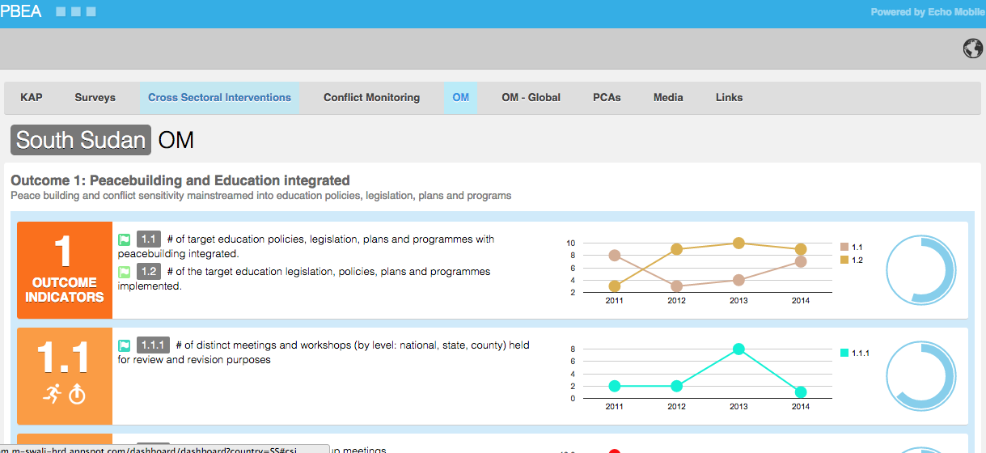
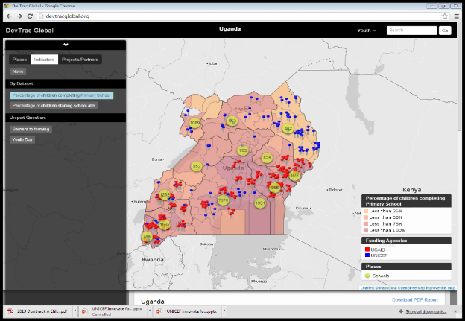
…and beyond process capturing
Research
Impact measuring
Developmental Eval.
Three-pillar research efforts in Myanmar, Liberia, Pakistan, Sierra Leone, and Uganda on policy, teachers, and youth in partnership with Universities of Amsterdam, Sussex, and Ulster
In Burundi, long term research partnerships have been established to investigate the mechanisms behind the intergenerational transmission of violence / resilience
Beneficiary population-based knowledge, attitude, and perception (KAP) surveys in South Sudan and Somalia in partnership with Echo Mobile
Population-based KAP surveys in Burundi and Uganda in partnership with Harvard Humanitarian Initiative (HHI)
Infusion of evaluable thinking, recognition of complexities, and process documentation in Myanmar

Slide 9
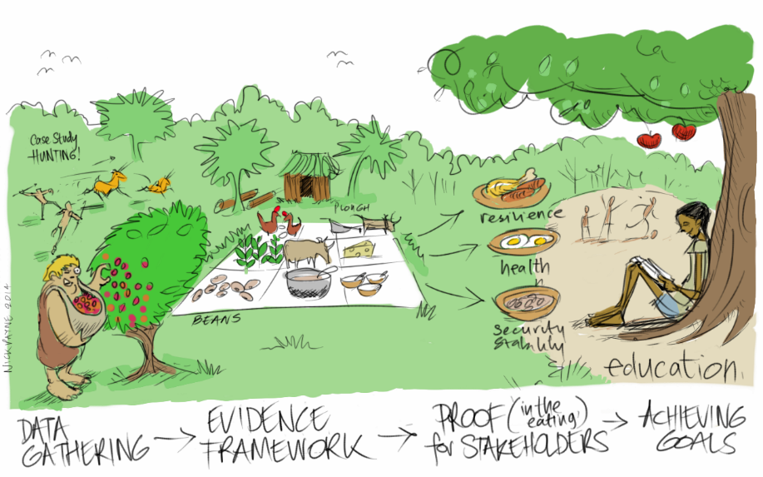
Key lesson learned: Balance
Structure vs. flexibility
Clarity vs. ambiguity
Bean counting vs. process and outcomes capturing
Peacebuilding outcomes vs. education outcomes
New system vs. existing system

Slide 10
Burning question
Global | Conflict driver | Theory of change | Activity | Output | Outcome
Impact
Strengthened resilience, social cohesion and human security in conflict-affected contexts
Country | Conflict driver | Theory of change | Activity | Output | Outcome
Is this the right way to do our M&E given the complexity of the program and peacebuilding in general?
Partner | Conflict driver | Theory of change | Activity | Output | Outcome

Slide 11
Approaches to Assessing Changes in Social Cohesion
Julie Younes
Design, Monitoring, and Evaluation Specialist
Search for Common Ground (SFCG)
jyounes@sfcg.org

Slide 12
The Challenge
Social cohesion is a fluid concept subject to multiple interpretations
No official guidance on definitions from UNICEF Headquarters at program outset
Political sensitivity (e.g., UNICEF Pakistan unable to use the term “peacebuilding”)
Difficulties integrating outcome statements and indicators related to social cohesion into program logical frameworks
“There are only a few indicators that track changes in the key concepts of social cohesion, resilience or human security – these need improvement.” (PBEA Evaluability Assessment Report November 2013)
Global Outcome 3
Individual Capacity Development: Increased capacity of children, parents, teachers and community members to prevent, reduce and cope with conflict and promote peace.
Global KPI 3.1
Pakistan KPI 3.1
% of targeted children (B/G), teachers and adult community members (M/F) reporting a positive change in their own ability to prevent, reduce and cope with conflict and promote peace [Social Cohesion].
% of targeted children (B/G), teachers and adult community members (M/F) reporting a positive change in their own ability to prevent, reduce and cope with conflict and promote peace.

Slide 13
Key Considerations – Pakistan vs. Somalia
Pakistan: Youth Social Cohesion Survey
Somalia: Social Cohesion and Resilience KAP Survey
Target group: Children
Questions are shorter and simpler, focused on personal, family and school interactions
Direct beneficiaries only
Administered by UNICEF PBEA Pakistan only
MOV for Indicator 3.1
Use: Inform ongoing programming
Qualitative data collection: Participatory focus groups
Target group: Adolescents and adults
Questions are more complex, delve into social and political issues
Direct beneficiaries only
Part of a regional survey effort, with questions adapted to local context
Not attached to a specific indicator
Use: Inform ongoing + future programming
Qualitative data collection: Case study

Slide 14
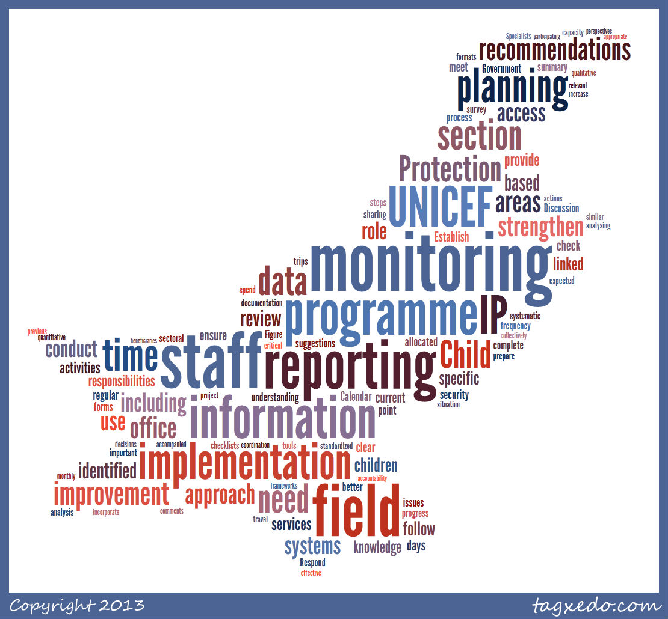
The Approach – Pakistan
Define concept of social cohesion: Five domains identified as most relevant to the Pakistan context
Develop initial survey questions based on existing literature
e.g. Cohesion Radar: Measuring Cohesiveness; Measuring Cohesiveness: Social Attraction Scale; Social Cohesion: Measurement Based on the Data from the European Value Study
First round of “piloting” with UNICEF Pakistan staff; second round of more traditional piloting with respondents who fit profile of program participants

Slide 15
The Approach – Somalia
Define concept of social cohesion: Five relevant domains identified, along with one section on resilience
Questions developed based on existing literature and previous large-scale surveys
e.g. World Bank working papers Understanding and Measuring Social Capital and Resilience in Education Setting Research; Surveys conducted by the World Bank and IOM in East Timor (2001-2003) and Aceh (2006-2009)
Part of an East Africa regional survey effort and thus could use existing versions of the KAP (e.g. South Sudan) as initial guidance
First round of “piloting”: Full-day workshop with UNICEF Somalia staff and local partner organizations to go through survey questions and adapt to local context; traditional piloting also conducted

Slide 16
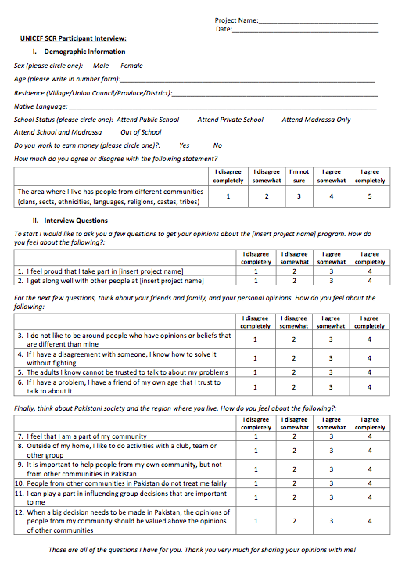
The Approach – Pakistan
Trust
If children are fighting in school, what is the first thing that the teacher should do?
Belonging and Inclusion
I feel that I am part of my community
Participation
Outside of my home, I like to do activities with a club, team or other group
Tolerance
I do not like to be around people who have opinions or beliefs that are different than mine
Recognition and Legitimacy
I can play a part in influencing group decisions that are important to me

Slide 17
The Approach – Somalia
Attitudes Towards Violence
If children are fighting in school, what is the first thing that the teacher should do?
Belonging and Inclusion
Do you think that schools should be equipped so that children with disabilities can study in the same school as children with no disabilities?
Respect and Trust
If you have a land dispute with your neighbor, how much do you trust your community elders to solve the problem?
Membership and Participation
Are you a member of a community group?
Attitudes Towards Social Services
If the government is planning an education project and you want to give your opinion on it, do you think they would listen?
Resilience
The last time there was a drought or a flood, did you have to sell any property?

Slide 18
The Approach – Pakistan
Results to inform programming:
Baseline for KPI 3.1: Overall, 27% of participants reported a positive Social Cohesion Score
Qualitative data collection: Participatory focus groups to take a deep dive into survey results (November 2014)

Slide 19
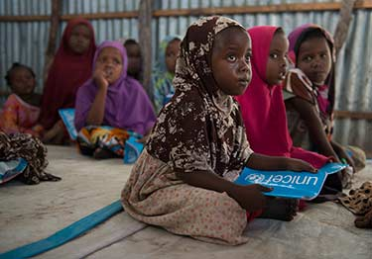
The Approach – Somalia
Results: Baseline data collected; currently in the data entry, cleaning and analysis phase, which is being conducted at the regional level
Results from the survey will feed into a regional dashboard to allow for analysis across program countries
Qualitative data collection: Case study to examine issues around social cohesion among targeted children and youth (specifically those younger than 14 who cannot take the KAP survey)

Slide 20
Lessons Learned
✓Break down the concept into measureable pieces most relevant to program context
✓Existing literature or surveys as a starting point
✓“Double” piloting
✓Reaffirmed utility of using of mixed methods for a single indicator

Slide 21
Thank you!

Slide 22
Panel discussion questions

Slide 23
Panel discussion questions
Experiences or suggestions for designing M&E systems for complex, global programs?
Approaches for defining complex concepts like social cohesion or peacebuilding?
Suggestions for qualitative data collection tools to complement Pakistan Youth Social Cohesion Survey?

Slide 24
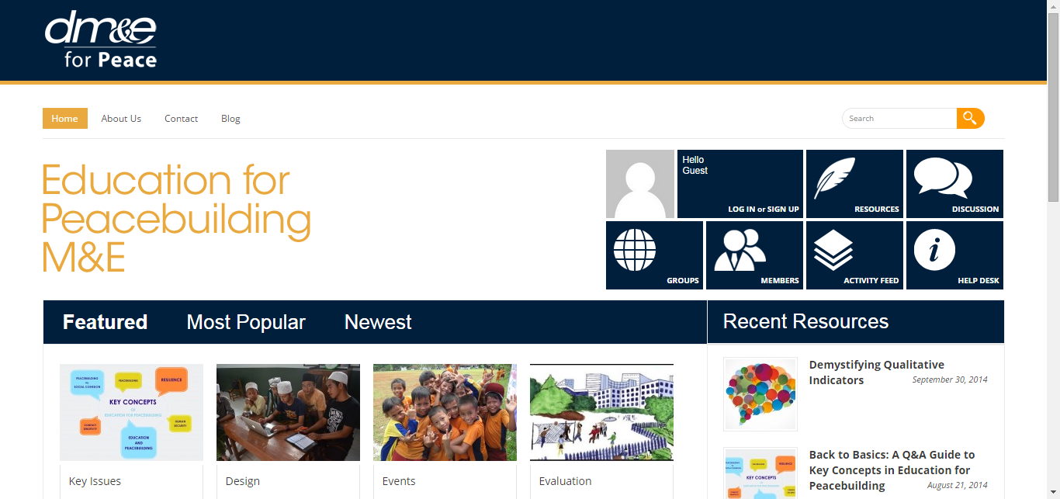
Useful links
UNICEF Learning for Peace
SFCG DM&E for Peace: Education for Peacebuilding M&E Community of Practice

