Slide 1
Transition Programs for Students with Intellectual Disabilities: Multiple Perspectives on Evaluation
Jennifer Sullivan Sulewski
Seb Prohn
Nicolette Salerno
Ann Cisney-Booth
Notes:
Welcome to our session on Transition Programs for Students with Intellectual Disabilities:
AKA TPSIDs.
With me today:
Seb Prohn, Western Carolina University
Nicolette Salerno, Bergen Community College (consultant)
Ann Cisney-Booth, University of Tennesse
Unfortunately Linda Grusenmeyer has left her position at the U of Delaware could not be here

Slide 2
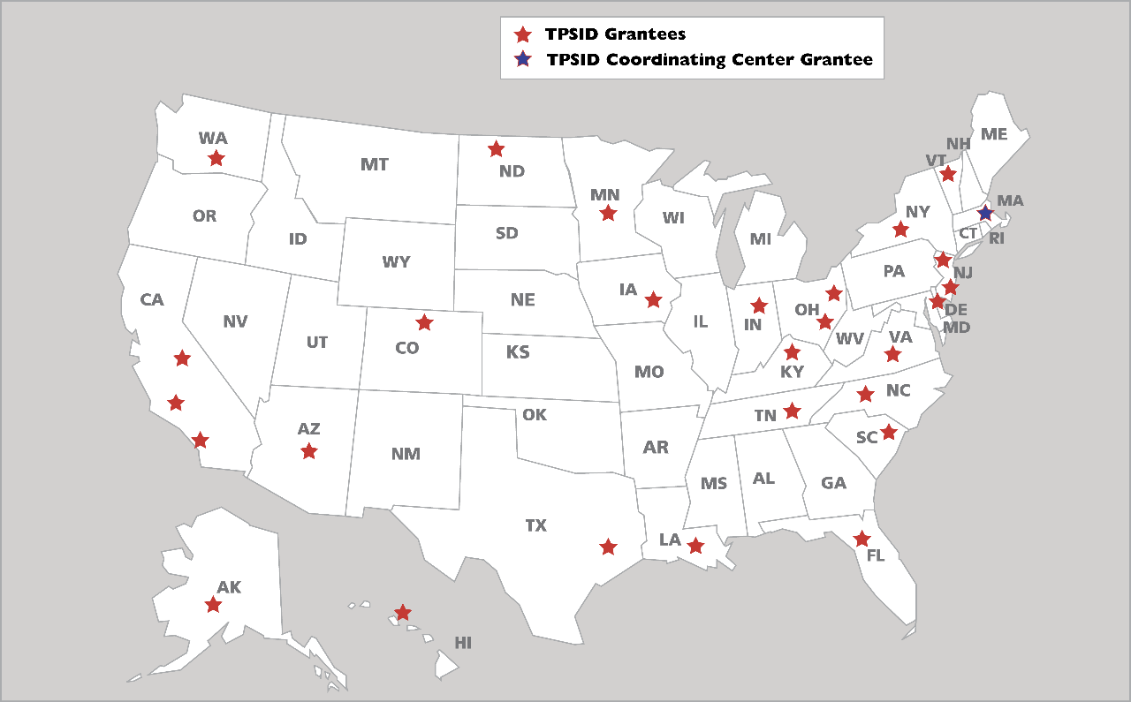
Transition Programs for Students with Intellectual Disabilities
Notes:
27 TPSIDs across the country, operating in XX sites.
Authorized by the Higher education opportunity act of 2008. 5 years demonstration funding. One CC.

Slide 3
National TPSID Evaluation
Jennifer Sullivan Sulewski
TPSID National Coordinating Center

Slide 4
The Vision

Slide 5
Student
Student
Student
TPSID
Coordinating Center
Student
Student
Site
TPSID
Student
TPSID
Student
Student
Site
Student
Student
Student

Slide 6
Evaluation Questions
What academic, social, employment, and independent living opportunities are TPSIDs providing to students enrolled in their programs?
What are the outcomes for students and how do these outcomes vary based on student or program characteristics over time?
Notes:
Also driven by requuired GPRA measures for TPSIDs.

Slide 7
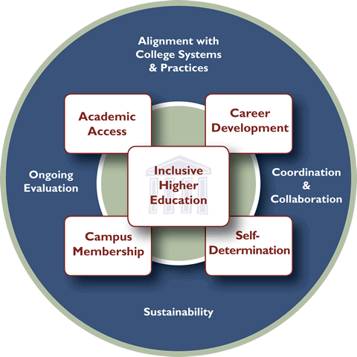
Think College Standards for Inclusive Postsecondary Education
Notes:
Developed by Think College using a Delphi process with panel of 38 experts on PSE for SWID.

Slide 8
The Process

Slide 9
© Pierre Metivier

Slide 10
System Development 2010-2011
Notes:
Measures include student & program level data on various topics inc. academic access, employment supports & outcomes, access to campus services, social involvement, and housing access, in addition to programmatic data such as staffing patterns, funding sources, and where the program is situated in the IHE.
Database requirements include ability to relate multiple levels of data (student, site, TPSID), ability to save partially entered data, ability to generate reports of data for use by TPSIDs, web-based interface that requires no additional software, accessibility to PWD (the one thing we had to compromise on).

Slide 11
OMB
OMG!!!

Slide 12
System Development 2011-2012

Slide 13
Where We Are Now

Slide 14
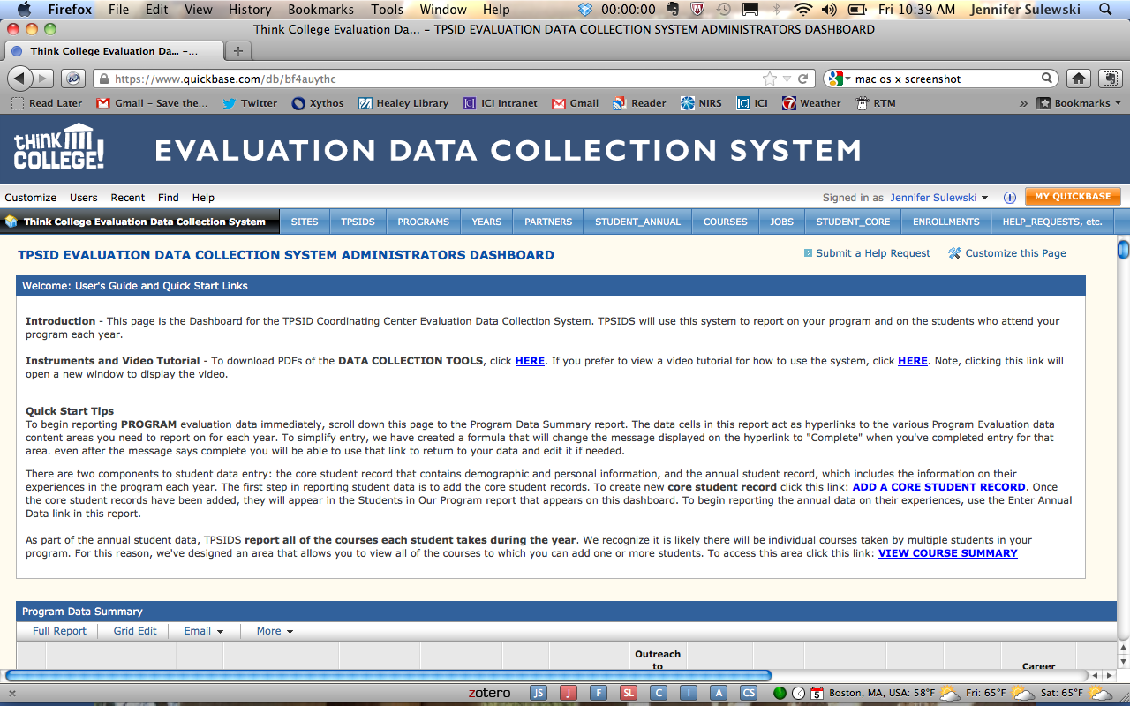
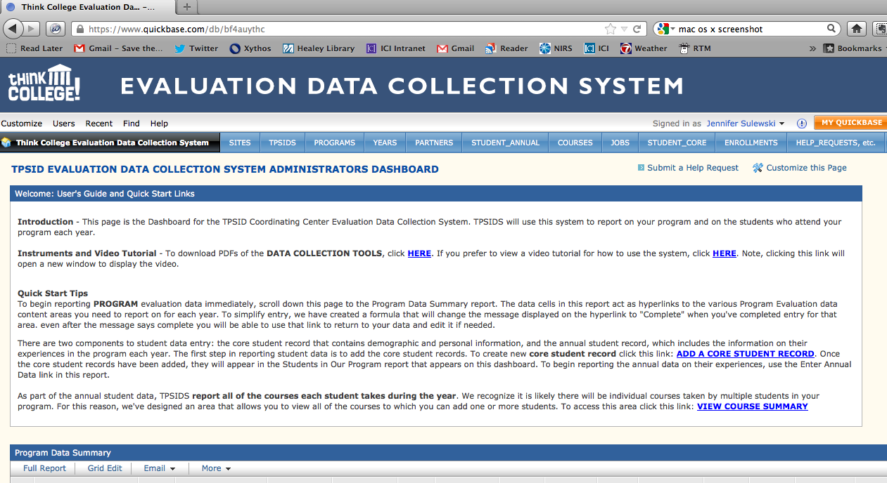
Notes:
Insert screen shot here.

Slide 15
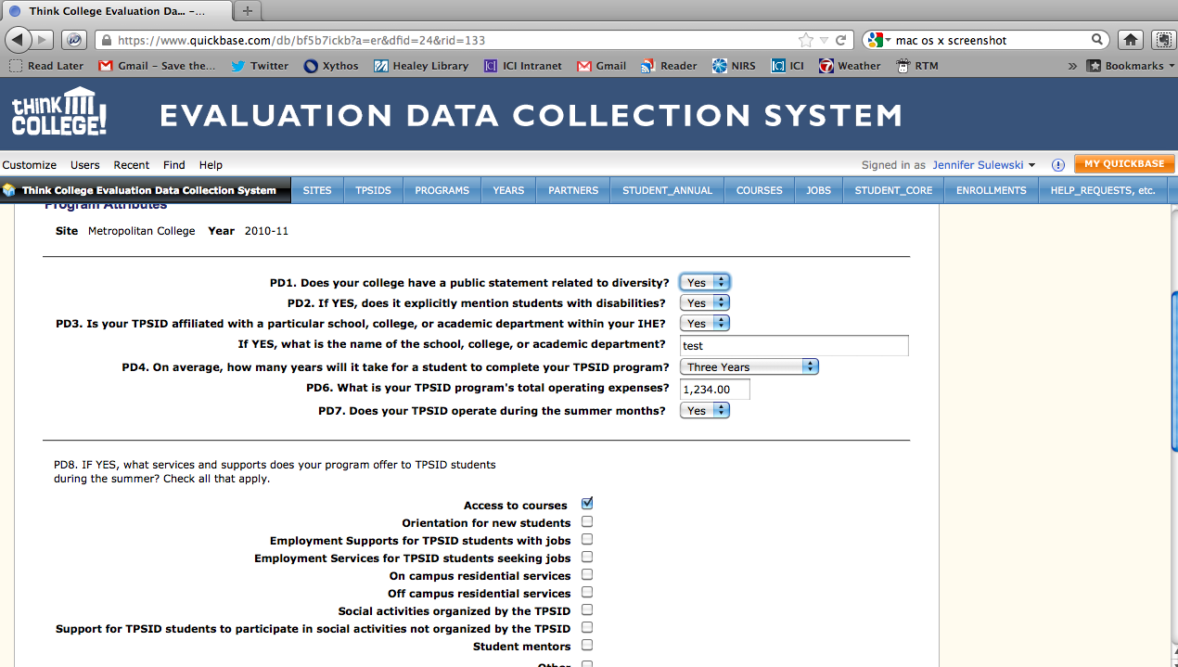

Slide 16
What’s next?
Notes:
Compare progress over time
TPSIDs can compare across sites, compare to the national profile.
Offering data system on a fee basis to other programs for SWID (non-TPSIDs).

Slide 17
Jennifer Sulewski
(617) 287-4356
Jennifer.sulewski@umb.edu

Slide 19
Initial findings 2010-2011 program year
© Marion Doss
Notes:
Hot off the presses!
Note: no student data included today; they are still a work in progress. Will talk more about that later.

Slide 20
Notes:
Other:
Award of Higher Education - from all 3 collaborative partners
Basic Skills, Human Resource Development
Career Readiness Credential (Workkeys)

Slide 21
Notes:
28/43 TPSIDs served students before grant; 15 did not.
Other:
AT training
Expand on research in the field
Increased internship options; postprogram support and options
job training
Provide technical assistance to other existing programs
Providing more employment supports for SWID
Providing potential employment opportunities at Elon University

Slide 22
Notes:
Other:
A multi-source funding process will be used beginning fall 2011 based on resource mapping of available resources conducted summer 2011
Agency Membership
County DD Transition and Employment funds
IT is anticipated that several of the sources listed above will be braided to meet the students' financial needs to attend our TPSID.
Roberts Wesleyan College Scholarship TPSID Funding.
Student Life funds

Slide 23
Do TPSID students have opportunities to access campus housing? (N=31)
Notes:
UPDATE
All living settings in one chart.
11 sites offer TPSID students the opportunity to access IHE provided housing (out of 27 sites where the IHE offers student housing)
Of those, 8 sites actually had students in IHE housing as of 2010-2011.

Slide 24
Notes:
Other:
Award of Higher Education - from all 3 collaborative partners
Basic Skills, Human Resource Development
Career Readiness Credential (Workkeys)

Slide 25
Notes:
UPDATE

Slide 26
Integration with the IHE (N=31)
87% follow the IHE’s academic calendar
97% hold TPSID students to the same code of conduct as other students
94% issue student ID cards to TPSID students (86% are identical to non-TPSID students’ IDs)
61% issue TPSID students a regular transcript
52% have TPSID students attend regular orientation

