Slide 1
From the Individual to the Environmental: Selecting, Implementing and Evaluating Environmental Strategies to Reduce Binge Drinking
April Hendrickson, MA
ahendrickson@omni.com
OMNI Institute – Denver, CO

Slide 2
Overview & Objectives
Project background
Challenges
Addressing challenges

Slide 3
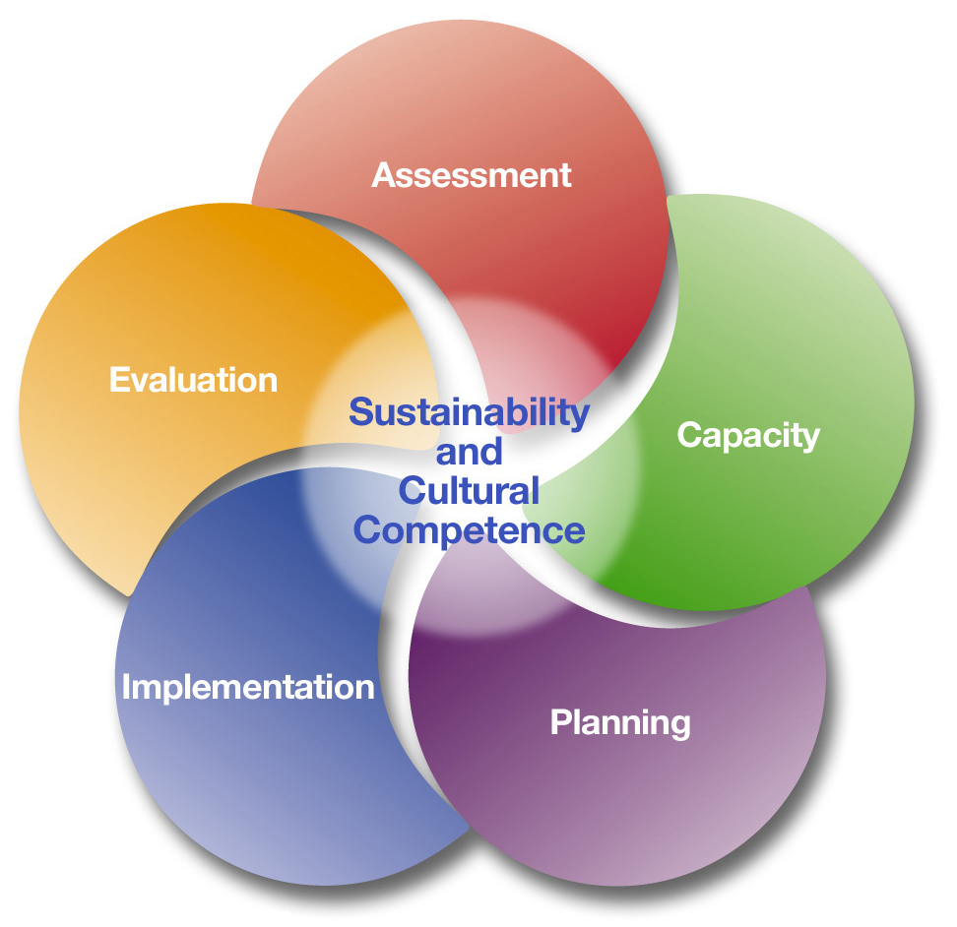
Previous funding
In 2004, CO awarded 5-year Strategic Prevention Framework State Incentive Grant (SPF-SIG)
5-step SPF model
14 community coalitions & 2 multi-county communities
Helped build infrastructure & community readiness

Slide 4
Current initiative
In 2009, CO awarded 5-year Prevention Partnership for Success Grant
Reduce binge drinking among Latino high school youth statewide
Four counties selected
Three participated in previous initiative

Slide 5
Targeted goals & timeline
Reduce binge drinking among Latino high school youth
Baseline: 30.75%
3 year goal: 25.75%
5 year goal: 22.75%
2009 2010 2011 2012 2013
State baseline set
County baselines set
State & county sample
County samples
State & county sample

Slide 6
Selecting strategies
Based on data
Comprehensive community needs assessment
Epi profile (data for related indicators)
Communities encouraged to:
Select at least two environmental strategies
Community-level social marketing campaign
Have a local coalition & data group
Chose culturally competent strategies

Slide 7
Implementation timeline
# of strategies

Slide 8
Implementing environmental strategies

Slide 9
Challenges of shifting to environmental strategies

Slide 10
Lessons learned
Timing of encouraged implementation
Perception of moving away from a comprehensive approach
“For me, it’s challenging to start an environmental strategy in the third year…I came into it understanding the CSAP strategies and understanding that it was a comprehensive approach with those strategies. And that’s the way we planned our first couple years of…our statements of work.”

Slide 11
Lessons learned
Need for education about environmental strategies
Common definitions and expectations
Implementing environmental strategies with fidelity
Need for community buy-in
“The people that we’re working with aren’t as familiar with those structures and what an environmental strategy is or CSAP strategy or anything like that…at this point I’d say I can’t really name a partner organization that’s interested in an environmental strategy.”

Slide 12
Lessons learned
Addressing the targeted goals
Preventing alcohol consumption
Latino youth
“They just did actually an evaluation of the southwest community of what the residents are most concerned about. And alcohol and drugs didn’t even make the list.”
“It’s like are we profiling again? Are we picking on a particular population? Or is this really the need and this is where we need to be providing attention?”

Slide 13
Lessons learned
Assessing impact
Recognizing shortcomings of state survey
Effects of environmental strategies take time
Limited resources for evaluating environmental strategies
“A lot of the messaging around environmental strategies is that you’re putting this in place now and over the long term it will [have] these effects which are very difficult to quantify right now…in the timeframe provided, it may not be realistic that some of these are implemented and…next year you see this reduction.”

Slide 14
Addressing challenges-successes!

Slide 15
Building capacity
Trainings
Fact Sheets
Technical Assistance
Grantees positioned as a resource
“But we’re called upon now as experts in the community regarding drugs and alcohol. And so various agencies, even some governmental agencies…will call us out yearly to do their trainings for their staff.”

Slide 16
Reaching the target population
Population consultant
Youth councils/leadership groups
Involving youth in the process
Framing the issue
Adapting method of delivering messages

Slide 17
Statewide evaluation plan
Data Sources | Reporting Requirements
Healthy Kids Colorado Survey | Administered annually in Fall to CO HS youth
Individual Evaluation Plans | Developed with communities in 2012 and updated on an ongoing basis
Community Reports | Collected from communities monthly
Site Visits | Completed with communities annually
Quality Process Measure | Community coalitions complete annually
Services and Strategies Data Collection | Collected from communities quarterly
Fidelity Assessment Tools | Communities complete when implementing environmental strategies

Slide 21
Online data collection

Slide 22
Statewide outcomes

Slide 23
Summary
Promoting and implementing environmental strategies requires clear and timely communication at all levels
Buy-in from stakeholders is important
TA around implementing and evaluating environmental strategies is essential
A comprehensive evaluation plan is needed to assess the process and impact
Involve and engage the target population in a variety of ways

Slide 24
Thank you!
April Hendrickson, MA
ahendrickson@omni.com

