Slide 1
Success Case Method: Application in a CTSA Context
CCTS
UIC Center For Clinical and Translational Science
Nancy J Bates, DrPH, RD, CHES
Timothy Johnson, PhD
University of Illinois at Chicago
Notes:
We use other types of case studies: Yin

Slide 2
OVERVIEW
SCM Steps
Focusing and planning the SCM
Creating an impact model
Surveying for best and worst cases
Interviewing & documenting success cases
Communicating findings, conclusions and recommendations
TL1 Success Case Example
Lessons Learned

Slide 3
The SCM Book
Notes:
Focusing and planning the SCM same as tailoring

Slide 4
Background: SCM
SIMILAR to other evaluation methods
UNIQUE purpose is to help stakeholders understand
what worked, what did not,
what important results have been achieved
what can be done to improve program delivery and outcomes
DOES NOT claim to be a comprehensive evaluation
Focusing and planning the SCM
Notes:
surveys, interviews and other familiar tools

Slide 5
Creating an impact model
O U T C O M E S
ACTIVITIES
OUTPUTS
SHORT-TERM
LONGER-TERM
Develop/
Implement formal program for TL1s and Pre-doctoral Support for Translational Research (TR) Program
# TL1s & TRs admitted/graduated
TL1s & TRs /faculty feedback/evaluation
# TL1s & TRs students supported by programs
# programs developed
Increased # of successful CTS researchers:
↑ TL1/TR placement in CTS track after grad
↑ CTS publications
Established TL1 training program & TR program
Notes:
Defines what success should look like.
The logic model for the TL1s fits this criterion.
Edited as needed based on findings.

Slide 6
SURVEY FOR BEST AND WORST CASES
Brinkerhoff recommends creating surveys to find relevant cases
Existing CCTS User data

Slide 7
Inclusion Criteria
More/Less Successful Cases

Slide 8
Interviews: Brinkerhoff’s Main Questions
What’s really happening?
What results, if any, is the program helping to produce?
What is the monetary value of the results?
How can the initiative be improved?
Notes:
MONETary: $$ seemed to be the biggest benefit to the student

Slide 9
TL1 Selected Interview Questions
1. What are you career goals? How will the program help you get there?

Slide 10
TL1 Selected Interview Questions
1. What are you career goals? How will the program help you get there?
2. In what ways is the program meeting (not meeting) your goals/needs?

Slide 11
TL1 Selected Interview Questions
1. What are you career goals? How will the program help you get there?
2. In what ways is the program meeting (not meeting) your goals/needs?
3. How are (will) you use the training in your work?

Slide 12
TL1 Selected Interview Questions
1. What are you career goals? How will the program help you get there?
2. In what ways is the program meeting (not meeting) your goals/needs?
3. How are (will) you use the training in your work?
4. What barriers do you experience?

Slide 13
TL1 Selected Interview Questions
1. What are you career goals? How will the program help you get there?
2. In what ways is the program meeting (not meeting) your goals/needs?
3. How are (will) you use the training in your work?
4. What barriers do you experience?
5. What challenges in balancing your time with the program?

Slide 14
TL1 Selected Interview Questions
1. What are you career goals? How will the program help you get there?
2. In what ways is the program meeting (not meeting) your goals/needs?
3. How are (will) you use the training in your work?
4. What barriers do you experience?
5. What challenges in balancing your time with the program?
6. What else would make the program more useful?

Slide 15
INTERVIEWING & DOCUMENTING SUCCESS CASES
Semi-structured interviews
Triangulation of data sources and methods
Cross case analysis
Atlas.ti software v. 6
Notes:
Semi-structured interviews
All 3 of the 2008-2011 TL1 students
One with a graduate
TL1 Director and REACH (Education core) Director
Triangulation of data sources and methods
Participant observation, semi-structured interviews document review, CCTS user data base
Cross case analysis
Atlas.ti software v. 6

Slide 16
INTERVIEWING & DOCUMENTING SUCCESS CASES
Brinkerhoff’s Impact Profile
Impact at a Glance
Impact Story: Background and setting.
Impact Story: Immediate outcomes.
Impact Story: Organizational impact.
Impact Story: What helped and what did not.
Notes:
Documenting Cases: Brinkerhoff’s Impact Profile
Impact at a Glance (a brief summary of the overall impact and immediate outcomes).
Impact Story: Background and setting.
Impact Story: Immediate outcomes. See LM “Outputs”
Impact Story: Organizational impact. See LM “Short term outcomes, Long term outcomes and Evaluation Questions”
Impact Story: What helped and what did not.

Slide 17
Documenting Case Example: Impact at a Glance: Outputs
Are you reaching the audience you intended to reach? Yes
# students admitted = 6
# students graduated = 2
Attrition: None
Student feedback: Very grateful for the opportunity and pleased with the program.

Slide 18
Impact at a Glance: Long Term Outcomes
↑ TL1 placement in CTS track after grad:
Grad 1: PhD: Job in consulting and life science
Grad 2: MD/PhD: matched a residency program that was her top choice
“[I hope to be] at a research institute teaching, doing research and clinical work. So if I can couple all those, I mean, that's my absolute dream to do.”
↑ CTS publications: MD/PhD grad: 2 published, writing others.

Slide 19
Impact Story: Background and Setting
Program Description: This mentored TL1 consists of . . .
Program Director: Larry Tobacman, MD, . . .
Target group: Basic biomedical PhD candidates and MD/PhD candidates who have a translational topic for their dissertation and are preparing for careers as translational researchers.
Reach: Are you reaching the people you intended to reach? All meet the eligibility criteria.
Attrition: None.

Slide 20
Impact Story: What Helped?
Funding
Allows them to focus on their research
Educational fund gives them a sense of ownership
Helps PIs tremendously since they don’t have to pay their whole stipend
Notes:
(Instead told us benefits of the program . . .)
Educational fund gives them a sense of ownership
Control over their own experiments, like what you can buy
Pursue your research in a certain direction that maybe your PI doesn’t necessarily agree with and wouldn't want to pay for.

Slide 21
Impact Story: What Did Not Help?
Did not understand the need for a clinical mentor
MD/PhD:
clinical training, clinicians on dissertation committee
BUT very excited to have a PhD advisor who did clinical work
PhD: just getting to clinical research

Slide 22
Impact Story: What to Improve? Sense of TL1 Community
Didn’t meet the other UIC TL1s until St. Louis meeting
Didn't know
What the administrative roles of people were
How the details of everything worked
Defined the community as having a:
Physical location for TL1s
Go-to person
Listserv
Place to hang out together and have informal conversations about their work.

Slide 23
COMMUNICATING FINDINGS, CONCLUSIONS AND RECOMMENDATIONS
Brinkerhoff:
Impact Profiles are often adequate in themselves
Our experience:
Generally true

Slide 24
LESSONS LEARNED
We found that incorporating the SCM with cross-case study analysis methods of Yin (2008) and Stake (1995) added to our overall understanding of program success.

Slide 25
REFERENCES
Brinkerhoff, Robert O. The Success Case Method: Find Out Quickly What’s Working and What’s Not. Berrett-Koehler Publishers, 2003.
Stake, Robert E. The Art of Case Study Research. Sage Publications, 1995.
Yin, Robert K. Case Study Research: Design and Methods. 4th ed. Sage Publications, 2008.

Slide 26
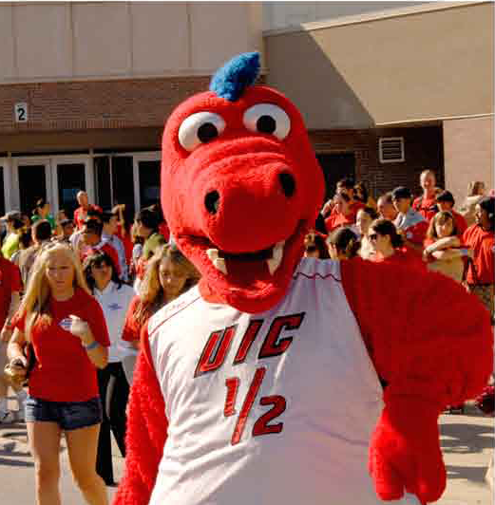
UIC Mascot Sparky D. Dragon

Slide 27
CCTS
UIC Center For Clinical and Translational Science
Nancy J Bates, DrPH, RD, CHES nbates@uic.edu
CCTS Senior Evaluation Specialist
Timothy Johnson, PhD, timj@uic.edu
Director, CCTS Evaluation and Tracking
Professor, Department of Public Administration Director, Survey Research Laboratory
This project was supported by the University of Illinois at Chicago (UIC) Center for Clinical and Translational Science (CCTS), Award Number UL1TR000050 from the National Center for Research Resources. The content is solely the responsibility of the authors and does not necessarily represent the official views of the National Center for Research Resources or the National Institutes of Health.

