Slide 1
Debunking a Misconception: How Systems Thinking Can Help Us Simplify Complexity
Emily Gates, Assistant Professor
Measurement, Evaluation, Statistics, & Assessment Department
Boston College

Slide 2
Misconception Systems Thinking Complexifies Complexity

Slide 3
What do you think of when you hear the words: system complexity?

Slide 4
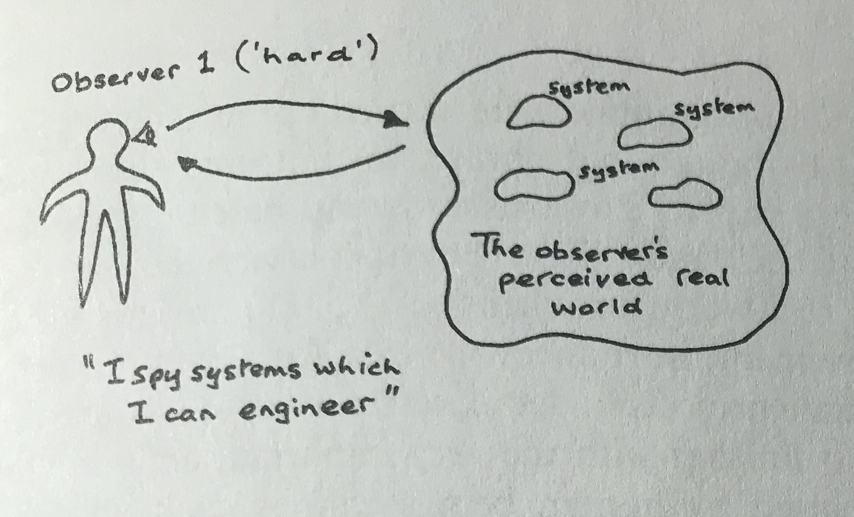
Source: Checkland, 1999

Slide 5
Evaluation
System
Intervention
Problem
Traditional Role of Evaluation

Slide 6
Complex
Intervention
Systems thinking in evaluation...
to the rescue!
Complex Problem
Complex
System
(Mowles, 2014)

Slide 7
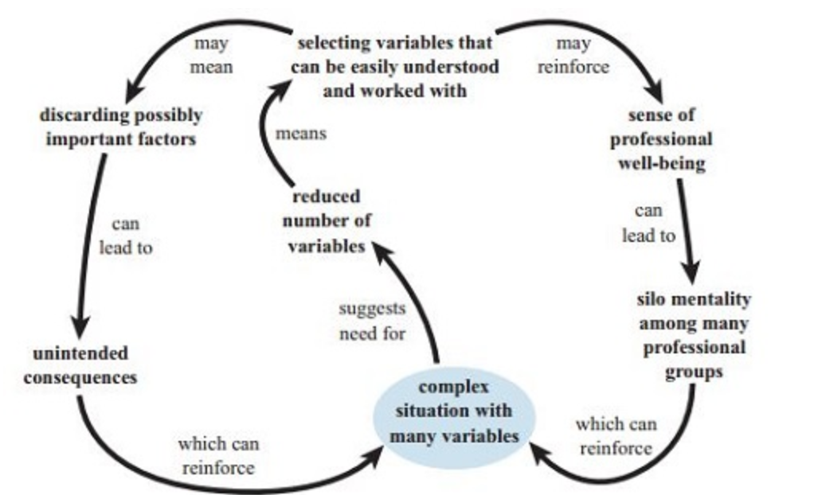
Reductionism as Traditional Response to Complexity
Source: Open University Systems Thinking in Practice Course

Slide 8
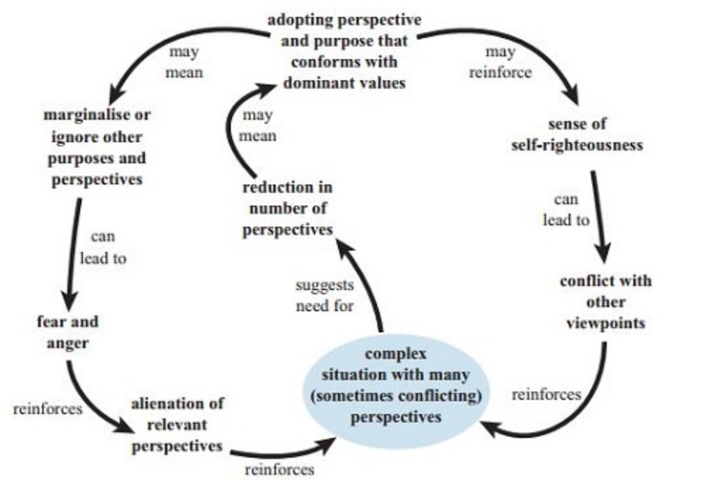
Dogmatism as Traditional Response to Complexity
Source: Open University Systems Thinking in Practice Course

Slide 9
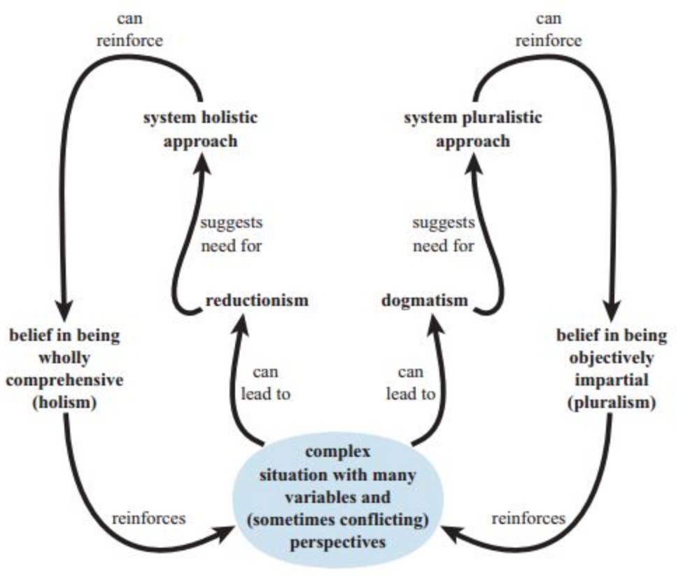
Systems Thinking
Holism to Counter Reductionism
Pluralism to Counter Dogmatism
Source: Open University Systems Thinking in Practice Course
Complexifies Complexity

Slide 10
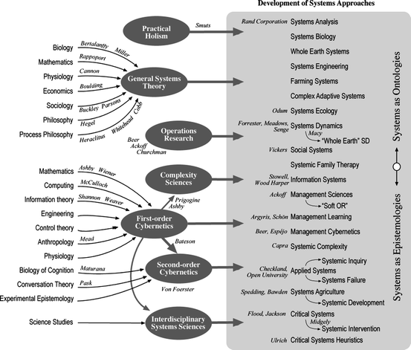
Requires New Tools
Source: Ison, 2013

Slide 11
Misconception Systems Thinking Complexifies Complexity
Complexity as characteristic of problems, interventions, & systems
Systems thinking calls for holism & pluralism
Systems thinking requires new tools, approaches, theories, & expertise

Slide 12
Systems Thinking Simplifies Complexity

Slide 13
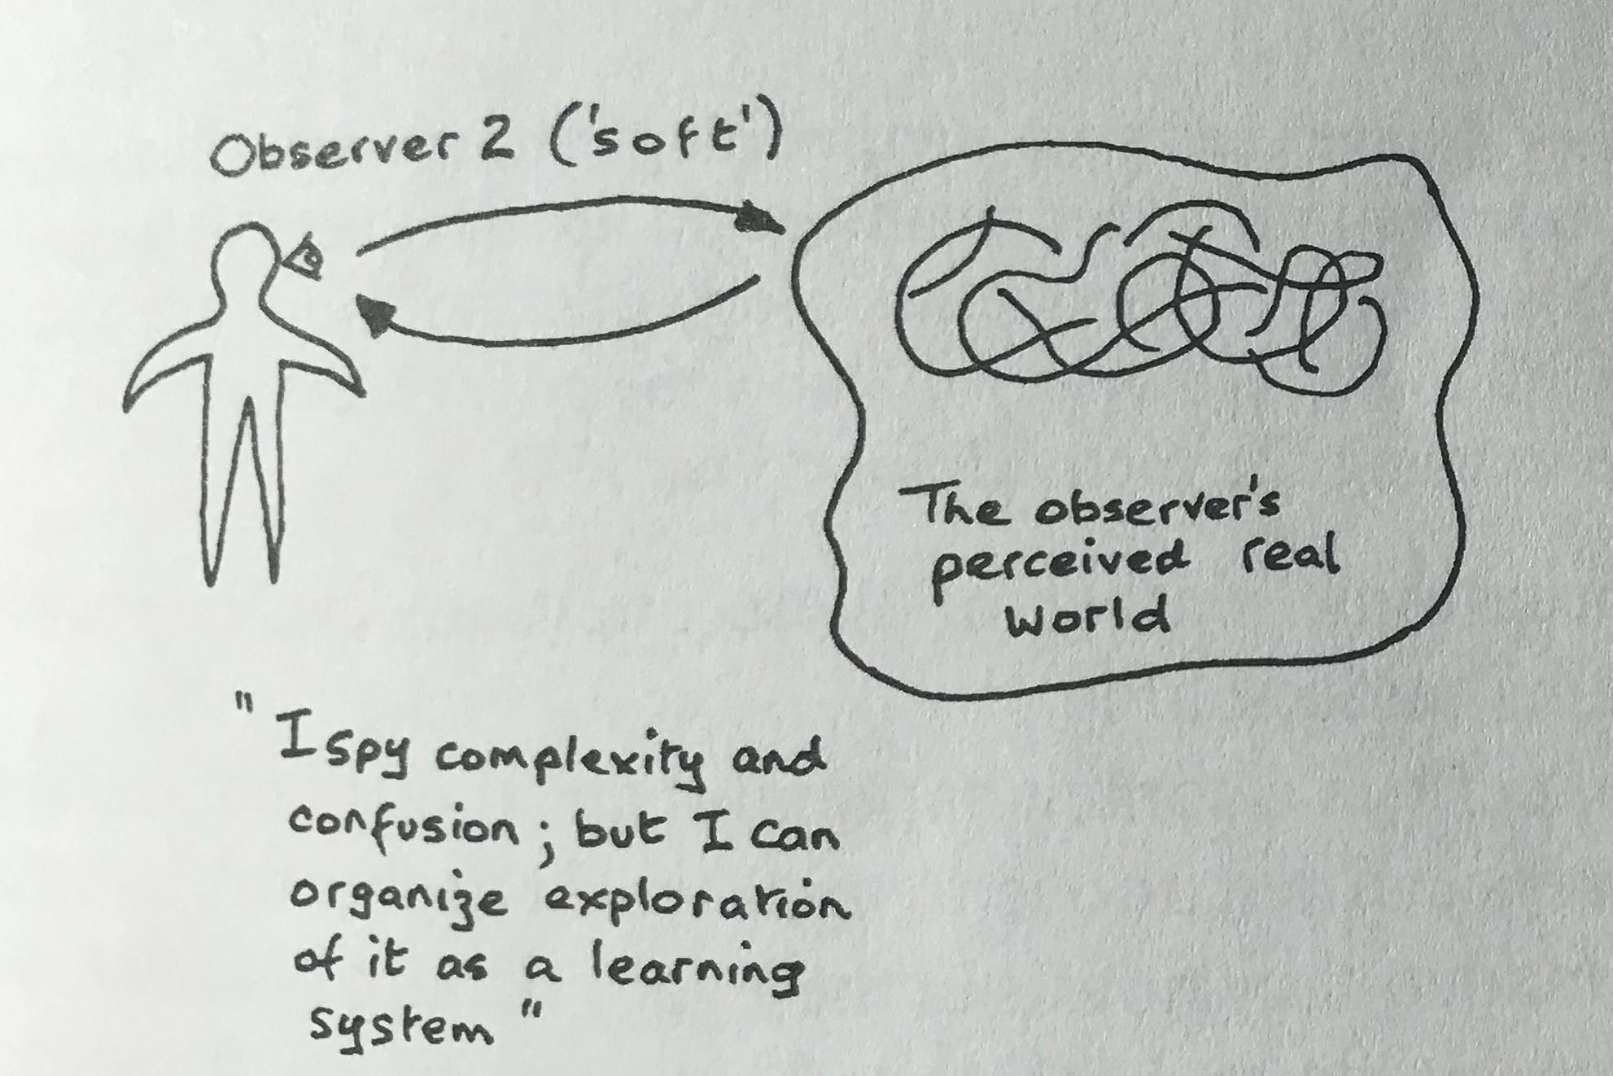
Source: Checkland, 1999

Slide 14
Alternative Role of Evaluation
Do
Evaluation
Plan
Evaluation
Evaluate
& Learn
Evaluation
(Gates, 2016; 2017)

Slide 15
Boundaries
Boundary Judgments Are Integral to Systems Thinking
Pluralism
Perspectives
Holism
Interrelationships
(Ulrich, 2005; Ulrich & Reynolds, 2010; Gates, 2018; Schwandt, 2018)

Slide 16
Requires Social Learning
Source: Ison, 2013

Slide 17
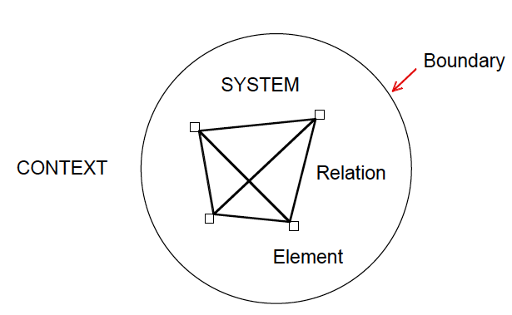
Rich Pictures
System Diagramming

Slide 18
Critical Systems Heuristics
(Ulrich, 2005; Ulrich & Reynolds, 2010; Gates, 2018)

Slide 20
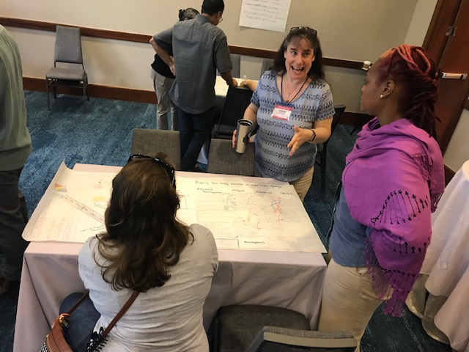

Slide 21
Systems Thinking Simplifies Complexity
Complexity as characteristic of situations; systems as constructs
Systems thinking calls for setting boundaries
Systems thinking means collective wisdom, deliberation, & learning

Slide 22
Systems Thinking…
Simplifies
Complexity as characteristic of situations & the world; systems as constructs
Systems thinking calls for setting boundaries
Systems thinking means collective wisdom, deliberation, & learning
Complexifies
Complexity as characteristic of problems, interventions, & systems
Systems thinking calls attention to holism & pluralism
Systems thinking means new tools, approaches, & expertise

Slide 23
Implications for Evaluator Preparation for the Future
Expand role of evaluation to facilitate social problem solving & learning
Incorporate systems thinking & approaches in evaluation training – from ‘hard’ to ‘soft’ and ‘critical’
Embrace interdisciplinarity & thinking about thinking via pictures, model building, and other approaches
Teach, model, & practice group facilitation & deliberation skills

Slide 24
References
Checkland, P. (1999). Soft systems methodology: a 30-year retrospective. West Sussex, England: John Wiley & Sons, Ltd..
Gates, E. F. (2018). Towards valuing with critical systems heuristics. American Journal of Evaluation. 39(2), pp. 201-220.
Gates, E. F. (2017). Learning from seasoned evaluators: Implications of systems approaches for evaluation practice. Evaluation. 23(2), pp. 152-171.
Gates, E. F. (2016). Making sense of the emerging conversation in evaluation about systems thinking and complexity science. Evaluation and Program Planning, 59, pp. 62-73.
Ison, R. (2010). Systems Practice: How to Act in a Climate Change World. Springer: Milton Keynes, United Kingdom.
Mowles, C. (2014). Complex, but not quite complex enough: The turn to the complexity sciences in evaluation scholarship. Evaluation, 20(2), 160–175
Open University. Systems Thinking in Practice Course. Retrieved here.
Schwandt, T. (2018). Evaluative thinking as a collaborative social practice: The case of boundary judgment making. In A. T. Vo & T. Archibald (Eds.), Evaluative Thinking. New Directions for Evaluation. 158, 125– 137.
Ulrich, W., & Reynolds, M. (2010). Critical systems heuristics. In M. Reynolds & S. Holwell (Eds.), Systems approaches to managing change: A practical guide (pp. 243–292). Milton Keynes, England: Springer.
Ulrich, W. (2005). A brief introduction to critical systems heuristics (CSH). Retrieved from http://wulrich.com/ downloads.html
Williams, B., & Hummelbrunner, R. (2011). Systems concepts in action: a practitioner’s toolkit. Stanford, California: Stanford: University Press.

Slide 25
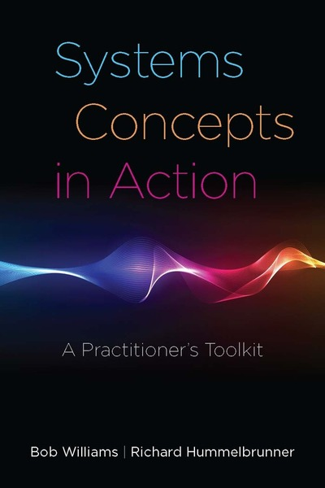
Causal Loop Diagrams
System Dynamics
Social Network Analysis
Outcome Mapping
Process Monitoring of Impacts
Strategic Assumption Surfacing and Testing
Strategic Area Assessment
The CDE Model
Assumption-Based Planning
Cynefin
Solution Focus
Viable System Model
Cultural Historical Activity Theory
Soft Systems Methodology
Dialectical Methods of Inquiry
Scenario Technique
Systemic Questioning
Circular Dialogues
Critical Systems Heuristics

