Slide 1
Oct. 27, 2016 | American Evaluation Association, Atlanta, GA| #EVAL16

Slide 2
Brief WashEval History
Origin: Founded in 1984 to organize DC-area evaluators
Mission: “devoted to fostering state-of-the-art knowledge and information sharing about evaluation”
In 1984 there were 12 members; In 2016, there are ~250 members.

Slide 3
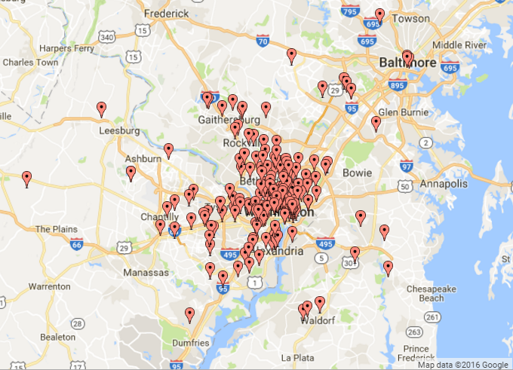
WashEval Membership Overview
92% of WE members live in the DC Metro Area:
Distributed across the 3 states:
DC: 36%
VA: 28%
MD: 28%
(Analysis of Members from 9/2015-9/2016)

Slide 4
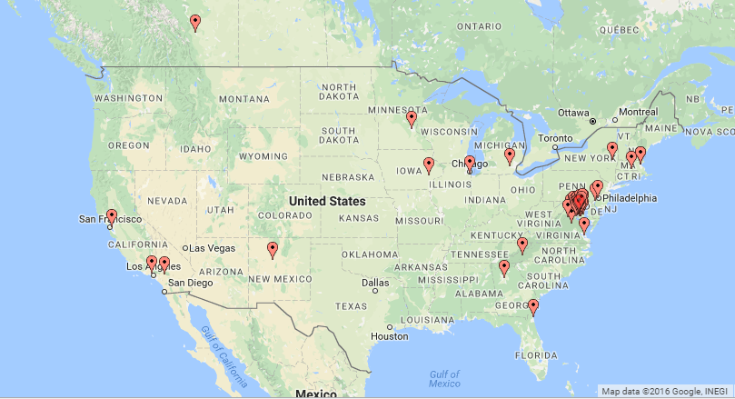
WashEval Membership Overview
But WE also has members in 16 states.

Slide 5
How does WashEval Sustain Members?
Offer a Wide Range of Professional Member Benefits
Sponsor Events that Align with Member Interests
Provide Mix of Volunteer Opportunities

Slide 6
Sample of @WashEval Member Benefits
Online networking (website, LinkedIn, Twitter)
Email digests with employment & contract opportunities
Access to members-only director
Discounted or free admission to events
Social events such as happy hours, dinners, and holiday parties
Learning opportunities through seminars and professional development events

Slide 7
@WashEval Events are Targeted at Members’ Diverse Backgrounds
Member professions:
40% government
20% academia
18% self-employed
12% NGOs
10% Private
DC-base means many members are connected to are working in government

Slide 8
DC Proximity Relates to Types of Events
WE is able to arrange for government and international NGO speakers at many seminars. For example:
Census Bureau staff on data linkage systems for evaluation
Labor and OMB staff on Pay for Success models
GAO staff on GPRA Modernization
World Bank staff on international evaluation programs

Slide 9
Spread Workload with Volunteer Opportunities
Volunteers are critical to the success, and ensuring no single volunteer is over-committed with WE responsibilities
Currently an eight member Board of Directors with numerous other responsibilities spread among committees. For example:
Social media coordinator
Website manager
Mentor lead
Member spotlight editor

Slide 10
Thank you!
Learn more about WE at
www.washingtonevaluators.org
@washeval

