Slide 2
The Convergence Partnership: Defining and Tracking the Success of Innovation, Collaboration, and Community Change for Health Equity
Jme McLean, MCP, MPH
PolicyLink, Program Director of the Convergence Partnership

Slide 3
The Convergence Partnership is a collaborative of seven major funders and the CDC engaged in multi-field, equity-focused, policy and environmental change efforts to achieve healthy people and healthy places.

Slide 4
Steering Committee
The Robert Wood Johnson Foundation
Nemours
W.K. Kellogg Foundation
Kaiser Permanente
The California Endowment
Kresge Foundation
Ascension Health
Centers for Disease Control and Prevention (Technical Advisors)

Slide 5
PolicyLink is a national research and action institute advancing economic and social equity by Lifting Up What Works. ®

Slide 6
Vision
Healthy People
Living in
Healthy Places
Notes:
This requires the broad expertise and influence of funders, advocates, and practitioners working across multiple fields to create healthy environments.
MOU and strategic planning
MOU among funders, and then one with CDC (which had never been done before)
Took time to build trust and relationships but the MOU and SP process helped to facilitate that
CP believe that partnerships are FUNDAMENTAL in achieving the vision of healthy people in healthy places

Slide 7
Vision
The Convergence Partnership envisions a nation in which every community fosters health, prosperity, and well-being for all, by promoting:
equity as the means to ensure that everyone has the opportunity to participate and prosper;
policies and practices that create conditions that sustain healthy people and healthy places; and
connections among people across multiple fields and sectors that catalyze and accelerate the work.

Slide 8
Values
Place matters
Policy matters
Equity matters

Slide 9
Place Matters
Communities of Opportunity
Good Health Status
Low- Income Communities
Parks
Sidewalks
Grocery Stores
Financial Institutions
Better Performing Schools
Good Public Transportation
Fast Food Restaurants
Liquor Stores
Unsafe/Limited Parks
Poor Performing Schools
Increased Pollution and Toxic Waste Sites
Limited Public Transportation
Poor Health Status
contributes to health disparities:
Obesity
Diabetes
Asthma
Infant mortality

Slide 10
Policy Matters
Policy = The Rules
Policy impacts the economic, social, physical and services environments

Slide 11
Equity Matters
Equity means just and fair inclusion
An equitable society is one in which all can participate and prosper. The goals of equity must be to create conditions that allow all to reach their full potential. In short, equity creates a path from hope to change

Slide 12
Health and Equity in All Policies
Health in All Policies: Policies not traditionally thought of as health policies (transportation, land use, education, economics) impact health and obesity rates.
Equity in All Policies: Policies can have either a positive or negative impact on low-income people and communities of color.
Notes:
What does it look like?
Consider the “conventional question” vs. the “equity question.”
Conventional question: How can we promote healthy behavior?
Equity question: How can we target dangerous conditions and reorganize land use and food policies to ensure healthy spaces and places?

Slide 14
Strategies
Collaboration
Equity-focused
Environmental and Policy Change
Multi-field Partnerships
CONVERGENCE

Slide 15
National Policy Initiatives
Built Environment
Federal Transportation Reauthorization
Access to Healthy Foods
National Healthy Food Financing Initiative
Farmers’ market access for SNAP recipients
Influencing the 2012 Farm Bill
Federal Policy Advocacy
Health Reform
Communities Putting Prevention to Work
Sustainable Communities
Healthy People 2020
Child Nutrition Reauthorization
Community Transformation Grants

Slide 16
Building the Field Locally and Regionally
Field Building
Innovation Fund
Regional Convergence
Violence Prevention-Healthy Eating Active Living Project

Slide 17
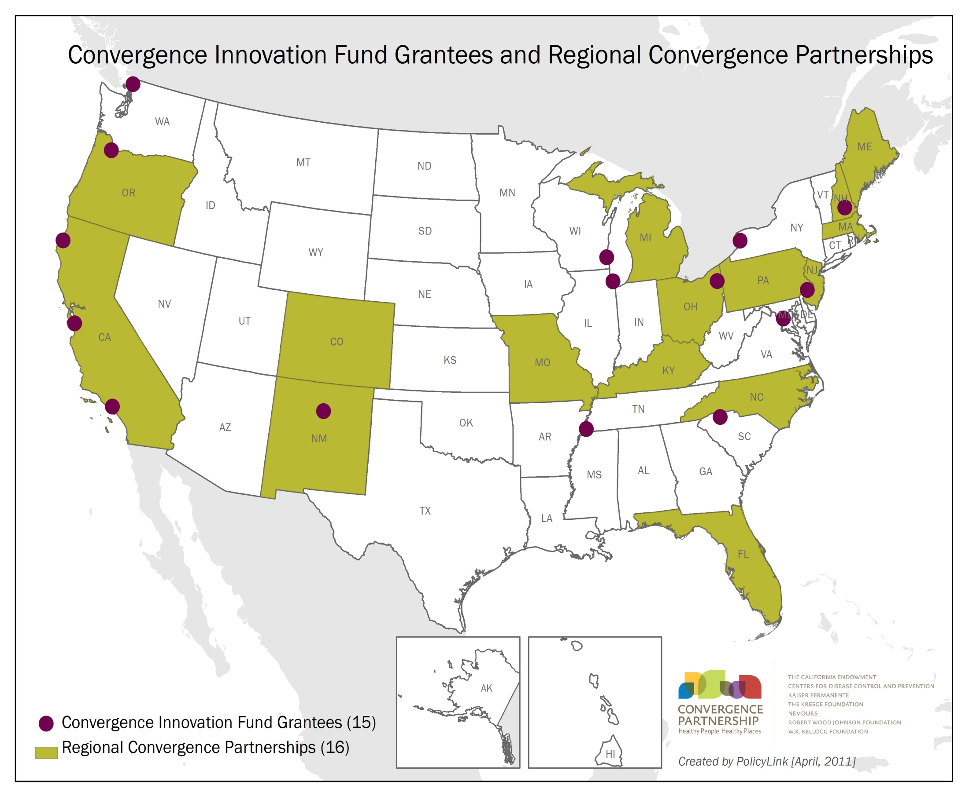

Slide 18
Innovation Fund Goals
Support foundations to shift grantmaking towards policy and environmental change strategies targeting health and equity;
Create local and sustainable resources for promising, innovative strategies to build healthy, equitable communities;
Promote multi-field partnerships on the ground, and;
Support partnership among foundations.

Slide 19
Regional Convergence Goals
Build new connections, leadership and capacity
Help practitioners, advocates, foundations and communities maximize their efforts
Stimulate resources for issues of local concern
Increase possibilities and momentum for comprehensive policy change
Expand capacity for equity

Slide 20
Regional Convergence Structure
Funders
Funder
Funder
Funder
Funder
Funder
Funder
Statewide Constituency Groups
Equity Economy Environment
Technical Advisors
Project Director
Fiscal Agent
Nonprofit
Community Constituency Groups
HPHP Investments & Activities
HPHP Community Projects
HPHP Investments & Activities
National Model
Colorado Model
Michigan Model

Slide 21
One size doesn’t fit all.

Slide 22
Convergence Partnership Support
Facilitate relationships across regions and with the national partnership
Provide technical guidance and mentoring
Help to identify, connect, and build momentum for policy change efforts
Provide seed funding to support regional convergence planning and implementation activities

Slide 23
Tools
Policy Briefs
Promising Strategies for Creating Healthy Eating and Active Living Environments
Recipes for Change: Healthy Food in Every Community
Fostering Physical Activity for Children and Youth: Opportunities for a Lifetime of Health
The Transportation Prescription: Bold New Ideas for Healthy, Equitable Transportation Reform

Slide 24
Communications and Evaluation
Communications
Strategic communications plan
Message guide
Online and in-person communications activities
Internal & External Evaluations
“The Whole is Greater than the Sum of Its Parts”
Policy impacts
Ongoing feedback loop

Slide 25
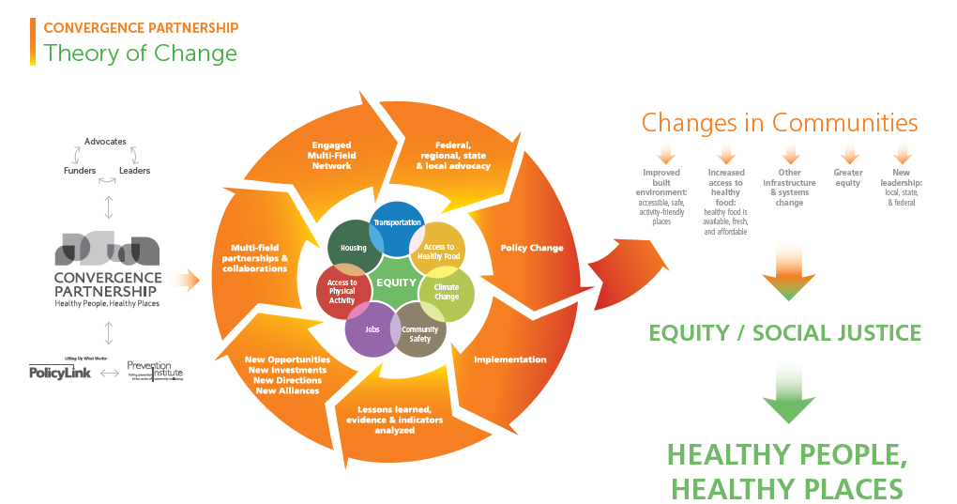

Slide 26
Evaluation is viewed as a critical element to show the impact of the Partnership in the field and in philanthropy.
It also serves as a continual feedback loop to the Partners on what has worked, what hasn’t worked and where course corrections may need to occur.

Slide 27
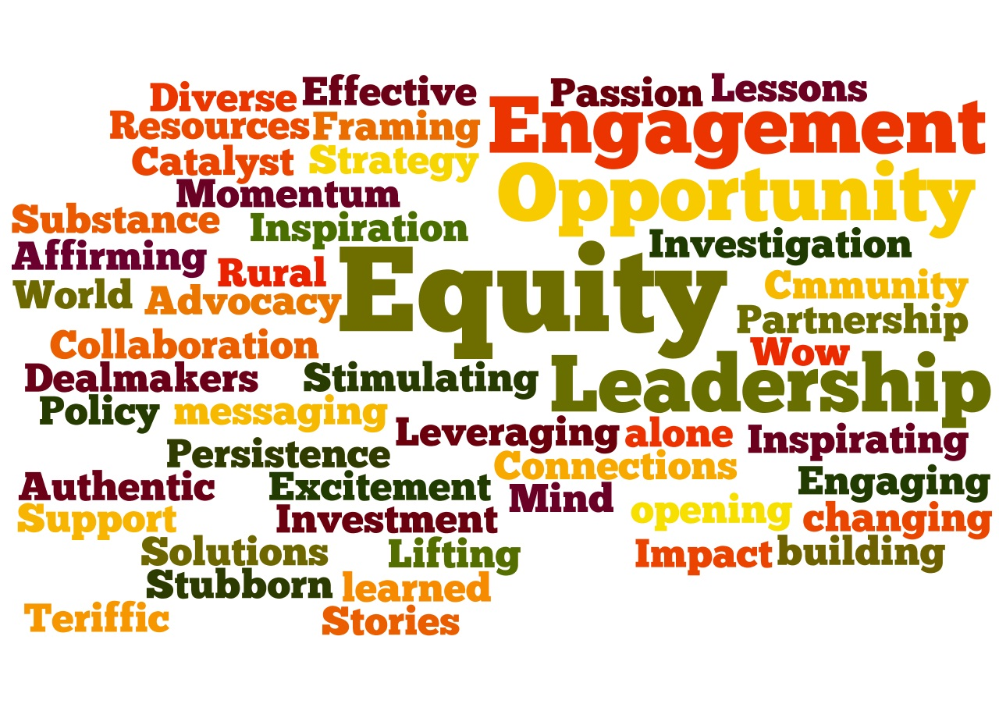

Slide 28
THANK YOU!
Jme McLean
jme@policylink.org
Convergence Partnership
www.convergencepartnership.org

