Slide 1
Photo by archer10 (Dennis) 78M Views - Creative Commons Attribution-ShareAlike License https://www.flickr.com/photos/22490717@N02
Created with Haiku Deck
Notes:
The health, safety, and well-being of commercial fishermen and their families are typically forgotten.
My name is Gretchen Biesecker. I proudly lead the internal evaluation work of Fishing Partnership Support Services as a long-term external consultant.

Slide 2
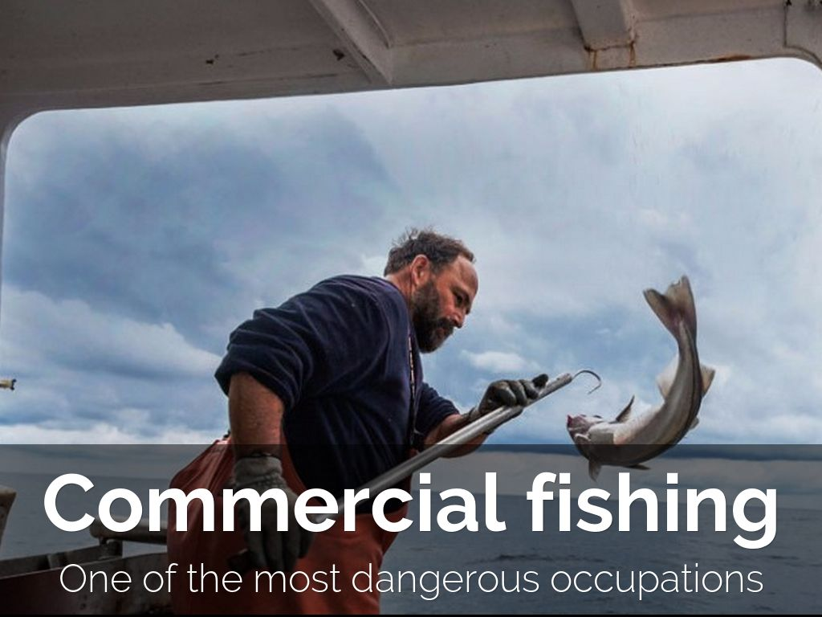
Notes:
Fishing is the most dangerous job in the country.
Groundfishermen are 37 times more likely to die on the job than a police officer.
There are over 19,000 fishing households in New England.

Slide 3
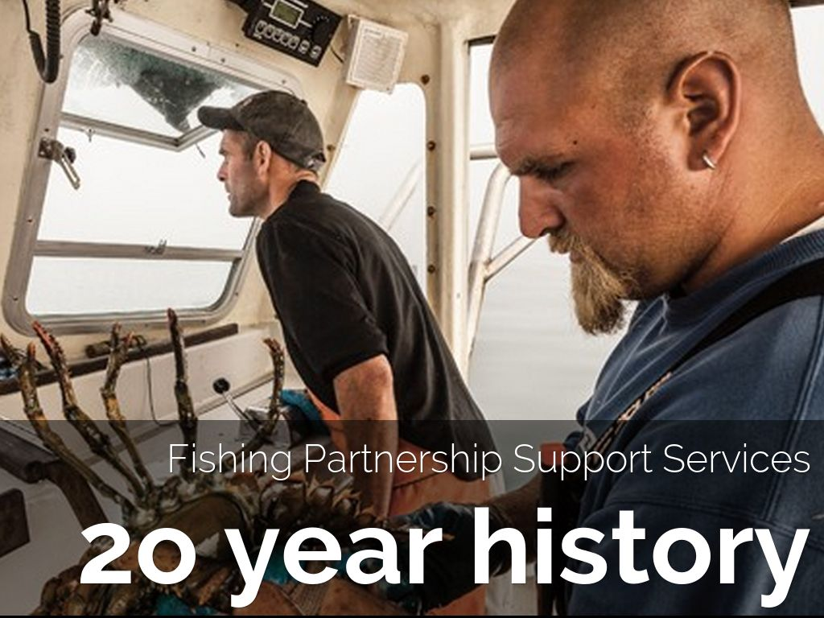
Notes:
FP began as an insurance provider to fishermen and their families.
Their work helped inform the Affordable Care Act.
Today, they are an innovative non-profit in New England, serving the most critical needs of the fishing community.

Slide 4
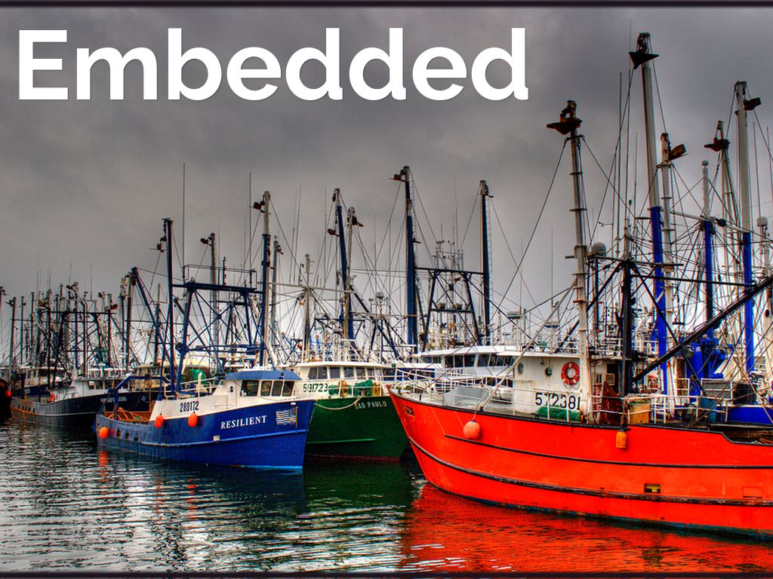
Photo by twoblueday - Creative Commons Attribution License https://www.flickr.com/photos/75224769@N00
Created with Haiku Deck
Notes:
In line with best practices in community health, the model employs and trains trusted women from the fishing community as health workers, with offices located harborside.
They are the wives and daughters of generations of fishermen.

Slide 5
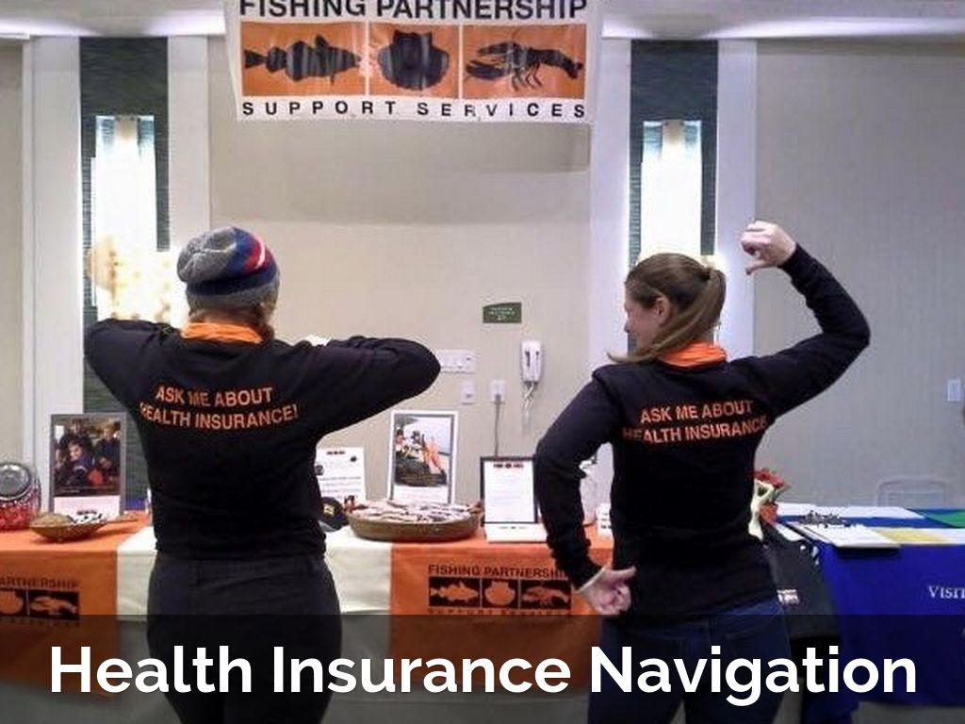
Notes:
They help families to obtain and keep health insurance.
Families’ incomes fluctuate greatly so the system can be especially hard to navigate.
And they brings other interventions like vaccines and dental screenings to the docks.

Slide 6
Notes:
But due to the dangers of the job, FP does more.
Many deaths and injuries can be prevented by hands-on practice and wearing flotations devices on the job.
Until recently, most fishermen in New England received no training on how to handle emergency situations.

Slide 7
Notes:
Fishermen who lost multiple friends to drowning deaths decided to take action and partnered with FP.
Together they replicated trainings that had begun in Alaska, where training reduced the number of deaths.
Here’s some of what they teach (see list of modules on slide).

Slide 8
Notes:
The fishing workforce is young and old.
It’s rare that either group has ever had hands on practice setting off flares, making mayday calls, or putting out fires.
And like CPR, we hope they never need to use these skills, but in an emergency, the practice is critical.

Slide 9
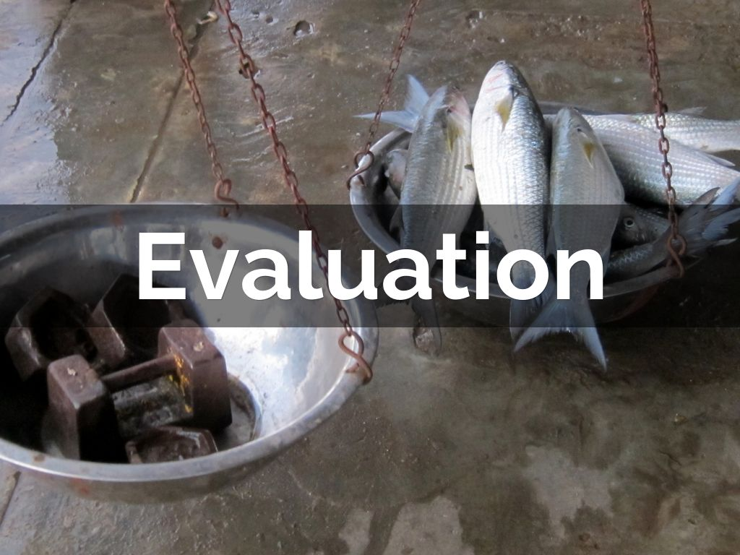
Photo by indi.ca - Creative Commons Attribution License https://www.flickr.com/photos/85113745@N00
Created with Haiku Deck
Notes:
So how do we evaluate the work of FP?
Currently we are a team of three—a full time Analyst
And me, an independent consultant who helps set our strategy, providing coaching and capacity-building with another member of my team.

Slide 10
Notes:
Empathy is core to the design of our evaluation activities
So in our design, we put ourselves in each other’s shoes.
In this photo I’m not in shoes ☺ I’m taking off an immersion suit, right after jumping in the water when I joined a full safety training with 40 fishermen.

Slide 11
Notes:
Journey maps are a design tool to walk through a process through the perspective of each person involved.
We collect lots of data at multiple points in safety training so we recently used journey maps to improve that process.

Slide 12
Photo by archer10 (Dennis) 83M Views - Creative Commons Attribution-ShareAlike License https://www.flickr.com/photos/22490717@N02
Created with Haiku Deck
Notes:
To evaluate and learn across FP activities, we use a range of methods including the ones shown here.
As one example, surveys at safety trainings and other learning events measure increases in knowledge, changes in attitudes, and participant satisfaction.

Slide 13
Photo by Calsidyrose - Creative Commons Attribution License https://www.flickr.com/photos/17557997@N02
Created with Haiku Deck
Notes:
How do we use all this data?
Well, it help us to do the things you see here. I will say that one of the biggest challenges is our reporting. For our state and federal grants, we are often required to submit weekly reports, and that can be grueling.
Assess needs and community interests
Assist families
Obtain feedback for continuous improvement
Measure and monitor performance against goals
Inform community health occupational health research and navigation work
Report to funders

Slide 14
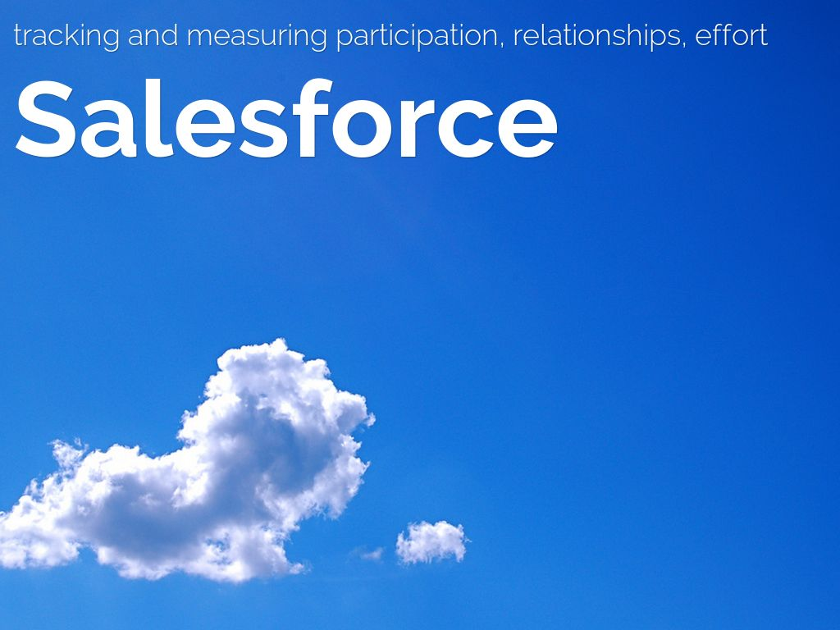
Photo by JD Hancock - Creative Commons Attribution License https://www.flickr.com/photos/83346641@N00
Created with Haiku Deck
Notes:
Fortunately, we have a cloud-based database, built on a Salesforce platform to track and measure performance, relationships, activities/outputs.
Navigators enter data close to real-time, while juggling other activities.
And there can be Tensions between attention to data quality and focusing on direct service to families.

Slide 15
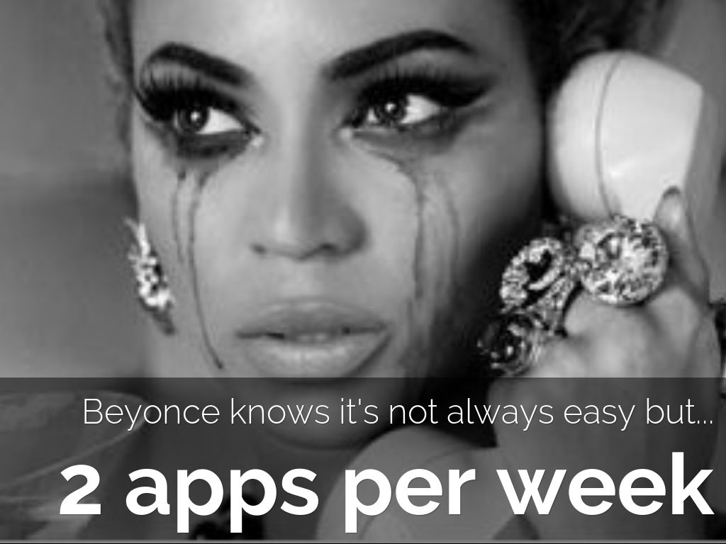
Notes:
So, we work hard to make the data meaningful.
We break down goals into actionable guidance.
And we try to design our internal data reviews to be fun and motivating.
This is an example from the spring, when we broke down an annual goal into what each Navigator needed to do per week.

Slide 16
Notes:
Some of the data that FP collects and analyzes is not yet common among similar programs.
For instance, FP determined that it takes 4 phone calls and 2 meetings on average to enroll one consumer in health care coverage.
For this and other work, FP won a state award this year.

Slide 17
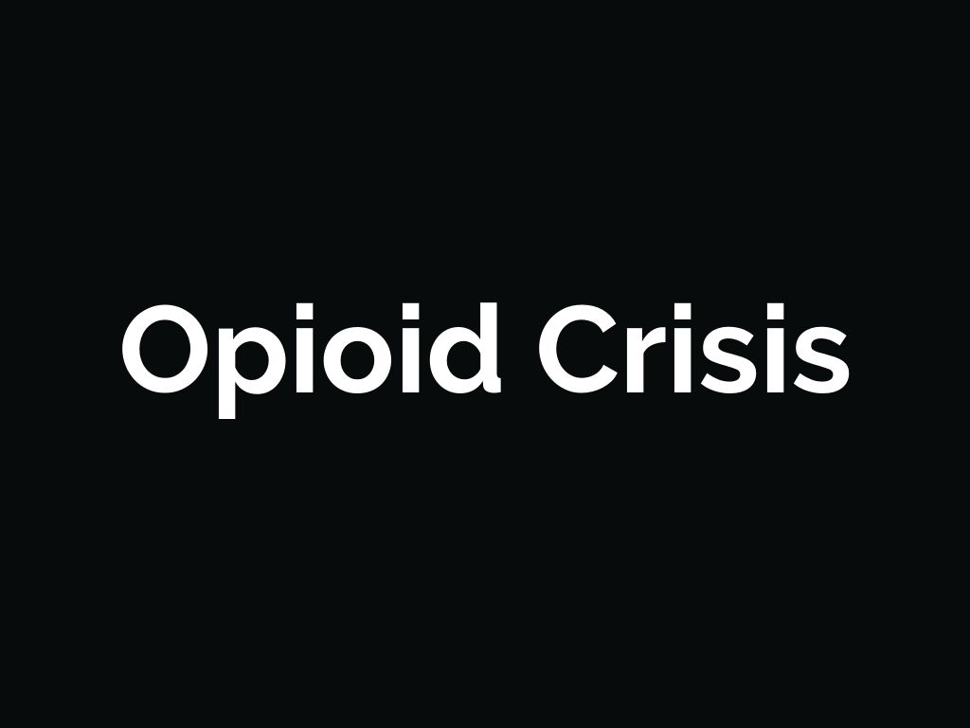
Notes:
But our work is not done…
In the last 5 years, the rate of opioid overdose deaths in Massachusetts was more than twice the national average.
Commercial fishermen are at especially high risk due to occupational injuries, isolation, stress, and poverty.

Slide 18
Photo by SammCox - Creative Commons Attribution-NonCommercial License https://www.flickr.com/photos/52755911@N03
Created with Haiku Deck
Notes:
FP is responding to this need, working with fishing communities, public health officials, and universities. We are piloting several new initiatives, including training boat captains and their crews on how to administer Narcan in case of opioid overdose
Motivational interviewing and peer listening
Women’s wellness
Narcan training on fishing vessels

Slide 19
Photo by shikeroku - Creative Commons Attribution License https://www.flickr.com/photos/98633608@N00
Created with Haiku Deck
Notes:
FP’s work and learning is rippling out.
They developed the first safety training manual and are fielding requests for it as far as Iceland
Our data on what it takes to get people insured and help them stay insured have been useful to other programs.

Slide 20
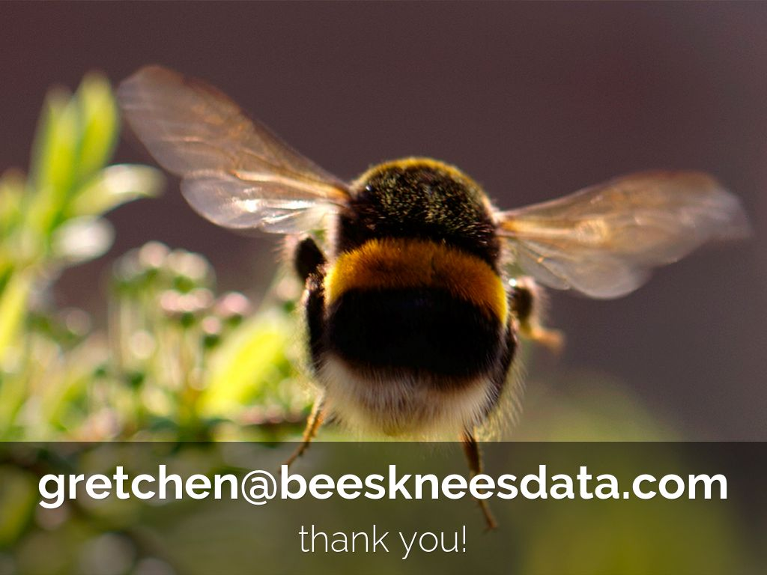
Photo by Miquel99 - Creative Commons Attribution-NonCommercial License https://www.flickr.com/photos/58826912@N05
Created with Haiku Deck
Notes:
As an evaluator, I feel incredibly fortunate to get to work with such caring and committed people and to explore a new world to me, with a new set of design challenges.
Thank you for hearing our story today, and please be in touch

