Slide 1
Practical methods to obtain 77% response rate: Lessons learned from over 2,000 respondents, 4 continents, and 8 languages
#137; Session Number: 2033
Wed, Nov 8; 7 PM-8:30 PM
Track: International and Cross Cultural Evaluation
Niranjan Konduri* @N_Konduri
L. Gustavo V Bastos**
*USAID SIAPS Program, Management Sciences for Health, Arlington VA
** Global Drug Facility, Stop TB Partnership, UNOPS, Geneva, Switzerland

Slide 2
Background (1)
Evaluators are concerned with declining survey response rates
Survey research is invaluable to inform progress, tailor interventions and make course corrections in global health programs
Our project implemented and scaled up an eHealth system in 10 diverse low and middle-income countries

Slide 3
Background (2)
After over 5 years of international technical partnership, we needed to conduct an end user evaluation on the eHealth system
With limited resources, we decided to conduct a web-based user experience survey in 10 countries
However, many of the public sector health workers (end users) are not accustomed to routine use of email

Slide 4
Objectives
Assess solutions to address bottlenecks in declining survey response rates in health informatics
Demonstrate low-cost and feasible methods of conducting user experience surveys among public-sector staff in low and middle-income countries for global health and development programs

Slide 5
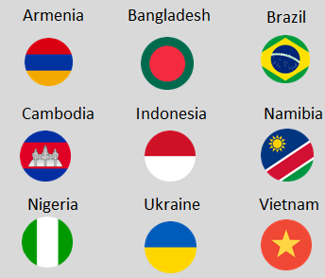
Methods (1)
9 of 10 countries agreed to participate
A 12-item instrument with 0-7 scale (strongly disagree to strongly agree)
Designed to be completed within 5 to 7 minutes; anonymous
Surveyed over 2,000 users covering over 1,500 health facilities
Local language: 7 countries English: 2 countries (Namibia, Nigeria)
Survey conducted between Sep-2015 and July-2016
Used SurveyGizmo portal to administer survey

Slide 6
Methods (2)
Country | Data collection period | Number of Active users | Method of sending invitation | Number and type of reminders
Armenia | 8 weeks | 70 | Email only | 1
Bangladesh | 21 weeks | 271 | Email; use of eHealth dialogue box | 2
Brazil | 21 weeks | 559 | Email; use of eHealth dialogue box; social media | 2
Cambodia | 5 weeks | 62 | eHealth dialogue box only | 1
Indonesia | 10 weeks | 268 | Email; use of eHealth dialogue box | 2
Namibia | 5 weeks | 55 | Email; whats app | 2
Nigeria | 23 weeks | 180 | Email; use of eHealth dialogue box | 1
Ukraine | 8 weeks | 565 | Email only | 1
Vietnam | 5 weeks | 102 | Email only | 1
9 country total active users surveyed – 2,132

Slide 7
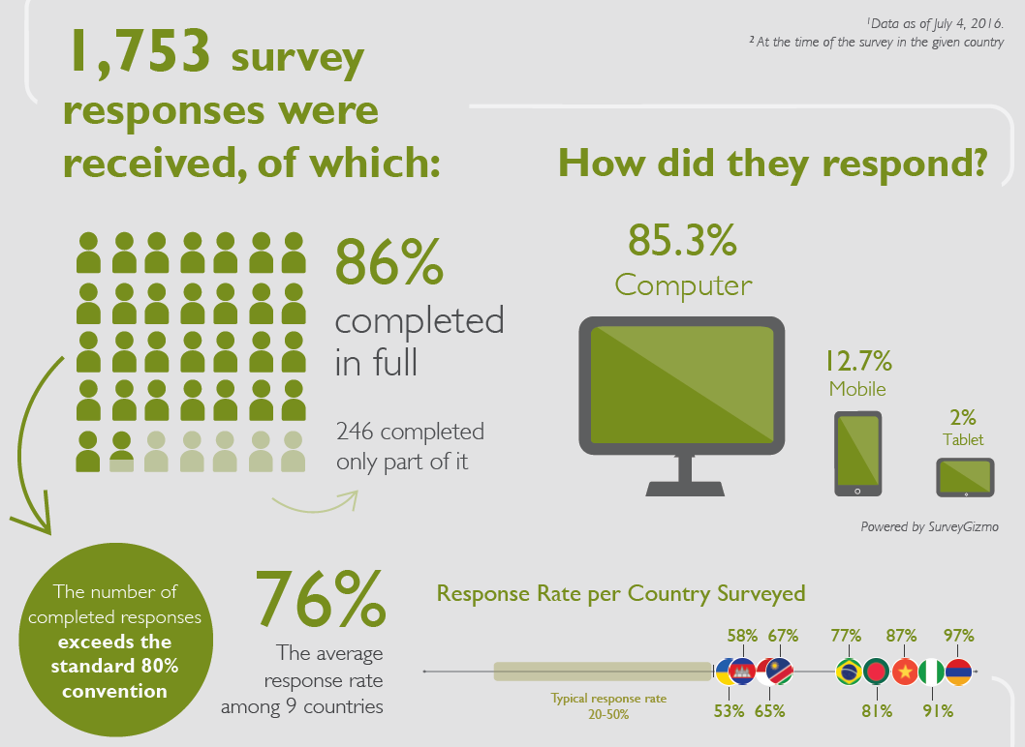
Results – response rates
1,751
240 completed only part of it
77%
The median response rate among 9 countries

Slide 8
Strategies employed (1)
When the survey began in Ukraine and Armenia, we learnt that it was crucial to obtain buy-in from regional supervisors to enhance response rate despite authorization from national level government staff
This strategy was subsequently applied with good results in Brazil and Cambodia. The host country authority made phone calls to several key influencers.

Slide 9
Strategies employed (2)
Bangladesh and Nigeria presented unique challenges because many health workers were first time computer users and did not have email addresses*
Among those that did have email address, they were not available centrally or were outdated. After understanding local context, we decided to establish an eHealth dialogue box with survey invitation.
*First time computer users meant they were new to the internet and email application, quite common in resource-constrained public sector settings. They may have a mobile phone but no email address.

Slide 10
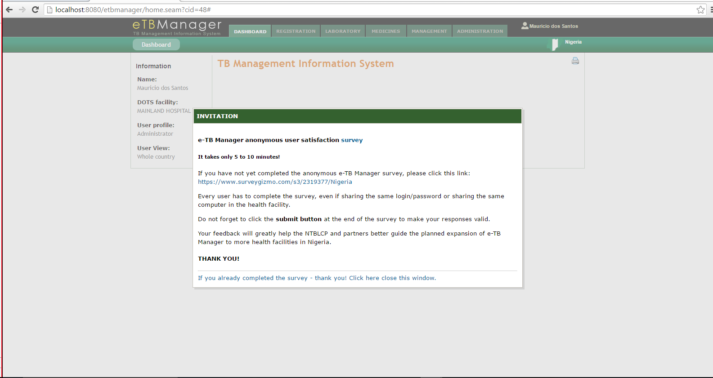
Example of eHealth dialogue box with survey invitation
eHealth system dialogue box – after login: This feature was developed after receiving poor
response rates in the initial participating countries. This was solved by placing a system
dialogue box after user login in the eHealth system. The dialogue box provided the official
invitation to complete the survey and assuring anonymity.

Slide 11
Strategies employed (3)
As a result, we received additional 154 responses from Bangladesh (total response rate=80%) and additional 59 responses from Nigeria (total response rate=81%)
In Brazil, email was not effective. Many email addresses were returned undeliverable. Social media and plenty of phone calls to state level authorities were key, who in turn sent state level invitations. This resulted in country level response of 77%.

Slide 12
Lessons Learned (1)
Keeping the survey short (5-7 minutes), in validated local language and securing buy-in from various hierarchical authorities was necessary but not sufficient
The 9 country study was iterative over a 10-month period and staggered across countries. Permission for longer duration of data collection helped enhance response rate
This allowed us to follow AEA’s principle of transferring lessons learned from one context into another (e.g. lessons from Bangladesh were applied in Nigeria and Brazil)

Slide 13
Lessons Learned (2)
Easter and carnival in Brazil affected response rates. We secured permission to prolong the length of the survey period as the government saw value when we shared initial responses received*
Use of social media in Namibia was effective and thereby applied in Brazil to enhance response rate
*Similar strategy applied in Bangladesh, Cambodia, Indonesia, Nigeria

Slide 14
Lessons Learned (3)
The 86.3% completion rate among responses received for all 12 required questions exceeds the recommended 80% completion rate, even in a possible situation of a low average response rate of 25% in survey research*
*References:
Fluid Surveys. Response Rate Statistics for Online Surveys -What Numbers Should You be Aiming
For? Dec 2014. Available at http://fluidsurveys.com/university/response-rate-statistics-online-surveys-aiming
Noble K. Tips for Increasing Survey Completion Rates. Survey Monkey. July2015.
Available at https://www.surveymonkey.com/blog/2015/06/25/tips-increasing-survey-completion-rates

Slide 15
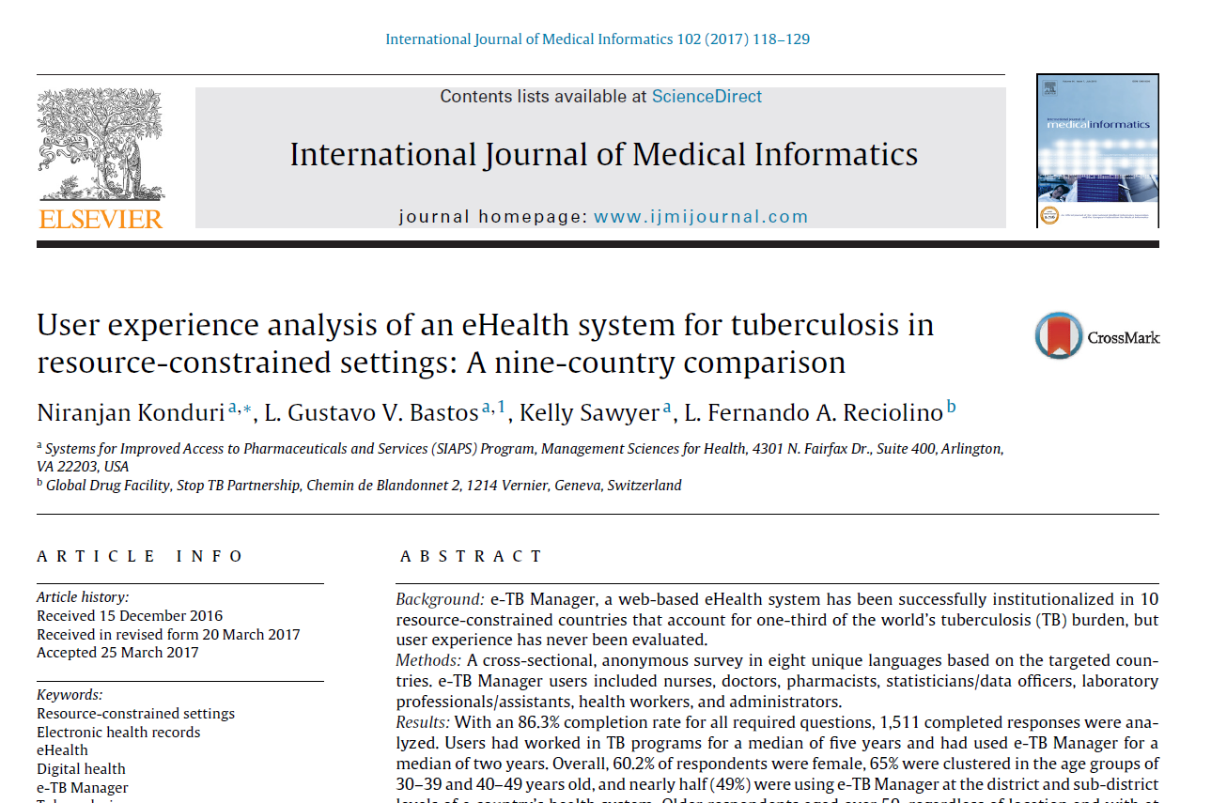
Learn more about our evaluation (1)

Slide 16
Learn more about our evaluation (2)

