Slide 1
Ripple Effect Mapping: A Participatory Strategy for Measuring Program Impacts
Presented at the American Evaluation Association
2012 Annual Conference
Scott Chazdon, Ph.D., Evaluation and Research Specialist
Extension Center for Community Vitality
Lynette Flage, Ph.D. Regional Director, North Dakota State University Extension

Slide 2
Overview
The Challenge of Capturing Impact
Socially complex interventions
Requiring collaboration among stakeholders or sectors
Highly emergent/evolving
Ripple Effect Mapping: A Possible Solution
Method
Analysis
Real World Example

Slide 3
Ripple Effect Mapping
Purpose – to better understand intended and unintended results of a program, intervention or collaborative for individuals, groups, communities and regions.
Completed post-program as part of impact evaluation
Notes:
Ripple Effect Mapping (REM), a promising method for conducting impact evaluation that engages program and community stakeholders to retrospectively and visually map the “performance story” (Mayne, 1999; Baker, Calvert, Emery, Enfield, & Williams, 2011) resulting from a program or complex collaboration. REM employs elements of Appreciative Inquiry, mind mapping, and qualitative data analysis.
REM was used to conduct an impact analysis of the Horizons program, an 18-month community-based program delivered to strengthen leadership to reduce poverty. The method (Kollock, 2011) was piloted in Washington, Idaho and North Dakota Horizons communities to illustrate outcomes of the program over time. While there were minor process variations in each state, the REM technique in all three states utilized maps to illustrate to community members what was accomplished as well as furthered their enthusiasm for taking action on issues.

Slide 4
Mind Mapping – Radiant Thinking
Pictorial Method
Note taking
Brainstorming
Organizing
Problem solving
Evaluation
For more on mind mapping, see Buzan, T. (2003). The mind map book. London: BBC Books.
Image: Mindmap, Graham Burnett, http://en.wikipedia.org/wiki/File:Mindmap.gif
Notes:
Mind mapping is the primary software tool – radial diagram that represents semantic or other connections between portions of learned material hierarchically (Eppler)
Historically, the standard approach for impact evaluation has been experimental research. Yet critics of experimental approaches emphasize that these designs are often politically unfeasible and yield very little useful information on a program’s implementation or its context (Patton, 2002).
REM, an example of qualitative methodology based on open-ended group interviewing, provides “respectful attention to context” (Greene, 1994: 538), and better addresses the concerns of program stakeholders. The participatory group aspect of this method engages participants and others to produce high quality evaluation data, and increases the likelihood of future collective action.
REM is a form of mind mapping, a diagramming process that represents connections hierarchically (Eppler, 2006:203). A fundamental concept behind REM is radiant thinking (Buzan, 2003), which refers to the brain’s associative thought processes that derive from a central point and form links between integrated concepts (Wheeler & Szymanski, 2005; Bernstein, 2000). This makes REM an ideal tool for brainstorming, memorizing, and organizing.

Slide 5
Ripple effect mapping: related approaches
Concept Mapping (Trochim, 1989)
Mind Mapping (Eppler, 2006)
Outcome Mapping (Outcome Mapping Learning Community, 2011)
Participatory Impact Pathway Analysis (Douthwaite et al, 2008)
Most Significant Change (Davies 2005)
Notes:
REM is a unique approach that builds on several distinct methods:
Group approach is similar to Concept Mapping, Outcome Mapping, and PIPA, but all these approaches are typically used to plan an intervention and map its program theory.
Focus on key informants, or expert stakeholders is similar to Padilla’s Unfolding Matrix method for qualitative data acquisition and analysis.
Appreciative inquiry emphasis is similar to Davies Most Significant Change technique, which focus on the “cream” that rises to the top.
Mind mapping is the primary software tool – radial diagram that represents semantic or other connections between portions of learned material hierarchically (Eppler)

Slide 6
How Does it Work?
Identify the intervention
Schedule the event and invite participants
Group mapping session held
Follow-up interviews
Cleaning, Coding, Analysis

Slide 7
Ripple effect mapping
Method
Identify the intervention
High engagement program or position
Cross-sector initiative
Collaboration
Invite stakeholder group
Participants
Non-participant stakeholders
12 to 20 participants
Two moderators
Notes:
Padilla: It is critical to sample participants who are presumptively most qualified at a given moment to provide the best insight into the specific phenomenon of interest to the researcher. This increases the likelihood that the researcher will capture an insightful characterization of the “target situation.” (Padilla 1999: 140). (The Unfolding Matrix)
Recruitment challenges --

Slide 8
Ripple effect mapping
Method
Appreciative Inquiry interview
Conducted among pairs of participants
Examples of questions:
Tell me a story about how you have used the information from the program?
Is there anything that resulting from the program that you are proud to share?
List an achievement or a success you had based on what you learned.
Notes:
The pairing phase “primes the pump.” Gets people started. Encourages input from quiet people.

Slide 9
Ripple effect mapping
Method
Mapping
On wall or using Concept Mapping software with data projector
Group cross-validation
Potential for probing using the Community Capitals Framework
Probe examples:
What happened as a result of this?
Did this lead to anything else?
Have you seen changes in the natural environment (or substitute other capital)?
Notes:
Handout frontstage and backstage agendas

Slide 10
Ripple effect mapping
Demonstration of Mapping Process
Think back to the first time you attended an AEA conference.
Is there anything that resulting from attending the conference that you are proud to share?
List an achievement or a success you had based on what you learned or who you met.
Floating topics
Beginning to categorize
Notes:
Handout frontstage and backstage agendas

Slide 11
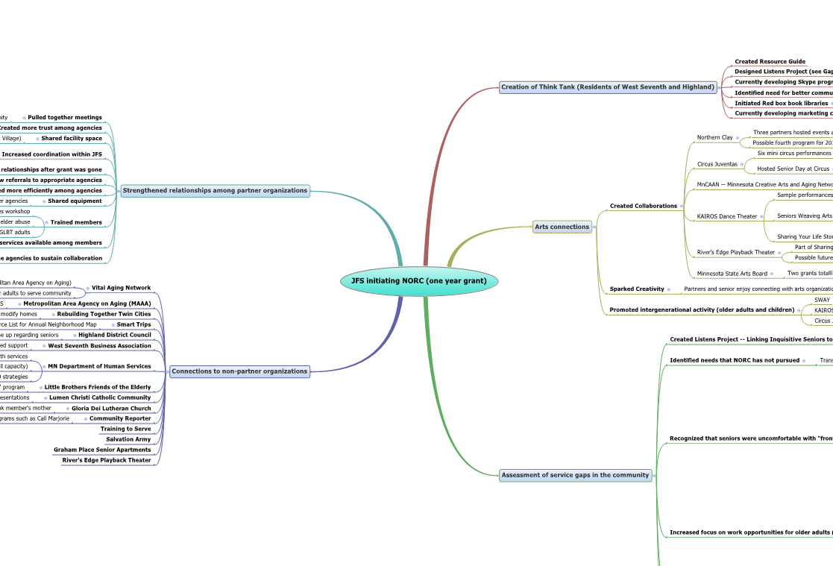
Example: Ripple Effect Map of the Naturally Occurring Retirement Communities Collaborative

Slide 12
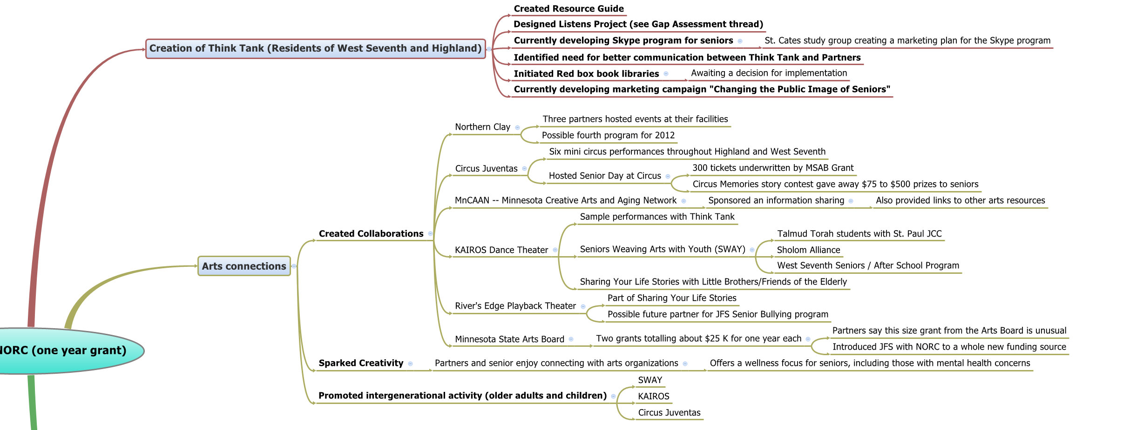
Example: Ripple Effect Map of the Naturally Occurring Retirement Communities Collaborative

Slide 13
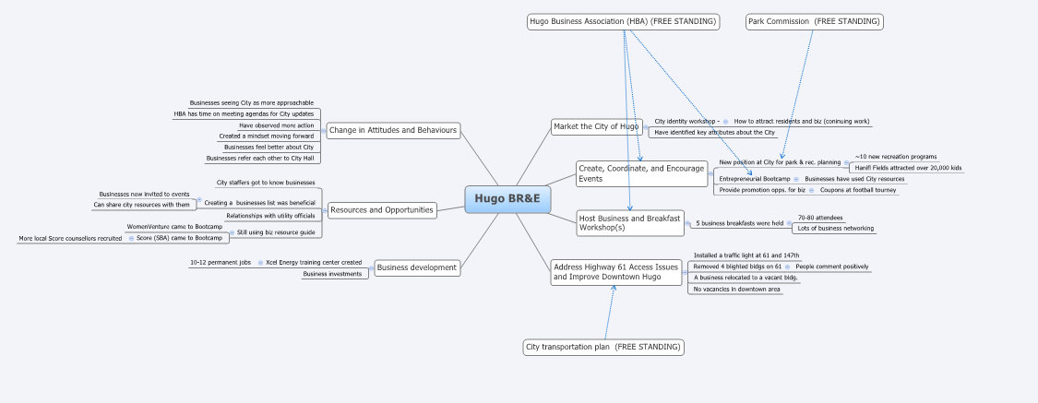
Example: Ripple Effect Map of Hugo, MN Business Retention and Expansion program

Slide 14
Ripple effect mapping
Cleaning, Coding, Analysis
Organize map to better identify pathways or combine pathways
Download data to Excel for coding
Code using Community Capitals Framework and type of outcome
KASA = something learned
Behavior change = action taken
Impact = change in system
Follow-up interviews if more clarity is needed

Slide 15
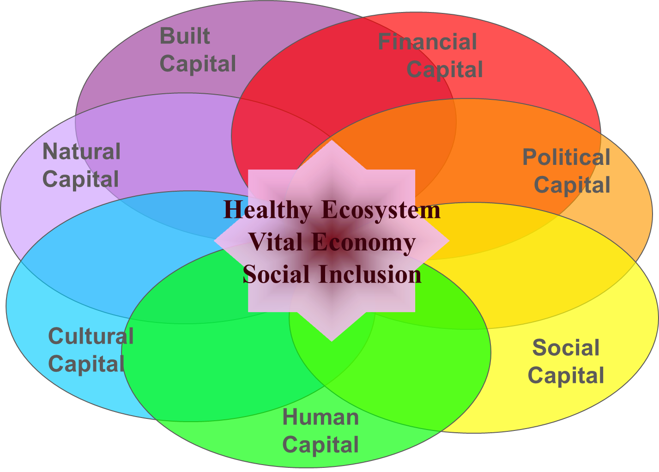
The Community Capitals Framework
(Emery and Flora, 2008)

Slide 16
Ripple effect mapping
Coding Demonstration
Notes:
Handout frontstage and backstage agendas

Slide 17
Coding Example
First order (core outputs) | Second order ripples | Third order | Fourth order |  | Human capital effects (knowledge and behavior change) | Social capital effects | Civic effects | Financial effects | Built capital effects | Health, Food and Nutrition Effects | Cultural effects | Natural environment effects
Market the City of Hugo
 | City identity workshop - |  |  |  |  |  | X | X
 |  | How to attract residents and biz (coninuing work) |  |  | X |  |  | X
 | Have identified key attributes about the City |  |  |  | X |  | X | X
Create, Coordinate, and Encourage Events
 | New position at City for park & rec. planning |  |  |  | X |  |  |  |  | X |  | X
 |  | ~10 new recreation programs |  |  | X |  |  |  |  | X
 |  | Hanifl Fields attracted over 20,000 kids |  |  | X |  |  |  |  | X | ?
 | Entrepreneurial Bootcamp |  |  |  | X | X |  | X
 |  | Businesses have used City resources |  |  |  |  | X |  | ?
 | Provide promotion opps. for biz |  |  |  |  |  |  | X
 |  | Coupons at football tourney |  |  |  |  |  | X
Host Business and Breakfast Workshops
 | 5 business breakfasts were held |  |  |  | X | X | X
 |  | 70-80 attendees
 |  | Lots of business networking |  |  |  | X | ? | ?
Address Highway 61 Access Issues and Improve Downtown Hugo
 | Installed a traffic light at 61 and 147th |  |  |  |  |  |  |  | X
 | Removed 4 blighted bldgs on 61 |  |  |  |  |  |  |  | X

Slide 18
Reporting Example (Hugo BR&E program)
Category of Community Program Effects | Definitions of Categories | Count of reported effects (out of a total of 41 effects reported) | Percent of reported effects | Examples
Human capital effects (knowledge and behavior change) | Changes in knowledge, attitudes, or skills among community members. | 25 | 61.0% | 1. Increased awareness of how many and what kind of businesses are in the community 2. City staffers got to know businesses
Social capital effects | Strengthened or expanded connections among people, groups and organizations. | 12 | 29.3% | 1. Hugo Business Association is gathering more often with a purpose. 2. City and business groups are interacting more.
Civic effects (aka Political) | Increased ability of communities to access and mobilize public resources. | 20 | 48.8% | 1. Created and filled a park & recreation planning position 2. City is still using a biz resource guide that was created in the BR&E program to assist businesses.
Financial effects | Increased private and public wealth that is invested in the well-being of communities. | 11 | 26.8% | 1. Xcel Energy creating a training center with 10 jobs and lots of visiting trainees. 2. Provide promotion opps. for biz 3. City actively recruiting events to be held in Hugo
Built capital effects | Improvement of structures and infrastructures that contribute to the well-being of communities. | 7 | 17.1% | Removed blighted buildings using 10 year, interest free loans with businesses.

Slide 19
Direct vs. Indirect Impacts
Collaboratives and high engagement programs often build social capital, but don’t take credit for it.
People do not act in isolation -- strengthened social capital is a necessary pre-condition for other impacts
Other impacts may occur that were not foreseen in program theory

Slide 20
Benefits
Simple and cheap retrospective tool
Captures impacts of complex or evolving work
Captures intended and unintended impacts
Participatory and appreciative approach that engages stakeholders
Group validation of results

Slide 21
Limitations
Risk of bias in participant selection and data collection
Participants may not have complete information about a program or program outcomes
Potential for inconsistency in implementation

Slide 22
Suggestions
Use same facilitator, recorder and “mapper”
Understand you will be “probing” for responses – think about some of those probes beforehand
Make decision prior to mapping whether to use community capitals as probes during group interviews
May need to recognize that one organization isn’t trying to take all credit for all change
It is important to probe for negatives
Notes:
Other important details – sign in sheet! Don’t use program staff as facilitators, though program staff can participate.

Slide 23
Lessons Learned Thus Far
Find the right balance between breadth and depth
Schedule the event along with another activity
Put much effort into recruitment and explaining the process
Choose a good setting – not too informal
Use external facilitators, not program staff
Notes:
Other important details – sign in sheet! Don’t use program staff as facilitators, though program staff can participate.
Overall lessons learned thus far. One challenge in facilitating REM sessions is finding the right balance between breadth and depth. The facilitators want to capture as much as they can during the session, but that makes it harder to go more in depth. This is why some follow-up interviewing is usually needed during the weeks after the session.
The logistics of group mapping exercises are a challenge. It is important to schedule the event to coincide with an educational or celebratory event that people will also want to attend, especially if the participants might be asked to travel long distances. Evaluation in and of itself is not enough of a draw.
It is important to explain the process to people and why their participation is important. For a different REM project that Extension is pursuing with the Kiwanis Clubs, we have recorded a brief online recruiting video presentation that explains the process.
It is better to have external staff conduct the Ripple Effect Mapping sessions. Program staff can attend, but should not facilitate the session. This helps ensure that participants will be comfortable reporting negative effects during the session.
The setting for the session is important. If the setting is too informal (e.g., someone’s home) the gathering may seem too social to transition into an evaluation research activity.
Total group size should be at least 10 participants, preferably 15 to 20.
It is important to do the upfront work to make sure that non-participant community stakeholders are invited and confirmed.

Slide 24
Hopes for REM
Broader Community of Practice
Extension professionals and others will use this regularly as an evaluation tool
Start discussion in the evaluation literature
Notes:
Note upcoming piece in Journal of Extension
Note strong interested of MN foundations

Slide 25
Mind Mapping Software
www.xmind.net
Freemind
www.mindjet.com
www.mindmeister.com (free)
IMindMap – www.thinkbuzan.com/us ($99-$225)

Slide 26
References
Baker, B., Calvert, M., Emery, M., Enfield, R., & Williams, B. (2011). Mapping the impact of youth on community development: What are we learning? [PowerPoint slides]. Retrieved from http://ncrcrd.msu.edu/uploads/files/133/Mapping%20Impact%20of%20Youth%20on%20Com%20Dev%2012-3-10.pdf
Buzan, T. (2003) The Mind Map Book. London: BBC Books.
Cooperrider, D.L. & Whitney, D. 2007 Appreciative Inquiry: A Positive Revolution in Change. Pp. 73-88 in P. Holman & T. Devane (eds.), The Change Handbook, 2nd edition. San Francisco: Berrett-Koehler Publishers, Inc.
Douthwaite, B., Alvarez, S., Thiele, G., & MacKay, R. (2008). Participatory impact pathways analysis: A practical method for project planning and evaluation. ILAC Brief 17.
Emery, M., & Flora, C.B. (2006). Spiraling-up: Mapping community transformation with community capitals framework. Community Development: Journal of the Community Development Society 37(1), 19-35.
Eppler, M.J. (2006). A Comparison Between Concept Maps, Mind Maps, Conceptual Diagrams, and Visual Metaphors as Complementary Tools for Knowledge Construction and Sharing. Information Visualization 5:202-210.
Hansen Kollock, D.A., Flage, L, Chazdon, S., Paine, N., and Higgins, L. (2012). Ripple Effect Mapping: A “Radiant” Way to Capture Program Impacts. Forthcoming in Journal of Extension (www. joe.org).
Hearn, S. (2010). Introduction to outcome mapping. Presentation on http://www.outcomemaping.ca
Kollock, D. A. (2011). Ripple effects mapping for evaluation. Washington State University curriculum. Pullman, WA.
Outcome Mapping Learning Community. (2011). http://www.outcomemapping.ca

Slide 27
Contact information
Scott Chazdon, Ph.D.
Evaluation and Research Specialist
Center for Community Vitality
University of Minnesota Extension
612-624-0982
schazdon@umn.edu

Slide 28
Thank you!

