Slide 1
http://miso.ncsu.edu/ An Evaluation Protocol for STEM Outreach Programs
American Evaluation Association Conference
November 5, 2011
8:00-9:30 a.m.
DRL #1038154
Notes:
What is that DRL number? The NSF ID?
Yes, this our NSF number.

Slide 2
MISO Team
Warwick Arden, Provost, Principal Investigator
Jim Zuiches, Vice Chancellor, Co-Principal Investigator
Eric Wiebe, Senior Research Fellow and Associate Professor, Co-Principal Investigator
Scott Ragan, Science House Director, Co-Principal Investigator
Tracey Collins, Research Associate, Project Coordinator
Tricia Townsend, Research Associate
Jeni Corn, Director of Evaluation Programs, jocorn@ncsu.edu
Alana Unfried, Graduate Research Assistant, alana_unfried@ncsu.edu

Slide 3
MISO Purpose
To creatively integrate longitudinal evaluation with innovation within NC State’s K-12 STEM outreach programs, particularly those funded by NSF, to help ensure the breadth and depth of the future U.S. STEM workforce

Slide 4
MISO Goals
Provide an innovative network of support and communications among University-based outreach project directors and educational evaluation experts
Develop and demonstrate a system of data-driven planning and analysis guided by best practices
Support more seamless transitions across critical educational junctures
Broaden participation among underrepresented groups in pre-college STEM outreach activities through integrated recruitment and support strategies

Slide 5
Intellectual Merit
First large-scale assessment of long-term student outcomes following participation in university pre-college STEM outreach activities using North Carolina Department of Public Instruction Data
Database on public school data will be used to longitudinally track students and teachers involved in STEM research
Data will be used to create a powerful tool for guiding development of best practices, to be shared in workshops
Notes:
This was a slide that Eric used in his initial introduction of MISO, I think when trying to recruit the advisory board.

Slide 6
Major MISO Activities
Partner with NC State STEM student and teacher outreach programs
Define project activities and outcomes
Identify commonalities
Identify/develop surveys and outcome indicators
Collect survey data across projects
Identify student and teacher participants and pull individual student and teacher data
Share data reports with project teams
Notes:
This slide kind of articulates what the rest of the presentation will cover.

Slide 7
Major MISO Activities
Partner with NC State STEM student and teacher outreach programs

Slide 8
MISO Pilot Project Partners
New Literacies
Kenan Fellows
Imhotep
STEM cubed
4-H School Enhancement
Kyran Anderson Academy
Engineering Place
Young Investigators Nuclear Engineering Camp
NC Quest
Notes:
If you can – I think that would be good or if you can articulate it without adding text to the slide.
I will leave the list as is for now and plan to come up with one-sentence summaries about each project.

Slide 9
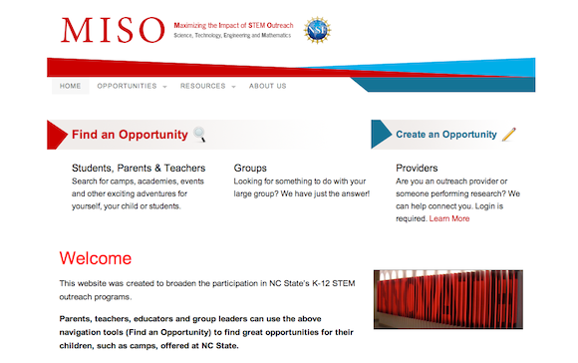
Web site has been launched to better serve the K12 community and the NC State STEM outreach community - http://miso.ncsu.edu
MISO Website
Easy-to-use search engine to find K12 STEM outreach opportunities for teachers, students and educators, such as camps, academies, workshops, group activities and departmental tours
This website is a collaboration between the North Carolina Cooperative Extension and funded by the Extension Seed Grant, Connecting Students to 21st Century Careers, from the Office of Extension, Engagement and Economic Development, and MISO.
Notes:
I put this with the pilot project partners, because I figured that recruiting them relates to our overall goal of “developing an innovative network of communications” between STEM outreach projects. It seemed to fit better here than at the end, and I do think it is an important component of connecting programs on campus.

Slide 10
Major MISO Activities
Define project activities and outcomes
and
Identify commonalities

Slide 11
MISO Logic Model Use
Held a workshop for project partners to:
Describe their program/project’s purpose, strategies, and goals in clear and concise language.
Create a logic model which explains how their project/program operates.
Learn about various STEM Outreach projects across NCSU.
MISO uses the project partner logic models to identify commonalities across projects
Notes:
Took out 2 slides – this audience knows what logic models are ☺

Slide 12
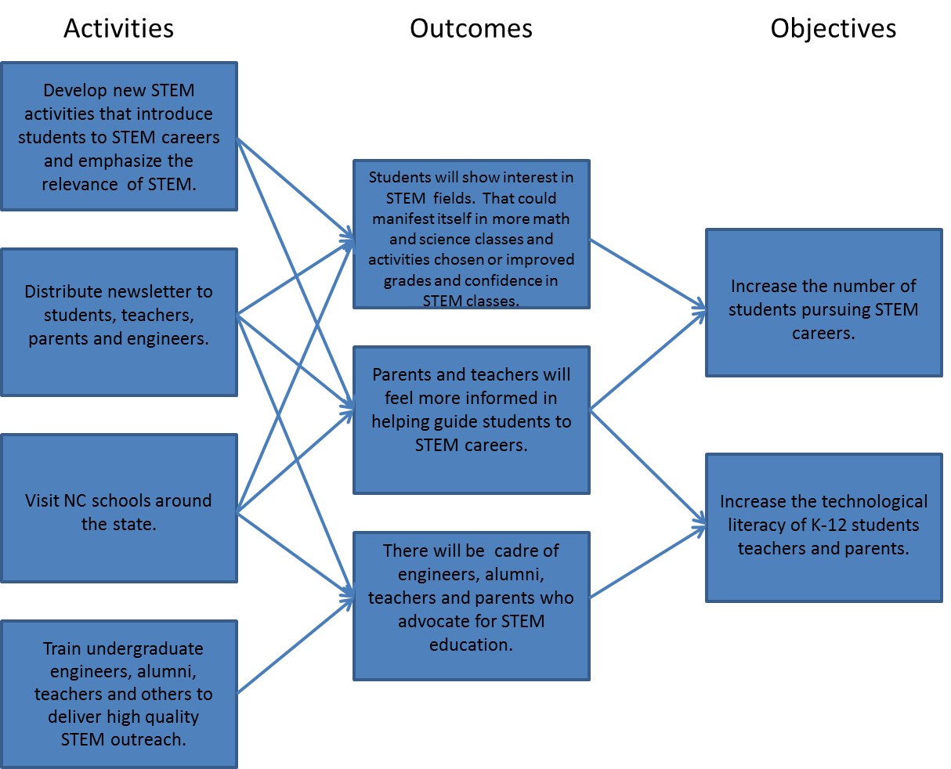
Sample Logic Model: Engineering on the Road

Slide 13
Major MISO Activities
Identify/develop surveys and outcome indicators and collect survey data across projects

Slide 14
Using Survey Data
Our goal is to help MISO Partners use data to continuously monitor and make effective decisions to improve their programs for the benefit of their stakeholders.

Slide 15
MISO Data Analytics Flow Chart
Objectives
Variables of Interest
Data Sources
Goal
Students: How do students feel about learning STEM content and future career paths?
Teachers: How confident are teachers about teaching STEM related content?
Surveys developed by MISO Project Team for use by MISO Project Partners to measure student STEM Attitudes, Interest in STEM Careers, and 21st Century Learning Skills; and teacher confidence and efficacy in teaching STEM.
(NC State K12 STEM Outreach Programs)
1. MISO Common STEM Survey Tools for Outreach Participants (teachers & students)
To determine the extent to which STEM outreach programs impact long-term educational outcomes
Students: How has student academic achievement changed over time?
Teachers: To what extent do teachers attain professional growth and remain in-field?
Existing NC education database that includes teachers’ education/licensure, experience, turnover; and students’ academic progress, attendance, course taking, growth and proficiency by academic subject, grade promotion and retention, transfer, dropout , and graduation status.
(All NC K-12 Public School Teachers and Students)
2. NC Educational Research Data Center (NCERDC) at Duke University
Students: Did MISO Project Partner Participants that entered NCSU pursue a STEM-related degree?
All information related to student applications and enrollments for the University, such as high school course grades/GPA, high school class rank, SAT scores, AP test scores, university enrollment, university matriculation, and university course grades/GPA.
(All NCSU Students)
3. NC State student database maintained by Enrollment Management and Services

Slide 16
Survey Development
MISO Survey development was guided by research and is derived in part from existing surveys
Pilot surveys may be completed via a web-based survey tool: http://fi.ncsu.edu/project/maximizing-the-impact-of-stem-outreach-through-data-driven-decision-making-miso/MISOSurveys
Pilot phase of MISO surveys is in process:
To establish validity and reliability of the survey instruments
To eliminate or rework specific survey items
Notes:
Presentation notes:
Alana conducted a literature review of STEM efficacy, attitudes, beliefs scales
Prefer electronic completion, but paper copies may be requested from the Project Coordinator

Slide 17
Survey Development
Teacher Surveys measure teacher confidence and efficacy in teaching STEM related content
STEBI-Science Teaching Efficacy Belief Instrument (Enochs & Riggs, 1990)
MTEBI-Math Teaching Efficacy Belief Instrument (Enochs, Smith, & Huinker, 2000) → added engineering, technology, elementary
Also developing an Administrator Survey
Notes:
Presentation notes:
Teacher-STEBI-Science Teaching Efficacy Belief Instrument (Enochs & Riggs, 1990); 2 other versions- "Revisiting the STEBI-B: Measuring Self-Efficacy in Preservice Elementary Teachers" by Bleicher
"Establishing Factorial Validity of the Mathematics Teaching Efficacy Beliefs Instrument (MTEBI)” Enochs

Slide 18
Survey Development
Student Survey measures STEM Attitudes, Interest in STEM Careers, and 21st Century Learning Skills
STEM Attitudes and basis for Career Exploration: adapted from an Evaluation of Women in Engineering (Erkut & Marx, 2005)
Careers : adapted from the Occupational Outlook Handbook from the Bureau of Labor Statistics, http://www.bls.gov/oco/
21st century Learning: adapted from NC Student Learning Conditions survey developed at the FI
Also developing an elementary student survey
Notes:
Note: our survey report document does not display the careers section, so we have no example of this to show to people.
Stem Attitudes/Career Question Format- 4 Schools for WIE. Evaluation Report" Ekrut and Marx
Careers were adapted from the Occupational Outlook Handbook from the Bureau of Labor Statistics, found here: http://www.bls.gov/oco/. List of careers shortened to 10, which will be used when the pilot period is over.
Students-21st Century Learning Construct-Student Learning Conditions Original Reliability 0.83

Slide 19
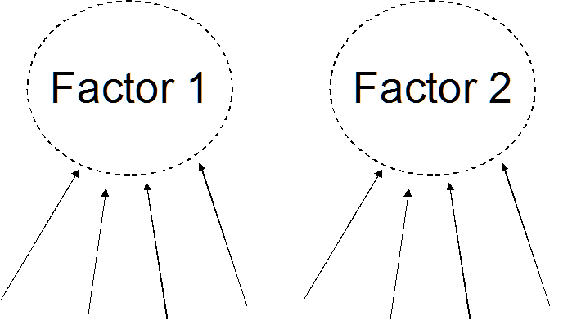
Survey Analysis
Conduct Statistical Analyses
Exploratory Factor Analysis
Confirmatory Factor Analysis
Teacher
Original Survey-STEBI with 23 Items loaded to factors (subscales)- 1) Personal Science Teaching Efficacy Belief Scale and 2) Science Teaching Outcome Scale
Once the pilot survey window is closed, analyses will be done to assess the validity and reliability of our surveys to see if factors hold stable for each survey

Slide 20
Monitoring Outreach Program Effectiveness
Potential problem: students taking the survey are already involved in STEM in some way since they are participating in a STEM outreach program. How can we see if the outreach programs enhance general STEM interest?
Many project partners will give both a pre- and post- program survey to monitor change in participant attitudes
Through another project at the Friday Institute, our surveys will also be used with a more general population of students and teachers that are not involved in these outreach programs
Still provides formative data about program implementation
Notes:
Jeni- I added this slide to account for some of the questions that came up in the workshop about what information our surveys actually give us.

Slide 21
Major MISO Activities
Identify student and teacher participants and pull individual student and teacher data

Slide 22
North Carolina Education Research Data Center
Established in 2000 through a partnership with NCDPI
Data Sources:
NCDPI, NCES, US Census, US DOE
Data from the mid-1990s forward
Longitudinal dataset with the ability to track students and teachers over time
E.g. - a teacher’s qualifications can be linked to school characteristics, and student academic performance can associated with district attributes

Slide 23
NCERDC Sample Variables
Students: test scores, free or reduced lunch eligibility, exceptionality status, dropout status, and incidents requiring disciplinary action
Teachers: Degree obtained, salary, work history, attendance, licensure, teaching in field status
Schools: school demographic composition, average test scores (End of Course, End of Grade, and SAT), dropout rates, and state recognition status under the ABCs accountability model.
School Districts: district composition, incidents of violence, district finances (revenues and expenditures), and average test scores.

Slide 24
Data Flow
Outreach Program
K-12 School
or District
NC Dept of
Public Instruction
NCSU Data Analytics
Group
Duke NCERDC

Slide 25
Major MISO Activities
Share data reports with project teams

Slide 26
Data for Project Partners
Data pull for all students from MISO partners
Need full name, DOB, NC WISE number or teacher ID number
Sample must be ≥ 20 so that individual students can not be identified within a given project
If < 20, a project partner will only receive data aggregated across all projects

Slide 27
MISO Next Steps
Return survey data to the project partners
Work with the NCSU Enrollment Data to see if students that participated in NCSU STEM outreach programs enrolled at NCSU and pursued STEM degrees
Track teachers and students longitudinally
Continue to build STEM Outreach Community at NC State as a model to expand to other UNC campuses

