Slide 1
Turning Communication into Collaboration: The Development of an Outcomes-Based Management Training Program
Stanley Capela│VP Quality Management & Corporate Compliance Officer │ HeartShare Human Services of New York

Slide 2
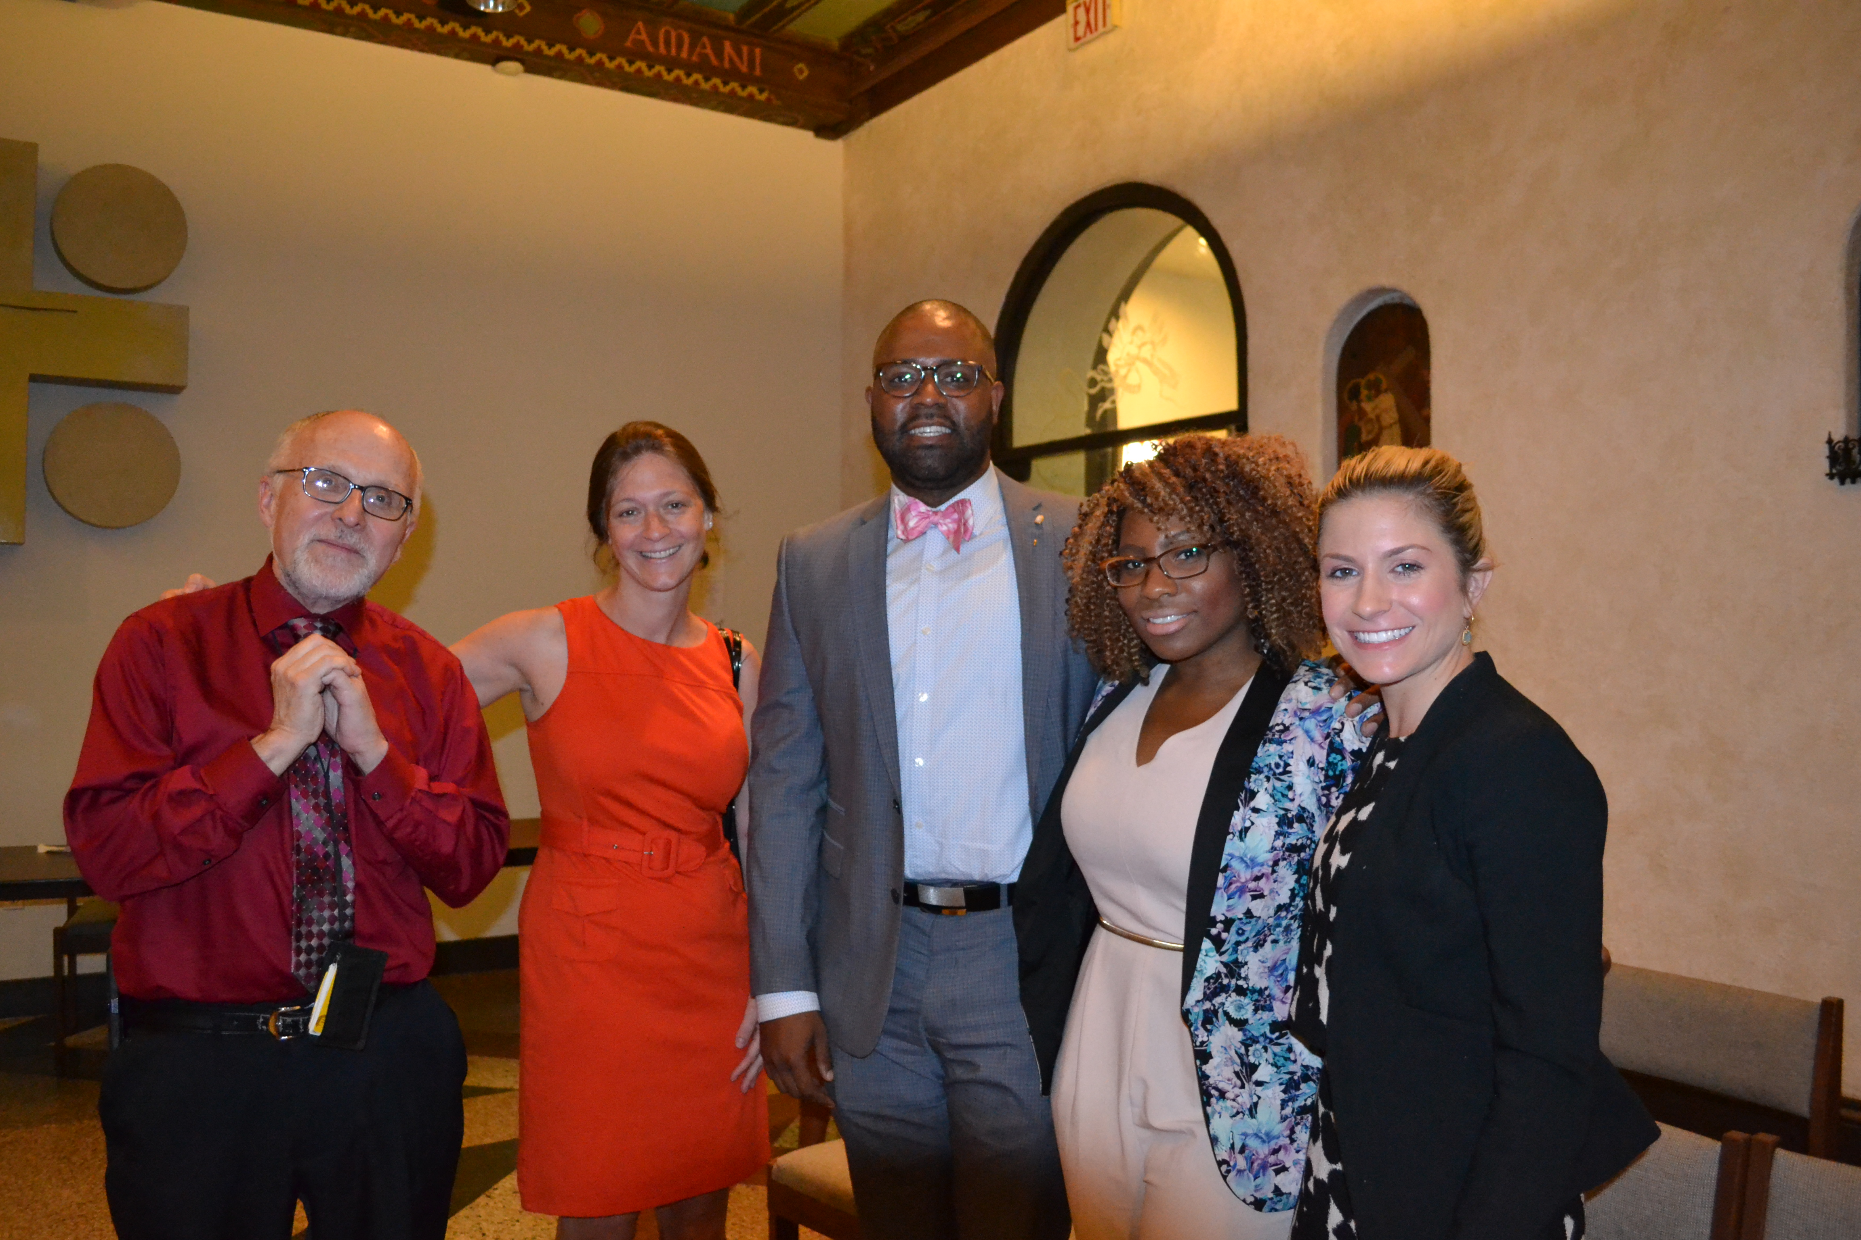
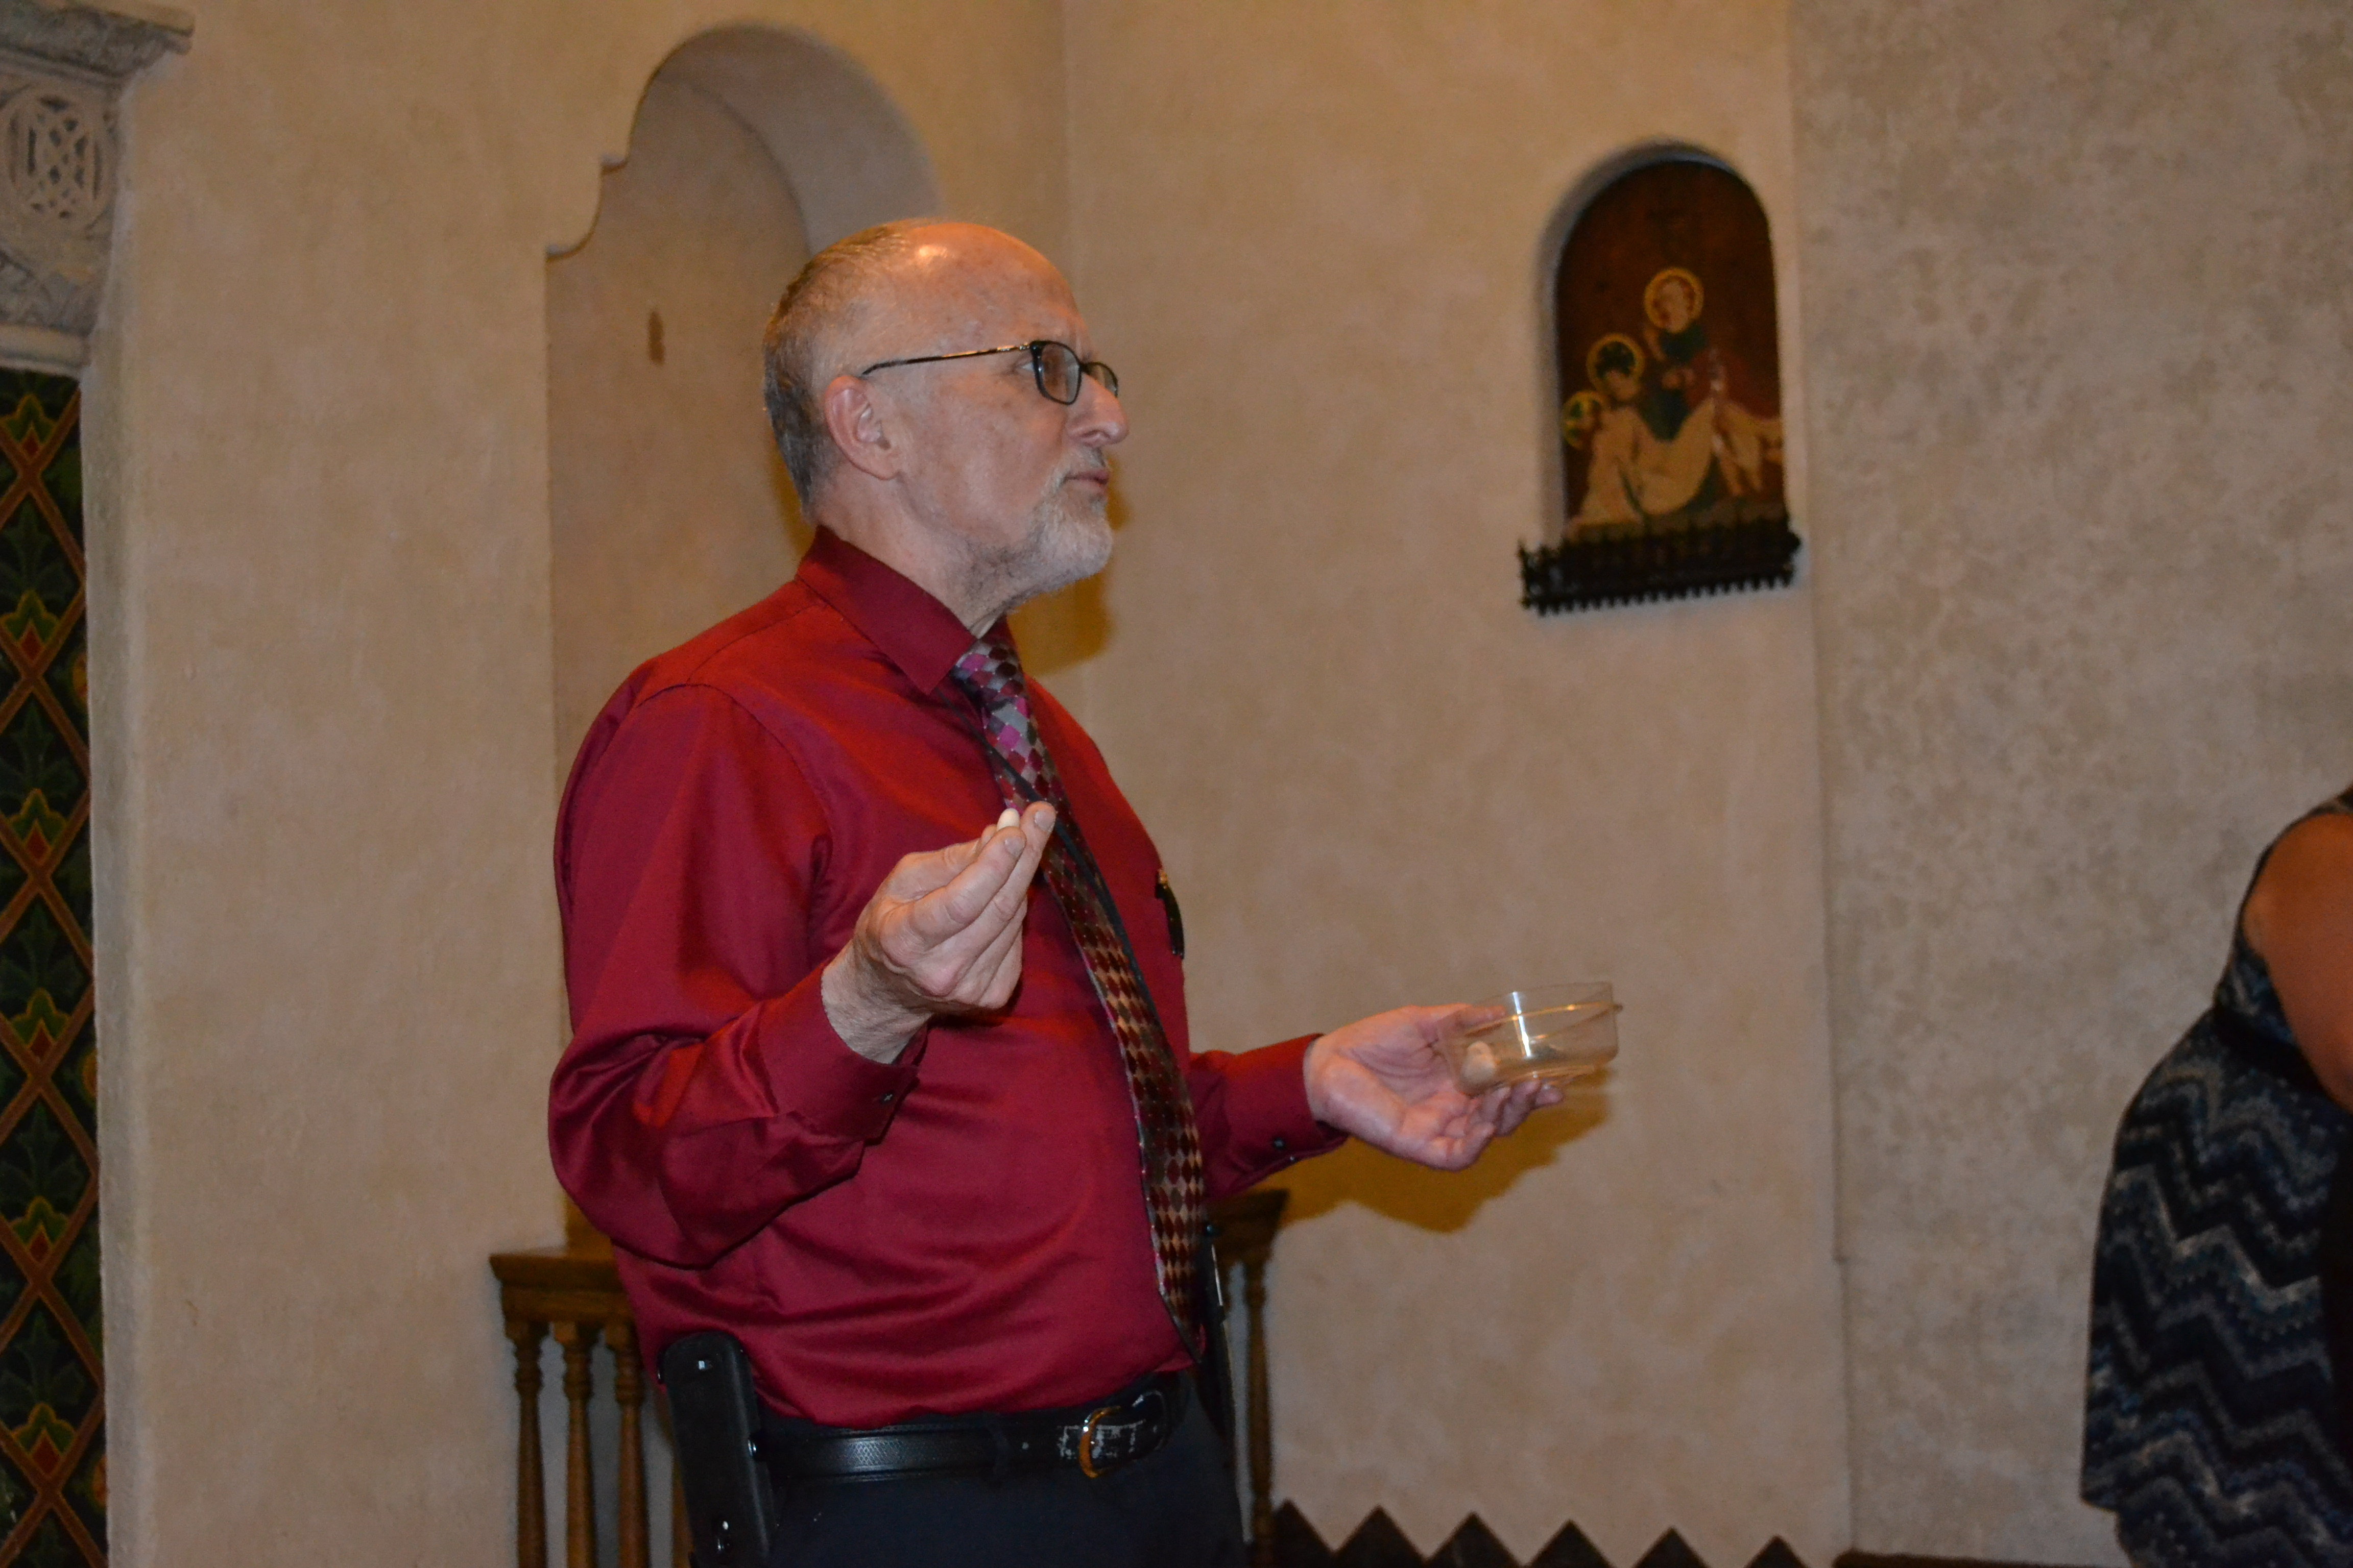
Agenda
Introduction of MTP
Outcomes and Results
Q&A

Slide 3
Why MTP?
In 2011, the HeartShare Forum identified two major needs:
(1) Improve staff morale
(2) Enhance front-line supervisors’ management skills.
These needs were reflected in the responses to our annual Job Satisfaction Survey.
Therefore, the Management Training Program was developed for emerging leaders in the field to strengthen their supervisory, communication, and leadership skills.

Slide 4
MTP is ….
An 18-Month Comprehensive, Competency-Based Management Training Program
For Emerging Leaders in the Field
Winner of the 2012 COA Innovative Practices Award
Long-Term Goal: Improve Staff Satisfaction and Retention Rates

Slide 5
MTP includes …
3 Tracks of Interactive Workshops:
(1) Supervision and Management Skills
(2) Communication Skills
(3) Leadership Skills
A mentor for each participant
Support from our MTP Committee
A final project

Slide 6
Outcomes and Results
MTP is assessed in multiple ways:
Participants evaluate each workshop and rate their overall experience with the program.
Pre and Post tests are conducted for each workshop to measure how well the participants have learned the material.
Participants conduct peer evaluations of each other.
Final projects are evaluated by MTP Committee members and the senior management team.
91 participants have successfully graduated from the program since its inception.
We just started Cohort 6!

Slide 7
This is a sample of the Cohort 5 workshop evaluation results.
Participants were asked to rate their experience after each workshop, on a scale of 1-5.
The overall rating was 4.6!
We also received several helpful suggestions that will be implemented in upcoming workshops.

Slide 8
This table reflects the difference in score between the Pre and Post test for each workshop.
The % of Improvement helps us monitor how well each participant is learning and how well each workshop is being delivered.

Slide 9
This chart is extracted from the final MTP evaluation analysis. It captures participants’ ratings of their general experience and satisfaction with the 18-month program.
Overall, participants’ responses were very positive! All respondents were either “Very Satisfied” or “Satisfied” with their experience.

Slide 10
Very satisfied= 5, Satisfied=4, Neutral=3, Dissatisfied=2, Very dissatisfied=1. Average=3
This is a sample of the Strongest Areas identified in our 2014 to 2016 Job Satisfaction Survey results.
On a scale of 1-5, supervision-related areas consistently scored over 4.

Slide 11
These 2 charts capture the Pre and Post LPI results for Cohort V participants. On a scale of 1-10, all participants’ LPI scores improved over the 18-month track.

Slide 12
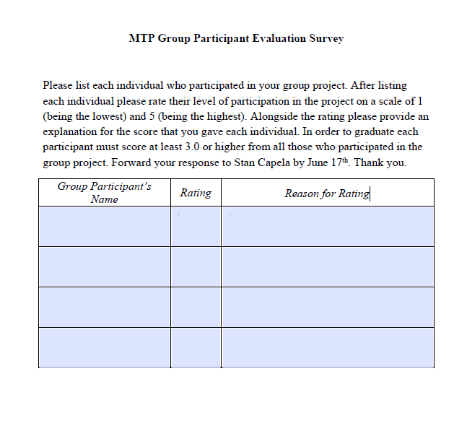
This is the Peer Review Sheet we provide to each MTP participants at the end of the group project.
On a scale of 1-5, each person is rated by his/her group members. If a member is scored lower than 3, he/she cannot graduate from the program.
On average, Cohort 5 participants achieved 4.3 for the peer review.

Slide 13
Thank you!
Any questions?

