Slide 1
Using Case Study Methodology Embedded in a Systems-based Framework
Catherine Freeman, MPA
Barbara Heath, Ph.D.
East Main Evaluation & Consulting, LLC

Slide 2
The iPlant Collaborative
Create a cyberinfrastructure (CI) for life science that will enable new conceptual advances through integrative, computational thinking
Community Driven
Virtual
Multi-institutional
Multidisciplinary
Multiple Sites and Partners
National, International
Cyberinfrastructure-centered
Notes:
The iPlant Collaborative is a NSF funded project that completed its first five years and was renewed for an additional five years in September 2013. Wew are currently beginning year 2 of the second 5 year round of funding

Slide 3
A new type of organization…
design, develop, deploy and maintain a national cyberinfrastructure to enable basic and applied biological research
train the next generation of scientists in its use
iPlant will achieve this by:
democratizing access to world-class compute resources,
encouraging innovation through collaboration and federation,
and fostering growth of the scientific community's computational abilities.
Notes:
Vision
The iPlant Collaborative enables life science researchers and educators to use and extend iPlant's foundational cyberinfrastructure to understand and ultimately predict the complexity of biological systems and their dynamic nature under various environmental conditions, thus stimulating the transformation of how the life sciences community does research.
Mission
The iPlant Collaborative will design, develop, deploy and maintain a national cyberinfrastructure to enable basic and applied biological research and to train the next generation of scientists in its use. iPlant will achieve this by democratizing access to world-class compute resources, encouraging innovation through collaboration and federation, and fostering growth of the scientific community's computational abilities.

Slide 4
Evaluation Questions
1. What results when analyzing iPlant as a complex human system?
2. What are the implementation activities executed by the project?
3. What is the impact of the activities on the community of users?
4. What sustainability models are viable solutions?
EMEC, LLC (2014)

Slide 5
The SHP Framework
Systems
Patterns of Action
Highlights
EMEC, LLC (2014)
Notes:
The SHP framework consists of three parts, a systems analysis, a highlights table, and patterns of action identification

Slide 6
Systems (S): CDE Model
The iPlant Collaborative as a Complex Adaptive System (CAS):
A system that exhibits certain types of behavior that arise from the interactions and patterns within the system (Mahon, McConney, & Roy, 2008).
Application of the CDE* Model:
1. Disaggregate project into units
CONTAINERS (C) are the units analyzed as a set, clustered on based function
2. Identify links to form iPlant System
DIFFERENCES (D) are what drives the actions of that group
3. Identify interactions between containers
EXCHANGES (E) are these interactions
Container 1
Container 2
*Eoyang, G.H. (2007)
Notes:
For the systems analysis, we selected the CDE Model from the many systems concepts that are available. The CDE model is best aligned to the context of the iPlant Collaborative.
We selected individual staff or small groups as our unit of analysis and built our initial containers based on roles, responsibilities, and function within the project, thereby, focusing our systems analysis on organizational properties of the project. Once containers were defined, we determined the differences and exchanges.
We selected to present the system as a diagram that represented the system at a specific time point.

Slide 7
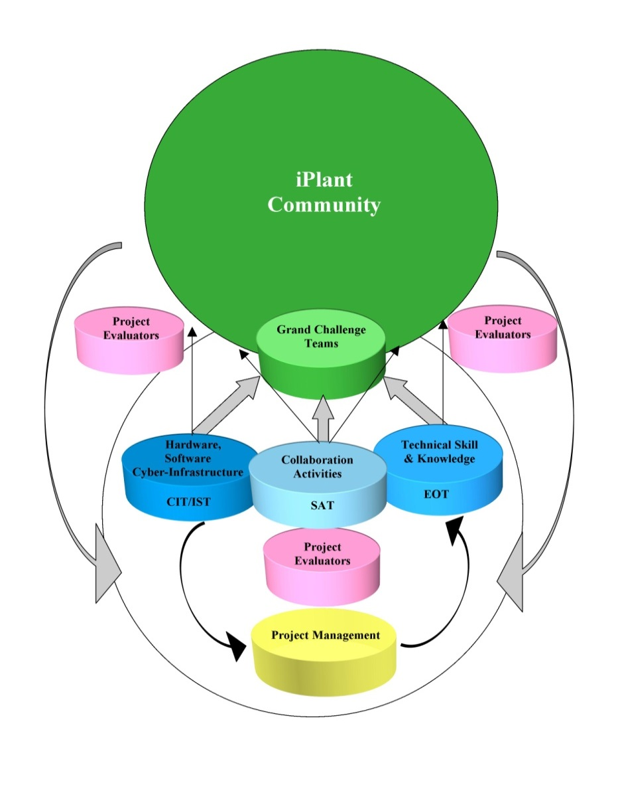
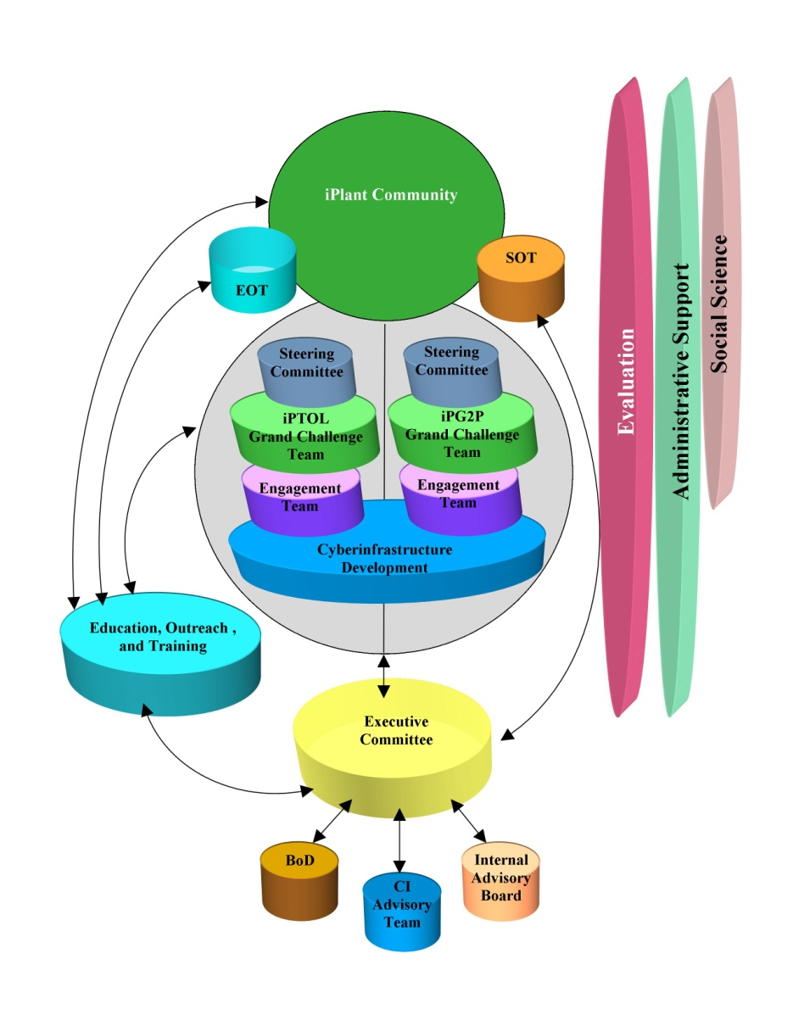
Systems (S)
January 2009
April 2009
Notes:
An early system diagram for the project. The discs are the containers and the arrows show the exchanges. It is difficult to show the differences visually, so each diagram was presented with associated narrative that described the details of the C, D, and E of the system at that time point.
As time moved forward, we decided to create diagrams on a quarterly basis. This provided an opportunity to compare diagrams, discuss the changes to the system by quarter, and identify longitudinal patterns.

Slide 8
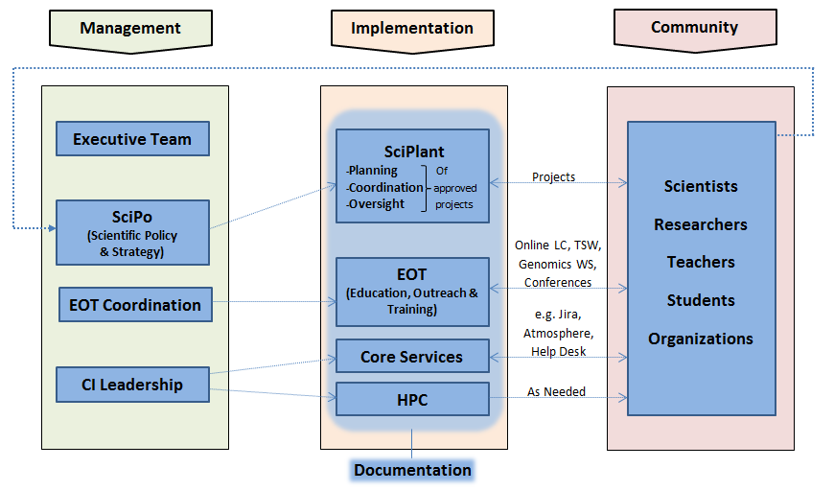
Systems (S)
January 2013
Notes:
As the project matured into year 4 and 5 of initial funding, the three tiers persisted and “self-organizing” behavior was recognized and depicted in one of our most recent diagrams. If you compare the earlier diagrams to this diagram, it is clear that the project became more organized (fewer containers), communication was more efficient (exchange arrows are fewer and more direct), and driving forces within containers (differences) were more aligned with project intentions.

Slide 9
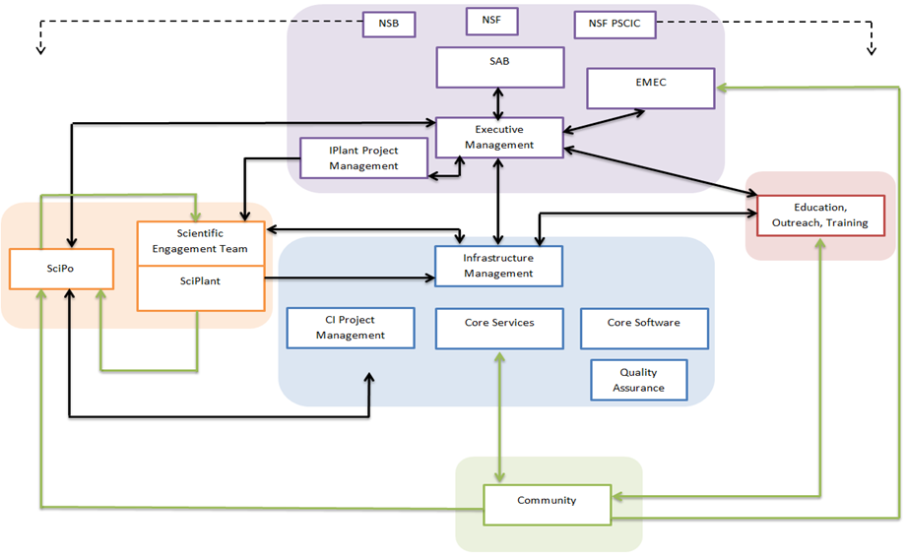
Systems (S)
June 2014
Notes:
One additional note, the system diagrams are helpful to those in the project as they show the project as an entire system. Many times, staff are focused on their part of the project and do not have time or the information to consider how their role/team fits within the larger context. This responsibility is usually allocated to the PI. However, the system diagrams are a quick way for project staff to “see” the project and think about how their position or team fits within the system. They can think about: Is this how it should be? Should things be changed? Is this representation consistent with my understanding? Etc.
At the same time we were conducting the systems analysis, we also were developing a highlights and emergent ideas table.

Slide 10
Highlights (H)
Continue applying systems methods to iPlant
Generate a significant amount of data and related analysis
Present a list of highlights for each quarter of project implementation
Identify highlights as deliberate events and emergent ideas
Notes:
To give a quick overview of where the “H” came from….
-During this time while applying systems methods to the project, we were generating a great deal of data and related analysis.
-As we were collecting data from all of those mentioned places like the wiki, meeting notes, staff interviews, and formal reports the project was moving at such a rapid pace we needed a way to organize the information to better understand and track.
-One particularly helpful practice was to present a list of highlights for each quarter of project implementation
-So this is how the “H” or “Highlights” developed.
-The items are described as deliberate event/activities and emergent ideas
-This tracking longitudinally provided us with a broad view of the progress and shifting focus of the project

Slide 11
Highlights (H)
Q:Y | Deliberate Events/Activities | Emergent Ideas
Q1:09 | GCT Selected BOD Meeting to review GCPs Recommendations for GC engagement Leaflet launched
Q2:09 | NSF Retreat Management structure reorganization: SOT, FAT, CA Advisory Genomics in Education Workshop iPToL kickoff meeting – 6 groups formed | Shift from consensus-based management to team-based management Engagement Team and Steering Committee concepts Compensation avenues for GCTs DNA Subway discussion initiated
Q3:09 | iPG2P kickoff meeting-5 groups formed CI Team meeting at TACC New Board Members inducted Board Chair change EOT Advisory Meeting in Chicago Website redesign | Stanzione to TACC – leverage human and computing capital at TACC Shift from management focus to implementation focus Tech talks begin
Q4:09 | SOT kickoff meeting iPlant/NESCent joint meeting VA Mutual Understanding Meeting | PI resigns My-Plant Workflows integrating data constructed via web-based services 1KP Consortium Atmosphere discussion initiated
EMEC, LLC (2014)
Notes:
Now to describe how to actually do the Highlights piece of the Framework I will show you how we did it for iPlant:
Here, an excerpt of our highlights table is shown from one of the earlier years of the project. It is organized appropriately by our selected time increments. Now this might be different for other projects: But we selected quarter and year to track the major events and activities longitudinally
The events and activities are labeled as deliberate or emergent
-For example: The project deliberately schedule an EOT Advisory team meeting in Chicago in Q3 - from this meeting the idea of tech talks emerged.
-These Tech Talks eventually became a regular part of project activity and are still taking place today with the most recent series of Tech Talks beginning again this month.
4. Now, the way that these items are selected as highlights is through a team decision – our evaluation team together selects items that are most relevant and significant together
5. This relevance and significance is based on how that event/activity impacts the entire system that was defined in the systems analysis that Dr. Heath just described for you
6. This process is time intensive and requires that project staff to be constantly going back and checking events while following their lifespan such as their success, failure, growth, change patterns, and so forth
-During this process events may be added or removed for each quarter and year
-In order to do this part of the framework successfully, there must be an active participant evaluation occurring simultaneously while applying systems methods and concepts to the project
7. BUT-- the work doesn’t stop here:
-We also look at this information for any patterns and also for feedback we can provide to the client
-From these highlights tables we are able to recognize different patterns

Slide 12
Highlights (H)
Q:Y | Deliberate Events/Activities
 | Community | Implementation | Management
Q1:09 | Leaflet launched | GCT Selected | BOD Meeting to review GCPs Recommendations for GC engagement
Q2:09 | Genomics in Education Workshop | iPToL kickoff meeting – 6 groups formed | NSF Retreat Management structure reorganization: SOT, FAT, CA Advisory iPToL kickoff meeting – 6 groups formed
Q3:09 | Website redesign | iPG2P kickoff meeting – 5 groups formed | iPG2P kickoff meeting – 5 groups formed CI Team meeting at TACC New Board Members inducted Board Chair change EOT Advisory Meeting in Chicago
Q4:09 | iPlant/NESCent joint meeting VA Mutual Understanding Meeting |  | SOT kickoff meeting
EMEC, LLC (2014)
Notes:
-Now in order to further illustrate how we did this for iPlant we used the same excerpt from the previous slide
But now you can see how the highlights table allows for the evaluation team to recognized hidden themes and patterns within project activities that may have otherwise been missed
1. First notice it is still organized appropriately by the selected time increments (Q, Y) to stay with tracking over time
2. But in this excerpt we show you an example of one of the recognized patterns
3. We realized that different pieces of the project were responsible for different highlights that were showing up in our data collection
-This could have been any group within the project such as the PIs or the EOT team
-When we began identifying the group responsible we realized that each group fell into one of the three tiers identified in the CDE model that Dr. Heath just described for you– including Management, Implementation, and Community
-Now, keep in mind more than one group is often involved in different activities and events - but we selected the primary one responsible
4. As you can see on this slide we have organized by color the different highlights into their category
Purple: Community
Blue: Implementation
Red: Management
-As mentioned before, this process is still time intensive and still requires also requires to constantly be reviewing the events and going back through the history of the project
-And now this information can then be looked at over time throughout the project….

Slide 13
Notes:
So here the information from the highlights table is put into a graph by Community (Community), Implementation (Blue) and Management (Red)
To point out some major points that we were able visualize here:
-As you can see there is a spike in management activity at the beginning of the project in 2009 as groups were forming and the project was becoming organized
- Then there is another spike in management activity in 2013 because the project was invited for a non competitive renewal at the time
-Implementation and community were lower at the beginning when tools and applications had not been fully developed
-Once the project was moving along tools and applications were developing at a very rapid pace and more collaborations were forming – So as a result the implementation and community activities jumped significantly
It is easy to visualize and identify project phase changes over time this way
As seen through this graph, patterns of activity in each tier align with specific project events
Now these examples are very general pattern recognitions but from this information the evaluation team is then able to further break it down to see the project through different lenses
-So to show an example how we did this for iPlant I will take the community tier and further break it down to show you…

Slide 14
Notes:
1. So here taking the Community Tier from the previous table - we can further break it down to visualize its own patterns
2. You can see we have split Community by E, O, & T as defined by the project - Education, Outreach and Training
3. It is important to note that Community as E, O, & T is not only referring to activities carried out by the EOT group – as EOT is a project wide effort
4. So again the community patterns align with specific project activities
-this occurs certain tools and services were developed and the project hit certain milestones and major points
-For example, in the early years of the project before there were tools and services developed, the project worked to spread awareness of iPlant
-Then you see training frequency increases at the end of 2010 and beginning 2011
-this is when the tools and services were being rapidly developed and the project was becoming more established
- It is also noticed there was very little happening in classroom education while most efforts were focused on training and outreach
-but then in 2013 there is a small uptick in education – because as iPlant was more established and had reached a portion of their target population it was being adopted by users for education in a classroom setting
5. So over all, this whole process allows the evaluation team to recognize any disturbances to the project system as well as any further patterns
6. Additionally, as the project continues to develop …streams of behavior and consistencies or inconsistencies with goals can be recognized

Slide 15
The SHP Framework
Systems
Patterns of Action
Highlights
EMEC, LLC (2014)
Notes:
1. So the Highlights table information is provided to the client to use as they want
2. It can often help them recognize strengths and weaknesses, and gain ideas for improvement
3. And also to better understand the characteristics of the organization, in turn leading to more informed decision-making, particularly if they would like to enact change.
The systems analysis and highlights table generated patterns that provided useful information that was used to inform the client and funding agency of project progress within the three tiers of Management, Implementation, and Community. But, we wanted to glean even more from the data that we had collected and analyzed.

Slide 16
Patterns of Action (P)
Patterns
Examine actions over time
Provide a visual representation
Theme selection
Understand project goals
Examine value to client
EMEC, LLC (2014)
Notes:
Using the work of Mintzberg (2007), we chose to consider patterns of action. If we examined actions over time, what would we find and how could we achieve this visually? We decided to select a few key themes on which to focus our analysis. Themes could be generated from project goals or from topics that are valuable to the client. For example, what patterns of action are evident if we looked only at the Management of the project?
Phases of Management
Science Portfolio Management
Community Collaboration
EOT Development

Slide 17
Patterns of Action (P)
EMEC, LLC (2014)
Notes:
When creating the patterns of action diagrams, we outline the activities on a timeline– then look for patterns of action within the selected theme. In this case, we noticed the difference in the type of management, thus labeling the diagram in two phases: direct supervision and executive management.

Slide 18
Patterns of Action (P)
EMEC, LLC (2014)
Notes:
In the next example, the focus/theme is the development of the scientific portfolio. In this case, the pattern of action centered on the type of team organization. Initially, there was a team-based effort, followed by a period of high growth and chaos that was rectified through a reorganization step resulting in a project-based model.

Slide 19
Patterns of Action (P)
Chaos
EMEC, LLC (2014)
Notes:
We can compare themed-based patterns of action to investigate even larger patterns or correlations between themes. In this example, the reorganization within the scientific portfolio development aligns with the creation and implementation of SciPlant in the Management diagram. One may also, notice that the resignation of the original PI appears a precursor to the Chaos phase of the SPD diagram. However, this is not the correct cause and effect relationship. You must know your data and be able to find evidence to support any patterns or patterns of action.

Slide 20
The SHP Framework
Systems
Patterns of Action
Highlights
EMEC, LLC (2014)
Notes:
Captures the dynamic nature of the system
For the Evaluator:
Identify and understand emergent themes
Adjust data collection and focus
Frame appropriate recommendations
For the Client:
Helps visualize history of behavior, actions, and decisions
Helps identify what worked and why
Encourages proactivity

Slide 21
What is missing?
What results when analyzing iPlant as a complex human system?
What are the implementation activities executed by the project?
What is the impact of the activities on the community of users?
What sustainability models are viable solutions?
EMEC, LLC (2014)
Notes:
Case study question

Slide 22
Case Study Selection
Originally allowed initial set of case studies to be suggested by the project
Selected three case studies, all were completed
But…need concrete metrics on IMPACT
Develop Impact Survey (IS) and utilize for case study selection
EMEC, LLC (2014)

Slide 23
Impact Survey (IS)
Two surveys developed:
Partners
Users
Goal to collect feedback from a target group on the effect of using iPlant resources with respect to being enabled, the resulting benefits and the associated impacts.
EMEC, LLC (2014)

Slide 24
Impact Survey (IS)
Partner Survey: Collaborators
Extended Collaborative Support
Powered by iPlant
Community Support projects
User Survey: Active Users
iPlant personnel provide use statistics for selected time period
From data, Evaluation team survey targets based on use patterns
Ex: Data Store number of files and size
EMEC, LLC (2014)

Slide 25
Impact Survey (IS)
3. Impact
2. Benefit
1. Enablement
EMEC, LLC (2014)
Notes:
Enabled: given the authority or means to do something (enabled by what?)
Benefited: which in turn benefitted you how? (perceived benefits)
Impacted: which in turn changed how you “do” you work in what way?

Slide 26
IS & Case Study Selection
Able to identify users who are most (or least) enabled, benefitted, and impacted
Select Case Studies supported by this data
After selecting Case Studies based on the IS, Case Studies are conducted using:
-Targeted Interviews
-SHP Framework
-Follow-up Interviews
-Document Review
EMEC, LLC (2014)

Slide 27
Case Study Use
Understand iPlant Community
What took place?
Track how Users move through the iPlant system
What was the impact (expected and unexpected)
Links between the project and case study participants
Evidence of “transformative” science and new discoveries
Status of data and workflow sharing, interdisciplinary collaboration
EMEC, LLC (2014)
Notes:
SHP for CLIENT use:
Step 1: Systems
Present organizational structure
Identify communication patterns
Show effectiveness of teams/individuals and duplication of efforts
Identify missing human resources
Identify strengths and weaknesses
Step 2: Highlights
Affirm progression toward the broad vision via the appropriate organizational entities
Understand the characteristics of the organization
Inform decision-making, particularly if they would like to enact change
Step 3: Patterns
Assist the client to think about strategy through a very specific lens, such as management or community development
Adjust strategy as necessary based on the current state of the project in comparison to the broad vision and mission
Consider possible cause and effect relationships

Slide 28
Evaluation Results
What results when analyzing iPlant as a complex human system?
What are the implementation activities executed by the project?
What is the impact of the activities on the community of users?
What sustainability models are viable solutions?
EMEC, LLC (2014)
Notes:
Between SHP Framework and Impact Survey - we are able to collect enough data and successfully evaluate a complex project such as the iPlant collaborative and by using the impact survey

Slide 29
References
Eoyang, G. H. (2007). Human systems dynamics: Complexity-based approach to a complex evaluation. In B. Williams, and I. Imam (Eds.) Systems concepts in evaluation: An expert anthology (pp. 123-140). Point Reyes, CA: EdgePress of Inverness.
Heath, B.P., & Lakshmanan, A. (2012, October). iPlant as Example: Promoting discussion of the relationship between systems and strategy evaluation. Roundtable presented at the American Evaluation Association Annual Conference. October 22 - 27, 2012. Minneapolis, MN.
Heath, B.P., Lakshmanan, A., Freeman, C.M. (2013). The Systems-Highlights-Patterns (SHP) Framework: A New Framework for the Evaluation of Complex Projects. Demonstration presented at the American Evaluation Association Annual Conference. October 14-19, 2013. Washington, D.C.
Mintzberg, H. (2007). Tracking strategies: Toward a general theory of strategy formation. New York, NY: Oxford University Press.
EMEC, LLC (2014)

Slide 30
Acknowledgements
The SHP Process
The iPlant Collaborative (NSF Award: DBI-1265383)
East Main Evaluation & Consulting, LLC
Barbara Heath, Ph.D.
Aruna Lakshmanan, Ph.D.
Courtney Humphreys
Contact Information
Catherine Freeman cfreeman@emeconline.com
www.emeconline.com
East Main Evaluation & Consulting, LLC
Wilmington, North Carolina

