Slide 1
21st Century Technologies & Evaluation: Deeper that the Façade.
Paul Lorton Jr & Moira Ann Gunn
School of Management
University of San Francisco

Slide 2
As was suggested in the 2nd Plenary
I’m just like you…
I’ve had a dog and now have a cat…
I’m married and have a job teaching young children…
I began evaluation by punching data onto cards…
so I can assure you…

Slide 3
There is nothing new under the sun
or, in other words, what goes around, comes around

Slide 4
We are at the Apex of Civilization
or at least the evolution of technology
We are here because we have bent energy to our will and reduced a continuous reality to numbers

Slide 5
The 19th Century Harbingers
George Boole
A mathematical/symbolic description of the human mind
Charles Babbage
The power of the age (stream) harnesed to control human error
Ada, Lady Lovelace
Punched cards to weave algebraic formulae

Slide 6
20th Century Changing the Game
from playing at machine computing to perfecting it
from theory to practice with a vengeance
from imagining to predicting

Slide 7
20th Century Technologists
Turing (Can machines think?)
Von Neuman (Eckert & Mauchly)
Noyce (& Kilby – integrated circuits)
Moore (the law or challenge)
Alan Kay (Dynabook)

Slide 8
Moore’s Law
The complexity for minimum component costs has increased at a rate of roughly a factor of two per year... Certainly over the short term this rate can be expected to continue, if not to increase. Over the longer term, the rate of increase is a bit more uncertain, although there is no reason to believe it will not remain nearly constant for at least 10 years. That means by 1975, the number of components per integrated circuit for minimum cost will be 65,000. I believe that such a large circuit can be built on a single wafer.
Moore, Gordon E. (1965) Cramming more components onto integrated circuits. Electronics, 38, #8, April 19, 1965

Slide 9
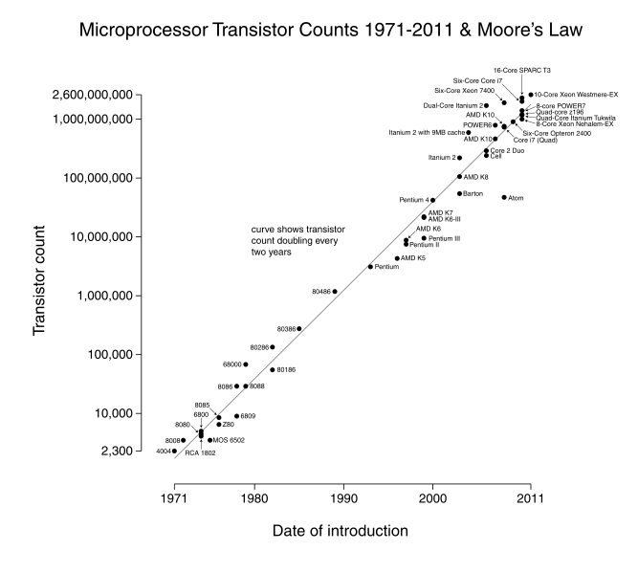
Intel’s progress & Moore’s Law

Slide 10
Noyce and Kilby & the IC
In 1958, a single transistor cost about $10. Today [2000], you can buy a chip with over 100 million transistors for about that price. Costs are almost certain to continue declining in the future. This decrease in cost of 100 million to one has greatly expanded the field of electronics.
Today, powerful personal computers sell for less than $1,000. And these are far more capable than the $10 million versions of the 1960s.
Kilby, Jack S. – “Nobel Lecture: Turning Potential into Reality: The Invention of the Integrated Circuit". Nobelprize.org. Nobel Media AB 2013. Pp 483-484 <http://www.nobelprize.org/nobel_prizes/physics/laureates/2000/kilby-lecture.html>

Slide 11
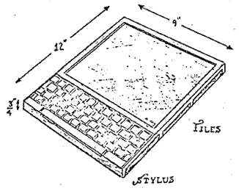
Alan Kay’s Dynabook

Slide 12
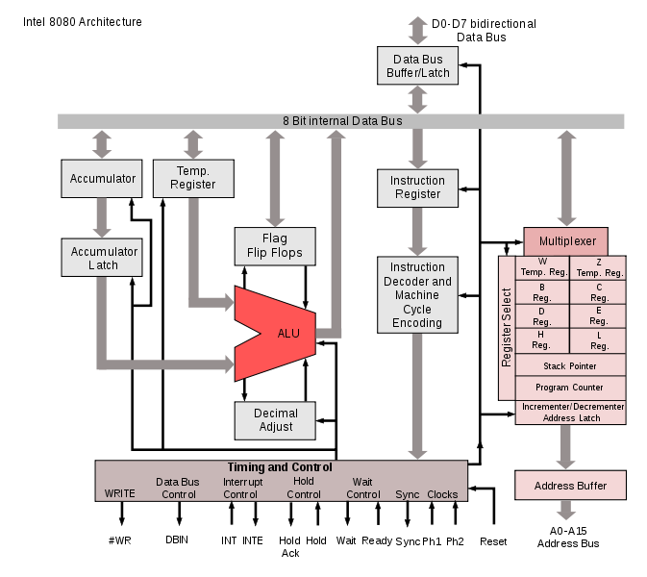
Intel 8080 architecture – 4,500 transistors

Slide 13
Now to the 21st Century where dreams come true
Moore’s inexorable law
Turing’s prediction of a Thinking Machine
A Trekie’s imagined and dreamed of world, a reality

Slide 14
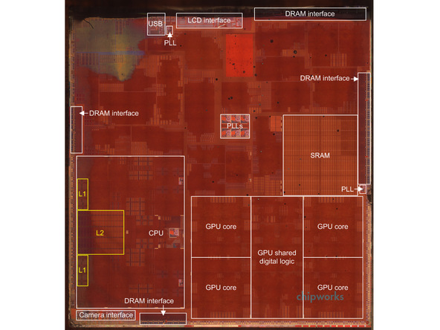
Apple A7 1billion + transistors

Slide 15
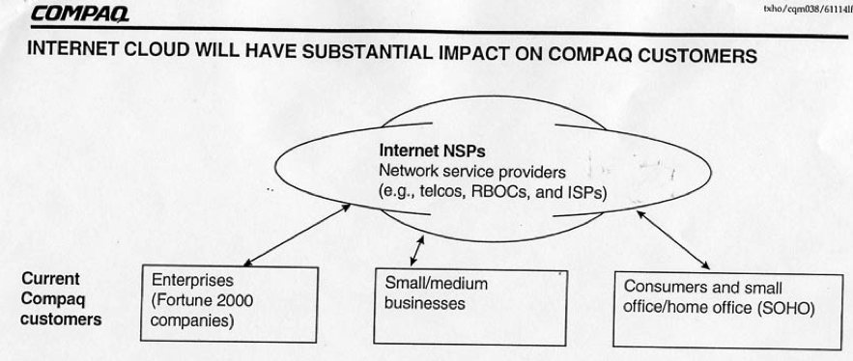
The Cloud

Slide 16
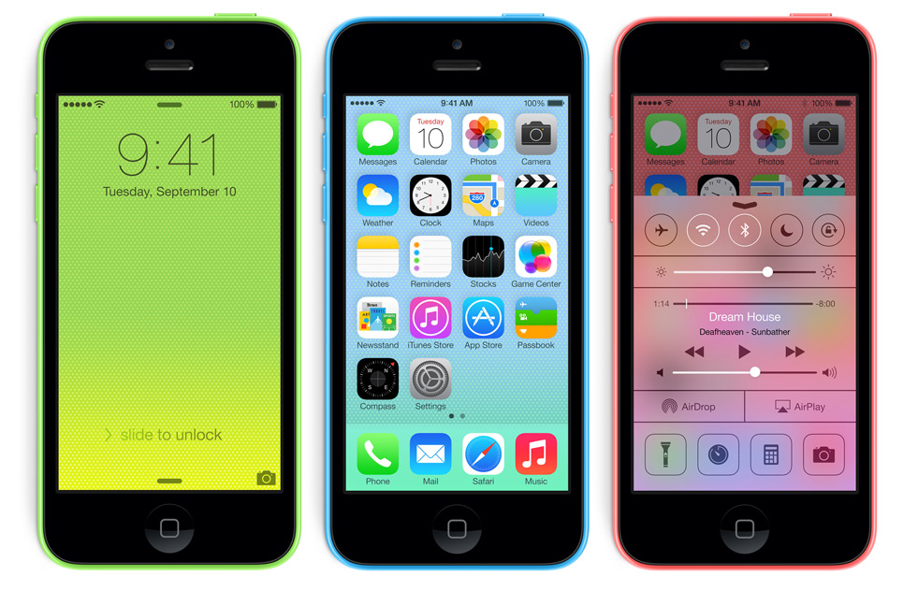
Smart Phone

Slide 17
What makes a smart phone smart?
All those things it does that don’t involve being a phone.
The fact that it does them on a platfom and in an infrastructure that is watching and listening all the time is a bonus?

Slide 18
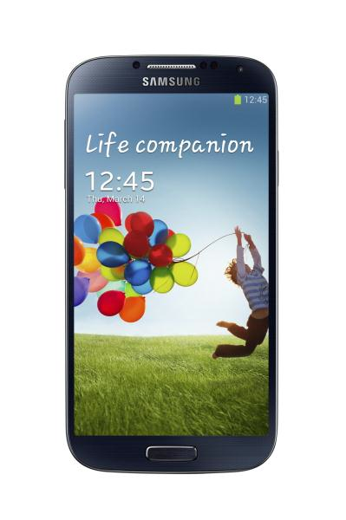
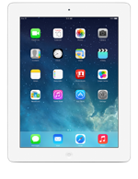
Tablet

Slide 19
Why did the iPad succeed?
Some Apple fans will disagree, arguing that iPad's size, design and user experience make it far superior to other tablets. I won't debate those points here but only observe they would be meaningless without the supporting ecosystem created by iPod and iPhone. Apple didn't launch iPad into a vacuum but with lush sales and distribution environment.
Wilcox, Joe betanews Jan 25, 2011

Slide 20
usability, usability, usability
Of course tablets are not new but there are three reasons why I think Apple will succeed this time and they all link to usability. Not the ‘usability is just making it easy’ type of usability but the ISO 9241-11 version, where usability is defined as: effectiveness, efficiency and user satisfaction.
Stewart, Tomeconsultancy.com Jan 29,2010
http://econsultancy.com/us/blog/5323-usability-usability-usability-why-the-ipad-will-succeed

Slide 21
Culminating in BYOD
At evey level, people want to use, as their information resource, the device with which they are most comfortable – the device they chose, use every where, and trust.

Slide 22
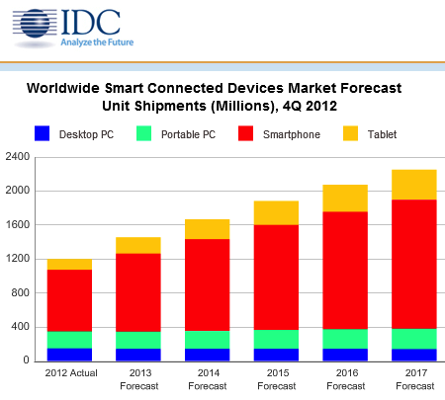
And here we are…

Slide 23
An Example: USF’s Evaluation of Teaching
Pencil and Paper though three generations
Hildebrand-Wilson-Dienst, IDEA, SUMMA
Changed in the past for reasons having to do with the comfort of the evaluated.
Now other reasons surface
Cost in time
Cost in effort
Cost in effacacy

Slide 24
Problems with the IDEA
1. The results of the evaluation of individual faculty were difficult to understand or use for purposes of improving teaching.
2. The IDEA system did not adequately reflect different class structures, e.g., seminars, laboratories, clinical experiences, internships, etc.
3. The “long form” version of the instrument was too long and was not always readily intelligible to the students.
4. There was a perception that the results could be manipulated by the individual faculty member’s selection of objectives on Faculty Information Form.
5. There were administrative concerns about the unpredictability of the return of the final results and the unresponsiveness of the developers to USF’s specific concerns.

Slide 25
Advantages of the SUMMA
1. It was a standardized system that provided comparative data within and across departments and schools/colleges.
2. It was more likely than other instruments to provide “reliable, valid and defensible data” as well as information about student learning that could be used to improve teaching effectiveness.
3. The instrument seemed to be sensitive to the evaluation of various pedagogical approaches in different classroom settings (seminar, lab, clinical, etc.).
4. The survey was easy to understand and could be easily administered within an acceptable time frame without the need for “excessive faculty background information.”
5. The committee thought that SUMMA was more likely to give timely and intelligible feedback to faculty than other instruments.

Slide 26
Requirements of a Replacement
1. Online evaluations tend to have a lower response rate than paper and pencil evaluations.
2. Students and faculty must be reassured that the online system is truly anonymous.
3. Concerns about who might have access to the data must be addressed, especially if the online evaluation is an in-house instrument.
4. Many fear that students will not take the online evaluation as seriously or will discuss their ratings with others before the evaluation is completed.
5. For the online teaching evaluation to work, students must have access to computers and must be assured that the online system is reliable and usable.
6. There may be resistance associated with changing from a long-established practice of using paper and pencil and moving to an online system

Slide 27
Glossed over issues
National norms
External validation of the measures
But added “Construct measurement”
1. Instructional Delivery
2. Instructional Design
3. Student Engagement
4. Student Learning
and a final source never evaluated by the original committee

Slide 28
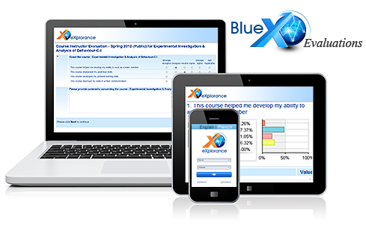
Blue by eXplorance

Slide 29
What it has
Cloud
BYOD
Make your own instrument

Slide 30
A Danger

Slide 31
Spied on by your own computer?
Computer expert Jim Stickley of TraceSecurity showed us how easy it is. From thousands of miles away he broke into one family's laptop and turned on their webcam to view teen girls in their bedroom and in their dining room as the family ate dinner. "It took about three minutes" to hack into their system, Stickley told us. (Today Jan. 24, 2013 at 10:32 AM ET)
http://www.today.com/news/webcam-hackers-can-spy-you-secret-1C8095607

Slide 32
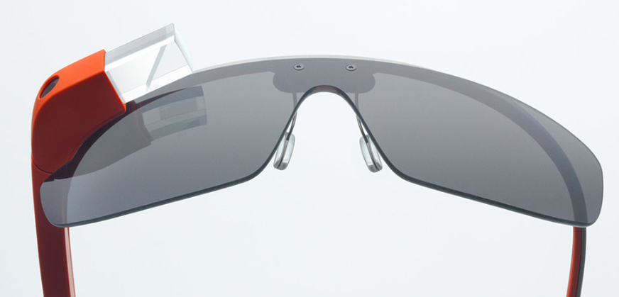
Google Glass

Slide 33
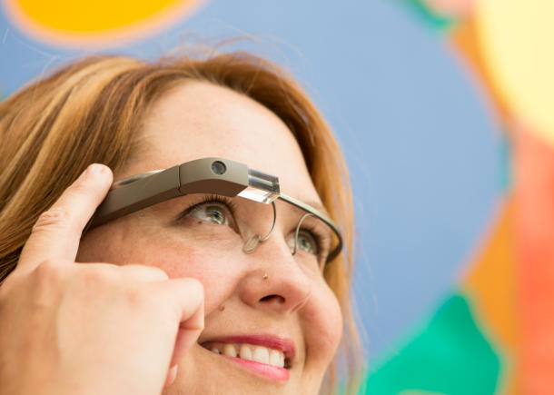
What does Google Glass actually do?
Glass takes photos and videos, sends text messages, engages in FaceTime-like Google Hangouts, makes phone calls, searches Google, and gets turn-by-turn navigation with maps. It can show the weather, the time, and headlines from The New York Times that have been pushed to the device, with spoken headline summaries.

Slide 34
In the end, 21st century technology will mean
We will have the capability to evaluate what we want, how we want…
We will have the tools to intrude into each life in ways that will allow us to monitor the most intimate behavior with dreamed of precision…
What will we do with these tools?

Slide 35
Thank you for your kind attention.

Slide 36
