Slide 1
Evaluation Capacity Building Empowering Pre-service Primary Mathematics Teachers to Formatively Assess Multi-level Learners
Dr. Garima Bansal
garima1agg@gmail.com; +91-9999914095
Assistant Professor
Lady Irwin College
University of Delhi, India

Slide 2
Overview
What is Evaluation Capacity Building (ECB)?
Why ECB for pre-service teachers?
Why ECB for mathematics teachers?
Context of the study
Structure of Professional Development Program
Educational Policy in India
Aims of the Study
Methodology
Evaluation model for pre-service teachers
An exemplar
Outputs

Slide 3
What is Evaluation Capacity Building?
Evaluation Capacity Building (ECB) is defined as “context-dependent, intentional action system of guided processes and practices for bringing about and sustaining a state of affairs in which quality program evaluation and its appropriate uses are ordinary and ongoing within one or more organisations.” (Baizerman, Compton & Stockdill, 2002, p.1).
ECB focusses on the organisational processes necessary to create and sustain quality evaluation.
Notes:
ECB depends on the realities on the each organisational sites. So to say, ECB in a hospital would be different from ECB carried out in a school. It is suggested that site culture, structures and practices are three crucial aspects influencing the overall ECB process. Site structure provides for appropriate resources, occupational orientation, and quality evaluation which makes ECB legitimacy as an useful organisational process. ECB processes have their explicit ethos, language, discourse; a cultural value of inclusiveness regarding a variety of disciplines and stakeholders. ECB orientation involves reflective, intentional, responsive practice.

Slide 4
Why ECB for pre-service teachers?
Evaluation education has often been overlooked in teacher professional development programs (Popham, 2011).
Pre-service teachers tend to repeat evaluation strategies that they experienced as students (Maclellan, 2004).
Mertler and Campbell (2005) noted when teacher candidates are provided Evaluation education they demonstrate confidence, competency, and readiness to assess student learning.
Voltane and Fazio (2007) noted that significant student achievement gains emerge when teachers constantly integrate evaluation into their classroom practices.
Notes:
This makes a case for research on ECB on pre-service teachers. As it si noted that what remains absebt from literature on assessment education is an understanding of the pedagogical conditions that support teacher candidates assessment literacy development (DeLuca, Chavez, & Cao, 2013). This would enable designing and delivery of effective teacher preparation programs. Also, pedagogies in PD programs act as a predominant force in changing the conceptions and perceptions of pre-service teachers.

Slide 5
Why ECB for mathematics teachers?
Mathematics is a connected body of knowledge.
Skemp (1976) observed that pupils need to build a relational understanding of how ideas interrealte.
Ideas are organised in a hierarchical manner.
Mathematical literacy requires understanding of the meaning, use and justifications of the mathematical ideas.

Slide 6
Context of the study
In India exists variety of teacher professional development programs, such as, Bachelors of Education (B.Ed), Bachelors of Elementary Education (B.El.Ed), Nursery Teacher Training (NTT) to name a few.
B.El.Ed teacher professional development is a four-year program undertaken by students after Grade 12.
This program integrates content knowledge in specific subject areas with elementary (Grade 1-8) teacher education.
Pedagogical approaches to teach Languages, Environmental Studies, and Mathematics is the focus for Grade 1-5 teaching; and any one particular liberal option (content area) is chosen by the students for middle grade (Grade 6-8) teaching.
Graduates from this program are deemed as professionals (teachers) in elementary grades.

Slide 7
Structure of the Professional Development Program (B.El.Ed)
Student candidates are taught papers on educational theory, philosophy, psychology etc. during the first two years. In the third and fourth years, focus is on Pedagogy papers and Material Development practicum.
There exists no component for ‘Evaluation education’. Consequently, their evaluation needs are adversely influenced which eventually worsens the learning outcomes of students taught by teachers having impoverished evaluation competencies.
There is a 20 week school internship in last year. Student candidates teach all subjects in primary grades for a period of 16 weeks and teach middle grades for four weeks.
During internship, they are guided by faculty teacher educators who act as mentors, supporting them in field.

Slide 8
Educational Policy Context in India
Right to Free and Compulsory Elementary Education Act (RTE, 2009): This right came into effect in April 2010. It made compulsory for the Indian State to ensure admission, attendance and completion of elementary education by all children in the 6-14 age group without being charged any kind of fee or charges for the same (http://mhrd.gov.in/rte). This Act made age-appropriate admission in grades mandatory in schools.
National Curriculum Framework (NCF,2005), a curricular review document, highlighted the problems with Indian school evaluation system. It advocated Continuous and Comprehensive (CCE) scheme of pupil evaluation in schools which became reality in September 2010. This scheme coupled summative and formative assessment.
Formative Assessment appeared for the first time in Indian school system.

Slide 9
Rationale for the study
ECB
need
No Evaluation education in PD
FA is new to school education
Multi-level learners in mathematics classrooms

Slide 10
Aims of the study
Upon realising the dire need for Evaluation Capacity Building of pre-service teachers, this study presents an action research project undertaken by the author herself to build evaluation competencies in the area of primary school mathematics. It had following aims:
To address evaluation capacities of pre-service mathematics teachers;
To equip them with tools and strategies for carrying out Formative Assessment;
To enable them to address the learning needs of differentiated learners in mathematics classrooms.

Slide 11
Methodology for ECB
“Process-based approach” (McAllister & Irvine, 2000) to evaluation education is adopted. This approach seeks to engage student teachers in active meaning making processes through critical reflection, dialogue, experiential and authentic learning.
Huffaman, Thomas and Lawrenz (2008) proposed collaborative immersion approach to ECB which is grounded in social-constructivist learning theory (Vygotsky, 1997). It involves immersing the individuals into complex real world problems.
Adopting DeLuca, Chavez, Bellara & Cao’s (2013) framework, following pedagogical constructs were adopted to orient pre-service teachers for the evaluation model:
(a) perspective-building conversations
(b) praxis activities,
(c) modeling, and
(d) critical reflection and planning for learning
Notes:
process-based pedagogies seek to engage students in active meaning-making through processes of critical reflection, dialogue, and experiential and authentic learning. Based on the assessment education literature, we identified three dominant process-based pedagogies relevant to preparing assessment literate teacher candidates. The first pedagogy involves practicing the art of assessment. Shepard, Hammerness, Darling- Hammond, and Rust (2005) stressed that teacher candidates need experience in designing, scoring, and interpreting assessments for a variety of purposes with an emphasis
Baizerman, Compton, and Stockdill (2002) concluded their New Directions of Evaluation volume about the art, craft and science of ECB with a call for more case studies and more conceptual articles on ECB.
King (2002) have presented a case study of ECB in school district context.
Arnold (2006) proposed a framework for ECB with 4-H faculty. It begins with development of logic models, followed by providing one-to-one help to individuals, facilitating small-team collaborative evaluations, and conducting a large-scale evaluation.
Huffman, Lawrenz, Thomas & Clarkson (2006) presented a model for ECB for STEM education.
Parsons, Lovato, Hutchinson, & Wilson (2016) developed Communities of Learning, Inquiry, and Practice (CLIP) model within higher education context.
on formative assessment processes. Specifically, they suggested that teacher candidates should engage in: (a) individual and group analysis of student work and learning, (b) designing and constructing standards-based student assessments, and (c) explicitly examining the various connections between learning motivation and classroom assessment
Practices; implement course-based learning into field-based teaching experiences (Darling-Hammond, 2006; Russell, McPherson, & Martin, 2004). Through this approach, learning is contextualized, related, and reinforced with an emphasis on the linkage between educational theory and practice. Brookhart (1999) also argued for a contextualized approach to assessment education. She stated, ‘‘teachers need to understand a wider range of assessments : : :
and need to be offered methods that can be used within the constraints of classroom
time and space and school district policies’’ (p. 5). Ediger (2002) recognized that assessment education must make room for teacher candidates to consider and explore the philosophical underpinnings of educational assessment as related
to the practice of teaching.
Finally, as a pedagogy that not only enables learning about assessment but also promotes teacher candidates’ metacognitive development, James and Pedder (2006) asserted the importance of utilizing assessment for learning approaches with teacher candidates. Assessment for learning involves actively engaging teacher candidates in formative assessment processes (including self-, peer-, and instructor-based assessments), throughout learning,
with the goal of providing them with a positive and authentic experience of assessment
(James & Pedder, 2006; Wiliam, 2011). It is through this experiential approach that teacher
candidates can begin to unlearn their negative conceptions of assessment and reformulate
assessment as a positive process in teaching and learning (Harlen & Gardner, 2010). An
assessment for learning pedagogy further supports the development of a stance of inquiry
as teacher candidates are encouraged to critically assess their experiences and knowledge as
the basis for establishing learning goals and plans for continued professional development
(Earl, 2003).

Slide 12
Participants
8 student teachers executed the evaluation model in different mathematical content areas, such as, geometry, arithmetic, data handling etc. with primary grade children during their school internship program.
Out of them, 4 conducted this project with me as their mentor. This study would describe case study of one of them as an exemplar.
This study was undertaken in the year 2015-16.

Slide 13
Evaluation Model for pre-service teachers
Phase 1: Identification of multi-level learners
Student candidates would observe the performance of students in their mathematics classrooms for a particular content area.
These observations will continue for a period of 10 days and for at least 10 activities per student. These activities will remain constant for all the students so that the difference between their abilities on a particular concept could be identified.
Based on their observations, student interns would fill this checklist for the students
It would enable them to identify patterns of performance of students to finally select three students – above average, average, below average- on their mathematical abilities to carry forward detailed analysis with them.
Performance Indicators | Excellent | Proficient | Marginal | Remarks

Slide 14
Contd.
Phase 2: Student Evaluation Profiles
Student interns will make a learning progression of the content area for which they are conducting student evaluation.
Upon identifying the levels at which their students exist in learning progression, they would design tasks to facilitate their students’ conceptual understanding; and hence, progression to higher levels.
Student interns will attach work samples to demonstrate student’s performance.

Slide 15
An exemplar
The evaluation model was carried out by a pre-service teacher in a State-run school with two Grade 2 learners.
Child 1:
Sex- Female
Age-7
Class- 2 (Studied class 1 in the same school last year)
Child 2:
Sex- Male
Age-7
Class-2 (Admitted directly to class 2 under the RTE Act, 2009)

Slide 16
Baseline Evaluation of Child 1
STRENGTHS
Demonstrated an understanding of numbers from 1 to 100
Able to recognize the mathematical operation to be applied in a given problem solving situation
She used advanced counting-by-ones on as a strategy when asked to answer orally
She used the standard algorithm for addition when asked to solve the problem on paper
WEAKNESSES
Problem in ‘carrying’ to add ‘4’ and ‘9’ of the units place while adding 24 and 9. She used a left to right approach and wrote 213 as the final answer
The child also showed discomfort while working with numbers having ‘zero’ as a digit.

Slide 17
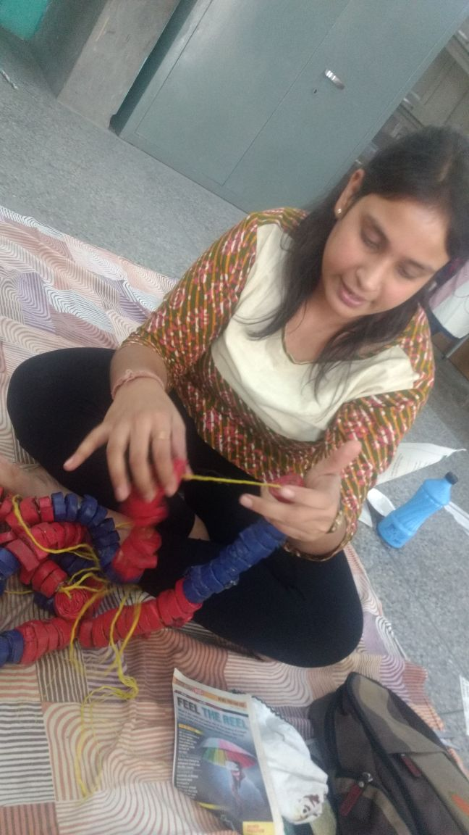
Evaluation procedures for Child 1
It was ascertained that the child viewed numbers as concatenated single-digit numbers instead looking at the number holistically. This shows a lack in her understanding of place value of numbers.
Concrete experience (placing 24 and 9 balls in a box and child counting it all)
Number chart (to add 24 and 9; and also to locate 213)
Bead String (counting in tens; forming numbers; addition without regrouping; addition with regrouping). https://drive.google.com/open?id=0B8_bluJCvsHAVlVMdnF2aXFZZi1IQ2RvTU1uYS11bDZBMnNr
Dienes blocks

Slide 18
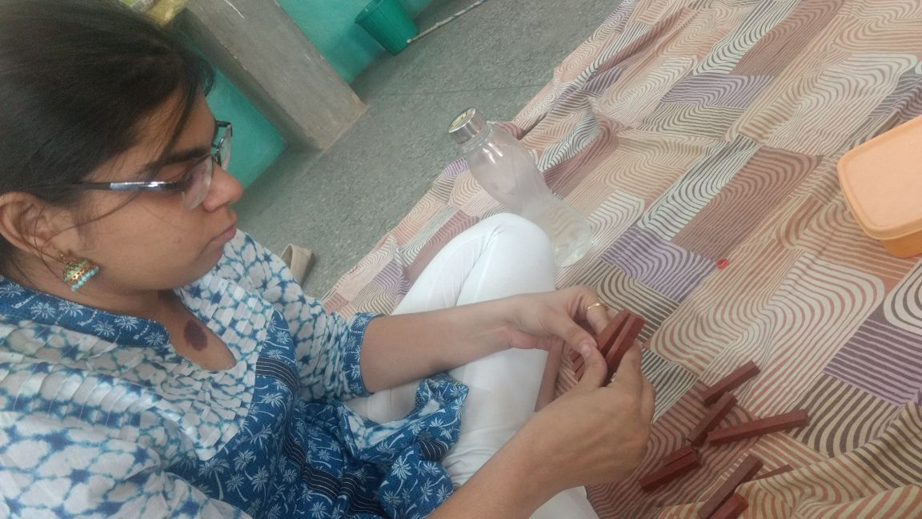
Evaluation procedures for Child 1
Child moved from use of procedural algorithms and developed her own informal strategies.
Child demonstrated the clear understanding of place value
Child moved from concrete to sub-concrete stage where she was able to work with visualisations.
Child’s ‘procedural knowledge of addition’ gradually getting converted to a ‘conceptual knowledge of addition’ when she started understanding place value as a part of this process.

Slide 19
Child 2: Baseline Assessment
The child could count up till 19 only
For an additive task, the child always needed concrete visuals (for e.g. marbles, balls etc.). If something concrete wasn’t available, he opted using his fingers, but then he used to get even more confused
Lost one-one correspondence whenever he tried counting faster
Used “count-all” strategy for addition

Slide 20
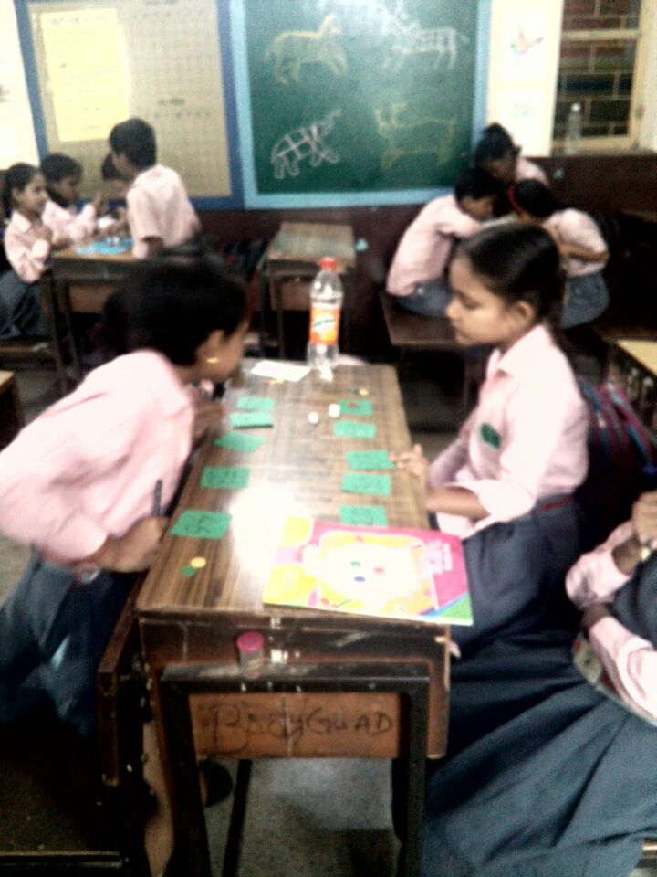
Evaluation procedures for Child 2
Expanded counting structures using various concrete materials (bead strings, marbles, balls etc.. Provided help with changes in language pattersn while counting, 20, 21; 30 ‘ty’ etc.
Count slow to prevent one-to-one correspondence error occurring
For strengthening the child’s knowledge of number representations (numerals), number cards with the numeral written on one side and the same number of dots on the other side were given to him. And he was asked to put them in a sequence.
To assist in count forward strategy, the child was asked to make additions with 1 or 2 as addend, i.e., 23+ 1=? And so on.
Using bead strings

Slide 21
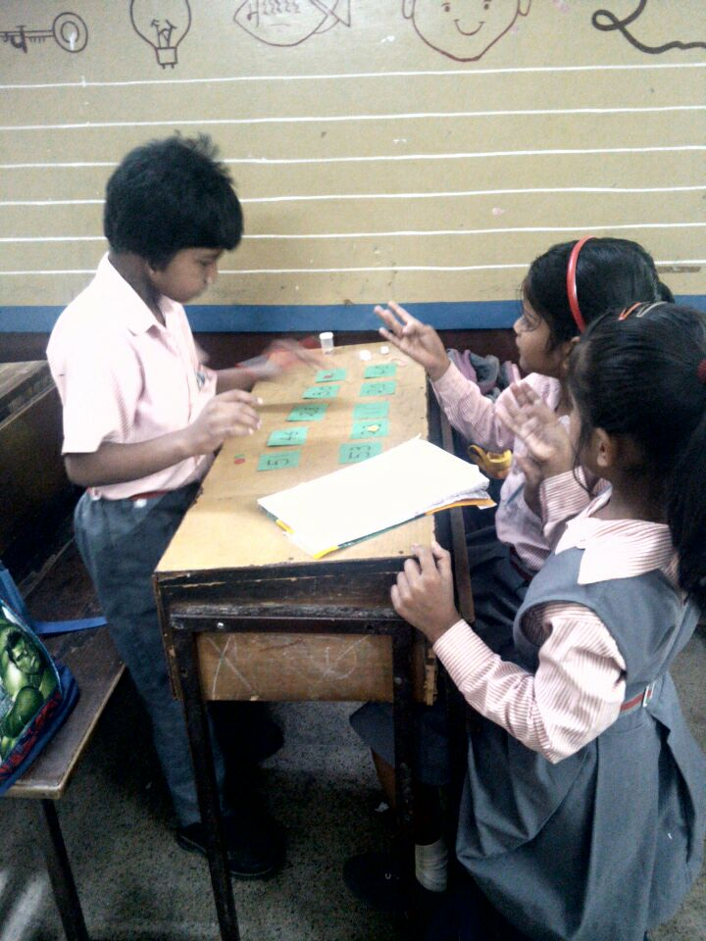
Evaluation procedures for Child 2
The child has now developed his count on strategy for adding.
He is between being a figurative counter and being a perceptual counter as he is able to visualize imaginatively the first addend but still needs to count concretely/sub-concretely the second addend to arrive at an answer.

Slide 22
Outputs
Pre-service teachers felt empowered to see changes in their students’ mathematical understanding by the use of Evaluation model which aided them to carry out Formative Assessment in real-time classrooms.
They developed skills in designing tasks, learning progressions of various content areas, identification of errors, and hence generating variety of ways to provide feedback.
They realised the importance to move beyond “entity theory” to help each child progress through the learning progressions
They realised the importance of contingent planning to capture assessment evidence emerging on-the-fly.

Slide 23
Thank You…
Dr. Garima Bansal
garima1agg@gmail.com; +91-9999914095
Assistant Professor
Lady Irwin College
University of Delhi, India

