Slide 1
Lessons Learned: The Minnesota Young Adult Alcohol Survey
American
Evaluation
Association Annual Conference October 26, 2012

Slide 2
Young Adult Alcohol Survey (YAAS) Background
In 2009 the Minnesota Department of Human Services received a Strategic Prevention Framework State Incentive Grant (SPF SIG) from the federal Substance Abuse and Mental Health Services Administration (SAMHSA).

Slide 3
YAAS Background (continued)
Data on young adult alcohol use is needed to assess and evaluate the interventions performed locally.
Invitation Health Institute was contracted to conduct the Minnesota YAAS.
Young adult populations are extremely difficult to survey.

Slide 4
YAAS Administration
Round One was conducted in the spring and summer of 2012 in eight SPF SIG communities and three comparison sites.
Round Two will be conducted in 2014 to evaluate the SPF SIG program.
Mail-based mode of administration was chosen.
All mailings included a URL for an online responses.
Attempts were made to contact up to 1,200 young adults aged 18-25 in each community.

Slide 5
YAAS Administration
The survey design
Employed a version of Dillman’s Tailored Design Methodology rooted in social exchange theory
Respondent participation motivated by the return on their actions (not necessarily monetary)
Takes into account changes in technology
Recommends specific sequences of survey mailings

Slide 6
YAAS Administration
Four mailings were sent:
Pre-notification postcard
Initial survey packet including incentive information
Follow-up survey packet
Reminder postcard

Slide 7
YAAS Administration
Small populations of some of the SPF SIG communities combined with narrow sample frame (for example,18-25 year olds) resulted in lower than normal list accuracy.
– Information appended onto address-based samples more likely to be incorrect or missing
– Not an issue for phone surveys, or surveys of whole populations
Low list accuracy makes calculating precise response rates impossible.

Slide 8
YAAS Administration
A total of 1,733 responses were received from all 11 communities.
Non-response bias was associated with several demographic characteristics.
Weighting was used to correct for non-response bias associated with gender and age.
– Adding weights that include additional variables, such as race and ethnicity, would have required the use of U.S. Census microdata, a more intensive process.

Slide 9
Respondent Gender

Slide 10
Respondent Gender

Slide 11
Respondent Age

Slide 12
Respondent Age

Slide 13
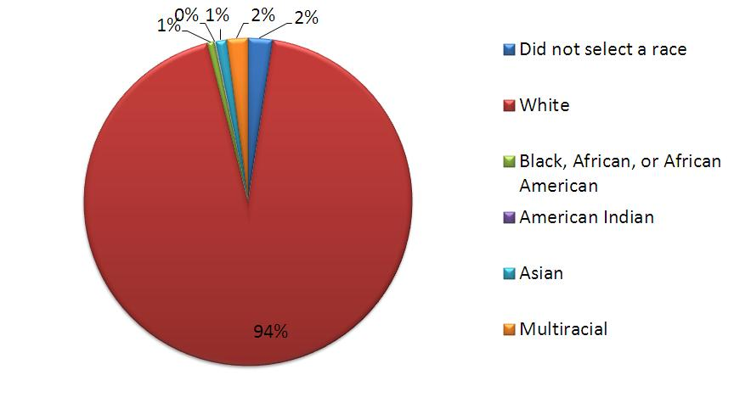
Respondent Race and Ethnicity

Slide 14
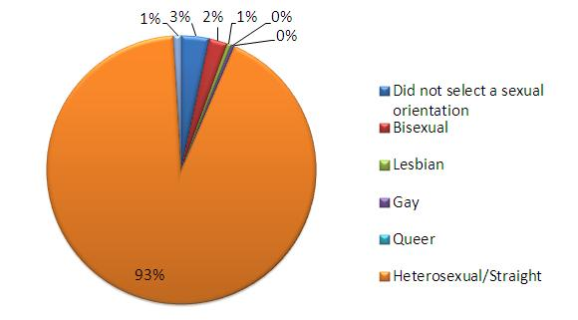
Respondent Sexual Orientation

Slide 15
Mode Effects
Key Findings

Slide 16
Mode Effects
The mode of survey administration (mail vs. online) did not have a significant effect on reported alcohol use.
Respondents who completed the survey online were more likely to report the following:
Past 30-day marijuana use
Employment
Being a student
Rural residence

Slide 17
Mode Effects

Slide 18
Mode Effects

Slide 19
Mode Effects

Slide 20
Mode Effects

Slide 21
Other Initial Findings
Males were significantly more likely to report past 30-day binge drinking.
No significant difference in any past 30-day alcohol use between genders
Whites were more likely to report past 30-day use and past 30-day binge drinking compared to all non-whites

Slide 22
Results by Gender

Slide 23
Results by Race and Ethnicity

Slide 24
Results by Race and Ethnicity

Slide 25
Results by Sexual Orientation
Respondents who identified as lesbian, gay, bisexual, transgender or queer (LGBTQ) were not more likely to report past 30-day use or binge drinking.
LGBTQ respondents were more likely to report:
Past 30-day tobacco use
Past 30-day marijuana use
Past 12-month marijuana use
Past 12-month other illicit drug use

Slide 26
Results by Sexual Orientation

Slide 27
Implications and Next Steps
SPF SIG grantees are currently using their YAAS data to perform assessment activities in their communities.
This, coupled with other assessment activities, will affect which interventions grantees choose.
When the SPF SIG enters the evaluation phase in 2014, the YAAS will be performed again.
Analysis will measure any change in:
Past 30-day binge drinking
Past 30-day alcohol use
Changes in “intervening variables”

Slide 28
Considerations for Implementation
Surveying small populations is very difficult.
Narrow sample frames can result in low list accuracy.
Organizations need sufficient capacity.
Mail-based survey cost considerations:
Printing
Postage
Mailing service
Staffing

Slide 29
Questions?

Slide 30
Contact Information
Bill Woywod, M.P.H., biostatistician (763) 712-7638 bwoywod@invitationhealthinstitute.org
Becky Sechrist, M.Ed., associate executive director (763) 712-7603 bsechrist@invitationhealthinstitute.org

