Slide 1
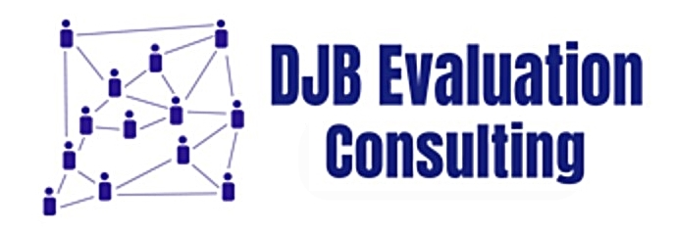
Revisiting US Government Contracting: Continued Challenges, Possible Solutions, New Insights
David J. Bernstein, DJB Evaluation Consulting, Panel Chair
Kathryn Newcomer, The George Washington University, Discussant
Jennifer Hamilton, NORC at the University of Chicago
Sarya Sok, US Department of State
Patricia Shaffer, National Endowment for the Arts
2019 American Evaluation Association Conference
Session #1503, November 15, 2019

Slide 2
Context and Background
The vast majority of United States Federal government evaluations are conducted by contractors. Effective contracting is rarely examined.
Agency practices differ across the Federal government.
There may be a lack of research (if any) focused on contracting for Federal evaluation work (although there are GAO and other studies on Federal contracting).
Panels of government evaluators, contractors, and academics addressed the issue at AEA 2012, 2013, and 2013 conferences to explore challenges and solutions.

Slide 3
Obstacle Areas
Legal/Regulatory
Pre-Bidding Issues: Requests for Expressions of Interest (REOIs) and Question and Answer (Q&A) Processes
Level of Effort Estimates and Time Frames
Practices that Discourage Bidding and Competition
Performance-based Contracting

Slide 4
Solution Areas
Evaluation planning and building scopes of work (SOW)
Negotiating the contract for evaluation services
Start-up activities and practices
Completing evaluations on time and within budget to address information needs
Effective reporting or presentation of evaluation findings

Slide 5
Contracting and Scopes of Work
Use competitive IDIQs/task order contracts to streamline contracting. Ensure they are open and competitive.
Have a staff person with real evaluation expertise and experience work with program staff to write the scope of work.
Be consistent with agency learning agendas.
RFPs should identify available data sources.
Level of effort for the evaluation (funding and/or contractor hours) need to be provided in the RFP.
Realistically stage evaluations. Realistically price evaluations.
The “best value” approach may be useful. If awarding to lowest bidder make sure proposals are realistic.

Slide 6
Negotiating the Contract
Proposal review panels should read proposals carefully to ensure the agency gets what it wants from the contractor. Scoring criteria should align with award criteria.
Is negotiation of the scope of work and methodological approaches possible?
Give contractors time to develop evaluation plans. Allow time for stakeholder input and briefings.
Budget for a task to have some give and take on data collection and analysis approaches.
Need flexibility for the up front “dance.” Can the winning proposal approaches be negotiated in light of additional information?

Slide 7
Start-Up Activities and Practices
First deliverable needs to be a thorough work plan.
Checklists (3ie, Western Michigan University) can help focus on evaluation quality and what should be included.
Use blanket OMB clearances (PRA) only when appropriate.
Use administrative data (no PRA) if relevant.
The kick-off meeting should be multiple meetings.
Set up “speed dates” for program staff and leaders to be available to the contractor staff to add depth of knowledge about the program.
Allow stakeholder input but make sure stakeholders clearly understand the evaluation focus. Include potential implementation challenges.

Slide 8
Completing Evaluations on Time and Budget
Frequent update calls with staff (not just the contract project director and government’s contract officer’s technical representative).
Routine, frequent informal communications as well as formal.
Adopt a “no surprises” approach.
Identify intended users and what they want. Keep them informed.
Agencies need to provide constructive, timely, honest feedback.
Keep technical expert panels small (e.g., 5 or less) with some evaluation expertise. Be prepared because there will be surprises.
Contact contractors immediately and informally (text) when questions come up.
Address rumors directly to build trust.

Slide 9
Reporting and Presentation of Evaluation Findings
Clarify reporting expectations at the beginning of the project.
Include briefings, not just reports.
Historical movement away from long reports (“the incredible shrinking Executive Summary”).
Include detailed information in appendices.
Include a communications plan as a deliverable. Address various audiences including professional conferences.
Include sufficient funding in the contract to focus on implementation/revisiting of recommendations.
See Klerman (2010) for approaches to ensure the independence of the evaluation reporting process.

Slide 10
Panel and Discussant
Are these practices consistent with your experience?
Are the solutions identified 5 years ago still relevant? If not, why not?
Any other changes in federal evaluation contracting in the last 5 years?
Trump vs Obama Administration evaluation approach?
The Evidence-Based Policymaking Act?

Slide 11
Panel and Audience
One more question:
Are there are practical solutions to producing high quality contracted federal government evaluations?

Slide 12
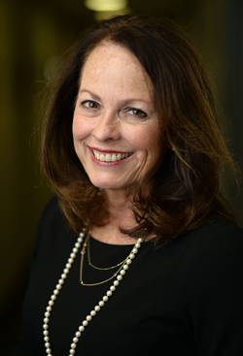
Discussant Wrap-Up
Kathryn Newcomer
Professor of Public Policy and Public Administration
The George Washington University

Slide 13
Want a Copy?
Visit the AEA Library at:
https://comm.eval.org/communities/community-home/librarydocuments?LibraryKey=1eff4fd7-afa0-42e1-b275-f65881b7489b
After 11/18/2019 search for Bernstein Contracting and look for this 2019 presentation.

