Slide 1
Meeting Community Needs Through Participatory Surveys and Pictures of Poo
Christina Bowles, MPH

Slide 2
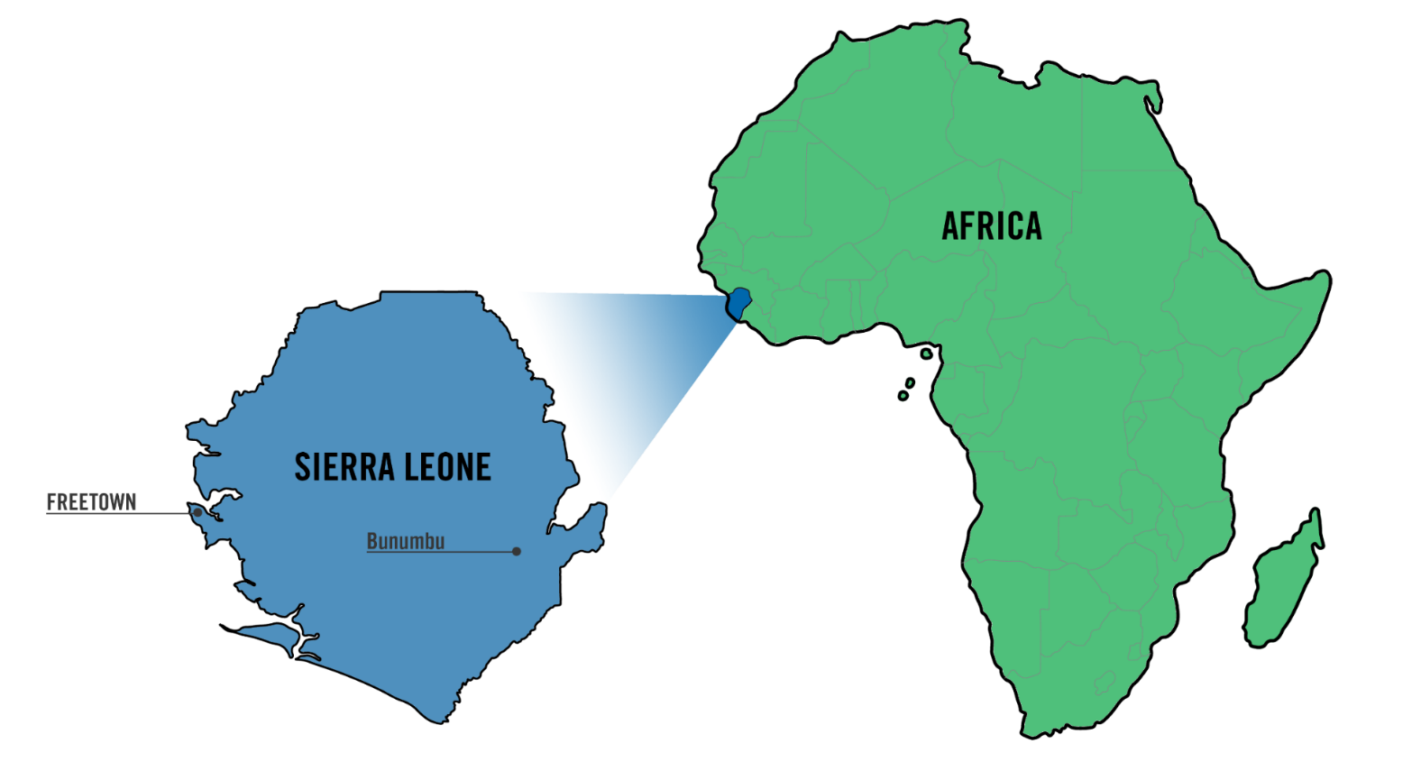
Where We Work
Notes:
OneVillage Partners in based in Sierra Leone, in West Africa. According to the most recent national demographic health survey, rural Sierra Leoneans have a literacy rate of 23%, access to clean drinking water of 46% and access to improved sanitation of 36%.

Slide 3
MISSION
Catalyzing community-led transformation in rural Africa
VISION
We envision the people of rural Africa engaged in building thriving, connected and resilient communities.
COMMUNITY-LED
DISCIPLINED
SUSTAINABLE
EQUITABLE
Notes:
Our organization’s mission is to catalyze community-led transformation. We achieve this through being community-led, disciplined, sustainable, and equitable. When we partner with a community, they identify their needs, design projects, lead implementation, and monitor outcomes, while we support them to achieve their vision.

Slide 4
WATER
SANITATION
AGRICULTURE
LIVELIHOODS
EDUCATION
HEALTH
Notes:
Because we are community-led, communities choose projects that address their identified priority needs. Projects fall in several technical areas including water, sanitation, agriculture, livelihoods, education and health.

Slide 5
Notes:
Our work creates impact in four main areas: inclusive leadership, gender equity, social cohesion and resiliency. We measure this impact through a mixed-methods approach with a focus on participatory methods, such as the Bristol Stool Chart.

Slide 6
Bristol Stool Chart
Notes:
This is the Bristol Stool Chart, a chart that divides stool into seven types based on its texture and appearance. According to the chart, types 1-3 represent constipation, types 4 & 5 represent healthy stool and types 6&7 represent diarrhea.

Slide 7
Photo with hands
Notes:
Now, how many of you would be comfortable explaining your last bowel movement to a data collector? Show of hands? Luckily for us, that number is much higher in Sierra Leone. Talking to others about bodily functions is culturally acceptable, making the Bristol Stool Chart a great tool for Sierra Leone.

Slide 8
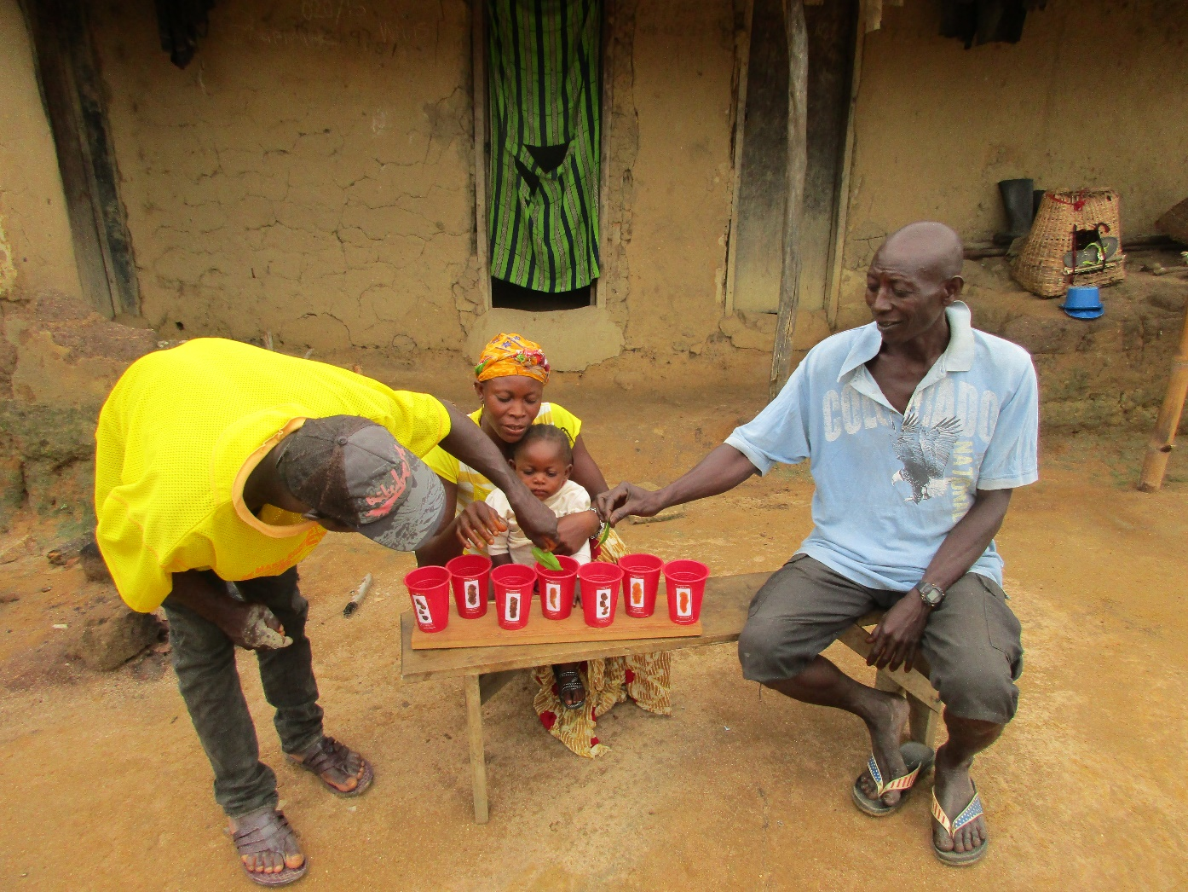
Notes:
OneVillage Partners has used the Bristol Stool Chart since 2016. In early surveys, we posted the images on plastic cups or mats and asked participants to choose their last stool type using a stone, stick, or leaf. The stone, stick, or leaf represented their age group.

Slide 9
Notes:
We adapted this data collection method based on participant feedback and available technology. Now, we have the chart on a tablet and the participant simply points to the picture that most resembles the stool type of their last defecation.

Slide 10
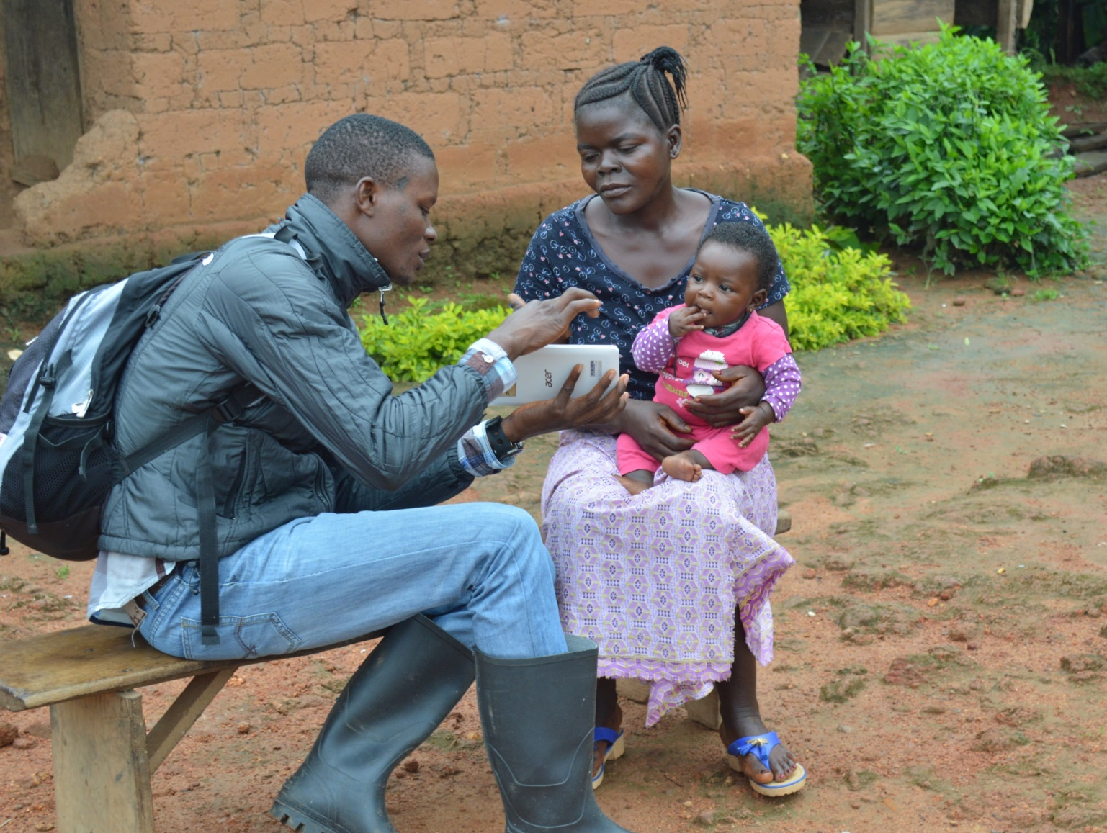
Notes:
The Bristol Stool Chart is used to evaluate water, sanitation, and hygiene projects. We conduct baseline, midline, and endline community–wide assessments where everyone within a selected household can participate. All age groups are involved, with caregivers reporting on the behalf of children under the age of five.

Slide 11
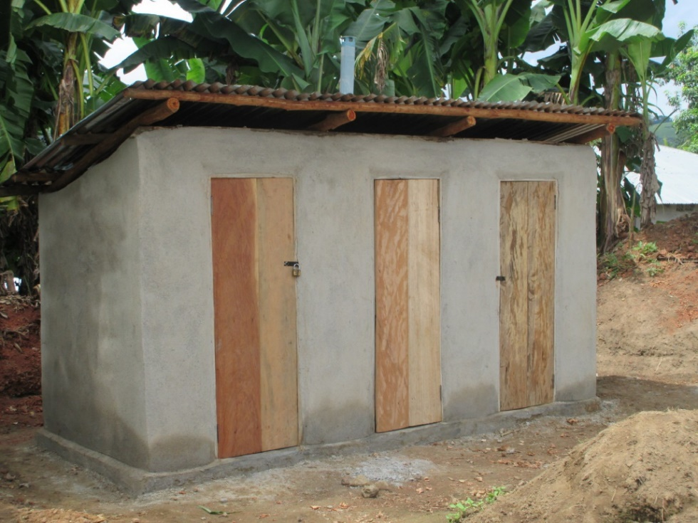
Additional Data
Notes:
When we first started using the Bristol Stool Chart we only collected information on age and stool type. We now collect data on gender, primary defecation site, drinking water source, and handwashing. This way in addition knowing the prevalence of diarrhea, we have data on the determinants of diarrhea as well.

Slide 12
Why Use the Bristol Stool Chart?
No recall bias
Eliminate translation errors
Health records can be insufficient
Notes:
We use the Bristol Stool Chart for many reasons. Traditional survey questions can introduce a recall bias or inaccurate translation of key descriptive terms. Health clinic records can have data quality issues and only capture cases where people sought treatment. Through directly asking people about their most recent stool using pictures, these issues are eliminated.

Slide 13
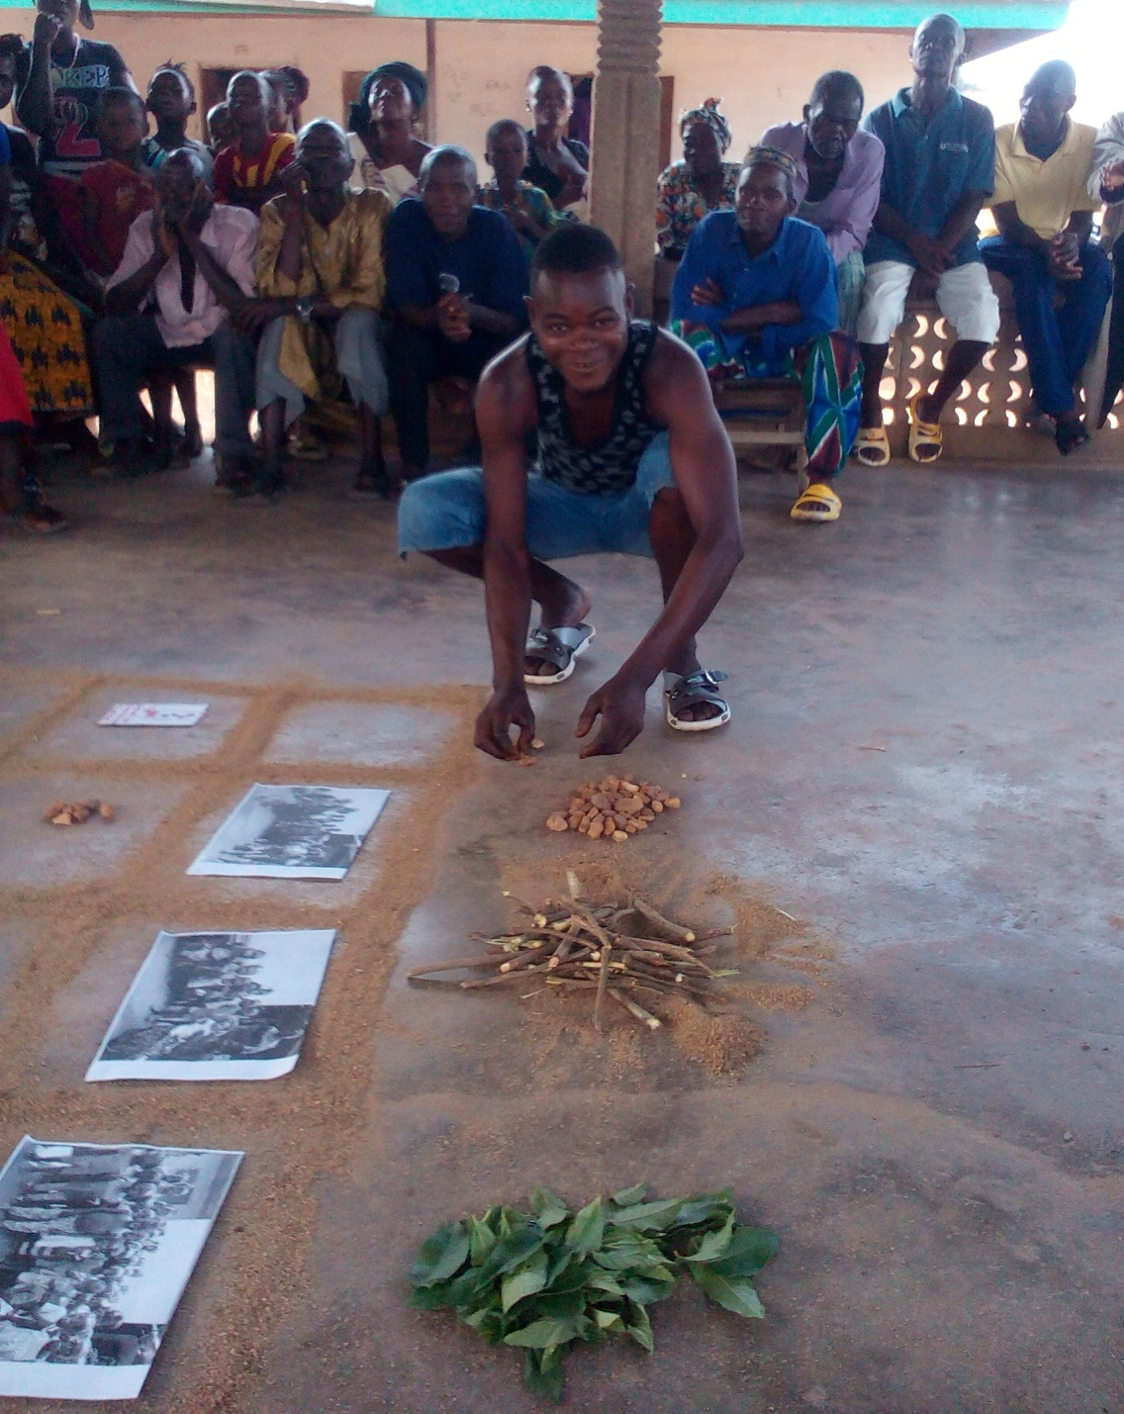
Why Use the Bristol Stool Chart?
Participation
Accountability
Notes:
Use of the Bristol Stool Chart ensures participation and accountability. The communities that choose to complete WASH projects do so because they want to improve their health. The Bristol Stool Chart provides quantitative evidence of health improvement over time.

Slide 14
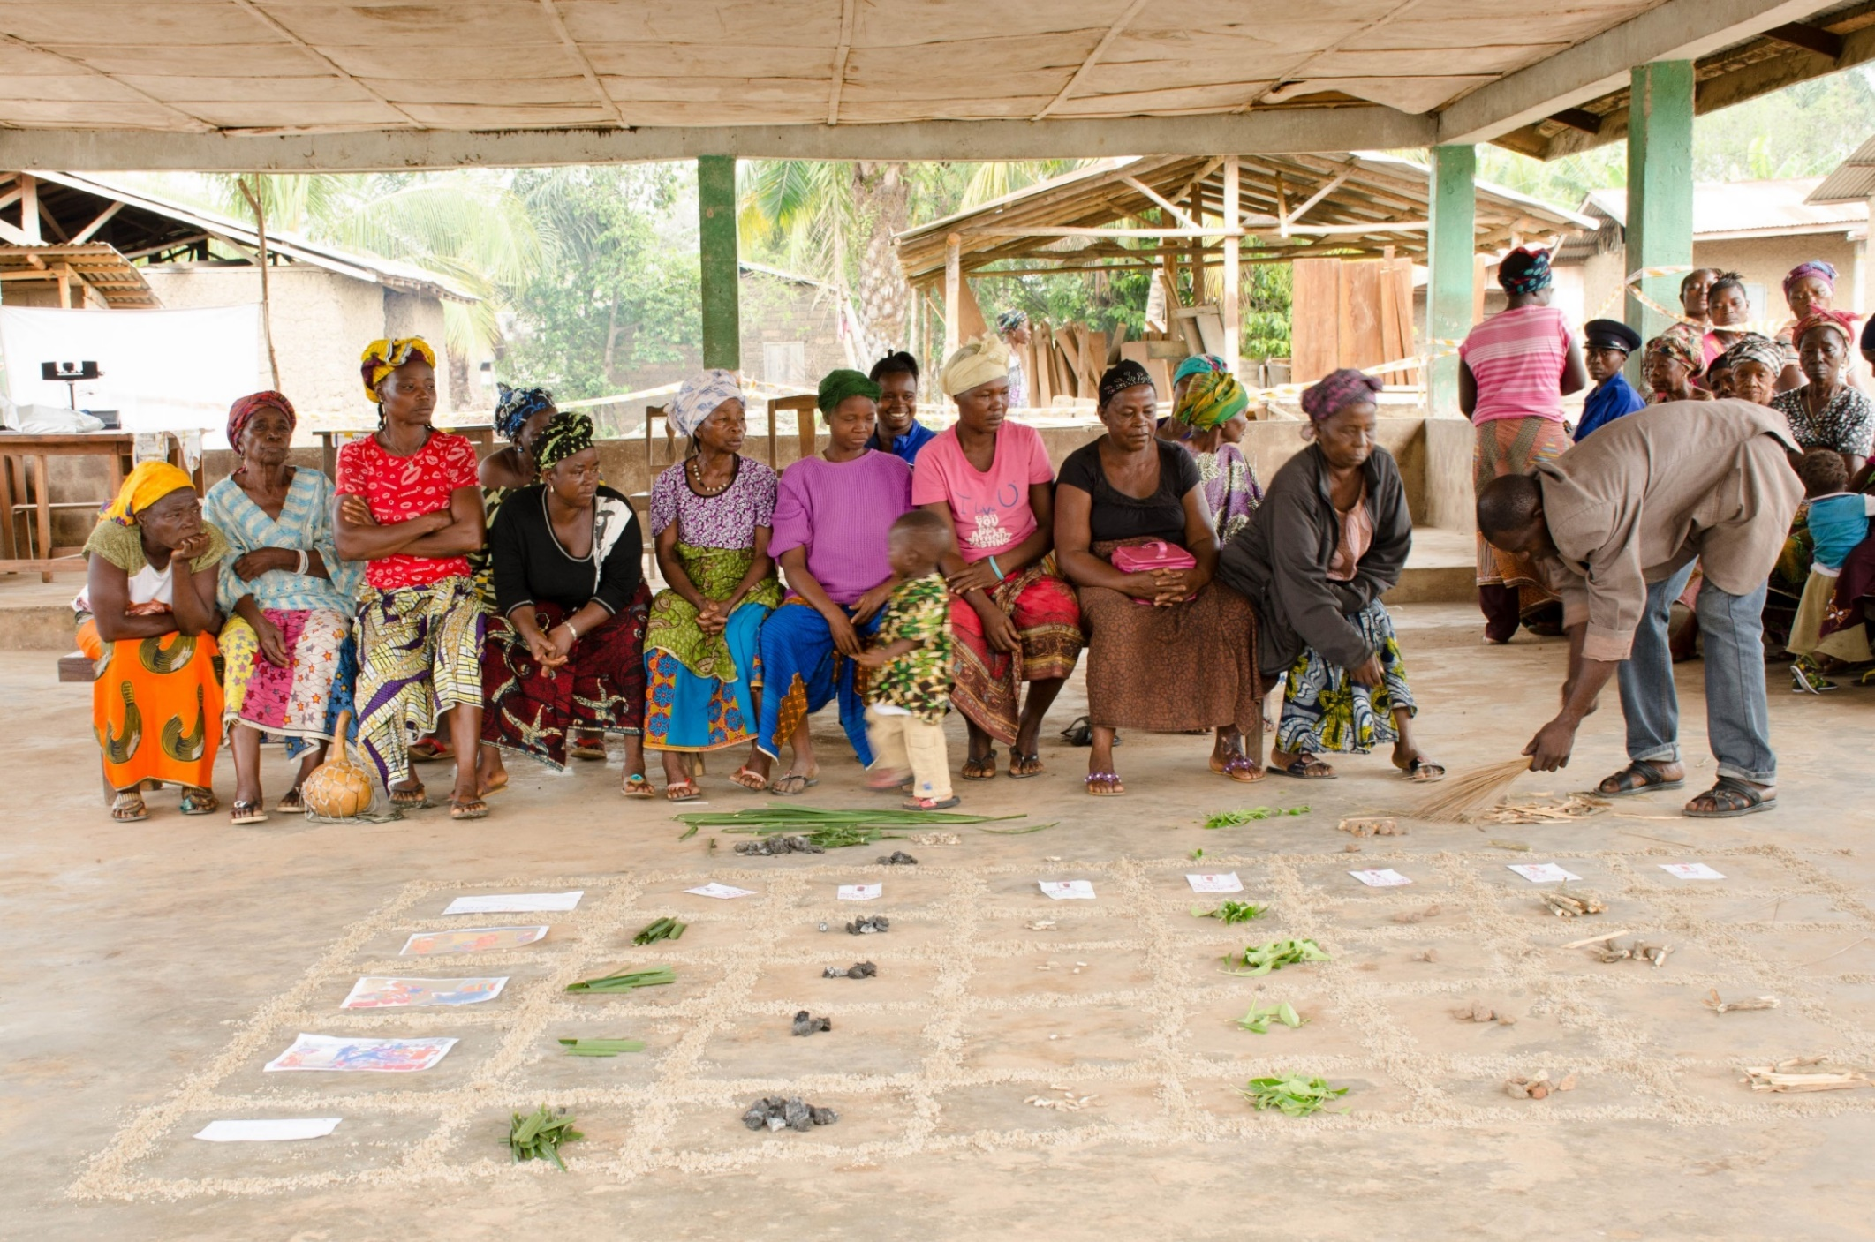
Notes:
All results are publicly shared with the community in an accessible way. This highlights the progress made on their self-determined goal and brings up potential areas of improvement. The community gathers to hear the results and then discusses their progress or what changes they need to make to reach their goals.

Slide 15
“OneVillage Partners is the only organization that goes to the community and gives feedback.”
-Majoe Community Member
Notes:
Our participants say it best, a community member in Majoe stated “OneVillage Partners is the only organization that goes to the community and gives feedback.” While a community member in Pejewa stated, “The BSC is a testing ground on how effectively we are using the toilet facility to combat the issue of diarrhea.”

Slide 16
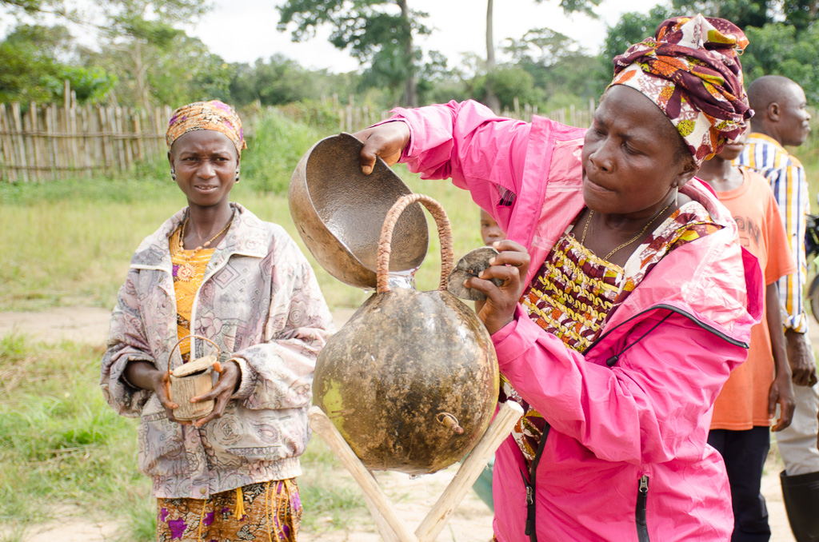
Notes:
Innovation is at the core of our work. When community members lead the process, they are more likely to trust and use the data we produce collaboratively. The Bristol Stool Chart is one example of how we have adapted traditional approaches to work for our participants.

Slide 17
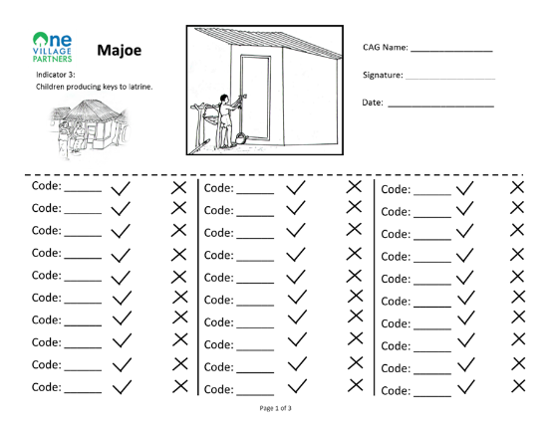
Community-Led Monitoring & Evaluation
Picture-Based Monitoring
Most Significant Change
Notes:
The Bristol Stool Chart is one of our M&E tools with community members at the center. We also implement Most Significant Change which uses story telling as evidence of impact and we train community volunteers to use picture-based tools to collect monitoring data.

Slide 18
Limitations
Participants’ comfort level with poo
Self-report, no verification by third party
Cannot identify medical conditions
Need to see stool post-defecation
Notes:
The Bristol Stool Chart has some limitations and may not work in every setting. Participants must be comfortable talking about feces. The chart relies on self-report, there is no verification by a third party. The chart can’t tell participants what is causing diarrhea and participants need to be able to see their stool.

Slide 19
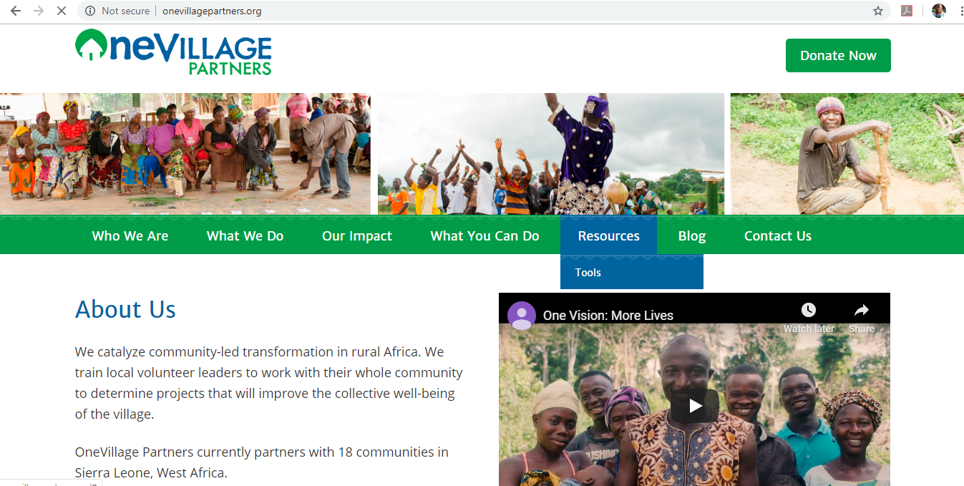
Notes:
If you would like to learn more about how we adapted the Bristol Stool Chart, check out the implementation toolkit on our website found under the Tools tab. The kit includes an explanation of the chart, tips on study and instrument design, staff training topics, results sharing methods, lessons learned, and limitations.

Slide 20
Christina Bowles, MPH
Christina@onevillagepartners.org
www.OneVillagePartners.org
@onevillagep
OneVillage Partners

