Slide 1
Hearing the Family Voice in Evaluation
AEA, 2011
HSRI
Linda Newton-Curtis and Julie Murphy

Slide 2
Introduction
Why do we care about family voice?
Ohio Experience: multiple projects & methods
Overview of presentation:
Describe Three Interventions
Key questions to be answered
How was family voice captured
Results
Concluding Discussion re: Pros and Cons
Notes:
LN:
Most restrictive in terms of closed-ended questions and less opportunity for additional comments: survey most, focus group, interview
Most quantitative data generated: same order

Slide 3
Differential Response: The Practice
A new approach to intervening with a subset of families who have been reported for abuse or neglect
Assignment to AR/IR based on
Presence of imminent danger
Degree of perceived risk
Type of previous reports (if any)
Type of alleged maltreatment
Vulnerability of alleged victim

Slide 4
Differential Response: The Practice
Philosophical shift
Emphasis on
Family engagement
Partnership between family and agency
And FAMILY VOICE!

Slide 5
Key Research
Did they feel more engaged in the process?
Did families feel more values?

Slide 6
Differential Response: The Evaluation
RCT
Data Collection Methods
State administrative data
Caseworker case reports
Family surveys

Slide 7
Differential Response: The Evaluation
Previous pilot
Survey Review Process
Cross-site collaboration regarding survey
Testing of instrument with families
Did it make sense?
Would families’ reading level be sufficient to understand the information?
Was it too long?
Notes:
Example of woman I called: Envelope with incentive was returned so called to ensure we had the right address:
told me her neighbor had read the survey to her.

Slide 8
Differential Response: The Survey
Family satisfaction
Treatment by caseworker
Help from caseworker
Relationship with caseworker
Relieved, angry, hopeful, afraid…………….
Help received from the caseworker
Family Outcomes
Are you better or worse now than before?
Are you a better parent because of your experience?
Notes:
Talk about the scale used for each

Slide 9
Differential Response: The Survey
Family Perspectives/Engagement
I really made use of the services my caseworker gave me
Working with my caseworker has given me more hope about how my life is going to be in the future
I wasn’t just going through the motions, I was really involved in working with my caseworker
What the agency wanted me to do was the same as what I wanted
Notes:
5-point Likert

Slide 10
ADD SLIDE Family Engagement

Slide 11
Notes:
How did you feel after the FIRST time the agency caseworker came to your home?

Slide 12
Notes:
How did you feel after the
FIRST time the agency caseworker came to your home?
All questions are closed ended so we’re putting the words in the families’ mouths? Therefore open ended question?
But only one?

Slide 13
Differential Response: Evaluation
Open ended questions?
Was there any help that you or your family needed but did not receive?
How to start visits again and what to do if it's bad again
Help paying for utilities and a bed
Really needed help in receiving public assistance

Slide 14
Differential Response
Whose voice is it anyway?
Response rate
Questions, open ended or structured
Notes:
Highlight some of the benefits of this approach over the more open ended approaches discribed next.
- Larger n, ability to quantify, while still getting context from open ended. Ability to test for representativeness.

Slide 15
Differential Response
So did we get family voice?
Yes! We did

Slide 16
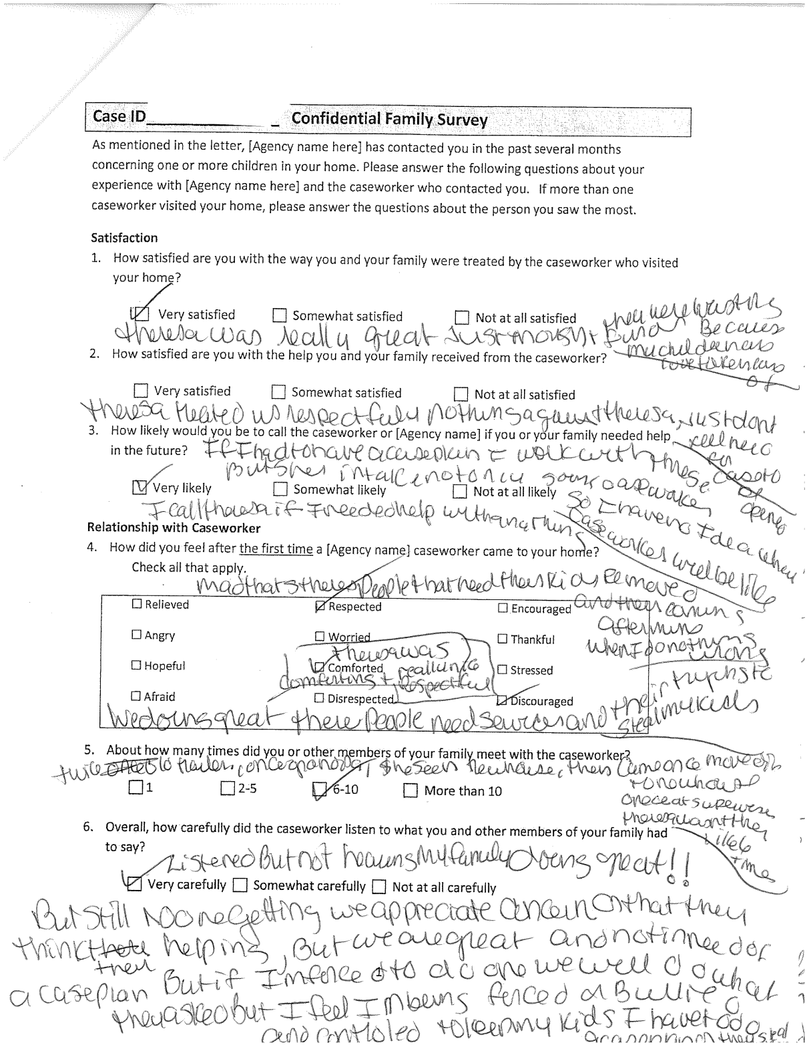
Or did we?

Slide 17
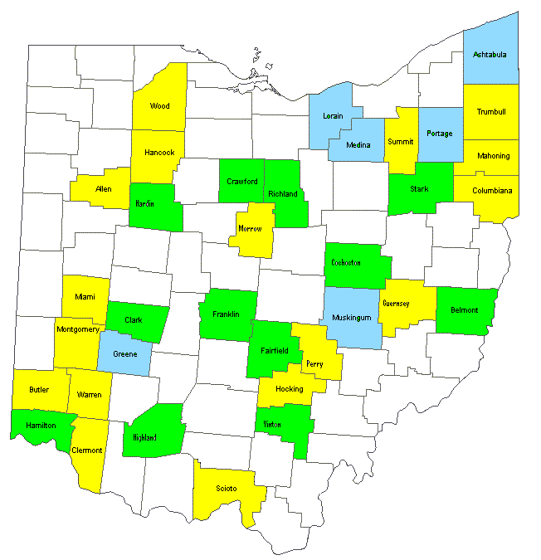
ProtectOhio
ProtectOHIO is IV-E Waiver (1997-2015); evaluation ongoing since 1998
Evaluation includes implementation, cost and outcome analysis, with 17 comparison counties.
Family Team Meetings core strategy since 2004; is well-defined intervention, adopted by all 18 counties
Kinship Supports core strategy since 2004, with six of the 18 counties participating
Notes:
JM

Slide 18
ProtectOhio Kinship Strategy
ACTIVITIES
New or additional staff dedicated to kin
ID and recruitment of potential kin placements
Array of supportive services & financial supports
Frequent communication with caregivers
Systematic use of placement and team meetings
OUTPUTS
# Kinship Caregiver utilized
# children in kinship placements
# services delivered, $ services purchased
Child able to stay with familiar caregiver
Community more familiar with PCSA work
OUTCOMES
More children placed with kin/guardian
Lower # CAN reports
Fewer children/days in agency custody, more children avoid out of home placement
Less re-entry into care
Shorter time in placement/to achieve permanency/closure
Increased stability
More children are safe (lower # CAN reports, fewer allegations in placement)
Notes:
Six ProtectOHIO demonstration counties agreed to focus on use of and support for kinship placements as an intervention strategy
“Kinship Care is the full-time care, nurturing, teaching, and protection of child by relatives (through blood, adoption, or marriage), tribes or clan members, and godparents; stepparents, or any adult who has a bond which the child, youth, or family recognizes as significant to them.”
Counties outlined activities, expected outputs and outcomes in logic model.
Evaluation team then tailored our data collection efforts to this model – collecting information primarily via structured interviews throughout waiver period, a case level survey conducted in 2008, and SACWIS data on outcomes
Challenges:
-Very little collected on the experience and percieved impact of this strategy on kcg.
-Because of role in cw system, little data gathered on these families.

Slide 19
Research Question: Process/Implementation Study
Does the kinship stategy make it more likely that current KCGs will remain committed to caring for children?
Does the kinship strategy provide services and supports to make caregiving easier and more rewarding?
Notes:
What we really wanted to know was….

Slide 20
Data collection efforts
Telephone interviews with PCSA staff(2006);
Site visits (2007-2008) including interviews with staff, as well as focus groups
Kinship Caseworker Survey
Kinship Caregiver Interviews
Notes:
Utilized mixed methods used to gain a more comprehensive understanding of dynamics of kinship placements:
Telephone interviews with PCSA staff(2006);
Site visits (2007-2008) including interviews with staff, as well as focus groups ;
Case study;
Kinship Case-Level Survey:
Kinship Caregiver Interviews: Survey explores kcg case flow from the PCSA perspective, but interviews offer insight into why kcg take on this responsibility, what makes them feel valued, and how they could be better supported. No differentiation by county groups.
completed by PCSA staff in 35 counties (2008): gathered details from assigned worker about placement. Population: FACSIS file of children formally placed with kin- random sample of cases from each county

Slide 21
Caregiver Telephone Interviews
Recruitment: Identified in caseworker survey, respond to a mailed flyer with a toll-free number. Incentive: $15 upon completion of the interview
Population: 62 caregivers
Interview: telephone, 20-40 minute interviews with focused but flexible questions.
Participation Rates/Representativeness: no assumption of representativeness, conducted no analysis by county groups
Analysis- qualitative data re kcg experience, allowed us to identify themes regarding experience.
Cost- estimate 30 hrs for interviews, …..
Notes:
Recruitment: Method: FACSIS used to identify cases where children formally placed with kin. Caseworker survey; randomly sampled to be completed. Of those completed, asked caseworker to provide contact information on kcg involved in identified cases. Agencies were sent list of kcg identified through cw survey and asked to recruit kcg, with goal of number of interviews to complete. Assured confidentiality, no loss of benefit or penalty for declining to participate. Interviewees self selected by responding to a flyer with a toll-free number. Incentive: $15 upon completion of the interview
Population: 62 caregivers, 10% of population responding to survey. 20-40 minute interviews with focused but flexible questions. $15 gift card incentive in thanks for their time.
Participation Rates/Representativeness: Of 62 interviewed, 8 from kinship strategy counties, 27 from other demo, 27 from comps. Self-selection in responding to a mailed flyer. We made no assumption of representativeness, conducted no analysis by county groups
Analysis- qualitative data re kcg experience, allowed us to identify themes regarding experience.
Cost- estimate 30 hrs for interviews, …..

Slide 22
Example of Interview Question
What has the experience of caring for been like?
Was this a  positive,  neutral, or  negative experience for you? Why?
Was it  helpful,  harmful, or  neutral as a placement for the child? Why? (could say difficult/harmful if BP conflict, separation from other sibs, etc.)

Slide 23
Using Interview Data
Overall Caregiver and Child Experience: Over half of the caregiver interviewees described their kinship caregiving experience as positive (56%), and an even larger majority (69%) felt the placement had been helpful to the child.
Caregivers who had a positive experience themselves talked of the joy the children brought them, and feeling as though the children were ‘their own’. Comments from these caregivers included:
“[The children are] a little piece of heaven.”
“I would fight like hell if someone wanted to take them away now.”
Notes:
Benefits:
Ability to probe in more detail, gather structured, but also more able to probe to gain the more detailed understanding, to stear interviewee for more detail, and may come up with new details or perceptions that had never been voiced before.

Slide 24
Family Team Meetings (FTM)
A method for engaging family members and other people who can support the family for shared case planning and decision-making.
Regularly-scheduled meetings throughout the life of the case, facilitated by a trained professional (FTM facilitator).
GOAL: creative and effective solutions to case challenges, ultimately to reduce the need for foster care placement and improve permanency outcomes.
Notes:
In second waiver period (2004-2010) that waiver counties implemented at least two targeted intervention strategies (out of five), and all 18 did FTM as the core strategy. In current period (2010 – 2015), FTM is one of two core strategies that every county is implementing.
Represents a paradigm shift from traditional child welfare services and has the potential to change the culture of welfare.
In our 2010 final report, found that 16 of 18 counties said that FTM has changed the culture, and say it will continue. Use quote.
61% said had significant impact on agency practice, 83% said had impact on agency culture,.

Slide 25
Core Components of FTM
Target Population: Children transferring to ongoing services with initial case plan goal of reunification or maintain in home
Meetings led by trained, independent facilitator
Meeting includes agenda, introduction, information-sharing, planning and decision-making
Facilitator responsibilities include: arrange meeting, help participants attend & know what to expect, and support family in preparing for and during meeting
First FTM occurs within 30 days of transfer to ongoing services
FTM occurs at least quarterly, including at critical events in the case
Meeting includes variety of participants (family members, substitute caregivers, other service providers, agency staff (caseworker, supervisor), other supports)
In addition to the elements listed above, fostering family engagement in the FTM and assuring Facilitator-caseworker collaboration in conducting the FTM are important aspects of the FTM process.

Slide 26
Family Focus Groups
Qualitative supplement to information on each meeting, observations
Key questions:
How FTM differs from other planning meetings
Interactions with the FTM facilitator
How FTM has been helpful, difficult (stories)

Slide 27
Focus Group Process
Invitations: through facilitators & caseworkers
Incentive: $10 gift card and food
Groups held in 15 demonstration counties
49 participants, with range of 2 to 6 participants.
Notes:
Faciliators will ask families that liked the experience or thought did well.
What was the range in number of people participating in each group- goal would be 5-7 at a focus group,
Five counties had only 2 participants, average 3.26
6 counties with 2 participants, 5 with 3 participants, 3 with 5 participants, one with six participants.

Slide 28
Focus Group Results
FTM different?
At 10 meetings, said different; voice is heard (7), invite friends & relatives (5)
Facilitator interaction?
Prep by facilitator (3), by caseworker (6);
Preparation: adequate (5), somewhat (4) inadequate (4)
Positive view of facilitator role during meeting (X), unrelated to amount of contact outside of meeting
Notes:
How FTM differs from other planning meetings
Interactions with the FTM facilitator

Slide 29
Focus Group Results (2)
Themes mentioned at 3 or more FGs
FTM Helpful?
Services & resources more available and better connected
Responsibilities/expectations clearer, more accountability
Voice heard, better support from agency
Respectful and positive tone
Shared update on progress
FTM Difficulties?
Scheduling
Uncomfortable, emotional
Felt blamed, unfairly accused, opinions not listened to

Slide 30
How Used Results
Produced summary document that was discussed with facilitators’ group
Informed training sessions, led to discussions
Added qualitative dimension to Final report
Incorporated into 2011 practice manual
Led to changes in evaluation data collection
Notes:
This rich level of information is what practioners are thirsty for. Want more real life examples and stories

Slide 31
Lessons Learned from FTM Focus Groups
Interaction among attendees increases range of comments and overall participation
Participants reinforce each other’s experiences, offer mutual support
Is one perspective among many, not generalizable but highlights concerns and positives

Slide 32
Comparison of Methods to Capture Family Voice

Slide 33
 | Survey: (N = 200 families) | Telephone Interviews : ( N = 62 kcgs) | Focus Groups (n=15)
Representativeness | Able to statistically examine representativeness | Interview to saturation? | How many is enough?
Participation Rates | How to increase participation rates with sensitive populations? | How many interviews before saturation? | Hard to coordinate multiple schedules, no shows
Value Added | Can gain a great deal of focused information very quickly | Can use previous interviews to generate new questions | Can tease out nuances
Level of Effort | Need to maintain tracking info for survey distribution and receipt | Time intensive, locating, scheduling, interviewing. | Can be difficult to facilitate, need skill to attain balance
Recruitment | How to make sure surveys are distributed? | agency asks just the people they want us to interview? | Does an agency person recruit, are they dependable?
Analyses | Relatively quick, can still ask open ended questions | Time intensive | Time intensive
Notes:
LN
Focus Groups
Focus groups need at least 4 people but no more than 7. so does one schedule too many people in order to allow for no-shows or schedule fewer in the hope that all show?
How many focus groups did we do and how many people were in each focus group?
Individual Families
consent forms: passive consent or active consent? Is verbal consent ok or does your IRB want you to have signatures. If signatures that ‘s a whole new area of tracking plus you may get the interview done but they don’t send back the consent form then can’t use the interview.

Slide 34
Discussion
Do we ever really capture family voice?
Is one approach better than others?
Under what circumstances?
What are the pros and cons, and to whom?
Given the many limitations of the methods used is it worth the effort: what’s the value?

