Slide 1
Building Evaluation Capacity Through Research Partnerships
REL Central at Marzano Research and Colorado Department of Education

Slide 3
A partnership united by goals to support the Colorado Department of Education school improvement system and ensure program alignment to the strategic plan.
Areas of Focus
Program Evaluation
Cost Analysis
District Data Use
Colorado Department of Education Program Evaluation Professional Development Modules
Notes:
Please use the correct project name on the slide.
(5.2.3) Colorado Department of Education Program Evaluation Professional Development Modules
(5.2.30) Colorado Department of Education Accountability and Data Analysis Resource Library
(5.2.4) Cost Analysis of District Interventions

Slide 4
Introductions
Colorado Department of Education (CDE) Unit of Federal Programs Administration
Regional Educational Laboratory (REL) Central at Marzano Research
Nazanin Mohajeri-Nelson
Director, Office of Elementary and Secondary Education Act (ESEA) Programs
Tina Negley
Coordinator, Data, Accountability, Reporting and Evaluation (DARE)
Jeremy Meredith
Senior Consultant, Title II Specialist, ESEA Programs Team
Jeanette Joyce
Researcher
Mckenzie Haines
Research Associate
Joshua Stewart
Senior Researcher

Slide 5
Goals
To introduce the need for, and the collaborative partnership that led to, the development of the program evaluation modules.
To introduce each of the five modules.
To share how CDE currently uses the modules, including lessons learned.
To invite questions.
To discuss the utility of the modules in other contexts.

Slide 6
Partnership and Collaboration
Working with CDE

Slide 7
A Statewide Need
Need to build local capacity for local education agencies to conduct program evaluation of the effectiveness of ESEA-funded activities
New federal education legislation requires use of evidence-based interventions
A statewide need for program evaluation training

Slide 8
Colorado’s Program Evaluation Journey
CDE has been conducting state-level program evaluations of federally funded programs since 2008.
In 2013, CDE started partnering with local education agencies (LEAs) to showcase local program evaluations.
Variability in LEA capacity, time, and resources to conduct program evaluation.
Identified need for supports, training, and guidance.
In 2014, CDE started using resources, trainings, and tools created by REL Central.
In 2017, CDE partnered with REL Central to develop training modules for LEAs.
In April–May 2019, CDE piloted training modules.
In 2019–2020, CDE will fully roll out the modules in partnership with REL Central.

Slide 9
Iterative Process
Development
2017
REL Central developed modules
CDE reviewed modules and provided feedback
Internal testing
2018
REL Central presented materials and trained staff
CDE gained capacity to train using modules, and provided feedback
External testing
2019
REL Central and CDE conducted pilot training with several Colorado districts
Districts provided feedback
REL Central incorporated feedback
REL Central revised and updated training materials
REL Central and CDE jointly revised and updated training materials
Rollout
2019–20
REL Central and CDE will provide joint training for districts in five regions across the state
Districts will conduct local evaluations with technical assistance from CDE
Flying solo
2020 →
CDE will provide training to districts and provide technical assistance
Hiccup! Pilot with 1 district

Slide 10
Logic Models
Module 1

Slide 11
What Is a Logic Model?
It is a framework for understanding how resources may lead to desired outcomes.
It is the center of evaluation.

Slide 12
Why Create a Logic Model?
To capture intents and processes that are valued but may not be readily observable.

Slide 13
Components of a Logic Model
If we have these resources in place
and do these things,
we will generate these deliverables,
achieve these changes in knowledge,
shape these behaviors,
and achieve these outcomes.
Resources
Activities
Outputs
Short-term outcomes
Mid-term outcomes
Long-term outcomes

Slide 14
After-School Math Program
A middle school has been experiencing issues with low rates of math homework completion, resulting in low math scores.
The middle school received a grant for a program to provide students with math tutoring after school.

Slide 15
Example Logic Model
Resources
Activities
Outputs
Mid-term outcomes
Short-term outcomes
Long-term outcomes
- Grant funding
- Volunteer tutors
- School facilities (classrooms, gym)
- Training of volunteer tutors
- Tutoring or homework help
- Developing information about the after-school program for families of students struggling with math
- Hours of provided tutoring
- Tutoring records
- Dissemination of information about the after-school program to families of students struggling with math
- Increased homework completion rates
- Improved math performance on local assessments and improved classroom grades
- Increased tutor knowledge of effective techniques
- Increased student awareness of the after-school program
- Teacher promotion of the after-school program by sending letters to the families of eligible students
- Improved performance on state assessments

Slide 16
Discuss Outcomes
Handout A
Sort the outcomes at your table into short-, mid-, and long-term outcomes.

Slide 17
Evaluation Questions
Module 2

Slide 18
Evaluation Questions (from Which Everything Flows)
All possible questions you want to answer (infeasible)
Logic model: the origin of evaluation questions
Questions crucial to providing actionable information for decision-making

Slide 19
Types of Evaluation Questions
Process questions ask who, what, where, when, why.
Was the program delivered as intended?
Outcome questions ask about changes, effect, impact.
Did the program accomplish what it set out to do?

Slide 20
PARSEC – Checking Questions for Quality
Specific
Answerable
Pertinent
Reasonable
Evaluative
Complete
PAR
S
E
C
PAR
S
E
C
PAR
S
E
C
PAR
S
E
C
PAR
S
E
C
PAR
S
E
C
P - Pertinent
A - Answerable
R - Reasonable
S - Specific
E - Evaluative
C - Complete
Is it able to inform program adjustments?
Does it align to logic model components?
Is it linked to program objectives?
Is the question meaningful for stakeholders?
Does it reflect the data capacity and constraints of the LEA?
In combination with other questions, does it thoroughly address the objectives of the program evaluation?

Slide 21
Prioritizing Evaluation Questions
The sweet spot
PARSEC criteria met
+
Urgent/important rating
=
Prioritization
Important
Urgent

Slide 22
Revising Example Evaluation Questions
Handout B
Choose one evaluation question below, assess it using the criteria in Handout B, and revise it so that it meets those criteria.
Did students report having more math homework?
Did tutors enjoy receiving professional development?
How much did students’ test scores increase three years after the program was implemented?

Slide 23
Data Quality
Module 3

Slide 24
What Is Quantitative Data?
They are numeric in nature.
They often answer how many/much and to what extent questions.
They are more common for outcome evaluation questions.

Slide 25
What Is Qualitative Data?
They are non-numeric in nature.
They often answer why and how questions.
They are more common for process evaluation questions.

Slide 26
What Is Data Quality?
The extent to which the collected information accurately represents program activities, outputs, and outcomes.

Slide 27
Elements of Data Quality
Data quality
Validity
Reliability
Timeliness
Accuracy
Trustworthiness
Completeness

Slide 28
Evaluation Matrix: Questions Through Time Frame
Handout C
Evaluation Question | Data | Collection Method | Time Frame | Analysis Method | Interpretation
What evaluation question are you seeking to answer? | What data will you use to address this question (e.g., assessment scores, survey response, focus group data) | How will you obtain these data (e.g., existing database query, online survey, in-person focus groups)? | When and how frequently will data be collected? | How will you summarize data to make them usable? | How will you reach a conclusion regarding your evaluation question?
To what extent do students complete homework with better than 80 percent accuracy? | Homework accuracy and completion data for students who did and did not participate in the after-school math program | Request gradebook data related to students’ math homework for students who did and did not participate in the after-school math program | Collect homework data quarterly throughout the academic school year | Compare homework accuracy and completion rates of after-school math program participating and non-participating students, using ordinary least squares regression | Participation in the after-school math program was associated with greater homework completion rates as well as improved accuracy
Notes:
Guide participants in completing the first four sections of the table.

Slide 29
Data Collection
Module 4

Slide 30
Before You Create an Instrument, Decide What You Are Measuring
Behaviors and practices
Skills
Knowledge
Attitudes
Goals, intentions, and aspirations
Perceptions of knowledge, skills, or behavior
Note. Adapted from A Step-by-Step Guide to Developing Effective Questionnaires and Survey Procedures for Program Evaluation and Research (Cooperative Extension Fact Sheet FS995), by K. Diem, 2002, New Brunswick: Rutgers, the State University of New Jersey, N.J. Agricultural Experiment Station, Rutgers Cooperative Research & Extension. Retrieved from https://njaes.rutgers.edu/pubs/fs995/.
Observable or measured variables
Unobservable or latent variables

Slide 31
Decide Which Type of Instrument Meets Your Needs: Survey, Focus Group, Interview, or Observation?
 | Survey | Focus Group | Interview | Observation
I need a large sample.
I have limited resources in terms of funds and staff time.
I need data from specific individuals.
I may need to clarify with participants in real-time to make sure they understand my questions.
I need quantifiable data.
I have concerns about my sample’s literacy skills.
I need full or very high participation rates from my selected sample.
I need to be able to ask follow-up questions.
I am concerned that the participants are influenced by social pressures.
I am looking for new ideas to emerge.

Slide 32
Let’s Talk About Surveys: Open-Ended or Close-Ended Questions?
Advantages of Open-Ended Questions | Advantages of Close-Ended Questions
They are easier to design. | They are easier to process and code (less room for error).
They may indicate saliency of issues. | They limit irrelevant or vague information.
Respondents are not influenced by response options. | They place a low burden on respondents.
The provide rich, in-depth information. | They may lead to a higher response rate.

Slide 33
More Survey Considerations: What’s Wrong with These Questions?
Please indicate how many years of teaching experience you have:
1–5
5–10
> 10
Do you agree that the program deserves more funding in order to continue the great work that is being done for students?
Yes
No

Slide 34
Let’s Write Some Survey Questions
Handout D
What factors affect students’ ability to complete homework?
To what extent does the after-school math program meet the needs of students?

Slide 35
Data Analysis
Module 5

Slide 36
Purpose of Data Analysis
To develop answers to questions through the examination, interpretation, and summarization of data, in order to drive decisions.

Slide 37
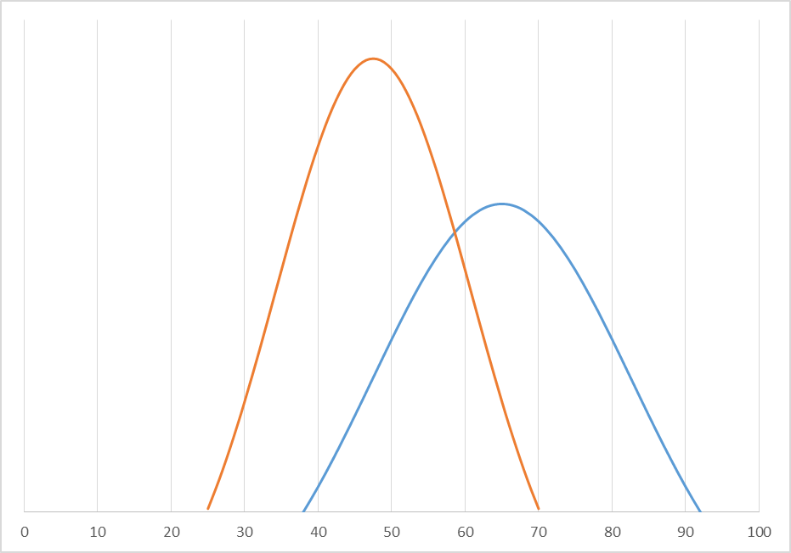
Choosing an Analysis Method
Your choice depends on what your research questions are and what you hope to learn. Common approaches include the following:
Student achievement
Student satisfaction with the after-school math program
Descriptive
Inferential
(describes the data)
(draws inferences based on a sample)

Slide 38
Data Preparation Strategies
Develop a system to organize the data related to your after-school math program:
Define a unit of observation.
Assign a unique participant ID.
Develop a codebook with variable names, response options, and numerical codes.

Slide 39
Visualizing Data
Visualization of data can help to identify patterns/trends as well as identify data errors.
On a scale of 1 to 5, to what extent did the after-school math program help students complete their homework?
Notes:
Based on the graph, what questions might you have about the data?

Slide 40
Spotting Errors with Visualization
Outside of Possible Scores
On a scale of 1 to 5, to what extent did the after-school math program help students complete their homework?
Notes:
Also discuss unexpected values, possible duplicates, and missing values.

Slide 41
Data Cleaning
Process for detecting and correcting/removing inaccurate records and for identifying incomplete or inaccurate parts of the data.
Remove problematic data
Correct errors
Spot checking
Double entry
Descriptive analysis

Slide 42
Potential Limitations
In considering the generalizability of results, keep the following in mind:
Limitations that may arise as a result of the sample used.
The appropriateness of analyses.
The existence of alternative explanations.
Too small
Population
Not representative

Slide 43
Evaluation Matrix: Analysis Method and Interpretation
Handout C
Evaluation Question | Data | Collection Method | Time Frame | Analysis Method | Interpretation
What evaluation question are you seeking to answer? | What data will you use to address this question (e.g., assessment scores, survey response, focus group data) | How will you obtain these data (e.g., existing database query, online survey, in-person focus groups)? | When and how frequently will data be collected? | How will you summarize data to make them usable? | How will you reach a conclusion regarding your evaluation question?
To what extent do students complete homework with better than 80 percent accuracy? | Homework accuracy and completion data for students who did and did not participate in the after-school math program | Request gradebook data related to students’ math homework for students who did and did not participate in the after-school math program | Collect homework data quarterly throughout the academic school year | Compare homework accuracy and completion rates of after-school math program participating and non-participating students, using ordinary least squares regression | Participation in the after-school math program was associated with greater homework completion rates as well as improved accuracy
Notes:
Guide participants in completing the last two sections of the table.

Slide 44
Next Steps
Launching the Training

Slide 45
Lessons Learned
CDE:
REL Central partners have greater skills, capacity, and resources to build training modules.
Needed for years and could not find time and resources to make it happen.
External support has had many added benefits:
Objectivity
Blending and enhancing expertise and knowledge
Has made work a priority
Divide and conquer the work
REL Central:
Identified need for online training modules.
Access to districts and programmatic information.

Slide 46
Next Steps
Training series will begin in December 2019 with modules 1–2 in person in five regions in Colorado.
Modules 3–4 will be online during January and February 2020.
Modules 5–6 will be in-person workshops in March 2020 in five regions in the state
After one year of trainings, we will review, revise, and finalize.
REL Central will publish materials on our website for other states to use.
We will disseminate online training modules for districts and other states to access.
CDE will continue to provide training and technical assistance.

Slide 47
Wrap Up
Questions

Slide 48
Questions
Handout E
Discuss how the modules might be helpful in your context.
Do you have any questions?
Notes:
REL:
Identified need for online training modules
Access to districts and programmatic information
CDE:
REL partners have greater skills, capacity, and resources to build training modules
Needed for years and could not find time and resources to make it happen
External support has had many added benefits
Objectivity
Blending and enhancing expertise and knowledge
Has made work a priority
Divide and conquer the work
Next steps:
Training Series will begin in December with modules 1-2 in person in 5 regions in the state
Modules 3-4 will be online during the months of January and February
Modules 5-6 will be in person workshops in March in 5 regions in the state
After one year of trainings, review, revise, and finalize
Publish materials on REL’s website for other states to use
Disseminate online training modules for districts and other states to access
Colorado Department of Education staff will continue to provide training and technical assistance

