Slide 1
Communities of Practice:
Balancing Internal Stakeholders’ Varied Needs for Monitoring, Evaluation, Accountability, and Learning
David Leege
Korinne Chiu
Adam Lipus
Heather Dolphin

Slide 2
What are communities of practice?
“Groups of people who share a concern or a passion for something they do and learn how to do it better as they interact regularly.”
Wenger-Trayner E. and Wenger-Trayner B., 2015

Slide 3
Some examples of a MEAL community of practice:
Worldwide MEAL staff at an international NGO have regular conference calls to discuss current trends and challenges in their work
Program staff collectively review recent data/evaluations to make sense of trends, lessons learned, and next steps
MEAL staff attend optional webinars to learn about the use of ICT for data collection

Slide 4
Your experience with MEAL communities of practice?
1
I have played a key role in initiating and/or maintaining one
2
I have participated in one but did not play a key role
3
I have not been a part of one
4
I have participated in one but didn’t find it worthwhile

Slide 5
A MEAL CoP can come in different shapes and sizes:
 | Purposes | keep people informed | network |  |  | share tips, lessons |  | produce body of work |  |  | make key decisions
 | Intended Duration | short-term |  |  | ← → |  |  |  | long-term or indefinite
 | Geographic Reach | local | sub-national |  |  | national |  | multiple countries |  |  | global
 | Number of Participants | less than 10 |  | dozens |  |  | hundreds |  |  | thousands or more
 | Means of Participating | in person |  |  |  |  | virtually
 | Nature of Participation | organic |  |  | formalized |  |  |  | institutionalized
Typology adapted from Dubé et al. 2006

Slide 6
A MEAL CoP can come in different shapes and sizes:
 | Purposes | keep people informed | network |  |  | share tips, lessons |  | produce body of work |  |  | make key decisions
 | Intended Duration | short-term |  |  | ← → |  |  |  | long-term or indefinite
 | Geographic Reach | local | sub-national |  |  | national |  | multiple countries |  |  | global
 | Number of Participants | less than 10 |  | dozens |  |  | hundreds |  |  | thousands or more
 | Means of Participating | in person |  |  |  |  | virtually
 | Nature of Participation | organic |  |  | formalized |  |  |  | institutionalized
Typology adapted from Dubé et al. 2006

Slide 7
A MEAL CoP can come in different shapes and sizes:
 | Purposes | keep people informed | network |  |  | share tips, lessons |  | produce body of work |  |  | make key decisions
 | Intended Duration | short-term |  |  | ← → |  |  |  | long-term or indefinite
 | Geographic Reach | local | sub-national |  |  | national |  | multiple countries |  |  | global
 | Number of Participants | less than 10 |  | dozens |  |  | hundreds |  |  | thousands or more
 | Means of Participating | in person |  |  |  |  | virtually
 | Nature of Participation | organic |  |  | formalized |  |  |  | institutionalized
Typology adapted from Dubé et al. 2006

Slide 8
A MEAL CoP can come in different shapes and sizes:
 | Purposes | keep people informed | network |  |  | share tips, lessons |  | produce body of work |  |  | make key decisions
 | Intended Duration | short-term |  |  | ← → |  |  |  | long-term or indefinite
 | Geographic Reach | local | sub-national |  |  | national |  | multiple countries |  |  | global
 | Number of Participants | less than 10 |  | dozens |  |  | hundreds |  |  | thousands or more
 | Means of Participating | in person |  |  |  |  | virtually
 | Nature of Participation | organic |  |  | formalized |  |  |  | institutionalized
Typology adapted from Dubé et al. 2006

Slide 9
A MEAL CoP can come in different shapes and sizes:
 | Purposes | keep people informed | network |  |  | share tips, lessons |  | produce body of work |  |  | make key decisions
 | Intended Duration | short-term |  |  | ← → |  |  |  | long-term or indefinite
 | Geographic Reach | local | sub-national |  |  | national |  | multiple countries |  |  | global
 | Number of Participants | less than 10 |  | dozens |  |  | hundreds |  |  | thousands or more
 | Means of Participating | in person |  |  |  |  | virtually
 | Nature of Participation | organic |  |  | formalized |  |  |  | institutionalized
Typology adapted from Dubé et al. 2006

Slide 10
A MEAL CoP can come in different shapes and sizes:
 | Purposes | keep people informed | network |  |  | share tips, lessons |  | produce body of work |  |  | make key decisions
 | Intended Duration | short-term |  |  | ← → |  |  |  | long-term or indefinite
 | Geographic Reach | local | sub-national |  |  | national |  | multiple countries |  |  | global
 | Number of Participants | less than 10 |  | dozens |  |  | hundreds |  |  | thousands or more
 | Means of Participating | in person |  |  |  |  | virtually
 | Nature of Participation | organic |  |  | formalized |  |  |  | institutionalized
Typology adapted from Dubé et al. 2006

Slide 11
A MEAL CoP can come in different shapes and sizes:
 | Purposes | keep people informed | network |  |  | share tips, lessons |  | produce body of work |  |  | make key decisions
 | Intended Duration | short-term |  |  | ← → |  |  |  | long-term or indefinite
 | Geographic Reach | local | sub-national |  |  | national |  | multiple countries |  |  | global
 | Number of Participants | less than 10 |  | dozens |  |  | hundreds |  |  | thousands or more
 | Means of Participating | in person |  |  |  |  | virtually
 | Nature of Participation | organic/informal |  |  | formalized |  |  |  | institutionalized
Typology adapted from Dubé et al. 2006

Slide 12
Three real examples of MEAL communities of practice
What type of CoP was it?
How did the CoP originate?
What have been the key successes/benefits?
What have been the key challenges?

Slide 13
CARE International: Global MEAL CoP
 | Purposes | keep people informed | network |  |  | share tips, lessons |  | produce body of work |  |  | make key decisions
 | Intended Duration | short-term |  |  | ← → |  |  |  | long-term or indefinite
 | Geographic Reach | local | sub-national |  |  | national |  | multiple countries |  |  | global
 | Number of Participants | less than 10 |  | dozens |  |  | hundreds |  |  | thousands or more
 | Means of Participating | in person |  |  |  |  | virtually
 | Nature of Participation | organic/informal |  |  | formalized |  |  |  | institutionalized

Slide 14
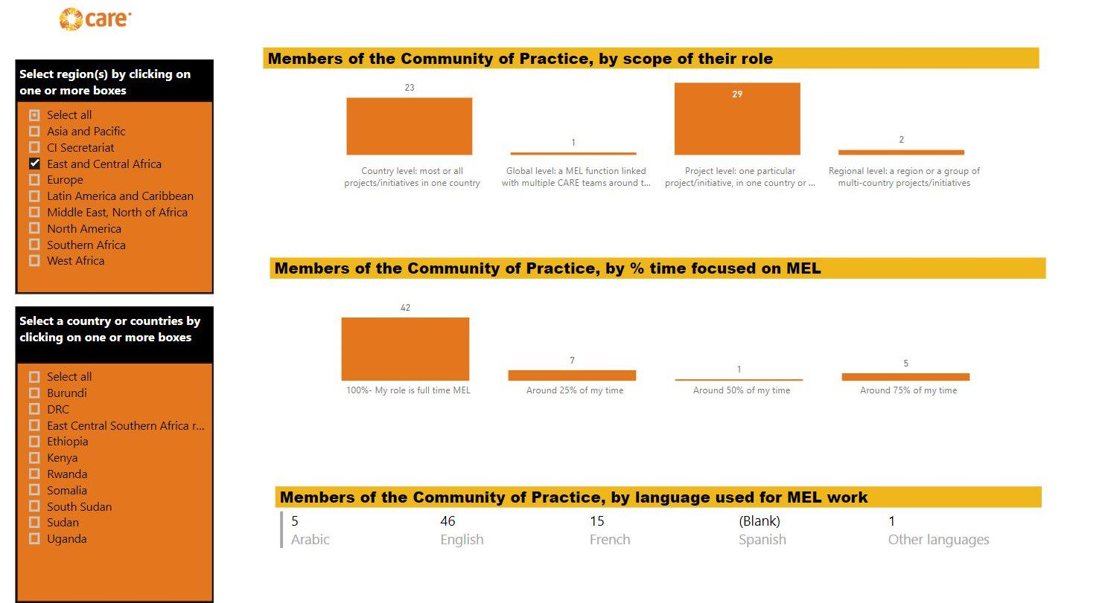
CARE International: Global MEAL CoP
Session highlights:
CARE and the SDGs
Learning from failures documented in evaluations
Measurement and Learning around CARE's Outcomes
Responsible Data
Digital Data Collection
RCTs

Slide 15
CARE International: Global MEAL CoP
Origin:
Began in 2017 with a ToR
Joint facilitation between CI and CARE USA
Accomplishments:
Over 300 members
Understand organizational MEAL capacity through opt-in process
Monthly sessions engaging 30-50 colleagues at a time
Challenges:
Accommodating multiple time zones and languages
Content dictates the audience-Global North vs. Global South
Notes:
Talk a bit about the CoP, e.g.:
How did it come about
Began in 2017 with ToR-prior to this, there was interest but we did not have capacity to regularly facilitate
First session in 2018 and have had sessions on a monthly basis
What does CoP engagement look like
Over 300 members
Monthly calls
Topical sessions
Sensemaking sessions from our global database
What has worked well
Opt-in to CoP-in order to be added to the listserv you must take the capacity assessment-gives us an idea of where our gaps are and can use in regional and global planning
Having 2 facilitators-take turns scheduling, facilitating, taking notes
Consistent platform to share updates on a regular basis (about global data collection, upcoming requests, action plans)
Good way to connect colleagues or for colleagues to connect on their own (use capacity assessment to connect directly)
What’s an unresolved challenge
Continuing to identify the demand of topics-initially we ranked sessions based on interest of the group-now this seems to be more difficult-would love to hear how others are identifying topics and presenters
Staff turnover and updating capacity assessments
Timing of sessions and availability in multiple time zones and languages
Content dictates audience-what is interesting for colleagues in the global North vs. South-and how to balance these

Slide 16
CARE International: West Africa Curiosity Collective
FW: invitation to join - West Africa Curiosity Collective
 | Terms of Reference
 | Sign-up Sheet for Document Review
 | Reporting Template

Slide 17
CARE International: West Africa Curiosity Collective
Perform document review
Discuss in virtual workshop
Synthesize in written report
Identify learning questions

Slide 18
CARE International: West Africa Curiosity Collective
 | Purposes | keep people informed | network |  |  | share tips, lessons |  | produce body of work |  |  | make key decisions
 | Intended Duration | short-term |  |  | ← → |  |  |  | long-term or indefinite
 | Geographic Reach | local | sub-national |  |  | national |  | multiple countries |  |  | global
 | Number of Participants | less than 10 |  | dozens |  |  | hundreds |  |  | thousands or more
 | Means of Participating | in person |  |  |  |  | virtually
 | Nature of Participation | organic/informal |  |  | formalized |  |  |  | institutionalized

Slide 19
CARE International: West Africa Curiosity Collective
What worked?
Open invitation, but core team of 5 to steer process
Small set of prioritized learning questions
Included concrete ask with structure in place to contribute
Challenges
Lack of quantitative data
What’s next?
Maybe the Curiosity Collective will dissolve – and maybe that’s okay
Maybe the learning cycle will continue
Notes:
Initial purpose: synthesize impacts and lessons from 20 years of women’s economic empowerment programming
Can screen shot or link the body of work created

Slide 20
CRS: ICT4D
 | Purposes | keep people informed | network |  |  | share tips, lessons |  | produce body of work |  |  | make key decisions
 | Intended Duration | short-term |  |  | ← → |  |  |  | long-term or indefinite
 | Geographic Reach | local | sub-national |  |  | national |  | multiple countries |  |  | global
 | Number of Participants | less than 10 |  | dozens |  |  | hundreds |  |  | thousands or more
 | Means of Participating | in person |  |  |  |  | virtually
 | Nature of Participation | organic/informal |  |  | formalized |  |  |  | institutionalized

Slide 21
CRS: ICT4D
Origin: 2010 Emerging ICT4D topics group included projects and vendors
Accomplishments
Data enabled diplomacy
Everything presented is monitored in terms of attendance, views
Weekly 30-minute webinars with 50-100 participants
Focus on field team presentations and priorities
Informed by ICT4D support desk, Regional IT staff, newsletter, blog
Challenges
Presentation limited to English and subtitled recordings​
Notes:
The CRS-internal ICT4D webinars were an evolution of a group that was meeting about emerging ICT4D topics from ~2010. The meetings always had an online aspect because of participant locations. We had a mix of field projects sharing experiences, external vendors coming to talk with us and other topics. They gradually became more formalized as webinars with each person who was responsible for facilitating them making improvements to format.
We also run an external webinar series under the banner of the ICT4D Conference. These started in 2017.
Everything presented is monitored in terms of attendance
30 minute sessions
Data enabled diplomacy, accept new ideas, experiment but if participation data doesn't support that topic, won't repeat, preserve relationships. Ignore single voices—look at the aggregate
Focus on field team presentations, strategic presentations eliminated vendor presenters unless they are collaborating with the field
Informed by ICT4D support desk within same unit, reinforced by newsletter, blog

Slide 22
CRS: Accountability
 | Purposes | keep people informed | network |  |  | share tips, lessons |  | produce body of work |  |  | make key decisions
 | Intended Duration | short-term |  |  | ← → |  |  |  | long-term or indefinite
 | Geographic Reach | local | sub-national |  |  | national |  | multiple countries |  |  | global
 | Number of Participants | less than 10 |  | dozens |  |  | hundreds |  |  | thousands or more
 | Means of Participating | in person |  |  |  |  | virtually
 | Nature of Participation | organic/informal |  |  | formalized |  |  |  | institutionalized

Slide 23
CRS: Accountability
Origin
2016 When proposed by first Accountability Advisor
Accomplishments
Each team's proposal to present is a success
Compendium of tools, initial KM
Dynamic exchange with diverse audience over 3+ years
Provides source of support without disrupting structure
Challenges
Direct engagement between members outside CoP
KM about the CoP
Balancing agility with formality
Notes:
Origin: 2016 First Accountability Advisor proposed the idea, to bridge pockets of great work
Accomplishments:
Started with KM of WWW with examples, links into a compendium
Outgrew these tools with so many participants and examples into more dynamic exchange
It’s a success whenever teams come forward with something to share
Provides source of support without disrupting structure
Challenges:
Direct engagement between members
KM about the exchange
Balancing agility with formality

Slide 24
Q&A / discussion
What have you found useful to get people to engage in a MEAL community of practice?
What challenges have you encountered in forming and/or maintaining MEAL communities of practice? How did you overcome those?

Slide 25
Contact information
David Leege: David.Leege@care.org
Korinne Chiu: Korinne.Chiu@care.org
Adam Lipus: Adam.Lipus@care.org
Heather Dolphin: heather.dolphin@crs.org

