Slide 1
Developmental Leadership and Evaluation
Danielle Campbell, Chris Roche and Linda Kelly,
Institute for Human Security and Social Change,
La Trobe University

Slide 2
The Warlpiri Education and Training Trust (WETT)
WETT wins national Indigenous Governance Award, 2018

Slide 3
Cynefin Framework
Snowden and Boone (2007) ‘A Leader’s Framework for Decision Making’

Slide 4
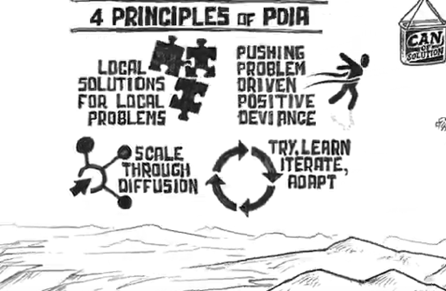
Key Messages
Mixed methods (Mertens and Hesse-Biber 2013; Cowen and Cartwright 2019; Ang 2019)
Feedback loops (Guijt and Roche, 2014; Ramalingam, Wild and Buffardi 2019)

Slide 5
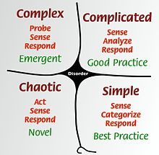
Key Messages - Power and politics matter
Local, contextual
knowledge more
valuable & often
created through
informal
exchange of
local knowledge
Generalisable
knowledge more
valuable &
usually created
through formal
Research or M&E

Slide 6
M&E Staff
Generalised, aggregated
succinct knowledge more valued
Senior Staff
And who is caught in
the middle?
Local, contextual,
rich knowledge & feedback more valued
Front-line staff, local people

Slide 7
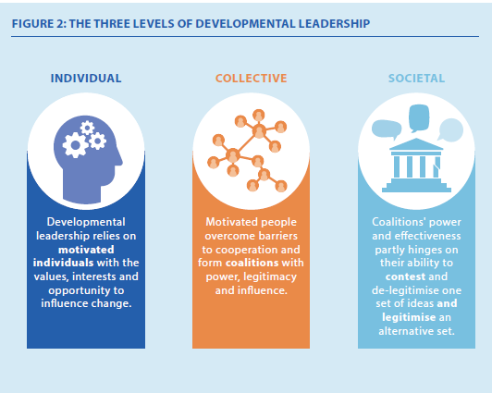
Key Messages
Developmental leadership (Hudson, McLoughlin, Roche and Marquette, 2018)
Appropriate governance arrangements (Roche and Denney 2019)

Slide 8
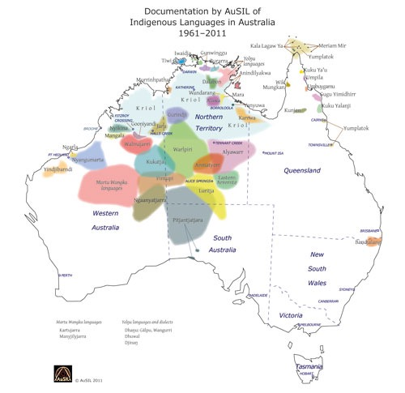
WETT set-up: 2001-07
WETT Painting by Advisory Committee members: Barbara Napanangka Martin, Nancy Napurrurla Oldfield and Maisie Napaljarri Kitson.

Slide 9
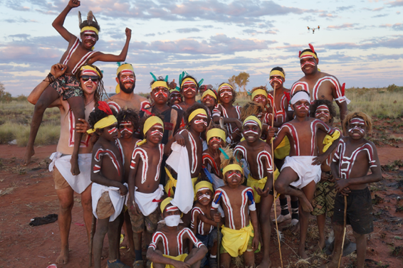
Context

Slide 10
WETT M&E 2008-18
Quantitative data collection
Financial reporting
Capacity measurement
Social return on investment

Slide 11
2008-18 M&E
Interviewing
Case studies
Staff reflections
Social network analysis

Slide 12
2019 - Developing a WETT M&E Framework
WETT Landowner and Advisory Committee members – Oct 2019
Co-facilitators - Marlkirdi Rose and Chris Roche

Slide 13
What do WETT committee members want WETT to support?
PLUS
Strong language and culture
Strong young people, families, leaders and communities
Respectful relationships with outsiders
Self-determination

Slide 14
Implications
Mixed methods approaches needed but the 'right' data/ methods mix influenced by politics, interests and world-views.
M&E practitioners must manage these different interests.
Developmental leadership may be helpful.
Appropriate M&E governance arrangements needed.

Slide 15
