Slide 1
Performance Evaluation on National Policies and Strategies for Child Development
Ujsara Prasertsin*, Chirdsak Khovasint, and Somjet Viyakarn
*Ph.D. Candidate Student in Educational Research Methodology Program at Department of Educational Research and Psychology,
Faculty of Education, Chulalongkorn University, Bangkok, Thailand

Slide 2
Thailand attended the 27th United Nations General Assembly’s Special Session on Children (UNGASS), which was held during the period of 8-10 May 2002 in New York, in order to follow up on progress made by member countries, and formulate future agenda for children.
The Special Session culminated in the adoption by member states of its outcome document known as “A World Fit for Children” as the new agenda for children for the new decade (2000-2010).

Slide 3
As a result of the adoption, member countries have obligations to develop, and implement, their National Plans of Action in pursuant of the goals and targets set forth in the document’s Declaration.
1. Promoting Healthy Lives
2. Providing quality education for all
4. Combating HIV/AIDS
3. Protecting children against abuse, exploitation and violence

Slide 4
Thailand’s policies, strategies and plan of action on child development focus on 11 key priorities
Family and children
Physical and psychological health
Safety promotion and prevention of injuries
Children and the impact of HIV/AIDS
Education and children
Children and recreation
Media and children
Culture and religion and children
Child participation
Protection for children in need of special protection measures
Legislation, rules and regulations concerning children

Slide 5
The ministry** has approved a national policies and strategies development for children. “A World Fit for Children”
(2007-20016) and used as a guide for development of all relevant agencies. Including the preparation of national action plans and provincial level within 3 years (2007-2009)
**The research is financially supported by Office of Welfare Promotion, Protection and Empowerment of Vulnerable Groups, Ministry of Social Development and Human Security.

Slide 6
Research Objectives
1. To evaluate the effectiveness of the operation of national action plans for the child development of short-term within 3 years (2007-2009) in the fiscal year ended 2009 as planned.
2. To evaluate the efficiency and appropriateness of the management and operation of national action plans for development of short-term within 3 years (2007-2009) in the fiscal year ended 2009.
3. To provide guidance on how to improve the operation of the policies and strategies development for children. “A world fit for children”.

Slide 7
Methodology I
The evaluation was based on mixed methods evaluation in form of triangulation design.
For quantitative research, survey study was employed in form of questionnaire for 448 of child development-related organization staff.
Besides, focus group was applied in 129 people from 16 provinces in qualitative study.
The two studies were analyzed to be compared for similarities and differences, as well as data accuracy (Creswell & Plano Clark, 2007).

Slide 8
Methodology II
The evaluation form was CIPP Model 7 of Stufflebeam (2002, 2007) which four aspects were focused-context, input, process and product. Then other four parts were divided for better model- impact, effectiveness, sustainability and transportability
Context evaluation
Identifying the objective
Input evaluation
Planning the goal
Process evaluation
Implementing and Improving
Product evaluation
Deciding and Applying

Slide 9
Research results

Slide 10
context
Provincial officers ran the operation as general work, not mission emerged from the strategies.
National plan of action focused on solving problems arising from social behavior of children and youth rather than protection and development.
Some mistakes occurred from coordination between various departments did not understand their roles and communication was not clear. Including migration and changing position of the officer without delegation.
Notes:
มีมาตรฐานในโครงสร้าง และการพัฒนาสอดคล้องกับกลุ่มเป้าหมาย มาตรฐานทางวิชาการ และงบประมาณ
บุคลากรในแต่ละฝ่าย เพียงพอ และมีความรู้ความสามารถได้มาตรฐาน
การประชาสัมพันธ์ และการคัดสรรกลุ่มเป้าหมายได้ตามที่หวังหรือไม่
วัสดุอุปกรณ์ และแหล่งเรียนรู้ที่จำเป็นเพียงพอ และมีคุณภาพ
มีความเต็มใจที่จะสนับสนุนโครงการของหน่วยงานที่เกี่ยวข้อง

Slide 11
input
The plan was standardized target groups, and its budget was adequately allocated.
Good action plan was the preparation of location, personnel, duration and budget as well as existing customized plan. However, learning resources rarely applied in action plan and activities.
Notes:
หลักการและเหตุผล ตลอดจนจุดมุ่งหมายของโครงการมีความเหมาะสมและปฏิบัติให้เกิดผลและมีคุณค่าต่อประเทศชาติ
แต่การกำหนดกลุ่มเป้าหมายดูจะขัดกับปัญหา หรือโครงการ (สภาพแวดล้อมทางสังคม กับ เด็กและเยาวชน)

Slide 12
process
The plans were appropriate and effective, and monitoring and quality assessment were run.
Strategy to complete all 11 parts showed that Thailand have been working continuously for child development. Before agreement of United nation focus fully or only develop on not specific strategy.
Most observation on national action plan activities were expected to heighten and/or development potential or desirable features of target groups such as risk group or group behavior is a problem rather than children with normal behavior affected these activities did not respond to all children or equality.
Notes:
โครงสร้างของการดำเนินงานเป็นไปตามกลไกของระบบราชการที่เป็นงานประจำ
เป็นไปตามแผนยุทธศาสตร์ที่วางไว้
มาตรการในการควบคุมคุณภาพ เช่น การนำองค์กรอย่างมีวิสัยทัศน์ การจัดกิจกรรมแบบเน้นการเรียนรู้ การเรียนรู้ขององค์กร
และบุคคล การเห็นคุณค่าของบุคลากร และพันธมิตรมีบ้างเป็นบางหน่วยงาน และจังหวัด

Slide 13
effectiveness
The percentage of target group children did not go down as planned.
Number of children and youth with have problem behavior about 15 percent were classified as problems of the province which is necessary to modify the action plan further.
The execution of the action plan was a kind of experimental. It was possible that the plan did not succeed as expected if the number of days or amount of activities not enough to affect behavior change.

Slide 14
impact
The plan officers concentrated on target group children’s behavior, not skill or proficiency improvement.
Implementation of the action plan in provincial level approached on knowledge development from working including knowledge about the nature of children, mission and coordination of each organization and strategy that focused to heighten an understanding of child development, family and community.
Notes:
คุณภาพของกลุ่มเป้าหมายมีการเปลี่ยนแปลงที่ไม่ชัดเจน จำนวนเด็กและเยาวชนในแต่ละปีไม่เปลี่ยนแปลง
แต่ไม่สามารถระบุได้ว่าเป็นกลุ่มเดิม หรือกลุ่มใหม่ จึงไม่สามารถสรุปประสิทธิผลที่แท้จริงของกิจกรรมในโครงการได้

Slide 15
sustainability
The society needed planned operations and offered help and support for cooperation.
The action plan should have been tested in pilot areas of each province before to determine the appropriate of efficiency and result.
Independent entity should be established for child development in each province via working on board system that responded to the needs of children included preventing and resolving of unwanted behavior certainly.
Notes:
โครงการ และการประเมินช่วยให้บุคลากรเกิดองค์ความรู้เกี่ยวกับเด็กในจังหวัด

Slide 16
transportability
The central national strategies and plans could not operated effectively, so each province was supposed to run its own plans and strategies with supports from the center.
One shirt size for all always not fit for everyone. The development followed “A World Fit for children” was the role of each province should be initiated and implemented by supporting and consulting from central rather than supervision and command.
Notes:
ความสำเร็จของโครงการเป็นไปในลักษณะการได้จัด หรือปริมาณ มากกว่าผลที่เป็นคุณภาพ
แต่ดัชนีทางสังคมด้านความต้องการและความจำเป็นของโครงการในระยะต่อไปยังไม่มีการเปลี่ยนแปลง
จึงสร้างความร่วมมือและสนับสนุนจากสังคมได้หากมีการประชาสัมพันธ์ที่ดี

Slide 17
The evaluation staff used quality administration framework called P-D-C-A
Plan-the objectives of the operation were appropriate and effective for child development.
Do-each of the provinces ran and develop the administration to meet the plan objectives, needs and satisfaction in administration and operation aspect.
Check-all operation staff found that it was medium success in all aspects, no strengths and weakness.
Action-a staff meeting after each activity should be conducted for better work achievement and satisfaction, and problems found must be solved for better operations.

Slide 18
Recommendations
recommendations on policy and strategy performance
child development-related organizations in national and provincial level had to establish data base of children and youths.
co operations and data exchange between divisions, departments and provinces were needed for networks.
it would be better to get adjustments from reactive to proactive method, visions for protection, and child improvement rather than problem tackling.
independent entity should be formed by representatives from originations, local people and youths.

Slide 19
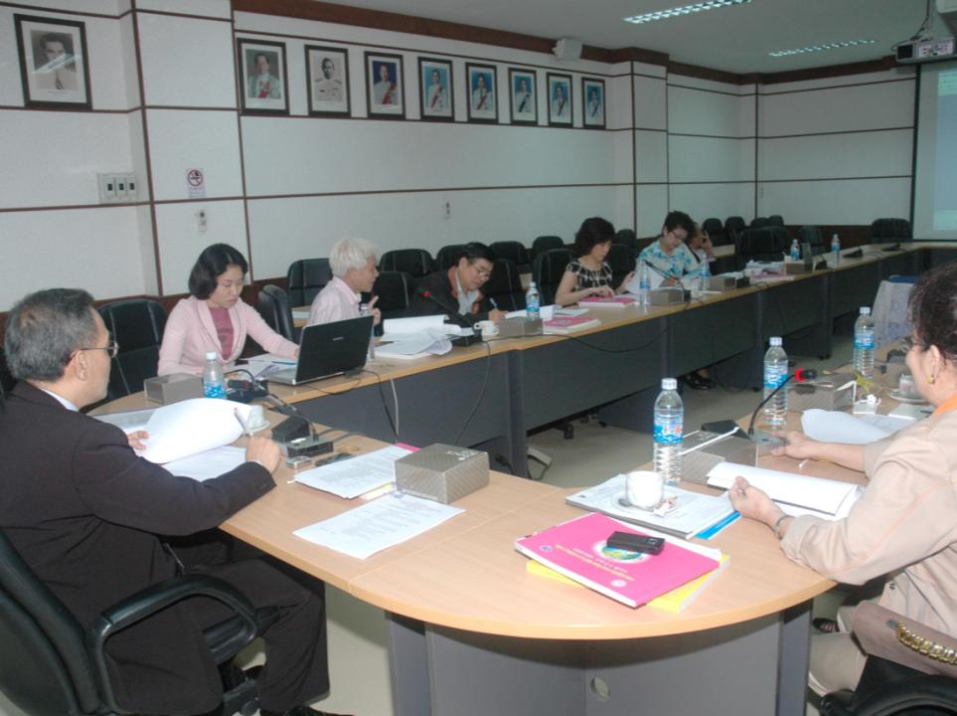

Slide 20
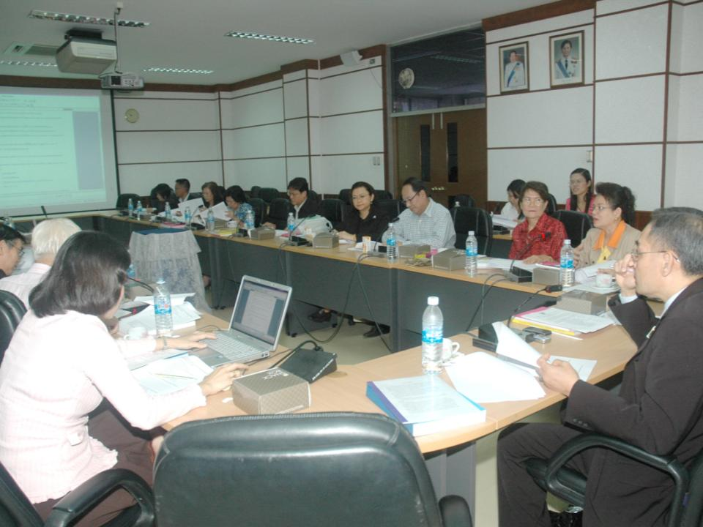

Slide 21
Thank You

