Slide 1
Effective and Sustainable Practices for Government Evaluation Contracting
David J. Bernstein, Westat, Chair
Kathryn Newcomer, George Washington University, Discussant
William H Scarbrough, PIRE
Rakesh Mohan, Idaho State Legislature
Jennifer Hamilton, Westat
Herbert Mark Baum, HMB Consulting Services
Connie K Della-Piana, National Science Foundation
October 17, 2014, 8:00-9:30; Room 708, Colorado Convention Ctr.

Slide 2
Session Outline
Panel Introductions
Session Introduction
5 Main Session Questions
3 Other Questions
Discussant Wrap-Up

Slide 3
Introduction
Problem: The vast majority of United States Federal government evaluations are conducted by contractors, but effective contracting is rarely examined.
Our panel of government evaluators, contractors, and academics will address questions related to evaluation contracting and how it can be done more effectively.

Slide 4
Contracting for Evaluation
http://bj-o23.deviantart.com/art/NOT-Rocket-Science-324795055

Slide 5
Main Session Questions
Name one legal and/or regulatory obstacle that can affect the quality of contracted evaluations. Potential solutions?
Do Requests for Expressions of Interest and question and answer processes improve the quality of evaluation Requests for Proposals (RFPs)?
How do government estimates of level of effort (or lack thereof) and time frames influence evaluation budgets and the conduct of evaluations?
How do contractors decide to bid or not? Do certain practices discourage bidding?
What are the pros and cons of performance-based contracting? Is it possible or desirable for contracting evaluation services?

Slide 6
Other Questions
What about competition?
What practices are effective in non-Federal government organizations?
What are effective measures for streamlining contracted evaluations, and in what contexts?

Slide 7
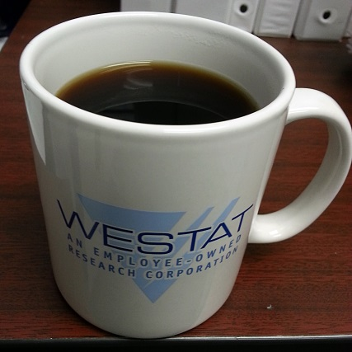
Session Format
Had your coffee yet?
15 Minutes Per Main Question
10 Minutes for Panelists/Discussant
5 Minutes for the Audience
*** Be Brief, Focused, and On Topic***

Slide 8
Question 1
Name one legal and/or regulatory obstacle that can affect the quality of contracted evaluations.
Potential solutions?
10 Minutes Panel
5 Minutes Audience

Slide 9
Question 2
2. Do Requests for Expressions of Interest and question and answer processes improve the quality of evaluation Requests for Proposals (RFPs)?
10 Minutes Panel
5 Minutes Audience

Slide 10
Question 3
3. How do government estimates of level of effort (or lack thereof) and time frames influence evaluation budgets and the conduct of evaluations?
10 Minutes Panel
5 Minutes Audience

Slide 11
Question 4
How do contractors decide to bid or not?
Do certain practices discourage bidding?
10 Minutes Panel
5 Minutes Audience

Slide 12
Question 5
What are the pros and cons of performance-based contracting?
Is it possible or desirable for contracting evaluation services?
10 Minutes Panel
5 Minutes Audience

Slide 13
Other Questions
Did we address these?
What about competition?
What practices are effective in non-Federal government organizations?
What are effective measures for streamlining contracted evaluations, and in what contexts?

Slide 14
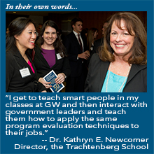
Discussant Wrap-Up
Kathryn Newcomer
Director, Trachtenberg School of Public Policy and Public Administration
Professor of Public Policy and Public Administration
The George Washington University

Slide 15
Contact Information
David J. Bernstein, Ph.D.
Senior Study Director, Westat
davidbernstein@westat.com
(301) 738-3520
@DJBernstein on Twitter

