Slide 1
Process & Outcome Evaluation
Jennifer Reineke Pohlhaus, PhD
AEA Meeting 2016

Slide 2
Anticipated Uses for IMAT Technology
Program Mission: To support the development, maturation, and dissemination of novel and potentially transformative next-generation technologies through an approach of balanced but targeted innovation in support of clinical, laboratory, or epidemiological research on cancer.
Cancer Research
Research Tool to Distribute to Others
Diagnostic Tool to Screen, Identify, or Characterize Abnormalities
Identify Therapeutics
Drug Development
Screenings and Testing Systems
General Commercialization
Overall Knowledge Gain
Automated Technology to Standardize Processes
Outside of Cancer Research
Sample Storage
Improved Research in Related Fields (neurology, maternal medicine)
Notes:
Interview data

Slide 3
Technology application areas of IMAT
Notes:
Survey – could select from multiple categories. As expected Cancer was number one, but additional applications as well.

Slide 4
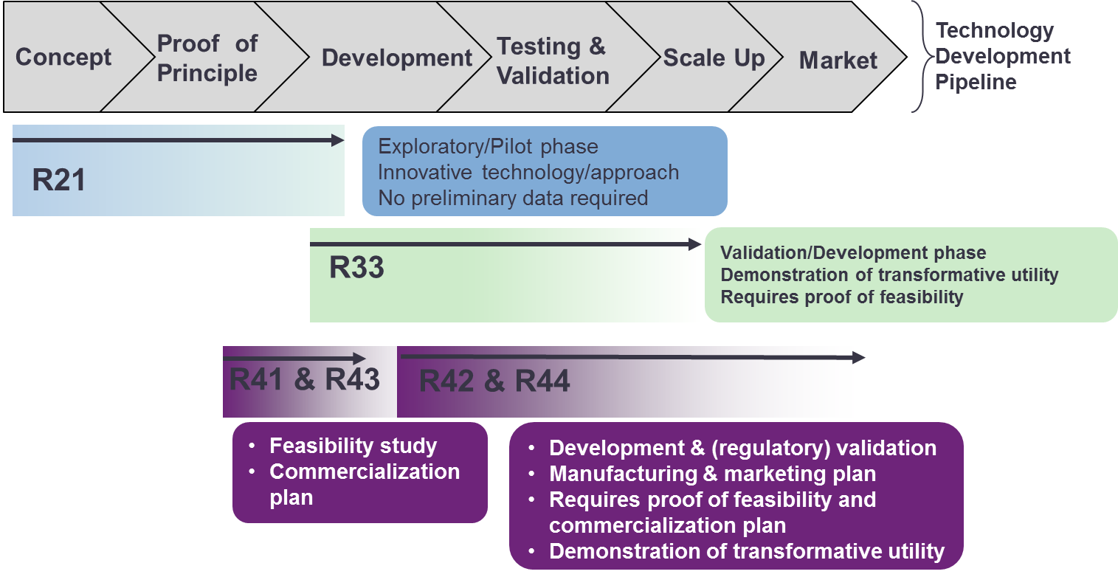
IMAT Program Support

Slide 5
Purposes of the Evaluation
PRIMARY: Conduct a comprehensive and rigorous evaluation to assess process & outcomes
Process: Understand program infrastructure challenges and successes for the purposes of improvement
Outcomes: Understand the successes of supported technologies
Help fulfill NIH’s charge to the Scientific Management Review Board to better “capture and communicate the value of biomedical research supported by NIH” (Dodson, 2016).
SECONDARY: Provide sufficient documentation (e.g., field structure, data relationship structure, and query process) to allow NCI to repeat the evaluation process in the future without having to re-create or revisit previous efforts

Slide 6
Logic Model (Conceptual Framework)

Slide 7
Evaluation Questions
Logic Model Area | Evaluation Question | Archival Data | Web-based Survey | Interview
Initial Investment | What were the pre-existing technologies that served as the basis for technology developed by IMAT? |  | ✓ | ✓
 | What technologies were proposed and what technologies were funded? | ✓ | ✓
Program Activities | How did the application process, FOA/solicitation, and IMAT funding structure (mechanisms) impact the development of the technology? |  |  | ✓
 | How were the technologies developed during the funding period for IMAT grantees? |  |  | ✓
 | How did interactions with NIH, NCI, or other organizations impact the development of the technology for IMAT grantees? |  | ✓ | ✓
 | How did the research environment (e.g. institutional support; other related research activities) impact the development of the technology? |  | ✓ | ✓
Short-, Medium-, and Long-term Outcomes | What was the technology development path after IMAT funding? | ✓ | ✓ | ✓
 | How were the details of the technology spread to scientific and/or clinical audiences? |  | ✓ | ✓
 | To what extent and in what setting(s) is the technology or methodology being used? |  | ✓ | ✓
 | Are there common themes for those grantees that did not achieve their aims within the IMAT funding period? If so, what are the themes? |  | ✓
 | Did the short-term and medium-to-long-term outcomes differ from the comparison group? Stage of Development |  | ✓
 | Dissemination of technology via publications and patent | ✓
 | Self-reported long-term impact |  | ✓
Process
P
Outcome

Slide 8
Data Sources
Archival Data
NIH Guide for Grants & Contracts (FOAs)
IMPACII (Applications & Awards)
USPTO (Patents)
SPIRES (Publications and Citations)
Web-based Survey
PD/PIs
Interviews
PD/PIs
End-Users

Slide 9
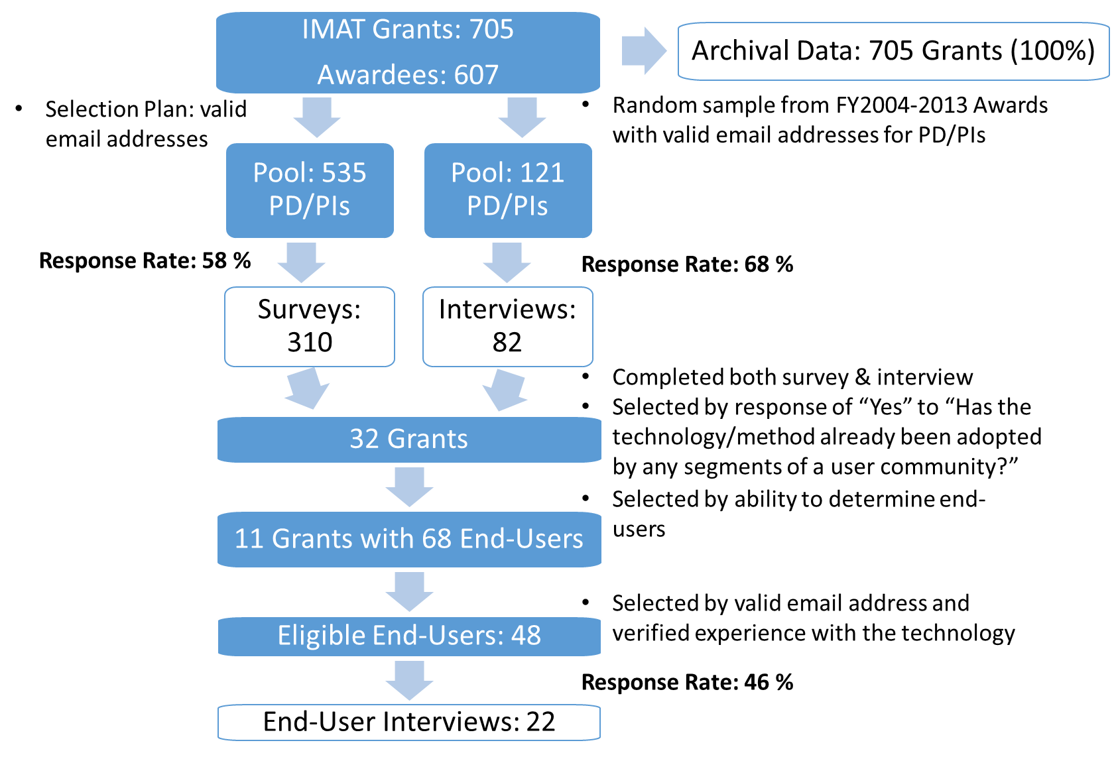
Populations

Slide 10
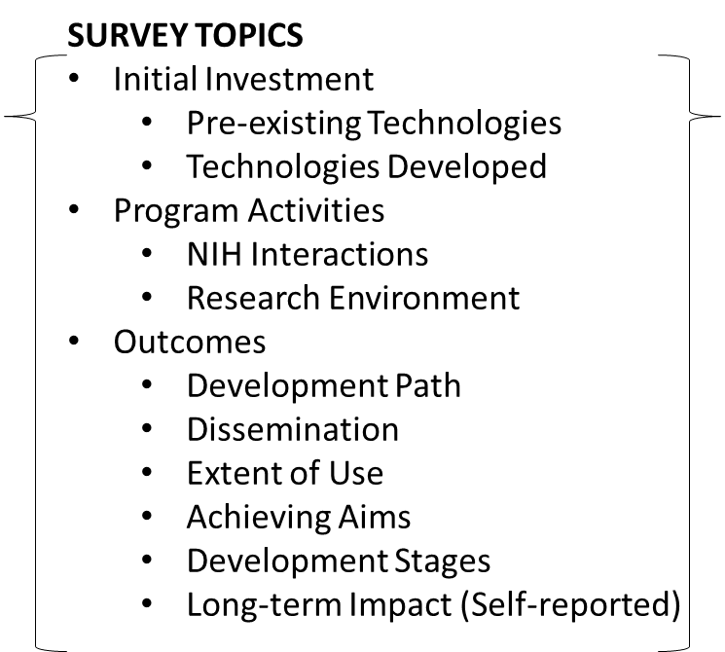
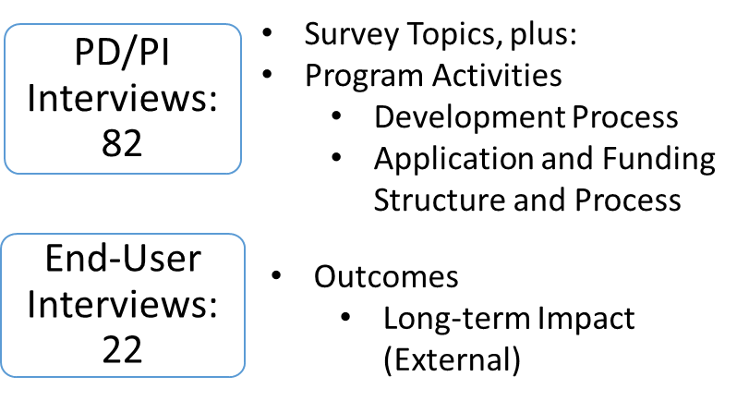
Population: Selection and Sampling

Slide 11
Summary of Findings - Overall
Overall, the results of this evaluation suggest that IMAT is an essential and productive program within NCI
As reported by the PD/PIs, the IMAT program fills a gap and funded major contributions to cancer research
The IMAT program was successful in funding major contributions to cancer research, including more published manuscripts and patent applications and receipts than the comparison group.
Technology End-Users found IMAT-developed technology to be valuable and felt it would enhance public health by enhancing the quality of research (21%), increasing technology efficiencies (21%), and advancing drug development (21%).

Slide 12
Process Findings – NIH Support
Opportunities to meet potential collaborators
Fostering a community of innovation
Learning about alternative funding
Grantees who interacted with NIH before and during the award period appreciated the knowledge, support, and encouragement provided by IMAT program officers and staff and found the interactions improved research plans and results.
Notes:
Interview data
Technical Assistance. Interviewed PD/PIs were asked if and how technical assistance from NCI could have helped overcome any potential challenges that may have arisen throughout the course of the grant. The majority of the PD/PIs reported that technical assistance was not needed or would not have been helpful for their project due to the following reasons:
The PD/PI had all necessary resources.
Technology was too specific for technical assistance.
Collaborators provided enough technical assistance.
Several PD/PIs stated that the only helpful technical assistance would have been additional funding and a longer grant period. Others specifically mentioned that funding cuts significantly impacted the project outcomes.
Participants reported that technical assistance from NCI could potentially be useful if PD/PIs were provided with access to existing resources and expertise from related fields. Others thought that NCI could potentially help connect them to companies or access other programs to obtain samples for technology testing.

Slide 13
Outcome Findings
Technology Development Theory of Action
Notes:
Interview data
Technical Assistance. Interviewed PD/PIs were asked if and how technical assistance from NCI could have helped overcome any potential challenges that may have arisen throughout the course of the grant. The majority of the PD/PIs reported that technical assistance was not needed or would not have been helpful for their project due to the following reasons:
The PD/PI had all necessary resources.
Technology was too specific for technical assistance.
Collaborators provided enough technical assistance.
Several PD/PIs stated that the only helpful technical assistance would have been additional funding and a longer grant period. Others specifically mentioned that funding cuts significantly impacted the project outcomes.
Participants reported that technical assistance from NCI could potentially be useful if PD/PIs were provided with access to existing resources and expertise from related fields. Others thought that NCI could potentially help connect them to companies or access other programs to obtain samples for technology testing.

Slide 14
Dissemination (PD/PI Surveys and Interviews)
95% presented at scientific meetings
89% gave research seminars
65% presented to clinical audiences
24% reported technology-specific uses and methodologies that extended to other projects based on successful results
10% reported adoption of the technology in other labs
27% described a general increase in awareness of their research among colleagues in their field, primarily through publications and presentations
40% reported technology-specific advances and the increased interest as a basis for other researchers’ work
Additionally, PD/PIs said that other researchers have contacted them directly to discuss questions, collaborations, and other potentially related research projects
23% reported that the grant was still in progress or that the technology was in too early a stage of development to be feasible for dissemination or other application
Notes:
An important goal of the IMAT program is to encourage further use of the technologies among researchers and clinicians to help benefit cancer-relevant communities. During the interviews, PD/PIs were asked about their knowledge of practical uses and applications of their technology. Common responses included use of technology by other labs and researchers, use as a starting point for additional research, publications and presentations, and commercialization efforts.
, as well as receiving requests from other scientists, labs, and companies to use their methods, technologies, and techniques. Additionally, participants also reported that the innovative technology has been used as the basis for both internal and external research groups.
PD/PIs discussed presentations and publications (n=32/119; 27%) as a key factor to extending the technology further. Participants reported that publications have led to increased citations and collaborations, and the increased exposure has helped raise more awareness about the utility of the respective technologies.
The vast majority of awardees presented findings from their IMAT research at scientific meetings or conferences (95%), gave seminars (89%), and presented to clinical audiences (65%).

Slide 15
Publications and Citations (Archival Data)
27% of surveyed PD/PIs indicated presentations and publications were key factors in extending their technologies
85% of surveyed PD/PIs reported writing papers and publications to disseminate their technologies
Of 705 IMAT awarded grants, 63% of PD/PIs produced publications
A total of 2,054 unique manuscripts were published under grants awarded by IMAT between the years FY1999 and FY2013.
An average of 150 manuscripts were published each year
Number of years from initial grant award to a manuscript publication
Average = 3 (Comparison Group average = 3)
Maximum = 14 (Comparison Group maximum = 10)
Notes:
PD/PIs discussed presentations and publications (n=32/119; 27%) as a key factor to extending the technology further. Participants reported that publications have led to increased citations and collaborations, and the increased exposure has helped raise more awareness about the utility of the respective technologies.
85% of PD/PIs wrote papers and publications to disseminate their technologies
Multiple grant awards from different fiscal years can contribute to the development of a single publication. In this case, an individual publication was attributed to multiple grant years. As a result, the sum of all publications by grant award year was greater than the number of unique publications.

Slide 16
Publications and Citations (Archival Data)
 |  | Distinct Pubs | Pubs per Grant (Mean) | Impact Factor (Mean) | Citations per Pub (Mean)
R21/R33 | IMAT | 1910* | 5.3* | 7.0* | 44.4*
 | Comparison | 656* | 3.3* | 5.3* | 30.1*
SBIR/STTR | IMAT | 148 | 3.3 | 4.9* | 43.7
 | Comparison | 77 | 2.2 | 4.2* | 30.4
Notes:
Publication Distribution Within the Comparison Group. Compared with the 2,054 unique publications attributed to 705 IMAT-funded grants, 733 unique manuscripts were attributed to 473 Comparison Group-funded grants over the same time period (Figure 23). Of 473 comparison grants, 50.3% (n=238) produced publications, which is less than the 63.4% IMAT-funded research grants that produced publications noted earlier.

Slide 17
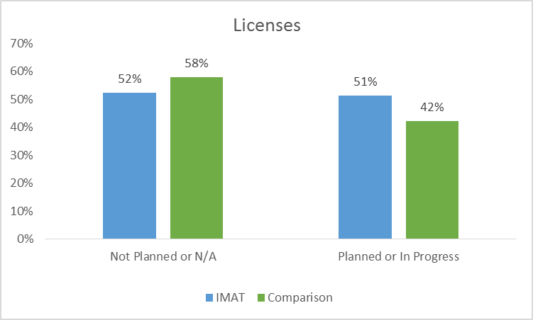
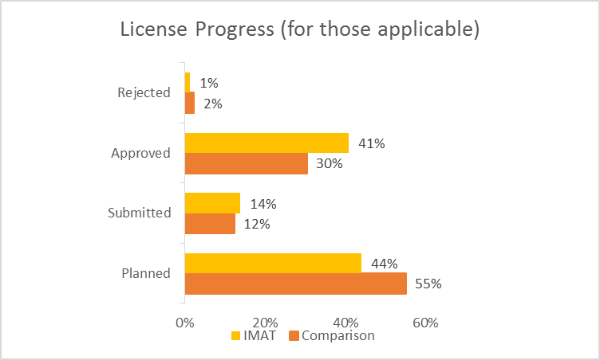
Licenses and Patents (Survey)
Notes:
Of those submitting patents, more than half had already received approval (n=111; 53%), most of the others were submitted (n=69; 33%) several (n=23; 11%) were still in the planning phase, and 2% had been rejected (n=5). Of those submitting licenses, 41% (n=65) already received approval, 14% (n=22) were submitted, 44% (n=70) were still in the planning phase, and 1% (n=2) had been rejected.

Slide 18
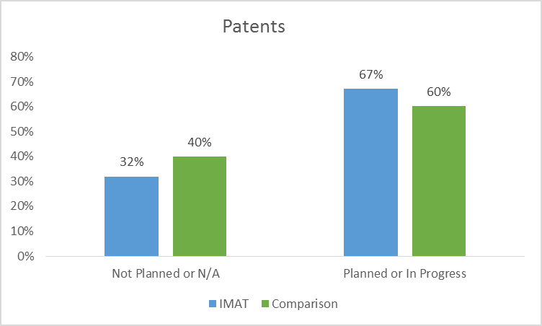
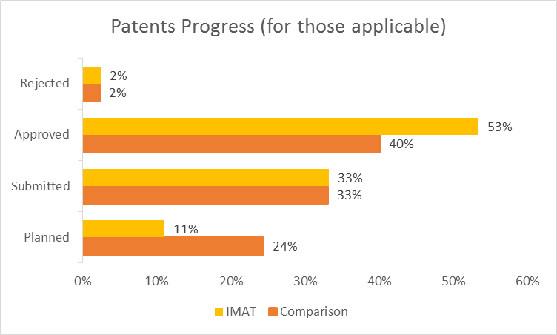
Licenses and Patents (Survey)
Notes:
Of those submitting patents, more than half had already received approval (n=111; 53%), most of the others were submitted (n=69; 33%) several (n=23; 11%) were still in the planning phase, and 2% had been rejected (n=5). Of those submitting licenses, 41% (n=65) already received approval, 14% (n=22) were submitted, 44% (n=70) were still in the planning phase, and 1% (n=2) had been rejected.

Slide 19
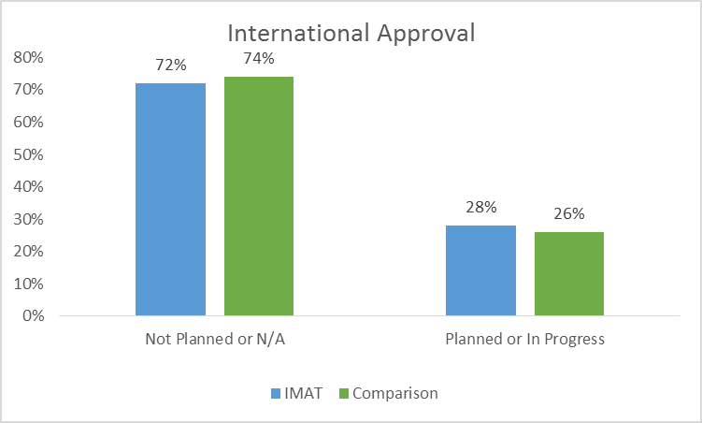
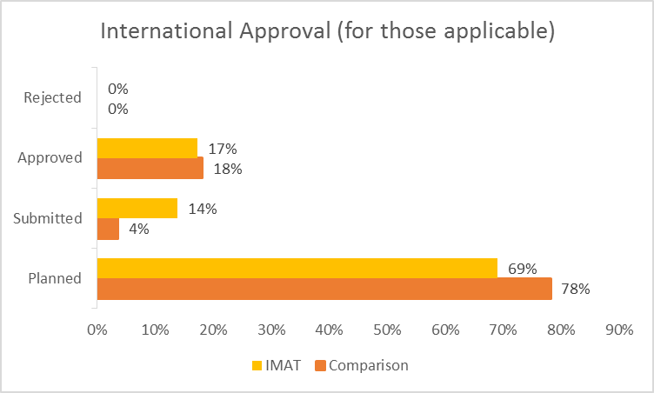
Development and Commercialism (Survey)
Notes:
Of those submitting patents, more than half had already received approval (n=111; 53%), most of the others were submitted (n=69; 33%) several (n=23; 11%) were still in the planning phase, and 2% had been rejected (n=5). Of those submitting licenses, 41% (n=65) already received approval, 14% (n=22) were submitted, 44% (n=70) were still in the planning phase, and 1% (n=2) had been rejected.

Slide 20
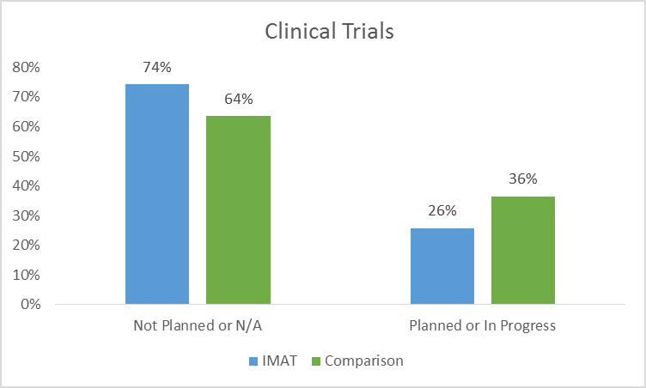
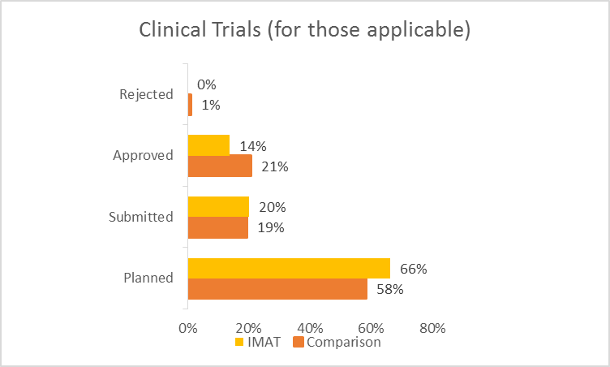
Development and Commercialism (Survey)

Slide 21
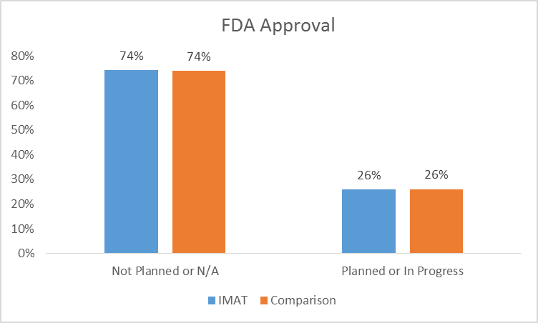
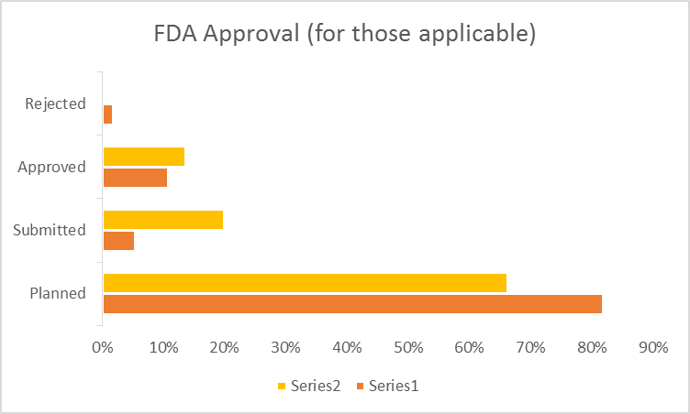
Development and Commercialism (Survey)

Slide 22
Development and Commercialization (Survey)
57% formed strategic partnerships
31% established spin-off companies
4% reported mergers or acquisitions resulting from the IMAT award
1% reported public offerings

Slide 23
Marketing and Widespread Use
54% IMAT technologies achieved marketability
41% Comparison Group technologies achieved marketability
If no, why not?
Notes:
Survey
Almost 30 percent responded to the open-ended option, “Other: please specify,” with almost half stating their research is still in progress (most R21 awardees). A small group reiterated a lack of funding as the problem; two stated a failure to transition to the R33 and two others reported that continued development was perceived as either too expensive or too long-term and risky

Slide 24
Reported Impact of IMAT Program
Notes:
Survey
Incorporate comparison group in the slides or in the notes

Slide 25
Archival Data is a useful data source
Straightforward
Possibility of automation
Reproducible process to keep data current (i.e. documentation provided on using an internal SharePoint database)
Comparison group strengthens our evaluation

Slide 26
Importance of PD/PI and End-User Interviews
PD/PIs believed with IMAT, their research would not have been otherwise funded due to lack of opportunities or high due to risk.
Because of IMAT, researchers identified other sources of funding and hurdles in technology development.
End-Users provided an external perspective to help understand experiences, challenges, and insights into public health impacts otherwise unavailable.
They believed the technology products were instrumental in moving cancer research forward

Slide 27
Program Structure Recommendations
Continue the extensive, responsive communication with PD/PIs
Enhanced PI meetings to include a wider variety of presentations, expansion of attendee types, more time for interactions between participants, and meeting-follow-up activities.
Provide additional resources to help with technology commercialization (e.g., workshops)
Notes:
Brian recommended explaining “technology” here

Slide 28
Challenges and Limitations of the Evaluation
Data quality
Changing external research environment
Program design
Evaluation questions focus on IMAT awards from 1998 to 2013
Comparison group needed to contextualize IMAT program success but not a true control
Notes:
1) Inconsistent reporting (e.g., references to grant number)
Limited enforcement (e.g., submission of final progress reports)
2) Differing success rates over time (33% in 1998 while 14% in 2013)
3) Reduction in funding
Different mechanisms of support
Ability to change aims during grant
4) Intended outcomes may not yet be realized for later grantees
Process questions may not be relevant for earlier awards

Slide 29
Lessons Learned from the Evaluation
To improve future data collection, it would help to:
Ask PD/PIs to include the formal and alternative names of their technologies in the progress reports;
Ask PD/PIs to include downstream development (licensing, adoption by others) in annual reporting;
Incorporate the stages of technology development in annual reporting or a supplemental survey;
Encourage grantees to consistently use NIH’s RePORTER to obtain more data on fields such as number of text mentions for "news" and "media" or number of press releases and "Research Matters" submissions;
Explore the potential to quantify measures of risk for future awards; and
Continue to use select survey items to measure “progress” across grantees.

