Slide 1
Managing Your Needs Assessment Session 827 American Evaluation Association Conference 2012
October 27, 2012
Ryan Watkins, George Washington University, rwatkins@gwu.edu Joy Behrens, World Bank, jbehrens@worldbank.org Maurya West Meiers, World Bank, mwestmeiers@worldbank.org

Slide 2
Session Abstract
Needs assessments may be small to large or simple to complex depending on the nature of the issue to be addressed. Having a process in place to plan and manage your needs assessment – whatever its size and complexity – will aid in the assessment’s success. Without a plan, you are at risk of missing critical steps. Guideposts for logistics and decision-making can help. This demonstration presents relevant needs assessment tasks and concepts in simple groupings, and demonstrates a checklist approach to conducting a meaningful needs assessment. A checklist can be a form of insurance against important pieces of your needs assessment falling through the cracks. Also demonstrated will be the application of several needs assessment methods by a team working in knowledge and learning who wanted to clarify and consolidate their work of advising on the monitoring and evaluation of projects.

Slide 3
Today’s Discussion
Overview of Needs Assessment
Managing a Needs Assessment
Process
Tools
Managing with Flexibility
Underscoring Why You Should Plan Ahead – An Example

Slide 4
What is a Needs Assessment?
Simply defined as: A systematic process to identify and prioritize gaps in current and desired results. Ultimately, needs assessments help to make better informed decisions.
Key issue – The discrepancy between the current and desired results.

Slide 5
Needs
Needs are gaps in RESULTS (not gaps in resources or activities)
Needs (gaps)
0
Process to achieve desired results
Current Results
Desired/Required Results
or
What is (WI)
or
What should be (WSB)

Slide 6
Quick Example
Issue: TRANSPORTATION
Ponder these two questions.
What are the current results that you get with your choice of transportation?
What is the desired results) of your transportation decision?
Next
What are some alternative solutions (activities, projects, etc.) to address the gap in results?
With more time, we would also look at the root causes (e.g., track maintenance) of the current situation.

Slide 7
Needs Assessments Help Us…
Collect useful information from a range of stakeholders that can inform our decisions
Link the results we want to accomplish to our decisions about “what to do”
Consider our alternatives
Verify that our activities will lead to desired results
Create consistency in decision making by implementing systematic processes

Slide 8
Why Needs Assessments…
Provides a systematic process to guide decisions.
Provides justification for decisions before they are made.
It is scalable for any size project, time frame, or budget.
Offers a replicable model that can be applied by novices or experts.
Provides a systemic perspective for decision makers.
Allows for interdisciplinary solutions for complex problems.

Slide 9
Needs Assessments Help Us Avoid…
Avoid those ‘pre-determined’ solutions to problems that have not fully been examined.

Slide 10
Needs Assessments all around us…
Medical (Health) Needs Assessments
Status of geriatric health
Community Needs Assessments
What resources are necessary?
How to spend tax dollars?
Individual-Decision Needs Assessments
Which new car should we buy?
How do I budget my time and money?
Organizational Needs Assessments
How can a project implementation unit can work more efficiently to track disbursements and monitor procurement?
What challenges will VPU staff face in the coming year and what new knowledge would help staff better meet those challenges?
What are the main economic trends faced by countries in a particular region (or organizations in a particular sector) and what actions should governments take to help their constituents?

Slide 11
Three Levels of Needs Assessments
Strategic Needs Assessment
Focus on needs of those external to the organizational (e.g., clients, communities, countries)
Tactical Needs Assessments
Focus on organizational performance and contributions
Operational Needs Assessments
Focus on individual (or team) performance
You’ll want to make sure these are aligned.

Slide 12
Managing a Needs Assessment

Slide 13
Managing: Finding Purpose (3)
Examples of key questions to ask and answer:
Issue to be addressed. Describe the nature of the issue (for example, problem, question, and so on) to be addressed through the needs assessment.
Purpose or goal. What is expected to be learned from the needs assessment? Why is the needs assessment to be undertaken?
Use. How will the needs assessment findings be used? Who will use them?

Slide 14
Managing: Creating a Plan (21)
Requesters
Sponsor(s)
Sponsor contributions
Authorizations
Budget
Time
Other resources
Scope
Terms of reference
Etc.

Slide 15
Managing: Collecting Data (9)
Logic model
Existing data
Data quality, credibility, and verification
Data sources and access
Useful missing data
Data costs
Data security
Sufficiency of data and sources
Sampling

Slide 16
Managing: Other key considerations covered in the book
Categories:
Stakeholders and Informants (10)
Data Collection Method and Instrument Development (10)
Data Analysis Plans (10)
Findings or Results of the Assessment (11)
Written Reporting of the Data (8)
Reviews or Editing of Reports (4)
Oral Reporting (8)
Follow-Up Action Planning after Completion of the Needs Assessment (5)

Slide 17
Managing with Flexibility
Subject: Direction for quality & results team
Training → Results-focused capacity development
Notes:
This effort took place in the context of organizational renewal in the capacity development arm of the World Bank.
The idea was to go from an old model that focused on training, where results were defined in terms of how many courses were delivered, and sometimes in terms of increased knowledge on the part of those who participated in training
To a new model that focused on the purpose of the new knowledge
In the new model – one way people refer to it is as results-focused capacity development – the process starts with developing a concept of the environment, of the development situation, and of what change in that broader environment or situation we are trying to accomplish in the context of capacity development.

Slide 18
Re-finding Purpose
Wanted:
Fewer “same old” training behaviors
More new behaviors around results-focused capacity development
Notes:
Our team, the capacity development and results unit, had the task of laying down infrastructure for the new model of organizing capacity development.
By infrastructure here, I refer to creation of new templates for describing streams of work, policies, procedures based on an overall results framework.
And had the task of working with other teams in small groups to ease the transition to the new perspective, build awareness and understanding of the new results framework.
Realized we were getting different kinds of results in terms of new behaviors – sometimes the new way was catching hold, other times it was not
Wanted to understand what worked, what didn’t work, in interactions with teams
Basically, an internal consulting function

Slide 19
Create Plan… or Seize Opportunity
Requester
Authorizations
Budget
Time
Terms of reference
Notes:
In the experience of it, this needs assessment felt more like taking advantage of an opportunity that presented itself, rather than creating a plan in the way one might like to do under ideal circumstances.
The opportunity was a unit-wide retreat last winter, which brought together subteams that did not necessarily work together every day, but that were doing similar kinds of work, to some extent making it up as they went along.
Still we had the elements of a plan – the requester was our unit manager, the authorizations were set in place partly by dint of the retreat organization; and the terms of reference ended up being clarified as part of the retreat preparation
Figure out what is working, do more of that so as to help teams better

Slide 20
Sources
Logic model: existing capacity development results framework
Staff who had been doing internal consulting
Internal clients?
Notes:
One of the things that having checklists like this helps with is that in times when you are working based on opportunity, you have a touchstone to refer to, something to go look up when things get chaotic
We did have materials to work with – an important source was our logic model, the capacity development results framework, and this gave us a point of reference – helped to bring the new team members up to speed, helped for different parts of the unit to understand better
Another important source were the people who had been working with teams, helping with the change process
By logic, another important source would be internal clients themselves – one of the drawbacks of the constraints of working by opportunity was that they were not in the room at the time this was happening… but there was a realization that their input would be needed
We had some input from their managers to our manager

Slide 21
Data collection
Nominal group technique
Review of documents
Notes:
The data collection that we identified we could do involved a structured process of understanding the different experiences in the room
We did this through a modified version of nominal group technique
Later, another data collection occurred through review of documents produced during the past half-year of advisory services

Slide 22
Data analysis
Concept mapping
Triangulation with document review
Notes:
The beginning of our analysis occurred during the retreat itself, when we grouped and prioritized the ideas that had surfaced during the nominal group technique portion of the retreat
Later, using the results of the document review, we further refined our groupings to come up with different areas that as a group we thought would be important in approaching internal client groups in different scenarios
(handout – diagram)
As you see, the groupings, the diagram, are still in draft, but the process that created this has been used

Slide 23
Findings
Templates for concept notes
Intranet resources
Modifications to internal information systems
Notes:
Started opportunistic, and remained opportunistic, in the sense that the concepts or the grouping of concepts fed into use rather than into reports in the sense of paper.
We ended up using what we had created to inform templates such as for concept notes, which are foundation documents for each work stream; assembled resources on an intranet site; used the grouping of ideas to inform modifications to internal information systems so that they better reflected the results-focused approach.
Moral of the story: Management under chaos is possible, and in that situation a checklist sure is handy – by which I mean it helps you bring structure and a systematic approach when you sorely need it.

Slide 24
Underscoring Why You Should Plan Ahead – An Example
Example: Arlington-Fairfax Pike Transport Initiative (trolley)*
The project report with many features that are useful to model when preparing your own needs assessment report.
But the project faces challenges, which we’ll discuss.
See handouts
*The presenters have no affiliation with this example.

Slide 25
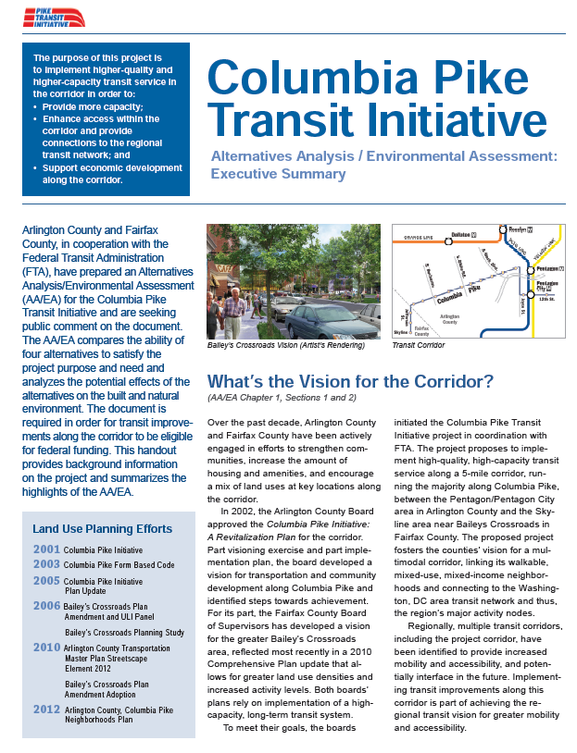
A type of needs assessment
Good example of desired results
Earlier vision planning done
Justification for this analysis – federal funding requirement
When was this study done?

Slide 26
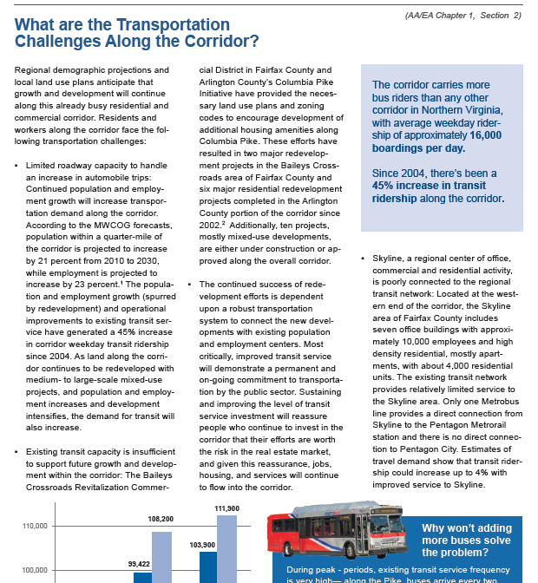
Challenges identified

Slide 27
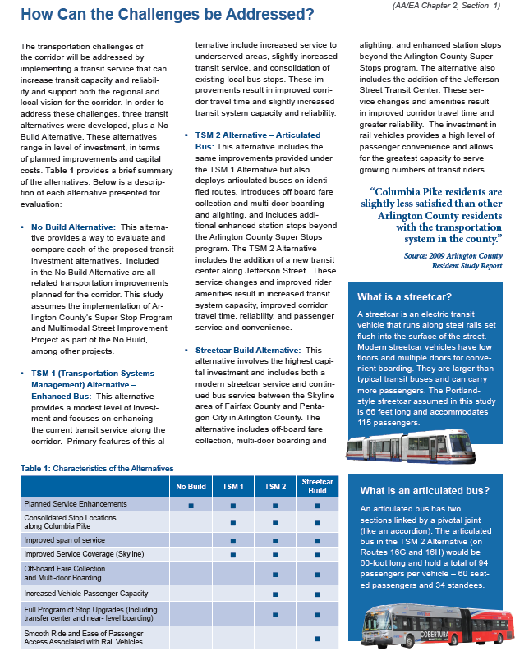
Good example of alternatives to address the gap – including a “no build” option

Slide 28
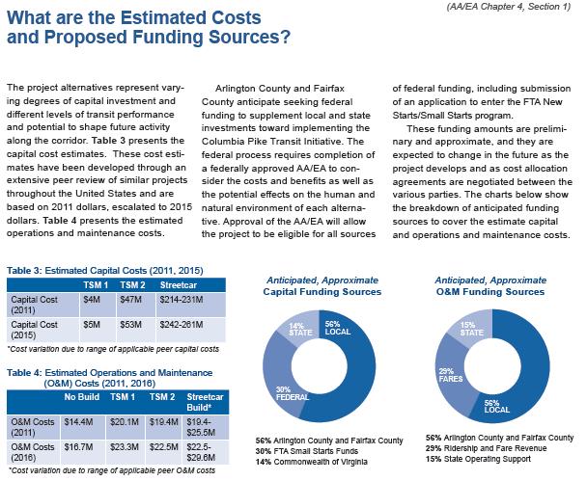
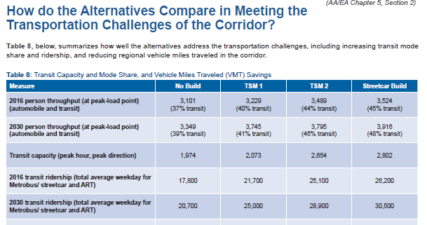
Good example of inclusion of a cost analysis plus how the alternatives meet the challenges

Slide 29
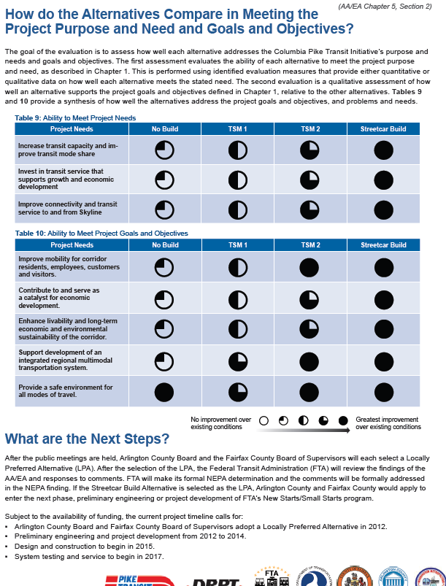
Example of Comparison of Alternatives
What conclusions do you have about the alternatives (based on this and other info)?

Slide 30
Final thoughts
Good example of what to document in the NA, though
Methodology missing from the executive summary (more in full report)
Info vague in the summary about who the sponsors are of the study and who prepared it
Most importantly, assessment was completed after a “solution” was predetermined (data does not seem to fully support the recommendation)
BIG ISSUE – It’s OK to reconstruct a NA if it was done and not documented. But doing one “after the fact” to justify a solution is problematic.

Slide 31
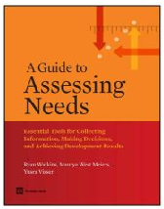
More resources
www.gapsinresults.com
www.needsassessment.org
Both maintained by Dr. Ryan Watkins, co-author of “A Guide to Assessing Needs.”
American Evaluation Association (AEA) Needs Assessment Thematic Interests Group (TIG) at www.eval.org.

