Slide 1
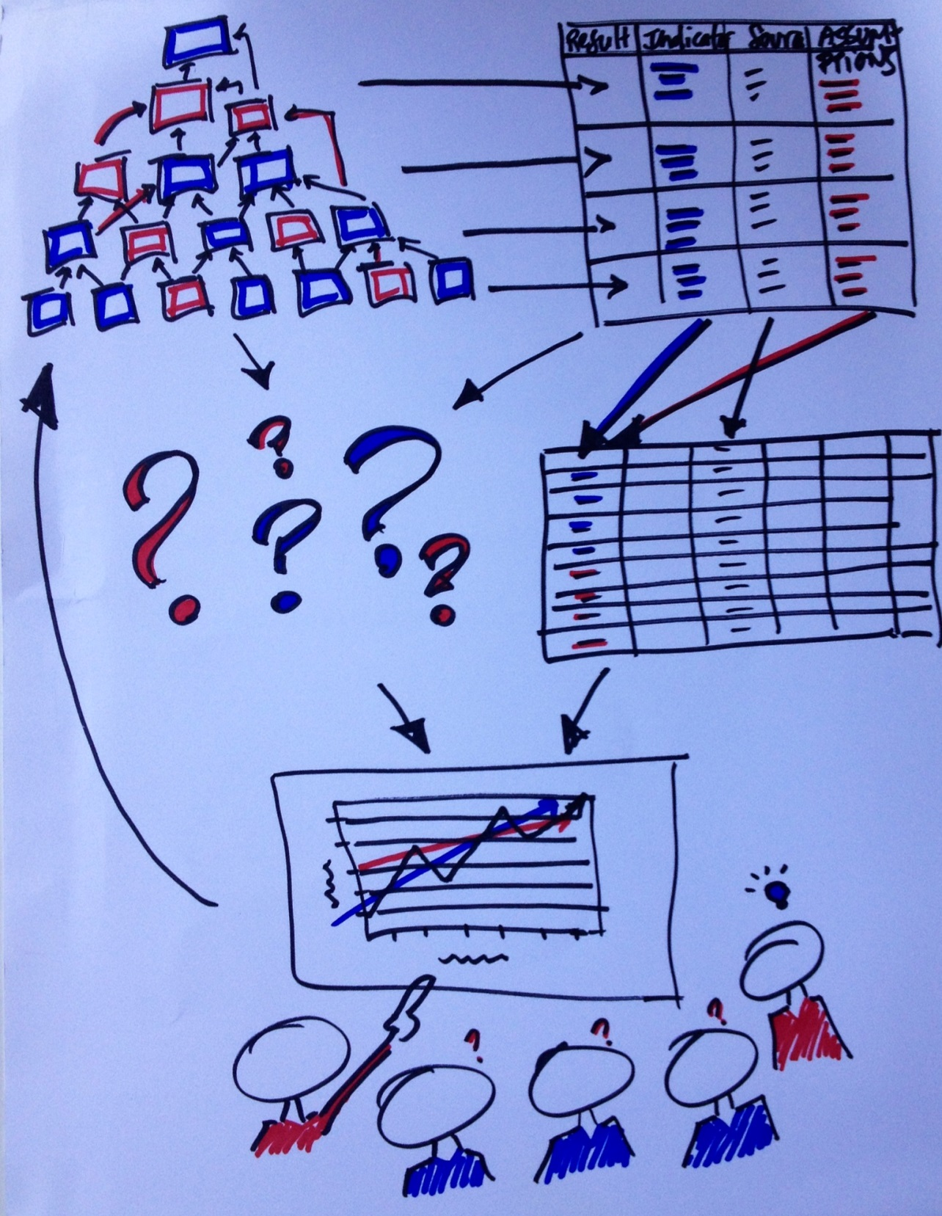
LIVING
LOGIC

Slide 2
What Was Mission Metrics?
An agency initiative to
understand how we – collectively –
are achieving our mission.
Mission Statement
Mercy Corps exists to alleviate suffering, poverty and oppression by helping people build secure, productive and just communities.

Slide 3
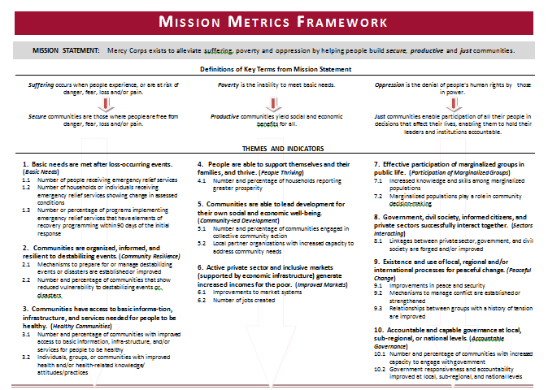
Definitions
Themes
Indicators
3

Slide 4
35
Mission Metrics Learning Cycle
Incoming Data
Analyze
Reflect/ Discuss
Cycle of Learning
Review Results/Learn
Make Decisions
Take Action

Slide 5
Mission Metrics – Lessons Learned
Focus early and often on use – what questions do you want to answer and who will listen/act? Is this about PR (‘telling our story’) or about improvement? Actionable?
Think hard about what it will take and what you will give up to make it happen –consider organizational culture – does it fit? Is it worth what you will invest?
Link closely to program M&E processes but limit extra data or work – put what you can on the front-end, even if it’s cost-loaded
Allocate quality IT and data management systems – invest more up front to avoid re-building and ongoing maintenance later
Limit expectations as you go – can’t be all things to all people, but they will still expect it – keep reminding them
Give it time – it may take up to 10 years to develop and fully embed - will your organization have that patience?
Be super careful about terminology – how to use ‘impact’ ; agency-level systems versus agency-level results
Keep track of the successes and examples of how it is used – you will be asked to explain and justify again and again

