Slide 1
Learning More From Teacher Logs:
An Example From the NASA Explorer Schools Evaluation
RJ de la Cruz
Sarah D. Sahni
Alina Martinez
October 26, 2012

Slide 2
Outline
NASA Explorer Schools (NES) Program
NES Evaluation
Why Use Logs for NES Evaluation?
Log Administration
Log Design
Reporting Results
Challenges

Slide 3
NASA Explorer Schools (NES) Program
Goals of the program
Inspire and engage
Foster authentic learning experiences
Achieving the Goals
Bring NASA into the classroom
Access to NASA’s people, missions, and research
Notes:
Goals of the program
Inspire and engage future scientists, engineers and technicians
Foster authentic learning experiences for middle and high school students
Achieving the Goals
Bring NASA into the classroom by sharing materials through an online website
Give educators access to NASA’s people, missions, and research

Slide 4
NES Project Materials
Featured Lessons
Science, technology, engineering and math (STEM) lessons that can be integrated into teachers’ curriculum
Professional Development
Live webinar format and on-demand video
Linked to specific featured lessons
NASA Now events
7 minute video clips relevant to current NASA activities

Slide 5
NES Evaluation
NES program was redesigned in 2008
Program had limited understanding of participant use
Incorporate evaluation and data into program decisions
Evaluation 2011-2012
Which NES materials are teachers using?
How are teachers using the NES materials?
What are teachers’ impressions of the materials?
Does teacher participation lead to a change in student interest in STEM?

Slide 6
NES Evaluation
Data collection components
Teacher surveys (online)
Student surveys (paper)
Monthly teacher logs (online)
Student focus groups (in person)
Program registration data

Slide 7
Why Use Logs for NES Evaluation?
Collect data when it is fresh
Ask about material use shortly after use takes place
Improved recall of material use
Multiple data points add detail
Survey: Last impression most salient
Log: Weigh impressions equally

Slide 8
Log Administration
Log invitations sent to all teachers participating in evaluation
Individualized links emailed at the end of each month
Online software used to administer monthly logs and track response rates

Slide 9
Log Administration
Response Rates
About 300 log invitations were sent out per month
About 200 logs were completed per month
Reminder emails and phone calls to improve response rates

Slide 10
Log Design

Slide 11
Log Design

Slide 12
Log Design

Slide 13
Reporting Results
Multiple ways to report results
Aggregate data (final report)
Sums
Averages
Month by Month data (final report)
Data varied over time
Real-time data (monthly report)

Slide 14
Reporting Results - Aggregate Data
Aggregate data examples
Participation Rate
Ex: 151 teachers reported using a featured lesson at least once during the year
Participation Level
Ex: teachers reported using an average of 3.5 unique featured lessons over the course of the year

Slide 15
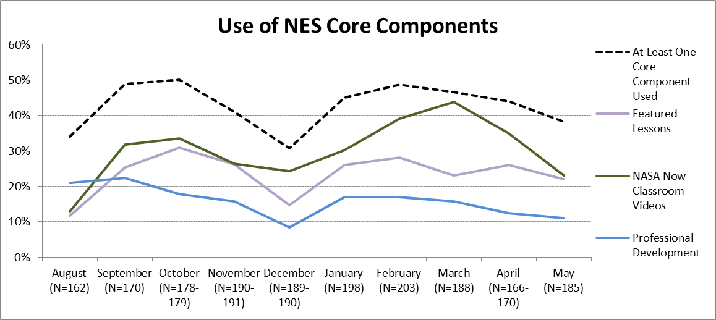
Reporting Results – Month to Month

Slide 16
Reporting Results – Real Time
Already collecting data in monthly increments
Request for preliminary data to be reported on a monthly basis
Program has quicker access to study results
Immediate informed strategic decisions
Respond to inquiries from agency leaders

Slide 17
Monthly Data Report Example

Slide 18
Using Real Time Results
Program identified a gap in the log protocol
Why do teachers choose NOT to use NES materials?
Question added to the log
Results added to the monthly data report.
Program can use results immediately
Identify the most common barriers to teacher participation and address them without waiting for final report.

Slide 19
Monthly Data Report Example

Slide 20
Using Real Time Results
Teachers provided examples of how they incorporated NES into their community
Program can share the best examples with the rest of the NES participants
"We invited community members and school board members to attend our Aquarius habitat unveiling."

Slide 21
Challenges
Resource intensive
Many reminders needed to maintain high response rate
How to treat data from a teacher who only submitted a subset of her logs
Teachers confused online log with online teacher survey

Slide 22
Questions and Comments?
Contact information
RJ de la Cruz
rj_delacruz@abtassoc.com
617-520-2447

