Slide 1
Data Interrogation: Using Complementary and Opposing Lenses for Un-and Dis-covering
Bradley Rentz and Sheila Arens
American Evaluation Association Annual Conference
November 15, 2019
Minneapolis, MN

Slide 2
Our Presenters
Dr. Bradley Rentz
Researcher
REL Pacific at McREL International
Dr. Rentz provides research and consultation support for a variety of projects under the REL Pacific contract. Dr. Rentz holds both a Ph.D. and M.A. in Linguistics from the University of Hawaiʻi at Mānoa and a B.A. in German and Linguistics from Marquette University.

Slide 3
Our Presenters
Dr. Sheila A. Arens
Executive Director, Research & Evaluation / McREL International
Dr. Arens provides research oversight for the REL Pacific contract. She holds a Ph.D. in Inquiry Methodology from Indiana University and a M.A. in Experimental Psychology from the University of Colorado.

Slide 4
Objectives
Examine the role of biases and downfalls in using linear regression analyses.
Present alternate analysis methods used in research that may allow for emergent patterns and categories from the data.

Slide 5
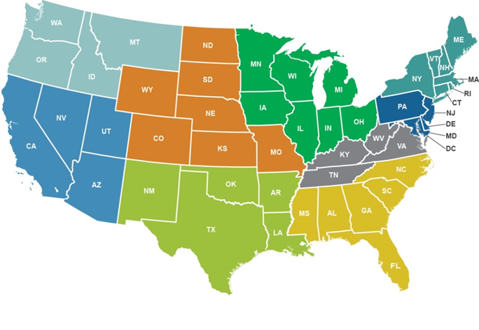
We are one of 10 Regional Educational Laboratories (RELs).
REL Northwest
REL Northeast
& Islands
REL Central
REL Midwest
REL Pacific is a five-year contract (2017–2022) funded by the
U.S. Department of Education.
REL
Mid-Atlantic
REL Appalachia
REL West
REL Southeast
REL Pacific
(only Hawai‘i shown)
REL Southwest

Slide 6
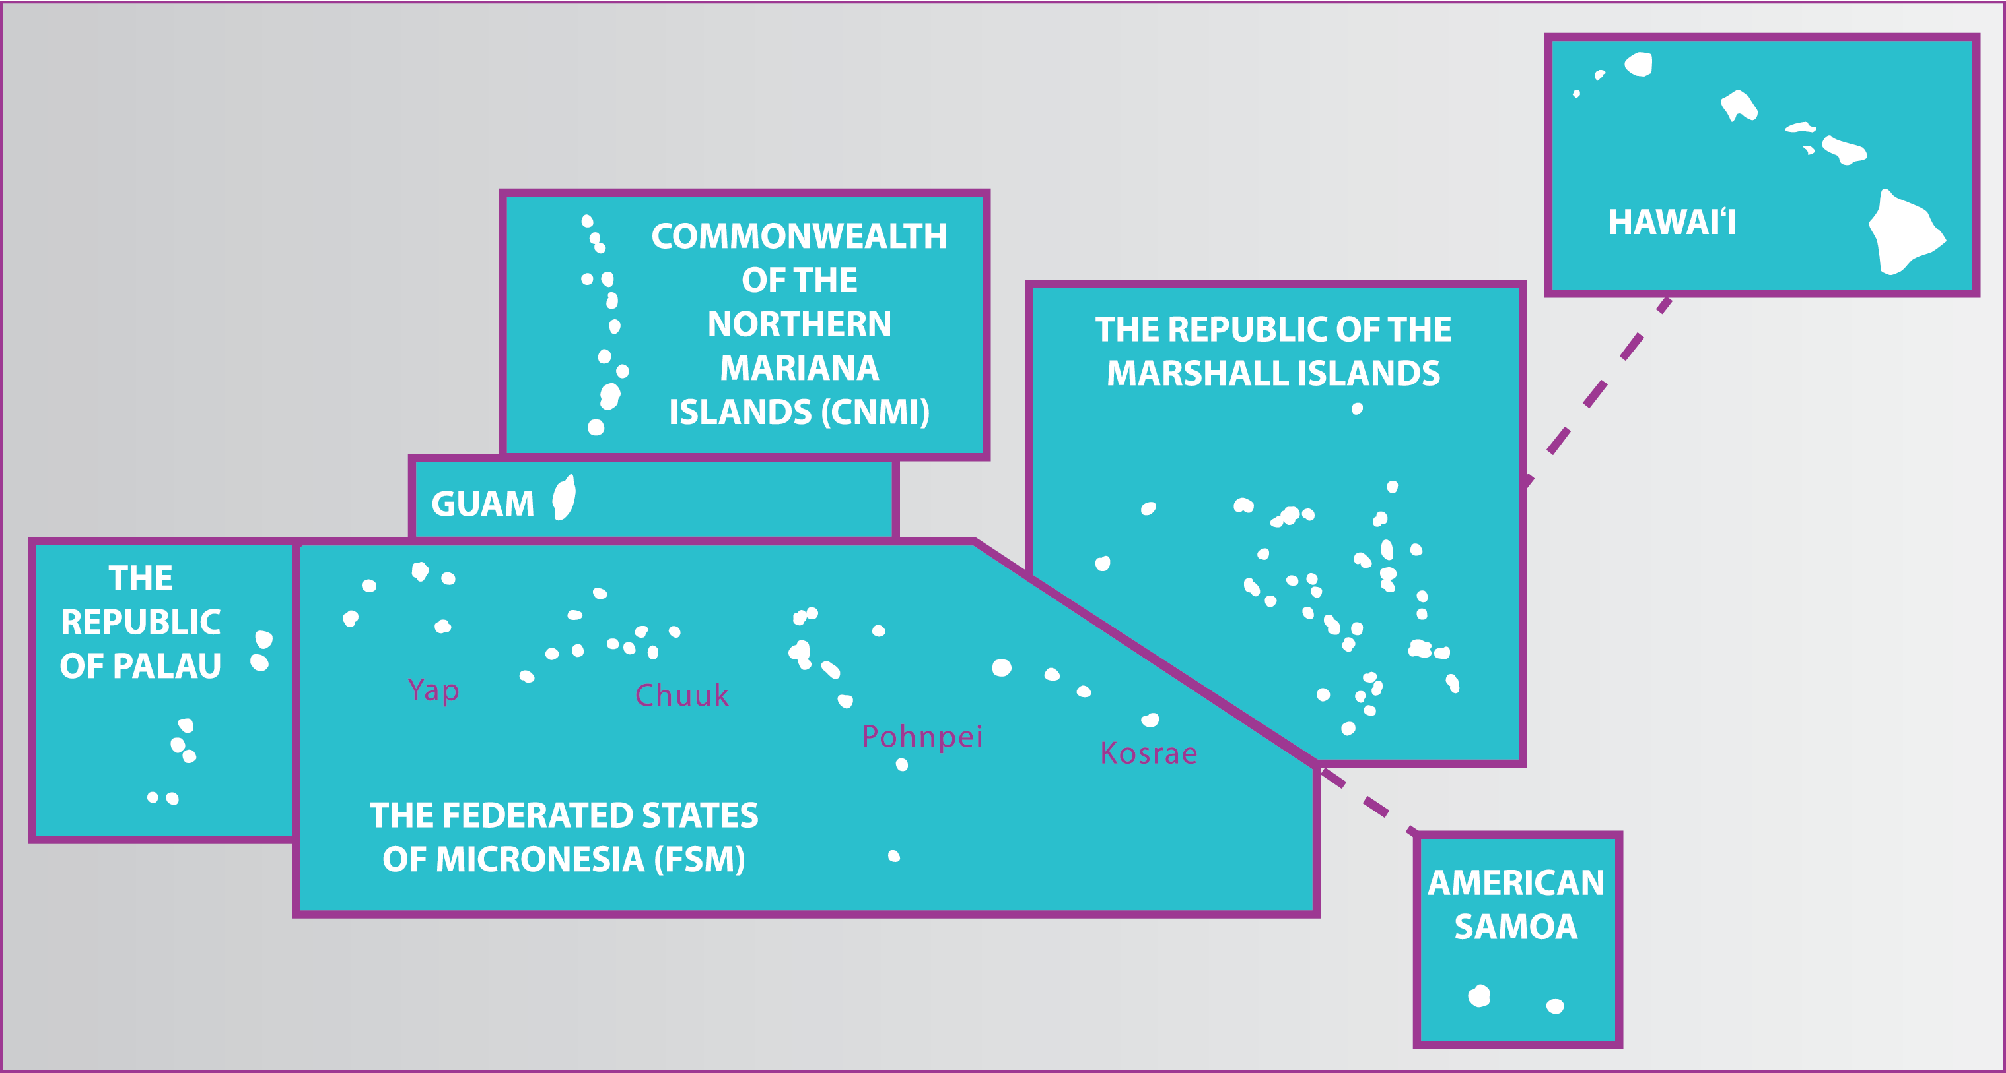
REL Pacific Service Region

Slide 7
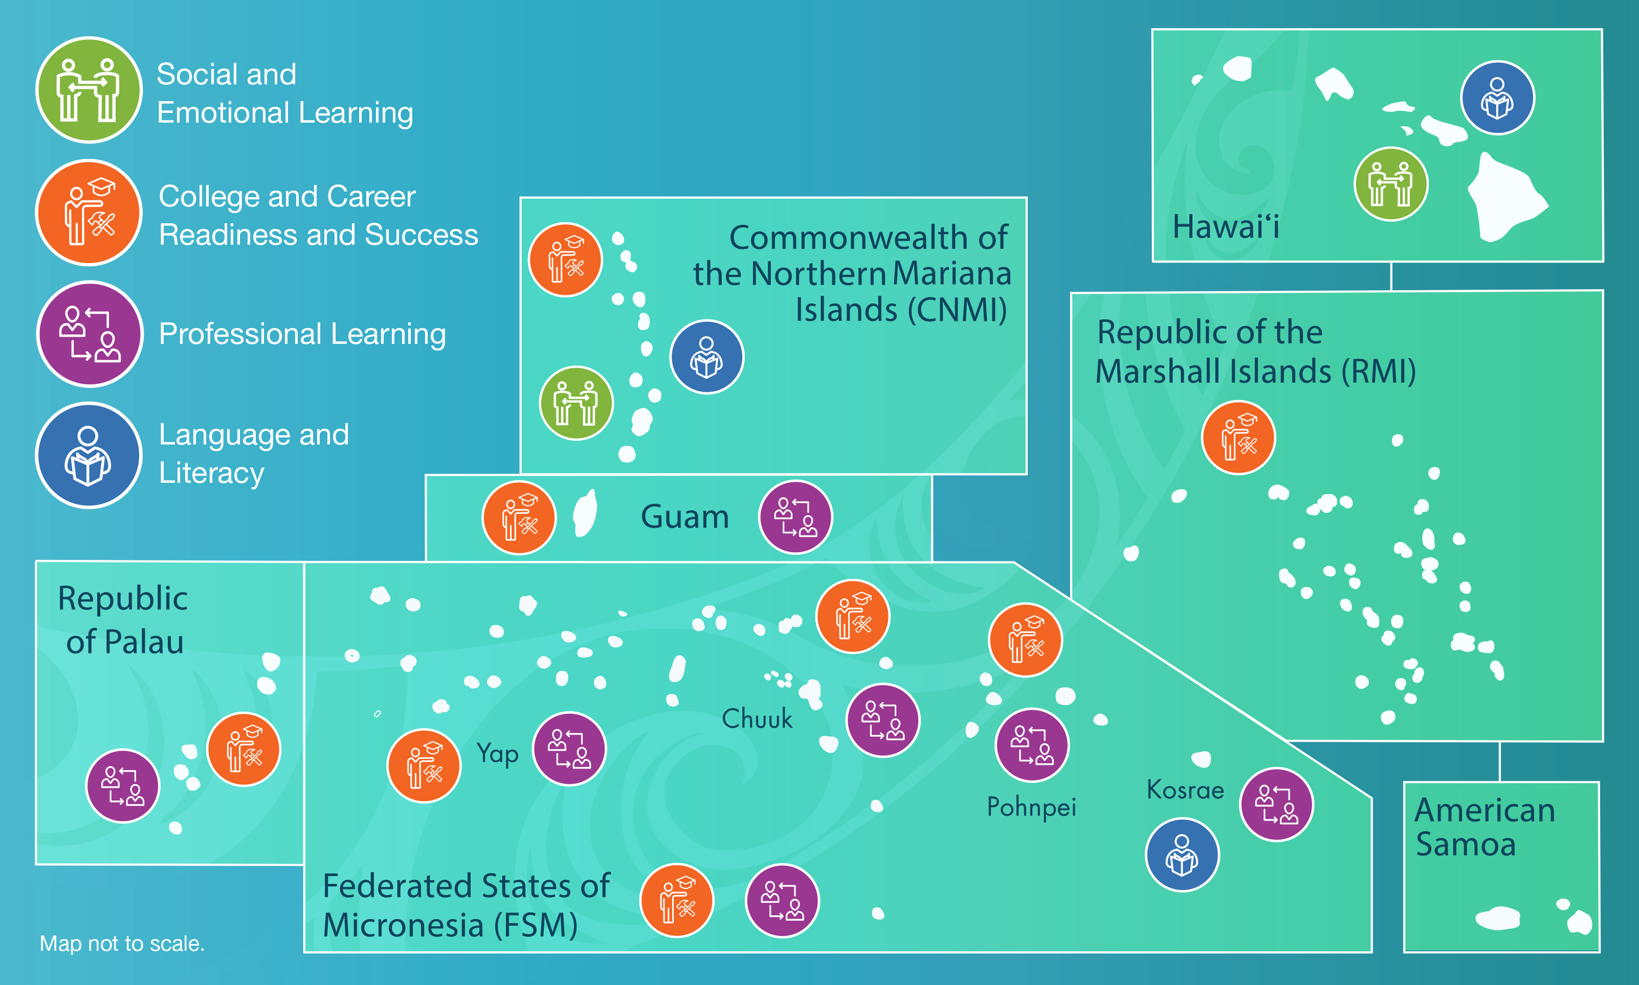

Slide 8
How Using Common Statistical Methods Can Embed Social Biases into Analyses
Common methods like the regression family of analyses can embed social biases into analyses, which can skew research results.
These biases may stem from the variables (i.e., demographic variables) commonly used in the analyses.
Sometimes it is of interest to test if those biases affect the outcome that is being studied, but at other times they may overshadow the actual reality.
(Walter & Andersen, 2013)
Notes:
All analytic methods can (and should) be critically examined—particularly when these may create or reify particular social biases. Researchers and those being researched may not even be aware of the implications that particular categories or labels (widely accepted categories to describe sub-samples of a population or researcher-created categories of labels that may facilitate data analyses by reducing the number of categories) may have. For instance, even when inquiry is descriptive, the categories used to describe the participants can begin to shape how those people self-identify.

Slide 9
Linear Regression: Easy but Biased
PRO: Linear regression is a very common analytical tool
Provides easily interpretable results.
Easy to perform (available in most statistical packages).
Is extremely useful when the relationship between variables is linear.
Multiple linear regression enables researchers to examine multiple predictor variables.
CONs: Very strong assumptions:
Independent variables (IV) must vary linearly with dependent variable (DV).
IVs must not be collinear with each other.
Variables must follow a normal distribution.
The model must be homoscedastic (the model’s residuals have equal variance).
The data points must not be autocorrelated (each observation must be independent of one another).
(Kuhn & Johnson, 2018)
Notes:
Researchers committed to helping others understand situations or problems of practice toward the end of finding actionable “solutions” to test should be interested in understanding the advantages and disadvantages of the decisions that drive their research. Although linear regression is commonly used (and relatively easy to use with common software), it is important to understand the pros and cons of embracing this as “the” approach.

Slide 10
Using Demographic Variables in Linear Regression Analysis
When using regression analysis, demographic variables (gender, race/ethnicity, socioeconomic status, first languages, age, etc.) are often used to observe differences in the outcome variable by different subgroups of the study sample.
Linear regression requires each demographic variable to meet the aforementioned assumptions.

Slide 11
Using Demographic Variables in Linear Regression Analysis (cont.)
BUT…does this represent reality?​
For example, do all women consistently have a single pattern?
Do all people who speak the same language tend to act the same?
Can a subgroup follow multiple patterns?​
AND … How do we know which demographic variables and categories are even meaningful for a given sample?​

Slide 12
Using Demographic Variables in Linear Regression Analysis (cont.)
Discussion by researchers about what are the appropriate categories for Pacific communities has been limited. Especially in the Pacific, the demographic categories that are used are often categories imposed from outside the region, such as:
Colonial governments imposing demographic categories (for instance, considering all Pacific Islanders in the same category or creating a Pacific Islander/Asian category).
Federal government or international organizations regulations tied to funding.
Western researchers/Western categories and methods familiar to researchers and reified by other Western research (Walter & Andersen, 2013).
Notes:
In our previous work in Saipan/CNMI, we found that Carolinians appeared to be disproportionately placed into non-credit bearing courses. The construction of a single category to represent Pacific Islanders would have limited our ability to detect the differential assignment (and perhaps differential treatment) of Carolinians. These data weren’t uncovered through the regression analyses, but through further descriptive analyses, which may not have seemed as “rigorous.” Alternative methods that enable a more rigorous examination of such subgroups may have held more “sway” …

Slide 13
Using Machine Learning to Address Bias in the Pacific Region
In the Pacific Region we recognize these limitations and biases of linear regression and have started exploring alternative approaches to better serve stakeholders.
In contrast to linear regression, there are analytic tools that have lower bias that are gaining traction:
We’ve been exploring supervised machine learning models (models that explain how variables predict a known outcome) to address some of these biases.
Notes:
Exploring ways to work backwards—predicting a known outcome, but using alternative methods that may better serve stakeholders.

Slide 14
Classification and Regression Trees (CART)
One supervised learning model that we are exploring in our research is CART.
The goal of CART is to create a decision tree that describes how certain values and combinations of predictor variables correspond to specific outcomes.
PROS:
Makes few assumptions about the data.
Allows for non-linear interaction of variables.
Able to pick meaningful predictors from a large set.
Provides easily interpretable decision tree to understand how the outcomes were predicted.
CONS:
Can be prone to overfitting so the tree needs to be trimmed and tested with cross-validation.
Random forest may be more robust, but interpretation is not as easy.
(Kuhn & Johnson, 2018; Koon & Petscher, 2015)
Notes:
There are also pros and cons for CART. For instance, although CART makes few assumptions about the data (compared to linear regression, it makes very few assumptions), researchers need to be mindful that the CART approach requires additional testing and cross-validation.

Slide 15
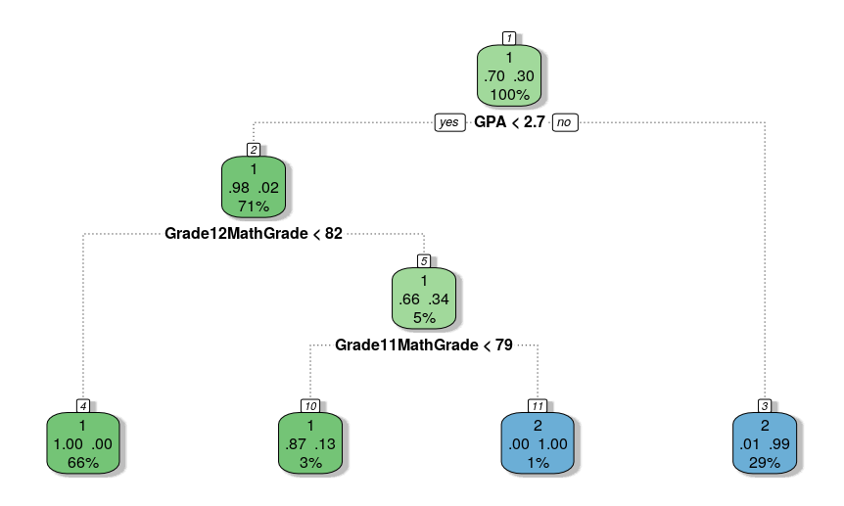
Example Supervised Analysis: CART
Notes:
Example of how CART could be used to explain course placement.
Group 1 = developmental and group 2 = credit-bearing.

Slide 16
Using CART in REL Pacific Research Studies
REL Pacific is using CART in two ongoing research studies:
Using High School and College Data to Predict Teacher Candidates’ Performance on the Praxis Core® Exam at the Unibetsedåt Guåhan (University of Guam)
Factors Associated with Third Grade Reading Outcomes of Students in the Commonwealth of Northern Marianas Islands Public School System
Both have relatively small sample sizes but potentially interesting predictors.
We hope that CART, as in Koon et al. (2014) and Koon & Petscher (2016), can provide more parsimonious models than regression with equal or greater predictive power.
This information could be used to explain subgroup differences despite small sample sizes AND provide meaningful information about two crucial education issues in the Pacific Region: (1) Improving teacher preparation pathways to address teacher shortages and (2) increasing the number of students who meet grade three reading standards.
Notes:
Koon, S., Petscher, Y., & Foorman, B. R. (2014). Identifying at-risk readers in Florida using two methodologies (REL 2015–036). Washington, DC: U.S. Department of Education, Institute of Education Sciences, National Center for Education Evaluation and Regional Assistance, Regional Educational Laboratory Southeast. Retrieved from http://ies.ed.gov/ncee/edlabs.
Koon, S., & Petscher, Y. (2016). Can scores on an interim high school reading assessment accurately predict low performance on college readiness exams? (REL 2016–124). Washington, DC: U.S. Department of Education, Institute of Education Sciences, National Center for Education Evaluation and Regional Assistance, Regional Educational Laboratory Southeast. Retrieved from http://ies.ed.gov/ncee/edlabs.

Slide 17
Next Steps
Examine the extent to which the proposed alternative approaches are comprehendible.
Explore ways to enhance the “uptake” of findings from these alternative approaches.
Continue to find ways to address research bias in the Pacific Region through alternative statistical models.
In addition to supervised machine learning models, REL Pacific is also looking for ways to employ unsupervised machine learning models that help identify emergent, latent subgroups in research projects.
Notes:
In our work, we know that elucidating findings from logistic regression has taken additional effort to convey to non-researcher audiences. We believe (and have some research-basis for this belief) that alternative methods like CART can be more easily interpretable—depending on how the findings are presented (reference to other RELs’ work using CART). However, we also know that this is an empirical question of sorts. We do know that understanding gaps in learning or gaps in teacher preparation that may be grounded in differences that might be missed if a traditional analytic approach is used is a disservice to our region that further marginalizes those who are “missed” by traditional analyses. If we are able to leverage alternative approaches—and ensure the findings from such are comprehendible—we believe it is our responsibility to the people we serve to do so.

Slide 18
Questions?

Slide 19
This presentation was prepared under Contract # ED-IES-17-C-0010 by Regional Educational Laboratory Pacific, administered by McREL International. The content does not necessarily reflect the views or policies of IES or the U.S. Department of Education, nor does mention of trade names, commercial products, or organizations imply endorsement by the U.S. Government.

Slide 20
Reference List
Koon, S., Petscher, Y., & Foorman, B.R. (2014). Using evidence-based decision trees instead of formulas to identify at-risk readers (REL 2014–036). Washington, DC: U.S. Department of Education, Institute of Education Sciences, National Center for Education Evaluation and Regional Assistance, Regional Educational Laboratory Southeast. Retrieved from http:// ies.ed.gov/ncee/edlabs.
Koon, S., & Petscher, Y. (2015). Comparing methodologies for developing an early warning system: Classification and regression tree model versus logistic regression (REL 2015–077). Washington, DC: U.S. Department of Education, Institute of Education Sciences, National Center for Education Evaluation and Regional Assistance, Regional Educational Laboratory Southeast. Retrieved from http://ies.ed.gov/ncee/edlabs.
Kuhn, M. & Johnson, K. (2018). Applied Predictive Modeling. New York: Springer.
Walter, M., & Andersen, C. (2013). Indigenous Statistics: A Quantitative Research Methodology. Abingdon: Routledge.

