Slide 1
Communicating Success Case Studies in Complex Organizations
Stuart Henderson, PhD
Julie Rainwater, PhD
University of California, Davis
Clinical and Translational Science Center & Schools of Health Evaluation Program
h.kopdelaney
American Evaluation Association
Annual Meeting 2012
Minneapolis, MN
October 27, 2012
Notes:
In my spare time I am the program chair for the AEA Data Visualization and Reporting Topical Interest Group, so I think a lot about how to visually represent ideas and data.
With success cases or case studies in general I think it is useful to think about how we communicate and represent our findings because they can be dismissed as anecdotal.
In this talk I am going to present multiple examples of how to present success case studies, focusing first on some standard approaches then some more visual approaches.

Slide 2
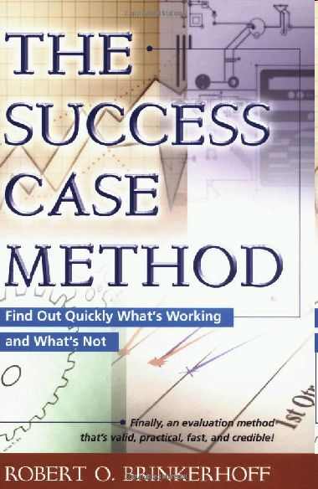
Different Approaches for Using Stories in Evaluation
Notes:
First, I want to acknowledge, as we have heard about in the other talks, there are multiple approaches to conducting success case studies. The assumptions, data, and goals that are associated with these approaches will impact the choice of how cases can be communicated and represented.

Slide 3
Factors impacting presentation
Successes
Non-Successes
Type of data:
vs
Summary description
Thick
description
Detail of data:
vs
General
Audience:
vs
Academic
Notes:
For example, depending on the approach the type of data will vary. The success case method suggests collecting both successes and failures; other approaches focus specifically on successes.
The level of detail also varies. Some approaches collect summary descriptions (collected through forms filled out by staff or the success object). Other approaches use more traditional qualitative in-depth interviews and collect thick descriptions of successes.
Obviously, if we collect summary data, we can only present summary information.
If we collect indepth information we have the ability to present either summary or detailed information.
If your CTSA or organization is like ours, you will want to present the data in multiple forms. For some audiences it makes sense to have a stand-alone story (for example, for a newsletter), for other audiences that want more evidence, (for example, in meetings with program leadership or funders), it is useful to take a more structured approach.

Slide 4
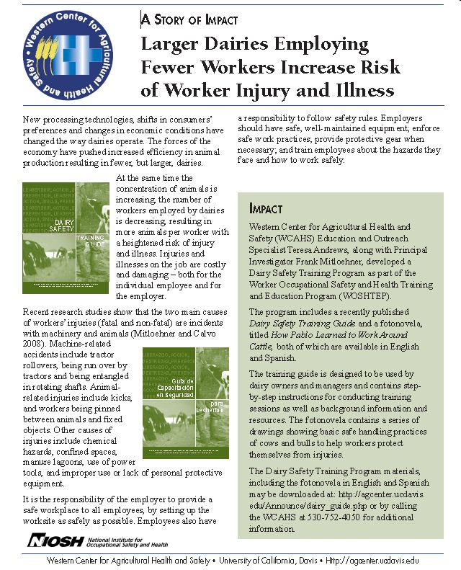
Story of Impact
+: well designed, focus on impact
+: good for general audiences or funders
- : isolated case; summarized
Notes:
Here’s an example of a story of impact.
It was used by the UC Davis Western Center for Agriculture Health and Safety to demonstrate their impact for (National Institute for Occupational Safety and Health) NIOSH, their federal funding agency.
The strengths are it is well designed, easy to skim. Especially strong for lay audiences or stakeholders, who just want a brief overview.
The weakness is that it is a single story and it is summarized data so it lacks rich details.

Slide 5
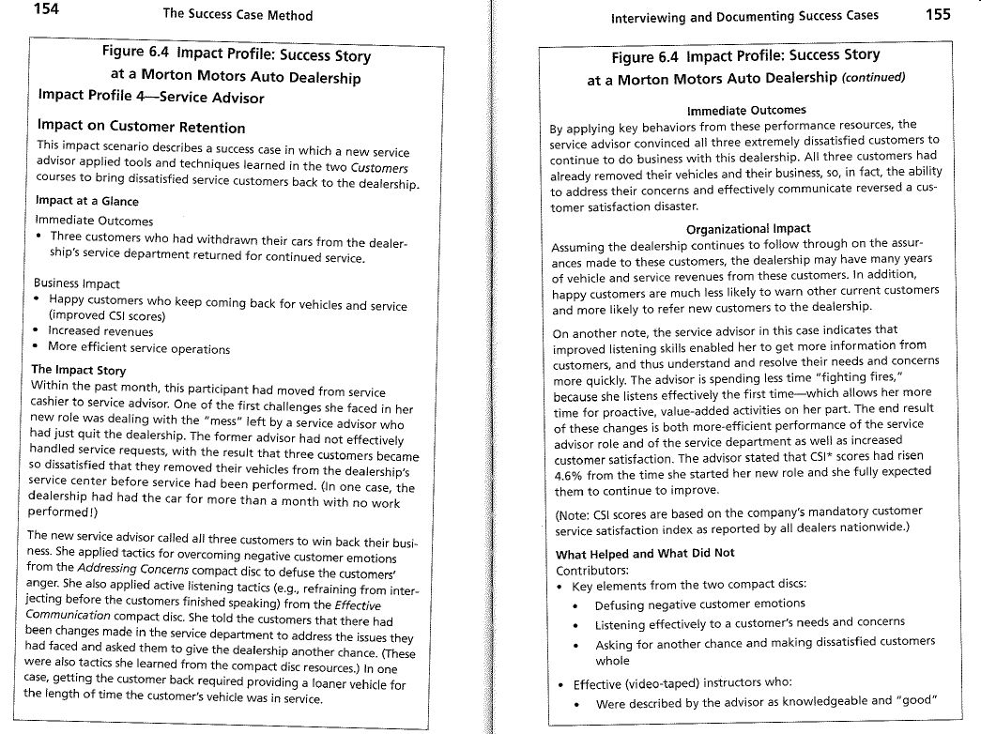
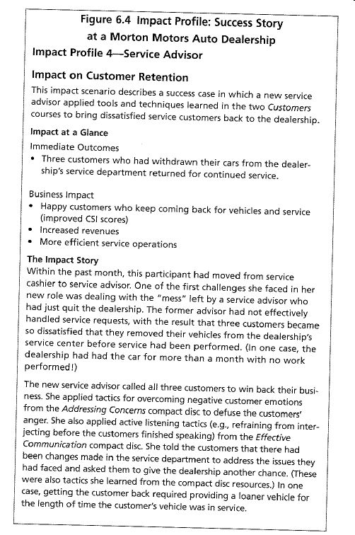
+: well structured, focus on impact
+: good for internal audiences
- : isolated case; summarized
from Brinkerhoff (2003)
Notes:
Here’s a second example, that comes from Brinkerhoff’s Success Case Method. It is probably stronger for an internal audience because it has more details, but it still has the weakness of being both a stand alone document and summarized data.

Slide 6
Challenge:
Stories may be seen as anecdotal
Flickr: Zen
Notes:
The challenge with these traditional representations of success is that while they present individual stories, they can also leave out the broader picture—they present the close-up view of a program success—the birds on a wire--but often fail to provide a distant view—where the wire is located.

Slide 7
“Stories without variables [themes] do not tell us enough about the meaning and larger import of what we are seeing. Variables without stories are ultimately abstract and unconvincing…”
Miles and Huberman. (1994). Qualitative Data Analysis: An Expanded Sourcebook (2nd Edition)
Notes:
Or put in a more academic way….

Slide 8
Combining stories and variables
Flickr: Zen
Notes:
So we have begun to explore ways to combine stories of impact with broader themes or themes we see across cases, so that we can represent both the specific details and the broader context of success stories.
Before I get into the specific examples, I should acknowledge that we are still in the process of developing these representations. The data I am presenting is hypothetical, so the focus should be on the ideas of how we are presenting the stories and themes together rather than the data.

Slide 9
Example 1:
Matrices
Notes:
One way to combine stories and variables is through Matrices.

Slide 10
Notes:
Here is a matrix of successful individuals who have gone through the CTSC training programs (again hypothetical data).
Each column represents one trainee so IV1 is a trainee, IV2 is another, etc.
Each row is a major theme that came out of the success case interview. So for example, the first row shows that mentor support was a theme; the second row shows pilot funding, and so on.
The themes would be determined through traditional qualitative research methods and coding. So for example, the themes might be pulled out inductively by a group of qualitative researchers after reading 3-5 of the interviews. Conversely, a deductive approach could be used in which themes are identified through the literature and applied to the interviews.
The colors on the matrix show the level of importance (as determined by coders) of that particular theme to the trainee’s success. So if we look at the Iv6, we see that mentor support was important, pilot funding was somewhat important, but a required course they had to take was not important.
We can also look across rows and see, for example that conference attendance was not important to most of the trainees’ success.
One benefit of this visual is that it provides a nice overview of the patterns between cases and it’s easy to compare different cases.
This information can be used for external audiences, but also for internal program improvement.
Now, you are might be thinking, well that’s nice but we have now tipped the balance between stories and variables completely the other way, where we are only showing variables and have eliminated the stories. In other words, we have just quantified our qualitative data.

Slide 11
Notes:
This is true.
Importantly, the plan is to connect the matrix to qualitative data.
So for example, if you clicked on the early intervention box,

Slide 12
Early Intervention
“[I received] a career development award, mentorship, grant-writing support, and opportunities to present research and obtain directed feedback from peers at a critically important time, early in [my] career development.”
-- Iv 3
Notes:
It would take you to a quote or quotes that illustrate the box.
For example, “I received a career …”
And you could have several of these behind each box.

Slide 13
Example 2:
Thematic Mapping
Notes:
I’m going to run through a couple of other examples, but the logic is the same.
There will be a visual representation of the text data that is linked or connected to the qualitative stories.
The next example, highlights the themes and their interconnectedness rather than the individual case studies.

Slide 14
Themes from Success Case Studies of Trainees
Notes:
So in each circle we have a prominent theme that came from the success case interviews of trainees. And we have connected the themes together (basically like a concept map or mind map).

Slide 15
Themes from Success Case Studies of Trainees
Notes:
Now, this representation by itself obscures the depth and nuance that we can get from success case studies.
However, like in the previous example, we can link this thematic map with qualitative data.
For example, if you wanted to see more about how planned happenstance-the idea of a kind of controlled randomness or chaos being behind success-you could click on the theme and see quotes (s) from interviews.

Slide 16
Planned happenstance:
“I was attending the graduation of a friend of mine and started a conversation with one of the other guests, who lived on the East Coast. It turned out that he knew of someone in my research field. I contacted the person and we ended up collaborating on a project.”
-Interview 9
Notes:
You would be taken to quotes or examples, such as ….

Slide 17
Example 3:
Chronological Charts*
*Hiller, P. 2011. “Visualizing the Intersection of the Personal and the Social Context.” The Qualitative Report. 16(4):1018-1033.
Notes:
One last example, which would work well if you want to do a chronology of success cases.

Slide 18
Notes:
In this example, we have basically two visual summaries of success case studies. Themes are on the left and then a timeline is across.
So for example, trainee 1 was in a training program from 2007 to 2009. Whereas trainee 2 was in the program from 2008-2010.
This kind of visual would work well if you had both successes and failures. For example, imagine trainee 1 was a success and trainee 2 was not as successful. You can compare the two chronological charts and quickly highlight differences.

Slide 19
Final Thoughts
Presentation of success stories important
Consider integrating the depth and nuance of stories with a contextual framing using themes or variables
Be creative -- Variety of ways to represent stories (including metaphors such as paths, networks, etc.)
Notes:
So to summarize
1) I am suggesting that the presentation of success case studies is important. It’s like with evaluation reports, if we write bad reports, they will be filed away and no one will read them. Likewise, with success case stories, if we don’t present them in interesting ways that capture the complexity of the stories, then we are potentially limiting the audience who is going to use them or take them seriously.
2) My main point here has been to think about integrating stories with themes or variables. But what takes precedence stories or themes? It depends on the audience, but 95% ot 5% either way is probably too much (Miles and Huberman 1994).
3) My goal was to stimulate thinking here, not to be prescriptive. There are many ways to present success case studies. I think it is important to explore different avenues and not be locked into the ‘right’ way. I suggest being creative and trying out different ideas.

Slide 20
The project described was supported by the National Center for Advancing Translational Sciences (NCATS), National Institutes of Health (NIH), through grant #UL1 TR000002.
Contact:
Stuart Henderson
Associate Director, Evaluation
UC Davis Clinical and Translational Science Center & Schools of Health Evaluation Program
stuart.henderson@ucdmc.ucdavis.edu

