Slide 1
Needs Assessment Tools to Guide Decision-making: Multicriteria Analysis and Pair-wise Comparison
Ryan Watkins, Ph.D.
George Washington University
www.NeedsAssessment.org
Maurya West Meiers
World Bank Group

Slide 2
What is a Needs Assessment?
A decision-making tool
A strategic planning tool
A logical process for differentiating “needs” from “wants”
A precursor to accomplishing desired results

Slide 3
Many Professions
Organizational Development (OD) Specialists
How do we improve organizational performance?
Managers
How can we improve individual and team performance?
Community Psychologist
What challenges do residents in our community face?
Human Resource Departments (or Trainers)
When to train and what to train on?
Evaluators
What results should a project/program be achieving?

Slide 4
Definitions for Needs Assessments
A systematic study of a problem or innovation, incorporating data and opinions from varied sources, in order to make effective decisions or recommendations about what should happen next (Rossett)
A process for identifying and prioritizing gaps in results based on the cost to meet the need versus the cost to ignore the need (Kaufman)

Slide 5
Why Needs Assessment?
Provides a systematic process to guide decisions.
Provides justification for decisions before they are made.
It is scalable for any size project, time frame, or budget.
Offers a replicable model that can be applied by novices or experts.
Provides a systemic perspective for decision makers.
Allows for interdisciplinary solutions for complex problems.

Slide 6
5 D Framework
D
D
D
D
D
Define
Design
Develop
Do
Document
Decision
Problem
Innovation
Framework
Identify
Analyze
Decide
Results chains
Tools
Data
Decisions
Participants
Manage
Monitor
Report
Evaluate
Improve

Slide 7
Develop
Driving Questions
What data has to be collected?
What data exist elsewhere?
Who can help help us learn?
What are the best ways for learning from them?
How do we record information?

Slide 8
Needs Assessment Tools and Techniques
Collecting information. For example:
What are the needs (performance gaps) of the organization and its clients?
What performance data verifies these “needs”?
How do different groups perceive these gaps?
What could be the causal factors leading to these needs?
Making decisions. For example:
Which needs are the highest priority?
Which solutions should be considered?
How can we manage the related changes?

Slide 9
Collecting Information and Making Decisions
Data Collection Tools and Techniques
Decision Making Tools and Techniques
Guided Expert Review
Systematic Document Review
Managing Focus Groups
Interviewing
Task Analysis (if/then, hierarchical, model)
Task Analysis (cognitive)
Performance Observation
Dual-response surveys
Case Studies
Data Mining
Root Cause Analysis
World Café
Speed Dating Data Collection Approach
Focus Groups – Nominal Group Technique
Focus Groups – Straw Votes
Focus Groups – Delphi Technique
Multi-criteria Analysis
Force Field Analysis
Risk and Rewards Analysis
Card Sorts
Tabletop analysis
Cost-Consequences Analysis
Consensus Building
Cross-impact Analysis
Gap Analysis
Pair-wise Comparisons

Slide 10
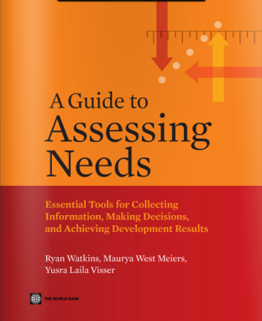
Collecting Information and Making Decisions, Continued
Multi-Use (Data Collection and Decision Making) Tools and Techniques
SWOT + Causal Utility (CU)
Johari Window
Fishbone Diagrams
Scenarios
Fault Tree Diagrams
Concept mapping
Future Wheels
Performance Pyramid
Find these tools in

Slide 11
Mix-n-Match
 | Interviews | Focus Groups | Surveys | Nominal Group Technique | Pair-wise | Multi-criteria
Step 1: Identify | ✓ | ✓ | ✓ | ✓
Step 2: Analysis | ✓ | ✓ | ✓ | ✓ | ✓ | ✓
Step 3: Decide |  |  |  | ✓ | ✓ | ✓
✓
= Applied
in Needs Assessment
= Featured in the session

Slide 12
Multi-Criteria Analysis
 | Criteria 1 <insert> | Criteria 2 <insert> | Criteria 3 <insert> | Criteria 4 <insert> | Sum Total
Option A <insert>
Option B <insert>
Option C <insert>
Option D <insert>
Option E <insert>
Option F <insert>

Slide 13
Sample Criteria
Affect achievement of specific business goals
Promise to increase our impact and relevance to clients’ needs in the medium and long term
Impact a large number of employees
Directly impact the quality of service given to a client or customer
Save the organization money
Improve operating efficiency (help us do something faster)

Slide 14
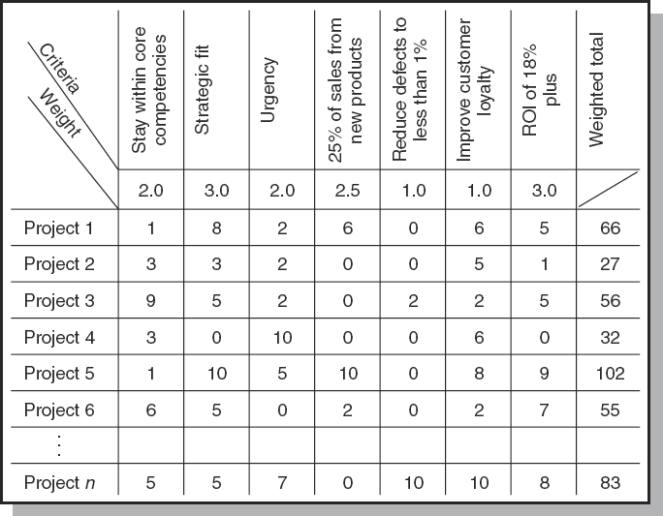
Example: Choosing a Project

Slide 15
Activity: Let’s Make a Decision
Hypothetical: Imagine that the planning committee for the 2016 AEA conference is divided on the primary needs of the association (assume a needs assessment was done and these were of high importance).
A. Short-term financial sustainability and growth of conference registrations
B. Attracting the next generation of evaluators
You are in either Group A or Group B.
Part of your work involves recommending a host city. Below are proposed cities from a nominating committee (which has done some initial scoping).
Option A: St. Louis
Option B: Boston
Option C: Honolulu
Option D: Arlington, Virginia
Option E: Chicago
Option F: Vancouver

Slide 16
Activity: Let’s Make a Decision
Round 1 (no weight)
Step 1: Identify your criteria
Step 2: Calculate the comparisons
Round 2 (weighted)
Step 1: Identify your criteria
Step 2: Apply weights to your criteria
Step 3: Calculate the comparisons

Slide 17
Pros & Cons
Pros
Easy to apply (though weightings can complicate)
Requires making decision criteria clear and known to everyone
Cons
Can’t combine alternatives (i.e., the best of A and the best of B)
All alternatives must be judged on the same (and all) criteria

Slide 18
Pair-wise Ranking
 | Option A <insert> | Option B <insert> | Option C <insert> | Option D <insert> | Option E <insert> | Option F <insert>
Option A <insert> |  | Option A | Option C | Option A | Option A | Option F
Option B <insert> |  |  | Option C | Option D | Option E | Option F
Option C <insert> |  |  |  | Option C | Option C | Option C
Option D <insert> |  |  |  |  | Option D | Option D
Option E <insert> |  |  |  |  |  | Option F
Option F <insert>

Slide 19
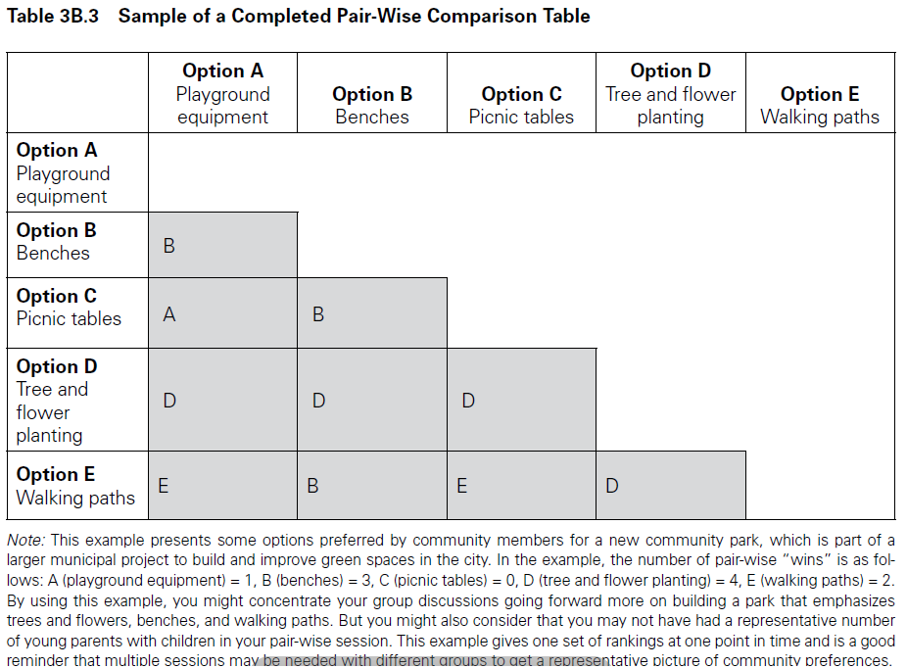
Pair-wise Ranking - Sample

Slide 20
Activity: Let’s Make a Decision
As part of your assessment your team identified gaps in capacity of local non-profits to efficiently manage the day-to-day delivery of social services across the community
Option A: Work with individual non-profits to improve efficiencies
Option B: Require project management training of staff from all non-profits
Option C: Change the criteria so management efficiency is of more importance in making funding decisions
Option D: Require the merger of several small non-profits
Option E: Increase the proportion of funding that can go to management salaries (currently capped at 8%)
Option F: Do nothing

Slide 21
Activity: Let’s Make a Decision
Step 1: As an individual, compare each pair
A vs. B
B vs. C
Etc.
Step 2: Add up how many times you selected each option
A = ? times
B = ? times
Etc.
Step 3: As a group, add up how many times you selected each option

Slide 22
What did we choose?
Volunteer
Which did you choose, A vs. B?
Why did you choose A or B?
Did others apply the same “criteria”?
Volunteer
Which did you choose, D vs. E?
Why did you choose D or E?
Did others apply the same “criteria”?
Volunteer
Was your group decisions the same as your individual decision?

Slide 23
Pros & Cons
Pros
Very easy (and quick) to do
Cons
Can’t combine alternatives (i.e., the best of A and the best of B)
Criterion are undefined and unknown to others
The more options, the less you have distinct (consistent) comparisons (i.e., people start doing it by memory)

Slide 24
Wrap-Up
All decisions making tools and techniques have strengths and weaknesses
Use techniques and tools to inform conversations, rather than “making decisions”
No one tool or technique will do everything
Know a variety of techniques so you can use the appropriate ones for different situations
Use more than one technique or tool when appropriate
Learn more at: www.NeedsAssessment.org

