Slide 1
We Reinvented the Wheel & Made it Square: Internal Evaluation Mistakes & What We Learned
Jessica Britt, Research & Evaluation
Matt Gajdowski, Research & Evaluation
Garrett Warfield, PhD, Research & Evaluation
Notes:
Hi, my name is Jess, this is Matt and this is Garrett and we all work for Year Up. At Year Up, the Research and Evaluation function was really created explicitly only three short years ago and in that time we have learned a lot from our mistakes. We want to share some of these learnings with you in hopes that they will be helpful.

Slide 2
About Year Up
Consent
Case-specific Research
Data Use and Quality
Takeaways
Notes:
We’ll start off with telling you a bit more about Year Up to set the context. We’ll then go over a few examples of what we’ve learned in the last few years and we’ll end with some takeaways that we hope will be helpful for other internal evaluators in the room, and for external evaluators as you liaise with your counterparts within organizations.

Slide 3
Talk with
companies
6-month paid
internship
Identify urban
young adults
6-month paid
classroom training
Graduation and
post-program
career support
Notes:
Year Up is a year-long program – that’s where the name comes from – not to be confused with Gear Up or Europe! We recruit urban young adults ages 18-24, and we talk to companies in that urban area about their entry-level talent needs. We train our young adults on both hard and soft professional skills for six months to get them ready for an internship with those companies, and then they intern there for 6 months. After the internship they graduate and we help them find work if they aren’t hired by their internship company.

Slide 4
25
sites nationwide
175
new program staff hired in 2016
3,000+
students/year
250+
corporate partners
$36,000
grads’ avg. yearly salary
Notes:
Let’s talk a little about scale – Year Up is growing very very quickly. It was founded in 2002 in Boston and we are now in 15 cities with 25 sites in those cities. We currently serve more than 3000 young adults per year and have served 14,000 to date. We work with more than 250 corporate partners. We have 75% retention, 85% are employed or in fulltime school after graduation. The average annual salary for an alum four months out is $36,000/year. Most importantly for our presentation, we had more than 175 new program staff hired in 2016 alone which means that training is crucial

Slide 5
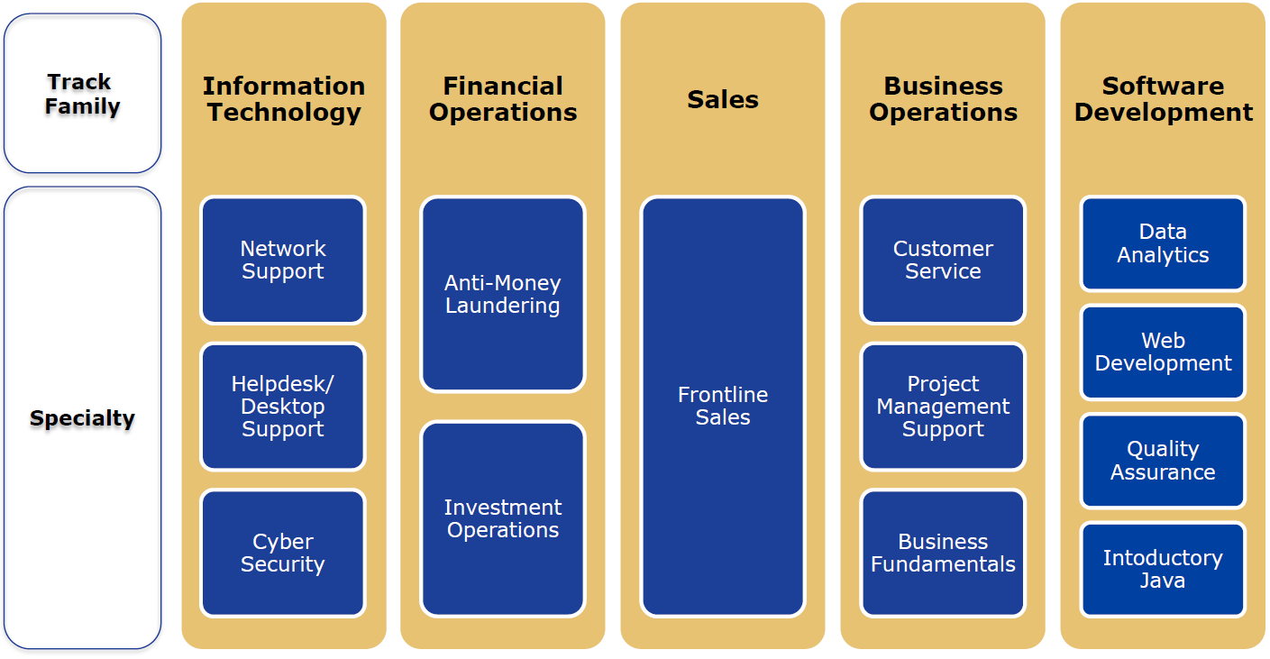
Diverse Curricula
Notes:
To give you an idea of the kind of curricula we offer, we break them into tracks and specialties – kind of like majors and concentrations. We work in IT, FO, Sales, BO, and Software development depending on the needs of corporate partners in a city.

Slide 6
Trials and Tribulations of Informed Consent
Example: Formal Feedback
Notes:
The first big whoopsie we want to share with you is our informed consent administration journey. Informed consent is a pretty dry subject and we know it’s Saturday morning on the last day of the conference so before we dive in I want to start us off with Ryan Gosling

Slide 8
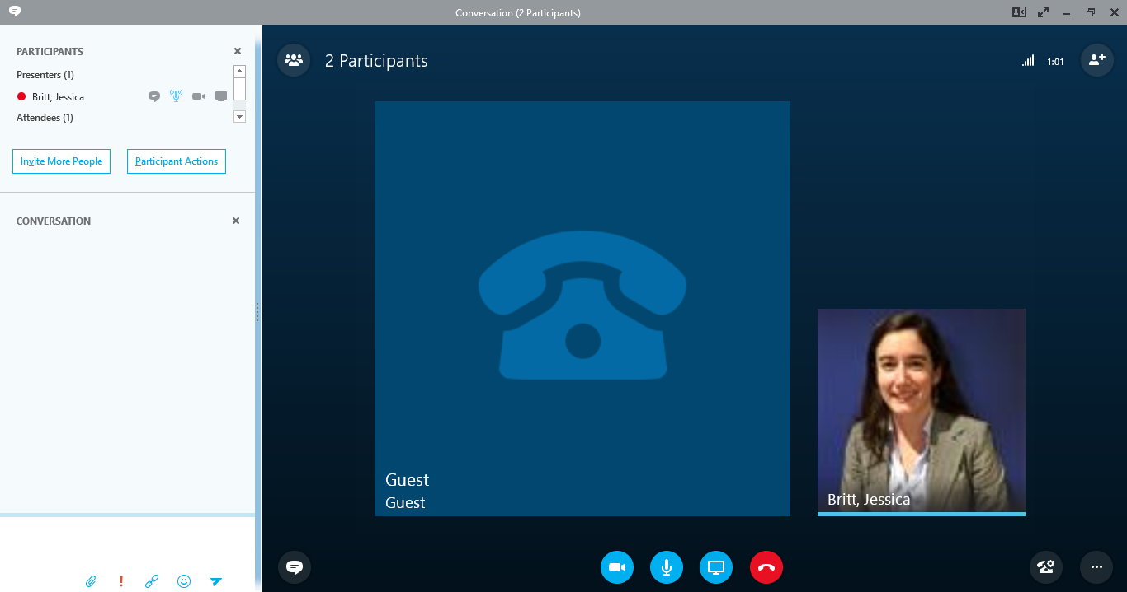
Take 1
Why do they want my SSN?
Other data sources? Who has my data?
I’m definitely not signing this – dude, don’t sign this
Notes:
We launched a study funded by IES (the Institute of Education Sciences) in late 2015 and needed to begin using administrative data from 8 of our sites immediately. We had no training in place for informed consent administration so our quickest bet was people on our national research and eval team administering consent…virtually. We called into orientation to administer informed consent over Skype. As you can probably imagine young white lady you’ve never met asking you to sign a form while you’re sitting in a classroom surrounded by 35 new peers was not a recipe for success. In some cases fewer than half of students consented.

Slide 9
Take 2
Rolling staff training
Reconciliation by hand
Wrong year, birthdate, missing date
Notes:
For our second take we offered training webinars for staff and then one-off, 30-minute trainings on a rolling basis. As you can imagine, with 24 sites and 175 new program staff members last year alone, there were periods when I was spending at least 1 hour per week holding the SAME training on informed consent
After consent forms were mailed, colleague at Abt Associates went through and then we spent hours on the phone comparing forms with our Salesforce database. My colleage at Abt would go through the forms she received and make a spreadsheet and then she’d call me while I had Salesforce open and we tried to decipher who was whom and who was missing.
So many date mistakes!

Slide 10
Take 3
Online video training module
Communication embedded in existing processes
Comprehensive checklist for accurate and efficient reconciliation
Notes:
For the class that was just admitted in August/September – we had rolled out an online video training module which has saved tons of time
We embedded communication about informed consent within regular communication coming out of our National Admissions/Recruitment function
We created a checklist and process by which sites performed the first round of reconciliation with salesforce (paying special attention to date errors) themselves before mailing the forms to Abt Associates. While we’re still spending time reconciling, it is way less time than it has been previously.

Slide 11
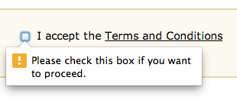
Dream
Notes:
Now we realize that we may always have to have some form of more formalized in-person consent administration when it comes to big studies governed by an IRB, Year Up also does a lot of research on our own and we want to make sure we’re protecting student data. Anticipating the end of our IES study, we are working with our legal team in hopes of getting some sort of data use/protection language included as terms and conditions upon application which will not only save us time, but also save time for all staff across the org.

Slide 12
Case-specific Research
Example: Formal Feedback

Slide 13
Anti-Money Laundering (AML)
One of our most successful specialties
One site decided to pilot a hybrid/blended learning model for specialty curriculum delivery
Competing hypotheses about value of this approach

Slide 14
Design Considerations
Small sample, short timeframe, no counterfactual
High stakes
A lot of stakeholders
Students
Program Director
Academic Director
National Staff
Local Corporate Relations Team
Corporate Partners
Instructor

Slide 15
Course Refinement Process
Gather Feedback
Gather feedback on courses
Synthesize, Vet, and Recommend
Analyze feedback
Decide
Vet findings externally
Vet findings internally
Surveys
Focus groups
Etc.
No content changes
Add new course
Remove, add, or modify course learning objectives
“Shelf” a course offering
Swap part of course
Notes:
To ensure that the academic components of the program are relevant, we developed an internal refinement process that incorporated some elements of evaluation.
This entails collecting feedback through a number of mechanisms, including surveys and focus groups.
The findings from this feedback are synthesized and vetted, and are then used to determine if there should be changed made to a course, and if so, what those changes should look like.

Slide 16
And then…
Data Analytics
Sales
Notes:
In order to maximize our responsiveness to market demand, the lead time for new program launches can sometimes be relatively short.
This can lead to scenarios where program evaluation is not incorporated into the design process
In the past two years, we’ve had multiple launches of new training programs where we determined that an evaluation was necessary after the program was already in progress.
Often reactive rather than proactive; evaluation flagged as a need once questions about program quality have already surfaced
Last-minute evaluation has led to challenges like scheduling issues; we’re being asked to evaluate a course that’s about to end.

Slide 17
Dream
Gather Feedback
Gather feedback on courses
Synthesize, Vet, and Recommend
Analyze feedback
Decide
Vet findings externally
Vet findings internally
Surveys
Focus groups
Etc.
No content changes
Add new course
Remove, add, or modify course learning objectives
“Shelf” a course offering
Swap part of course
+
Comprehensive Evaluation Plan
New Program Design
Notes:
Dream state would include:
The process we developed for determining whether course content is relevant and is training students with the skills required by our corporate partners and the broader job market.
Comprehensive evaluation plan would be included in the design process for all new programs of study
This will help us avoid logistical bottlenecks and ensure that evaluation resources are allocated efficiently

Slide 18
Data Quality and Data Use
Example: Formal Feedback
Notes:
We have a ton of data at Year Up, but we’ve fallen victim to a few fallacies over the years that can be easily demonstrated through one particular example.

Slide 19
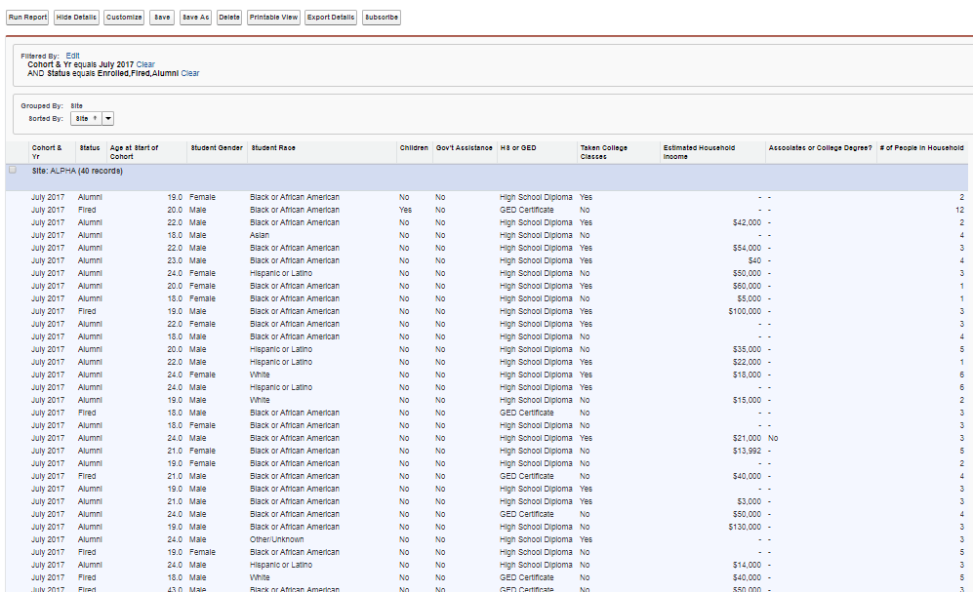
Take 1
Notes:
We have always collected key demographic information to help us keep track of class composition. These data are collected throughout the admissions process and stored in Salesforce and accessible to anyone. Bad assumption number 1: people know how to pull Salesforce reports ☺

Slide 20
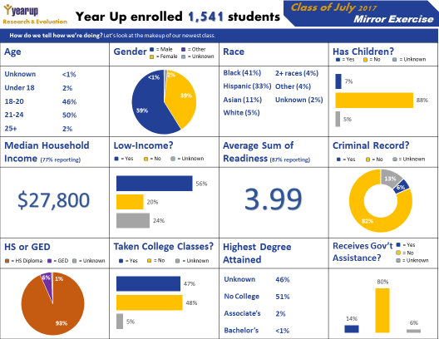
Take 2
Notes:
We realized that we needed to give these data to people in a much more user-friendly way so developed these one-pagers about one year ago. They were met with enthusiasm but had some serious drawbacks: time spent, static snapshot, etc.

Slide 21
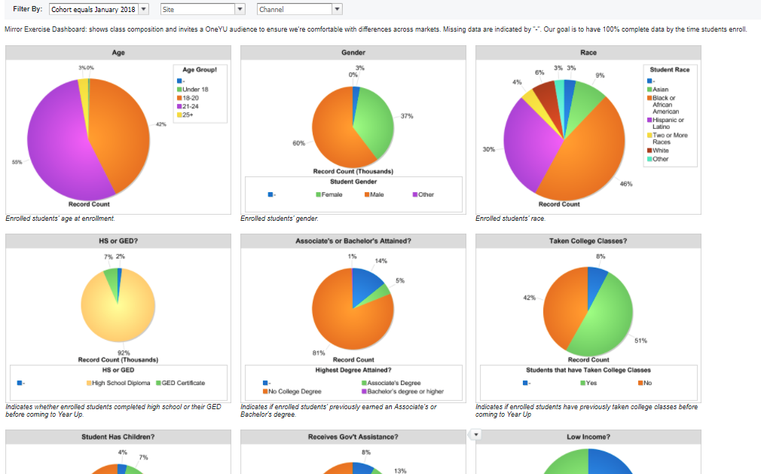
Take 3
Notes:
To offer drill capabilities and save us time, we then worked to develop a dashboard in Salesforce. Most obvious drawback: bad visualizations and still assumes that folks will know where and how to access in Salesforce

Slide 22
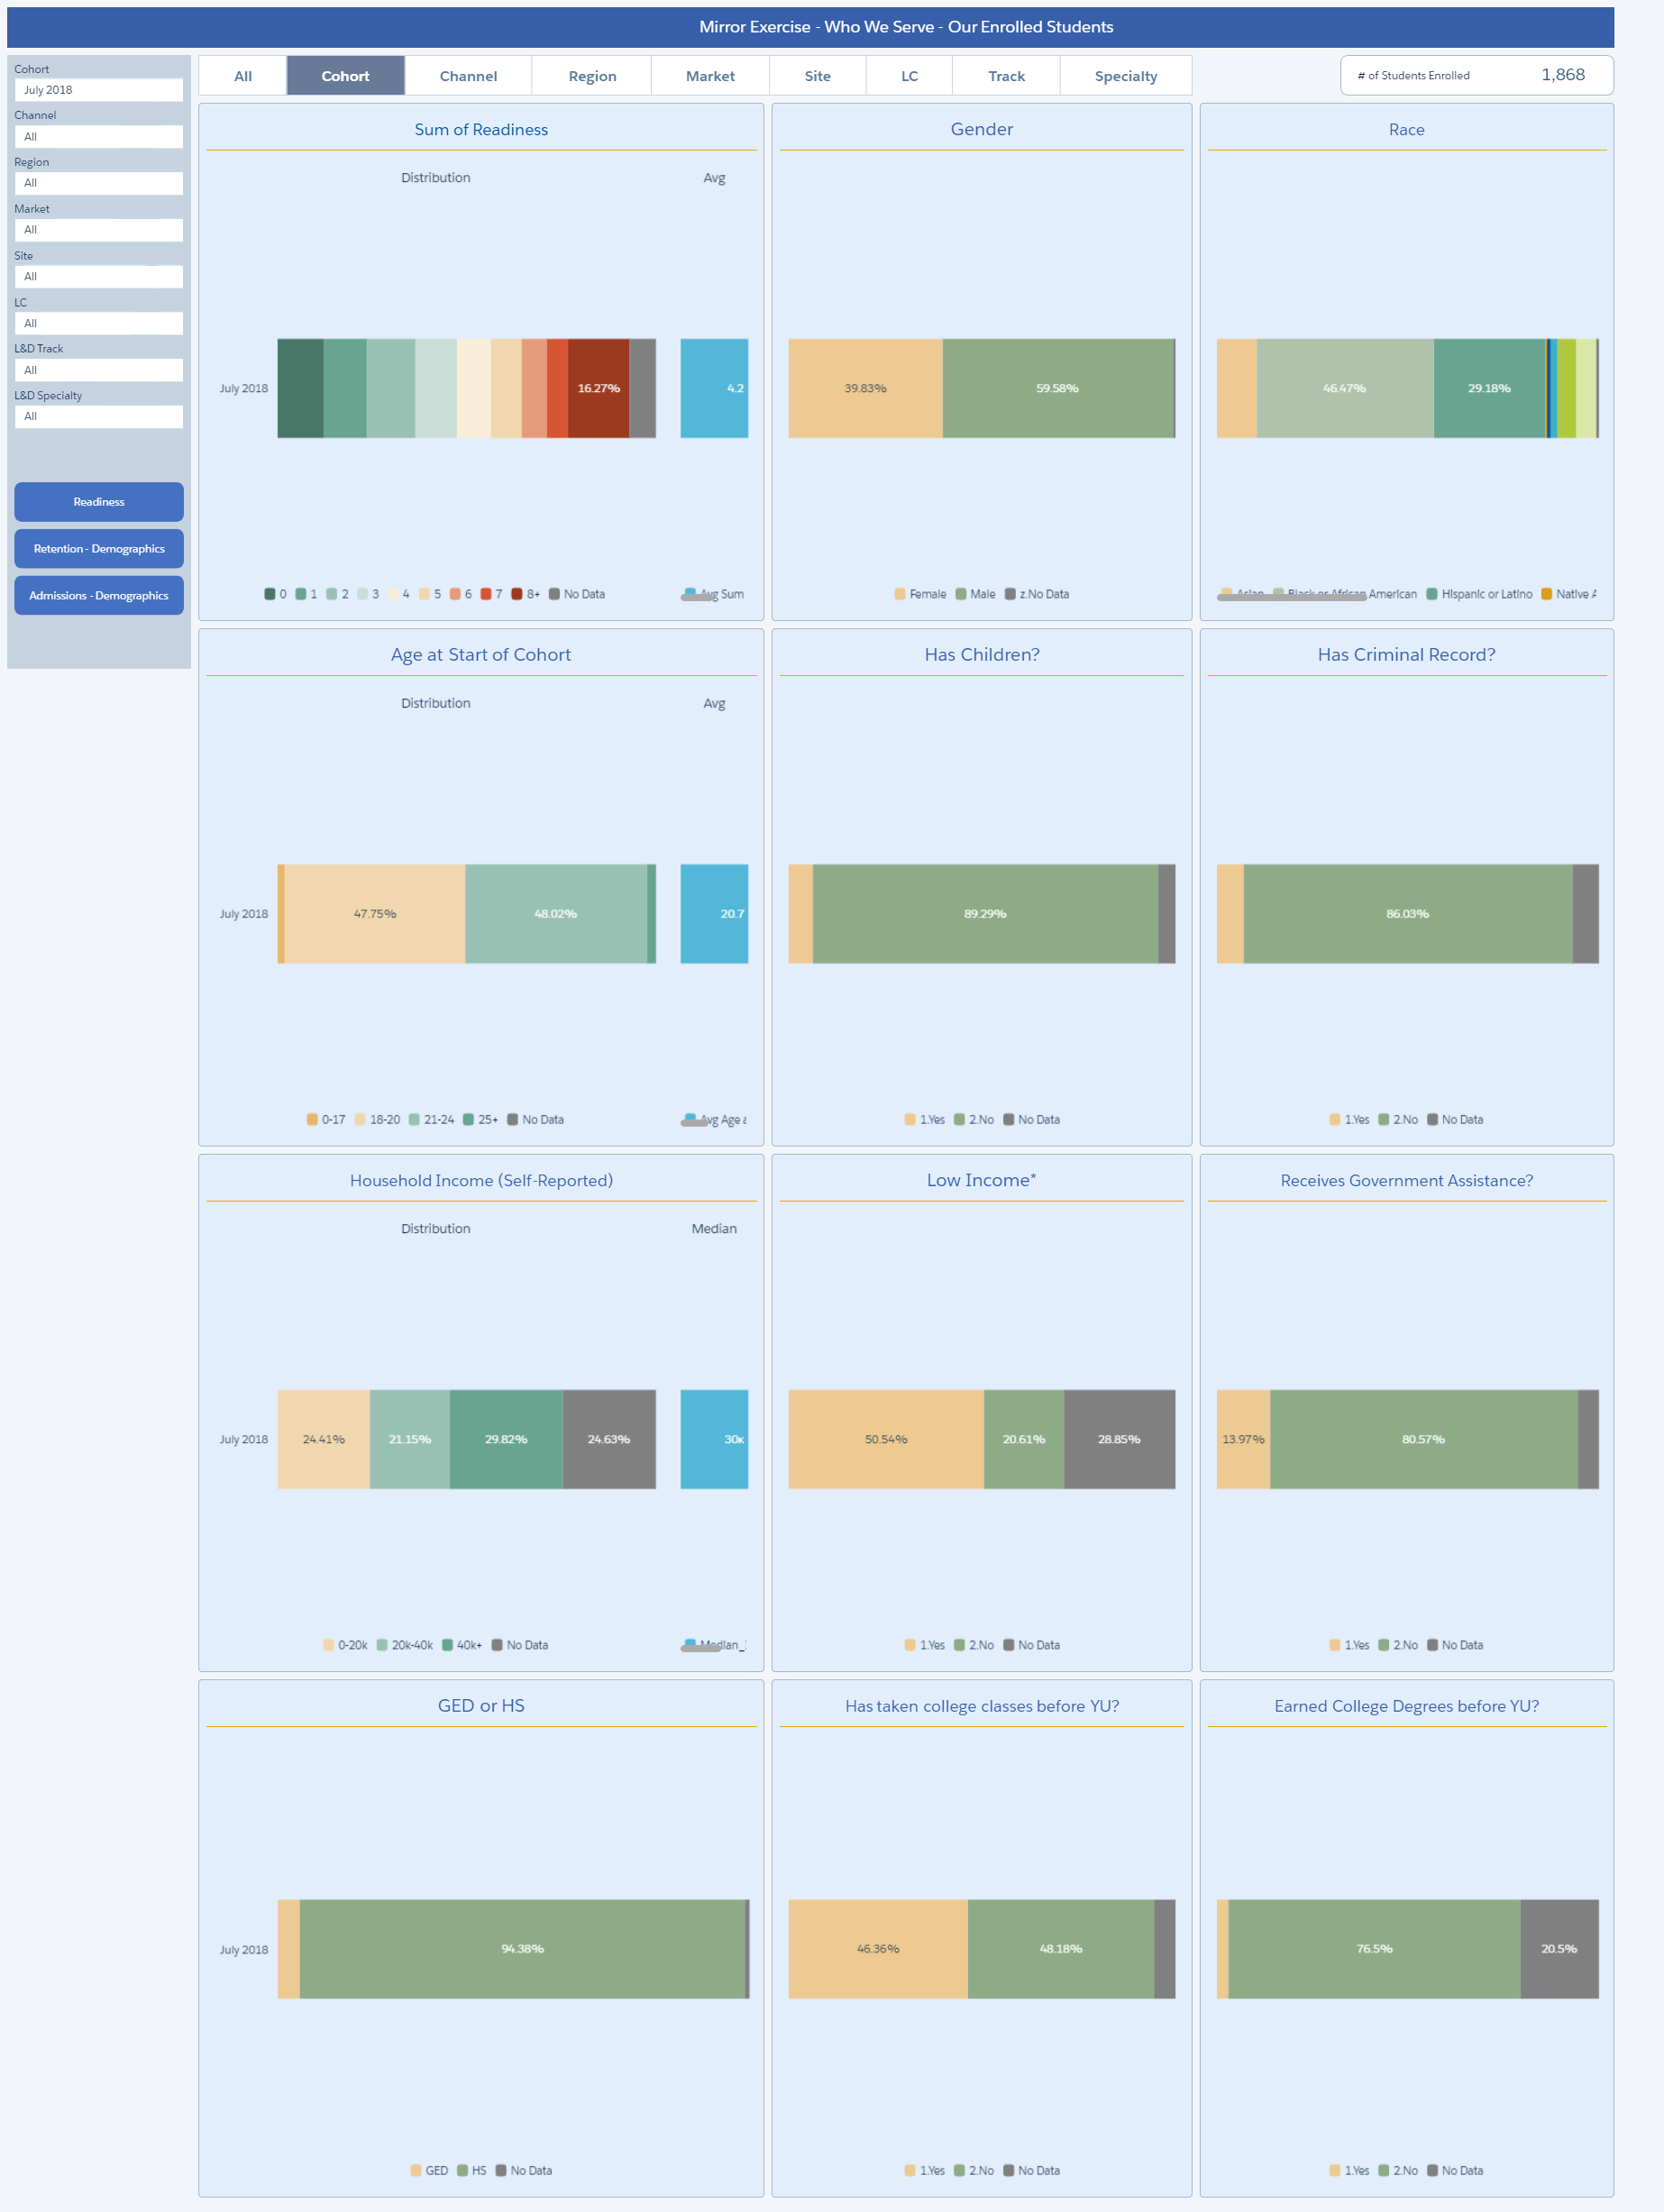
Take 4
Notes:
Here we are now – we have an interactive dashboard in wave!

Slide 23
Take 4
+
Notes:
Not only that, but we have paired the new tool with extensive online training modules and accompanying job aids to help people make the most of their data

Slide 24
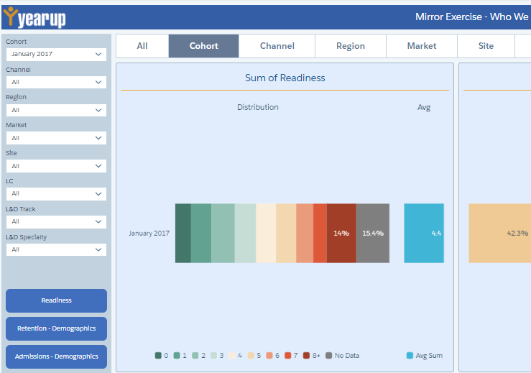
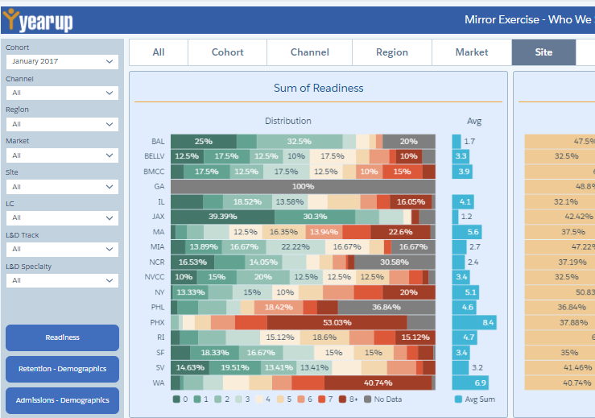
Careful what you dig for…
No data
Notes:
Unfortunately, we are still victim of inconsistent data quality. Now that we are looking more closely at our data, we are noticing some egregious cases of missing data that we are now working to correct.

Slide 25
Takeaways
Notes:
One of Year Up’s Core Values is strive to learn. Striving to learn and continuing to strive to learn is essential for building out an internal evaluation function. We want to share a few of our main takeaways with you in hopes that it will help you with your work

Slide 26
Takeaways
Iteration is necessary
Online video trainings save time and improve adoption
Find a way to insert into existing processes
Create tools to facilitate success
Notes:
We often say that at Year Up we are building the plane while we fly it which applies to our internal eval work as well. It’s better to test something, fail, and learn from it than to wait to push that data out to the organization. The key part is learning from it and being willing to pivot.
At Year Up we are really working to build out our training library and we’re finding that trainings related to data entry and collection (e.g., Salesforce, and survey administration) are equally as valuable as trainings on using data. One of the biggest benefits is having somewhere to point people when they ask a question, even if they’re not finding the trainings proactively
Whenever possible it’s important to fit your needs as an internal evaluator into pre-existing processes. If it feels like business as usual, folks will be more likely to follow through
Help people be successful by giving them clear tools, checklists, and processes to use.

Slide 27
Questions
www.yearup.org
jbritt@yearup.org
mgajdowski@yearup.org
gwarfield@yearup.org

