Slide 1
Acknowledging the “Self” in Developing Cultural Competency
Osman Özturgut, Ph.D.
University of the Incarnate Word
Cindy A. Crusto, Ph.D.
Yale School of Medicine
American Evaluation Association
June 20, 2013
Notes:
Good afternoon, Osman and I are both members of the AEA Public Statement on Cultural Competence in Evaluation Dissemination Working Group, whose mission is two-fold:
First, the group seeks to: Disseminate the Statement the so that evaluators and people who commission evaluations understand the importance of cultural competence in evaluation and the essential concepts and essential practices that characterize culturally competent evaluations.
Second, the Working Group seeks to: Translate the statement into real change both for evaluation practice and for those communities that we serve.
We are very excited to talk with you all today about “Acknowledging the ‘self’ in Developing Cultural Competency”, as this webinar is one way to advance the mission of the Working Group.

Slide 2
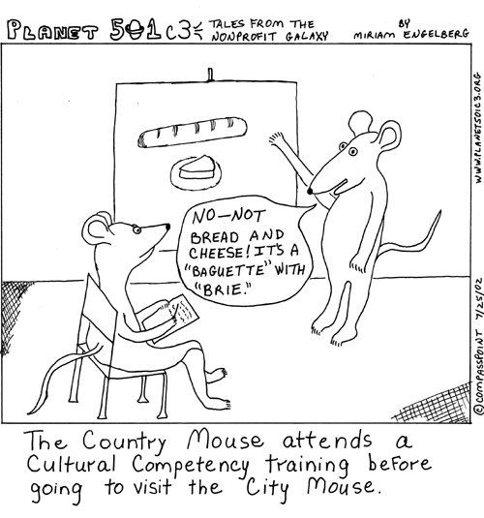
Workshop Purpose
To investigate the concept of Cultural Competence in Evaluation, drawing from the Developmental Model of Intercultural Sensitivity.
Notes:
Slide 2: Workshop Purpose - Cindy
The purpose of today’s webinar is: To investigate the concept of Cultural Competence in Evaluation, drawing from a particular theory called the Developmental Model of Intercultural Sensitivity or DMIS.

Slide 3
AEA Public Statement on Cultural Competence in Evaluation
AEA Diversity Committee
Task Force on Cultural Competence in Evaluation
Building Diversity Initiative (BDI) Recommendation #10
Engage in a public education campaign to emphasize the importance of cultural context and diversity in evaluation for evaluation seeking institutions
Notes:
We’d like to start by telling you a bit about the AEA Public Statement on Cultural Competence in Evaluation, which can be found on the main page of AEA’s website.
It was drafted by a Task Force of the Diversity Committee, and it was reviewed by the AEA Board and approved by a vote of the full AEA membership in April 2011.
The statement represents six years (2005–2011) of work, and there were many advisors and numerous individuals, references, and resources that contributed to the Task Force’s ever emerging understanding of cultural competence in evaluation.
The statement is the result of a recommendation made by the Building Diversity Initiative, an effort of the AEA and the Kellogg Foundation that began in 1999 to address the complexity of needs and expectations concerning evaluators working across cultures and in diverse communities.
The recommendation encouraged AEA to “Engage in a public education campaign to emphasize the importance of cultural context and diversity in evaluation for evaluation-seeking institutions.”

Slide 4
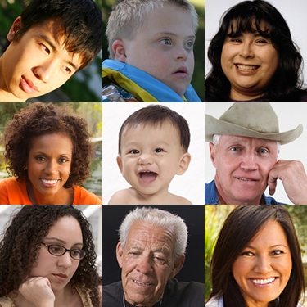
AEA Public Statement on Cultural Competence in Evaluation
Relevance
Purpose
Notes:
Slide 4: Relevance of the Statement - Cindy
The statement is relevant or important in that it is a statement on behalf of the public that first, affirms the importance of cultural competence as a criterion for assessing the quality of evaluation efforts. That is, the public should pay attention to cultural competence, and cultural competence is one criterion for assessing the quality of evaluations.
Second, the statement confirms the importance of practicing evaluators attending to relevant dimensions of culture. That is, it confirms that evaluators should pay attention to culture in their work
Third, the statement illuminates important elements of cultural competence relevant to the interpretation and use of evaluation findings.
Purpose:
With respect to the Statement’s purpose, it was commissioned by AEA as an expression of the importance of cultural competence in evaluation and is grounded in AEA’s Guiding Principles.
It moves beyond the Guiding Principles to further explore and expand cultural competence and its significance in evaluation.
The basic stance of AEA and the Statement is that cultural competence in evaluation practice must be improved for the greater good of society and the profession.
The call for increased attention to cultural competence is consistent with the core values expressed throughout the AEA Guiding Principles.

Slide 5
Defining Cultural Competence
“Cultural competence is not a state at which one arrives; rather, it is a process of learning, unlearning, and relearning.”
Notes:
Slide 6: Defining Cultural Competence - Cindy
According to the Statement, “Cultural competence is not a state at which one arrives; rather, it is a process of learning, unlearning, and relearning.”
We know that there are several different terms used to convey the idea that cultural competence can never be fully achieved, that one cannot be granted a certificate in cultural competence, or that there is no checklist that ensures cultural competence. Some of these other terms are “cultural humility”, “culturally responsive evaluation”, “culturally relevant evaluation” . Whichever term you prefer, the idea is that cultural competence is a journey and not a state at which one arrives, and we would not advocate for a certification process.
This webinar is one example of how individuals can engage in the process toward becoming more competent in evaluation work with respect to culture and to context.
Next, I will turn it over to Osman who will talk about what we mean by Understanding the “self.”

Slide 6
Understanding the “Self”
“Cultural competence requires awareness of self, reflection on one’s own cultural position, awareness of others’ positions, and the ability to interact genuinely and respectfully with others”
Notes:
Slide 7: Understanding the “Self” - Osman
AEA’s Cultural Competency Statement explains that “Cultural competence requires awareness of self, reflection on one’s own cultural position, awareness of others’ positions, and the ability to interact genuinely and respectfully with others” and that “ Culturally competent evaluators refrain from assuming they fully understand the perspectives of stakeholders whose backgrounds differ from their own.
In order for us to be better evaluators, we need to examine a wide variety of perspectives, including our own. And, we argue that awareness of one’s own assumptions, prejudices and stereotypes is the first step in developing cultural competency.
When we are working with diverse stakeholders in diverse contexts, it is of course important for us to learn about the context but we cannot necessarily make sense of it without understanding the “self” as professionals. That is, we need to have a stronger understanding of the “self” in regards to why we do what we do. We need to look at our reflections in the mirror and think about how it influences the work we do. Because we identify ourselves better and more easily with those who resemble us but we are generally not aware of how mono-cultural patterns influence our ways of thinking and that we may be blinded to significant aspects of our own culture. Furthermore, many of our values operate behind the back of our consciousness. This requires extensive self-reflection and critical self-analysis

Slide 7
Developmental Model of Intercultural Sensitivity (DMIS)
The underlying assumption of the model is that as one's experience of cultural difference becomes more sophisticated, one's competence in intercultural relations potentially increases.
The first three DMIS stages are ethnocentric, meaning that one's own culture is experienced as central to reality in some way.
The second three DMIS stages are ethno-relative, meaning that one's own culture is experienced in the context of other cultures.
Notes:
Osman Slide 8: Developmental Model of Intercultural Sensitivity (DMIS) - Osman
Having said this, we wanted to introduce the Developmental Model of Intercultural Sensitivity, introduced by Milton Bennett in 1986 and later revised in 1993. It describes six stages of cross-cultural experience, especially the management of differences in culture.
The underlying assumption of the model is that as one's experience of cultural difference becomes more sophisticated, one's competence in intercultural relations potentially increases.
The first three DMIS stages are ethnocentric, meaning that one's own culture is experienced as central to reality in some way.
The second three DMIS stages are ethno-relative, meaning that one's own culture is experienced in the context of other cultures.

Slide 8
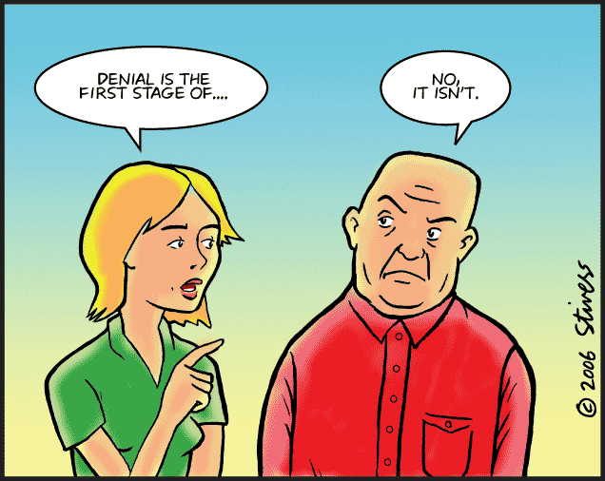
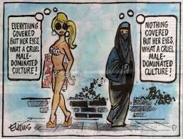
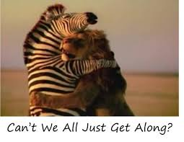
Ethnocentric
Denial
My cultural experience is the only one that is real and valid. There is little to no thought of "other"
Defense
"We" are superior" and "they" are inferiors. One feels threatened and is highly critical.
Minimization
Other cultures are trivialized or romanticized. One tends to deny differences and only seek similarities
• “All big cities are the same-lots of buildings, too many cars, McDonalds.”
• “With my experience, I can be successful in any culture without any special effort.”
• “I never experience culture shock.”
• “I wish these people would just talk the way we do.”
• “These people don't value life the way we do.”
• “Boy, could we teach these people a lot of stuff.”
• “What a sexist society!”
“Customs differ, of course, but when you really get to know them they're pretty much like us.”
“I have this intuitive sense of other people, no matter what their culture.”
“It's a small world, after all!”
Notes:
Denial of Differences
Denial is the most basic stage of ethnocentrism and reflects an orientation which assumes there are no real differences among people from different cultures.
• “All big cities are the same-lots of buildings, too many cars, McDonalds.”
• “With my experience, I can be successful in any culture without any special effort.”
• “I never experience culture shock.”
Defense Against Difference
In this state, differences are not only viewed suspiciously; they are considered threatening to one's self-esteem and identity.
• “I wish these people would just talk the way we do.”
• “These people don't value life the way we do.”
• “Boy, could we teach these people a lot of stuff.”
• “What a sexist society!”
Minimization of Difference
The Minimization worldview over-generalizes similarities between self and other, allowing cultural differences to be trivialized and therefore rendered "harmless.“
“Customs differ, of course, but when you really get to know them they're pretty much like us.”
“I have this intuitive sense of other people, no matter what their culture.”
“Technology is bringing cultural uniformity to the developed world”
“While the context may be different, the basic need to communicate remains the same around the world.”
“It's a small world, after all!”
Acceptance of Difference
Involves an acknowledgment that identifying significant cultural differences is crucial to understanding human interaction.
“The more difference the better-more difference equals more creative ideas!”
“The more cultures you know about, the better comparisons you can make.”
Adaptation to Difference
This does NOT mean a person “assimilates” to the dominant pattern by giving up his/her own cultural values, beliefs, or practices. Rather, it represents an expansion of one's perspective and skills to incorporate other ways of communicating.
“I can maintain my values and also behave in culturally appropriate ways.”
“To solve this dispute, I need to change my behavior to account for the difference in status between me and my counterpart from the other culture."
Integration of Difference
Describes the effort to integrate disparate aspects of one's cultural identity into a new whole.
“Whatever the situation, I can usually look at it from a variety of cultural points of view.”
“I truly enjoy participating fully in both of my cultures.”
“My decision-making skills are enhanced by having multiple frames of reference.”

Slide 9
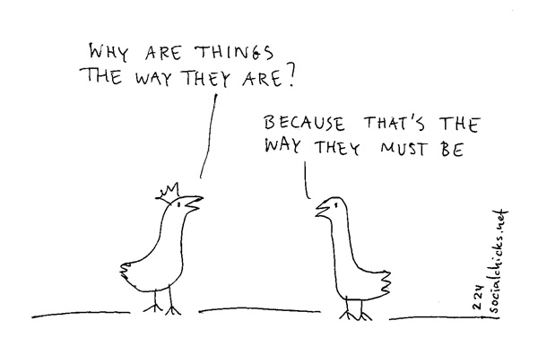
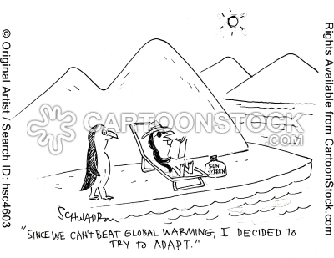
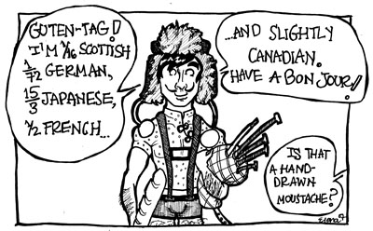
Ethnorelative
Acceptance
I accept but may not agree with other cultures. Generally, I am curious and respectful.
Adaptation
I "see" the world through different eyes and make intentional changes in my own behavior and values
Integration
I easily move in and out of different cultural worldviews.
“The more difference the better-more difference equals more creative ideas!”
“The more cultures you know about, the better comparisons you can make.”
“I can maintain my values and also behave in culturally appropriate ways.”
“To solve this dispute, I need to change my behavior to account for the difference in status between me and my counterpart from the other culture."
“Whatever the situation, I can usually look at it from a variety of cultural points of view.”
“I truly enjoy participating fully in both of my cultures.”
“My decision-making skills are enhanced by having multiple frames of reference.”
Notes:
Denial of Differences
Denial is the most basic stage of ethnocentrism and reflects an orientation which assumes there are no real differences among people from different cultures.
• “All big cities are the same-lots of buildings, too many cars, McDonalds.”
• “With my experience, I can be successful in any culture without any special effort.”
• “I never experience culture shock.”
Defense Against Difference
In this state, differences are not only viewed suspiciously; they are considered threatening to one's self-esteem and identity.
• “I wish these people would just talk the way we do.”
• “These people don't value life the way we do.”
• “Boy, could we teach these people a lot of stuff.”
• “What a sexist society!”
Minimization of Difference
The Minimization worldview over-generalizes similarities between self and other, allowing cultural differences to be trivialized and therefore rendered "harmless.“
“Customs differ, of course, but when you really get to know them they're pretty much like us.”
“I have this intuitive sense of other people, no matter what their culture.”
“Technology is bringing cultural uniformity to the developed world”
“While the context may be different, the basic need to communicate remains the same around the world.”
“It's a small world, after all!”
Acceptance of Difference
Involves an acknowledgment that identifying significant cultural differences is crucial to understanding human interaction.
“The more difference the better-more difference equals more creative ideas!”
“The more cultures you know about, the better comparisons you can make.”
Adaptation to Difference
This does NOT mean a person “assimilates” to the dominant pattern by giving up his/her own cultural values, beliefs, or practices. Rather, it represents an expansion of one's perspective and skills to incorporate other ways of communicating.
“I can maintain my values and also behave in culturally appropriate ways.”
“To solve this dispute, I need to change my behavior to account for the difference in status between me and my counterpart from the other culture."
Integration of Difference
Describes the effort to integrate disparate aspects of one's cultural identity into a new whole.
“Whatever the situation, I can usually look at it from a variety of cultural points of view.”
“I truly enjoy participating fully in both of my cultures.”
“My decision-making skills are enhanced by having multiple frames of reference.”

Slide 10
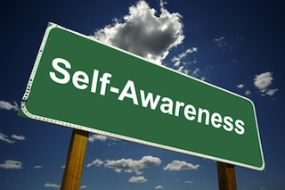
DMIS Reflections
Where do you see yourself with respect to the DMIS stages of cross-cultural experience?
Does your stage of cross-cultural experience differ by the different cultural groups that you work with or are a part of?
How might evaluation be influenced or impacted by each stage of development?
Notes:
Cindy Slide 10: Developmental Model of Intercultural Sensitivity (DMIS) – Reflections – Cindy
We thought we’d pose two sets of thought questions for you to reflect on after the webinar, either individually, within your evaluation or research team, or within your organization.
The first set relates to the DMIS model:
1) Where do you see yourself with respect to the DMIS stages of cross-cultural experience?
2) Does your stage of cross-cultural experience differ by the different cultural groups that you work with or are a part of?
3) How might evaluation theory, practice, policy be influenced or impacted by each stage of development?

Slide 11
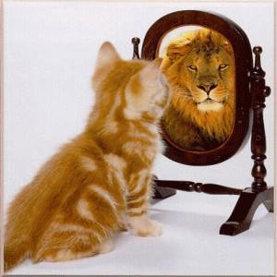
Thought Questions
* How has culture shaped your professional training as an evaluator?
* How can understanding and exploring the “self” impact/change/improve/ your work as an evaluator (i.e., practitioner, researcher, teacher, etc.)?
* What other experiences can you
engage in to further “self’ exploration?
Notes:
The second set of questions deals with culture more broadly:
1) How has culture shaped your professional training as an evaluator?
2) How does understanding and exploring the “self”, as we have done in this webinar, impact/change/improve/ your work as an evaluator
(i.e., practitioner, researcher, teacher, etc.)
3) What other experiences can you engage in to further “self’ exploration for you individually or for your team members?

Slide 12
QUESTIONS/COMMENTS?
Cindy & Osman
Cindy.crusto@yale.edu
&
Ozturgut@uiwtx.edu
Notes:
Slide 12: Thank you & Questions - Cindy
We thank you for your time today, and we welcome your questions or comments.

Slide 13
Resources
American Evaluation Association. (2011). American Evaluation Association Public Statement on Cultural Competence in Evaluation. Fairhaven, MA: Author. Retrieved from www.eval.org.
Hammer, M. R., Bennett, M. J., & Wiseman, R. (2003). Measuring intercultural sensitivity: The intercultural development inventory. International Journal of Intercultural Relations, 27(4), 421-443.
Sammut, G., Daanen, P., & Moghaddam, F. M. (Eds.) (2013). Understanding the Self and Others: Explorations in Intersubjectivity and Interobjectivity. Routledge.
SenGupta, S., Hopson, R. and Thompson-Robinson, M. (2004), Cultural competence in evaluation: An overview. New Directions for Evaluation, 2004: 5–19. doi: 10.1002/ev.112
Notes:
The second set of questions deals with culture more broadly:
1) How has culture shaped your professional training as an evaluator?
2) How does understanding and exploring the “self”, as we have done in this webinar, impact/change/improve/ your work as an evaluator
(i.e., practitioner, researcher, teacher, etc.)
3) What other experiences can you engage in to further “self’ exploration for you individually or for your team members?

