Slide 1
Team Science Evaluation: Developing Methods to Measure Convergence of Fields
American Evaluation Association
October 27th, 2012
Unni Jensen, PhD, PMP
unni.jensen@thomsonreuters.com
Custom Analytics and Engineered Solutions
Discovery Logic, Thomson Reuters

Slide 2
Agenda
Acknowledgements
Introduction to Physical Science-Oncology (PS-OC) program
Indicators for program evaluation
Authorship Publication Analysis
Content Mapping Burstiness
Conclusions
Resources/References

Slide 3
Acknowledgements
National Cancer Institute (NCI) / Center for Strategic Scientific Initiatives (CSSI) / Office of Physical Sciences-Oncology (OPSO)
Jerry Lee
Larry Nagahara
Nicole Moore
Karen Jo
Science and Technology Policy Institute (STPI)
Brian Zuckerman
Discovery Logic / Thomson Reuters
Josh Schnell and Greg Young
Jodi Basner and Didi Cross
David Jones and Vick Chan

Slide 4
Physical Sciences – Oncology Centers (PS-OC) Program
To unite the fields of physical science with cancer biology and oncology
To develop trans-disciplinary teams and infrastructure
To generate new knowledge and catalyze new fields of study
Program Goals
Grant Program at NIH/NCI/CSSI/OPSO
Established in 2009 with ~$150M
U54 Collaborative Research Grants

Slide 5
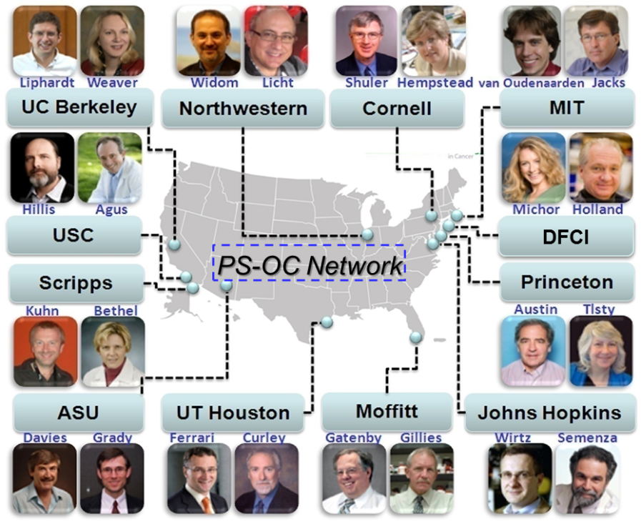
PS-OC Network
Twelve centers were funded for a five year period from 2009-2014; received ~$10-15M
PS-OC Centers
Initially there were 150 main investigators from the fields of physics, mathematics, chemistry, engineering, cancer biology and clinical oncology

Slide 6
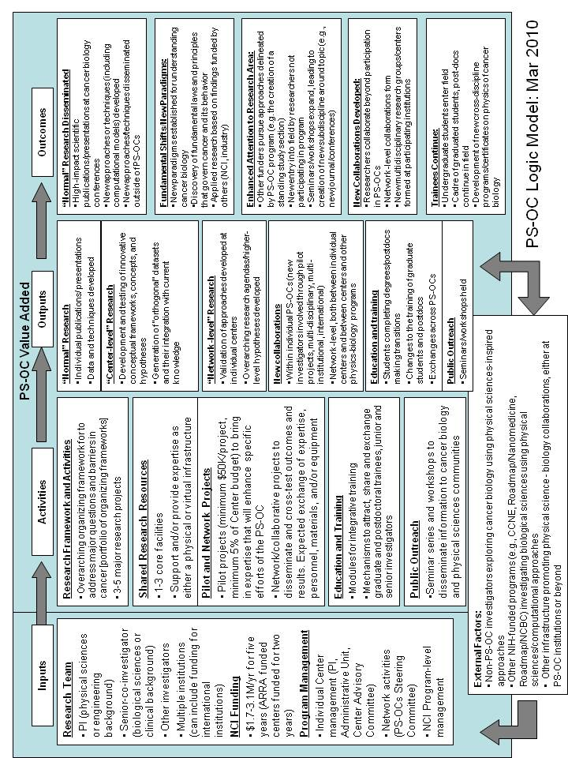
PS-OC Logic Model
Center Activities
Research Projects
Core Facilities
Pilot and Network Projects
Education and Training
Public Outreach
Developed by STPI

Slide 7
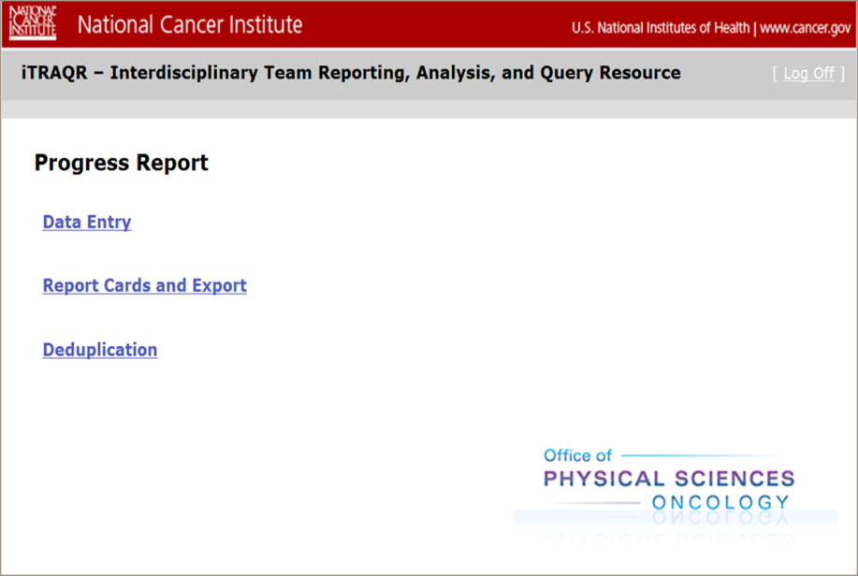
PS-OC Progress Reports
Developed to monitor the five logic model “Center Activities”
Consists of comprehensive semi-annual PDF reports of 60-100 pages; 72 out of 120 reports collected to date (3 out of 5 years)
Thomson Reuters Engineered Solutions team built an Interdisciplinary Team Reporting, Analysis, and Query Resource (iTRAQR) System
Fully web-based system
Captures both the data and the
relationships contained
Data deduplication
Robust analysis and evaluation tools
Network charts and graphs; “report
card” views; search functionality;
data exports

Slide 8
PS-OC Logic Model
Network–level
Development of innovative research concepts
Network-level
Collaboration formation
Developed by STPI

Slide 9
PS-OC Indicator Types
Thomson Reuters Custom Analytics team developed two types of indicators to help facilitate the program evaluation:
Publication Authorship Collaboration analysis developed to look at “network-level collaboration formation”
Content Mapping Burstiness analysis looking at “network-level development of innovative research concepts”

Slide 10
1. Publication Authorship Collaboration Background
Is the PS-OC initiative impacting the occurrence of within network publication authorship collaborations?
Each of the 262 main center investigators self-designated their discipline as a Physical Scientist or Oncologist
Definitions
Intra-disciplinary Collaborations: Physical Scientist co-authors with another Physical Scientist; Oncologist co-authors with another Oncologist
Cross-disciplinary Collaborations: Physical Scientist co-authors with an Oncologist

Slide 11
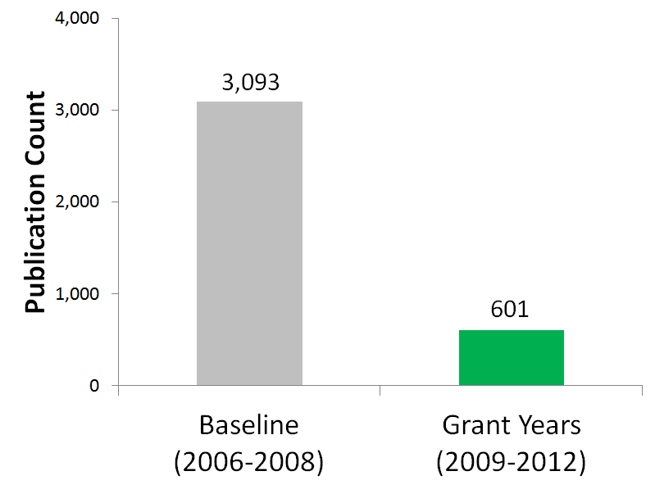
1. Publication Authorship Collaboration Input Documents
Baseline Years: Publications identified in ScienceWire® from 2006-2008 using given meta-data
Grant Years: Publications reported in center Progress Reports from 2009-2012

Slide 12
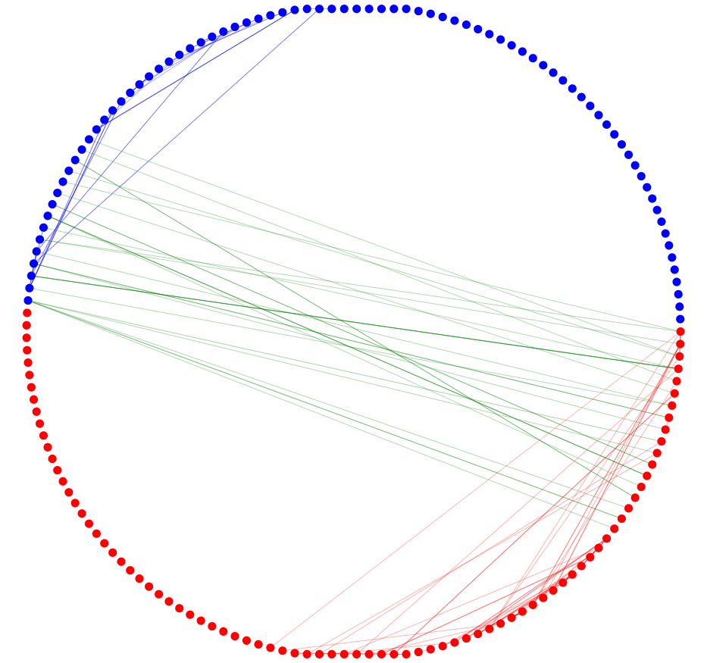
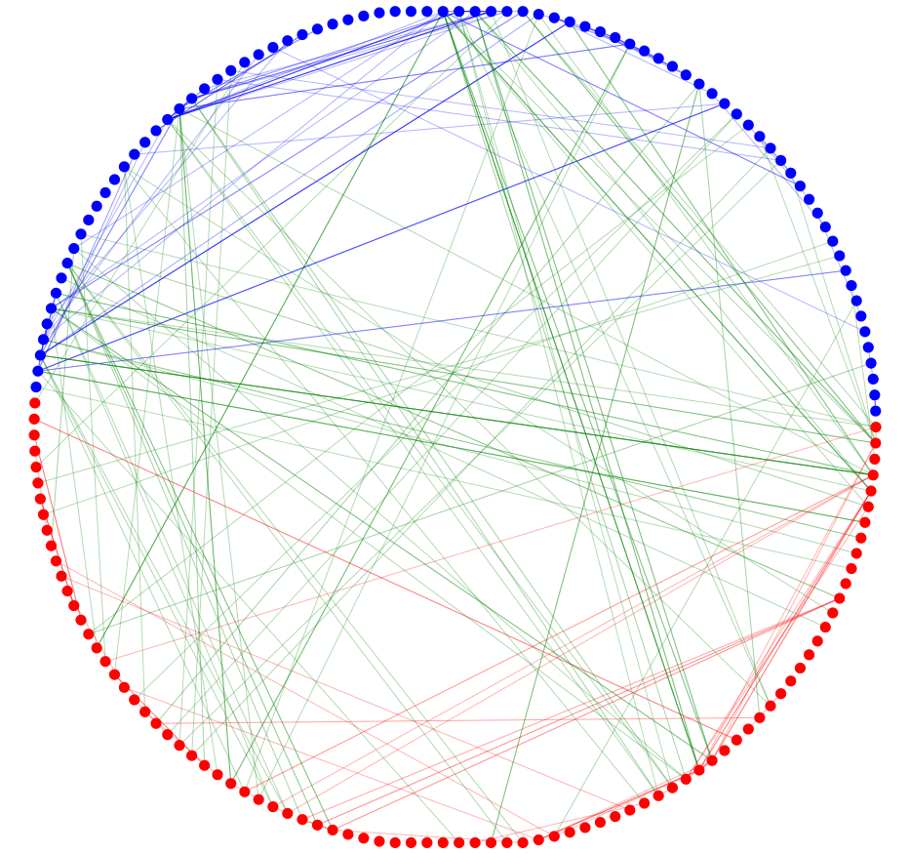
1. Publication Authorship Collaboration Program Impact on Fostering “Network-level Collaboration Formation”
> 3-fold Increase in Cross-disciplinary Collaborations
Physical Scientist
Oncologist
Baseline Years
Grant Years
Software: NodeXL¹

Slide 13
2. Content Mapping of Bursty Research Topics^{2,3} Overview
What research topics are the main investigators working on with increased activity due to participation in the PS-OC program?
Content Mapping: Performed text extraction of research documents from 262 main investigators
Burstiness: Used automated algorithms and manual evaluation by subject matter experts

Slide 14
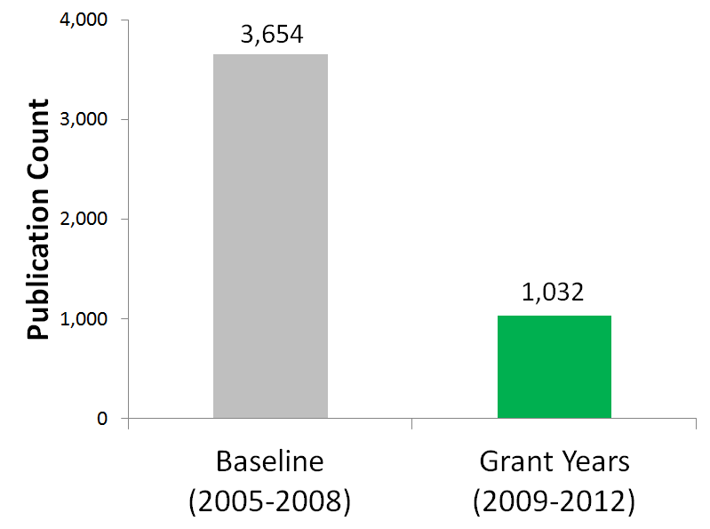
2. Content Mapping of Research Topics Input Documents
Baseline Years: Publication titles + abstracts identified in ScienceWire using given meta-data
Grant Years: Publication titles + abstracts and text sections reported in Progress Reports

Slide 15
2. Content Mapping of Research Topics Text Extraction and Preprocessing
A) Remove non-alphanumeric characters (: , . ;)
B) Stemming (cells = cell)
C) Remove stop words:
D) Manual merging of synonyms and removal of noise terms
slide figure
Standard (a, the, of)
inhibitor tki AND tyrosine kinase (acronym)
Custom/non-specific - top 1,500 most frequently occurring terms in a set of 10,000 randomly selected publications from an unrelated Journal Subject Category

Slide 16
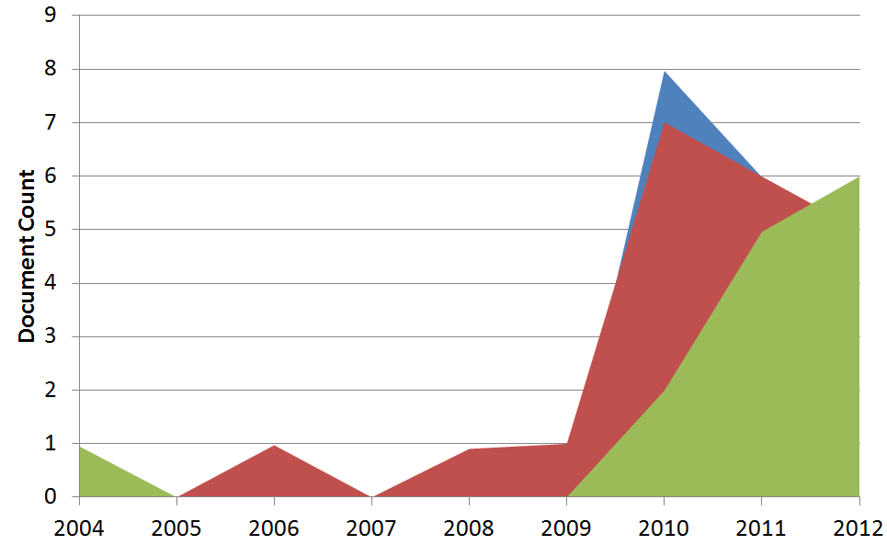
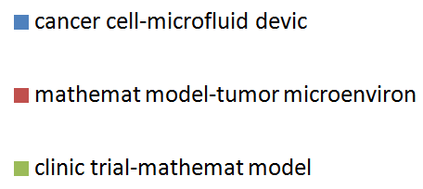
2. Content Mapping of Research Topics Measure Annual Term Co-occurrences
Term occurrence: Cancel Cell
Term co-occurrence: Cancel Cell – Mathematical Model
Number of Distinct Documents Per Co-occurrence
January 2010 to June 2012
1,186 terms occurrences
5,246 term co-occurrences

Slide 17
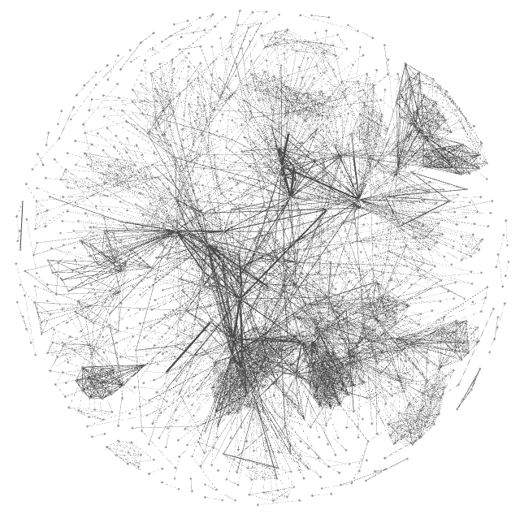
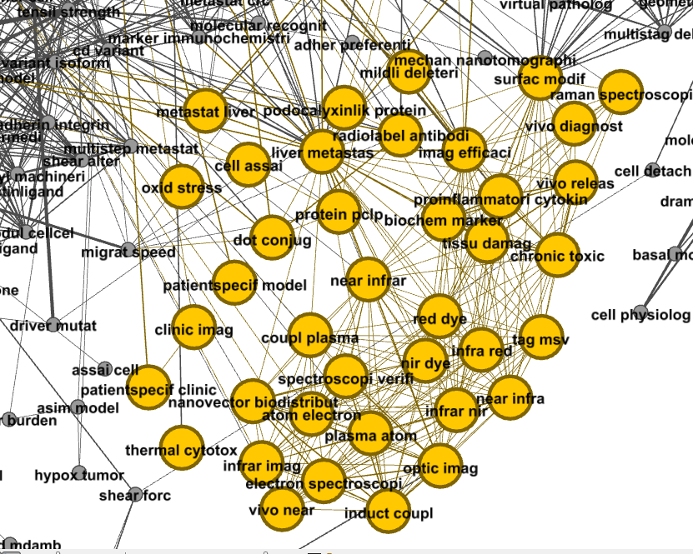
2. Content Mapping of Research Topics
Assumption: An interconnected group of co-occurring terms (cluster) is a topic^{2,5}
The “Optical Imaging” and “Liver Metastasis” terms are connected
Software: Gephi⁴

Slide 18
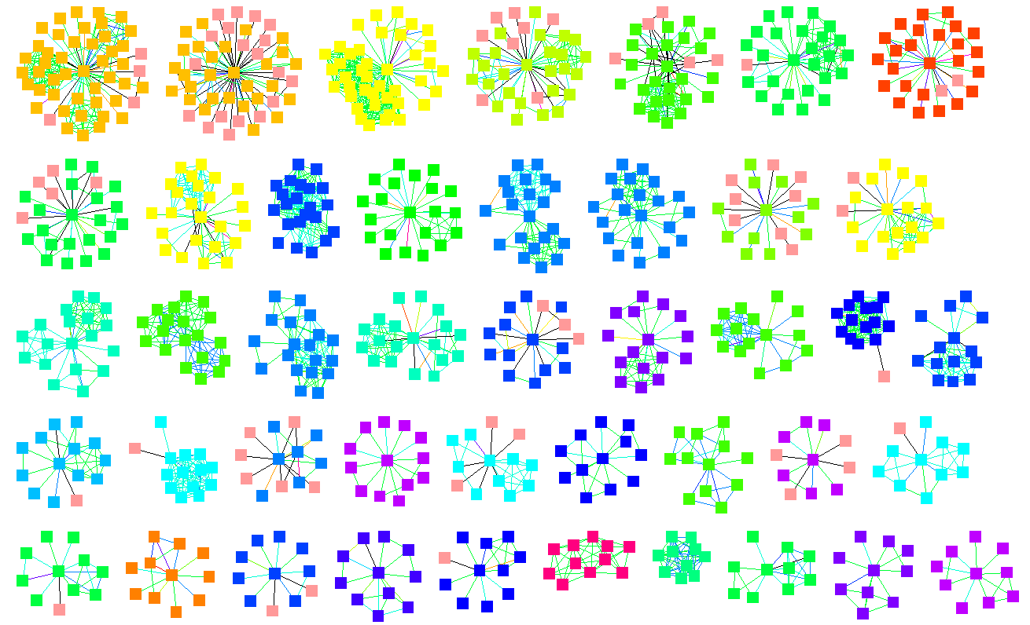
Affinity Propagation Method^{2,5} on Grant Year Documents Identified 45 Clusters with >=5 terms

Slide 19
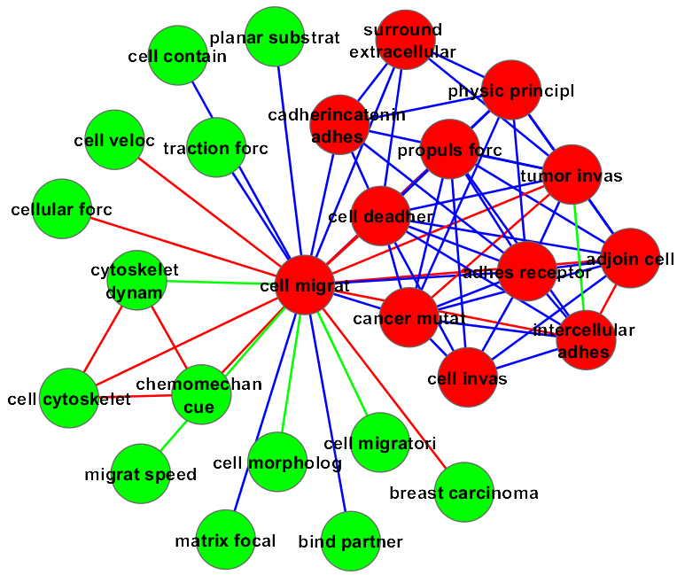
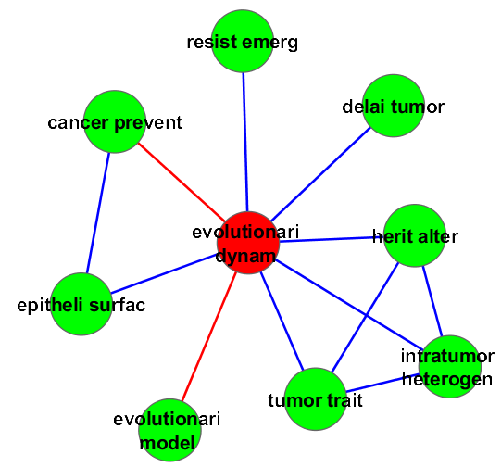
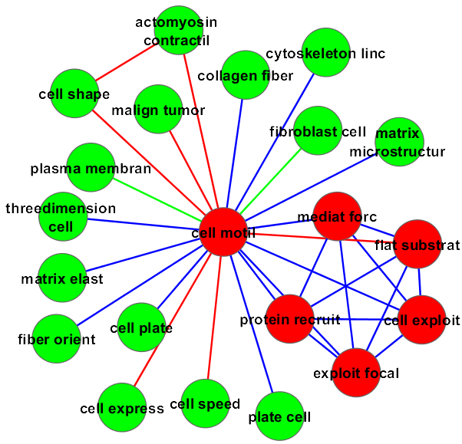
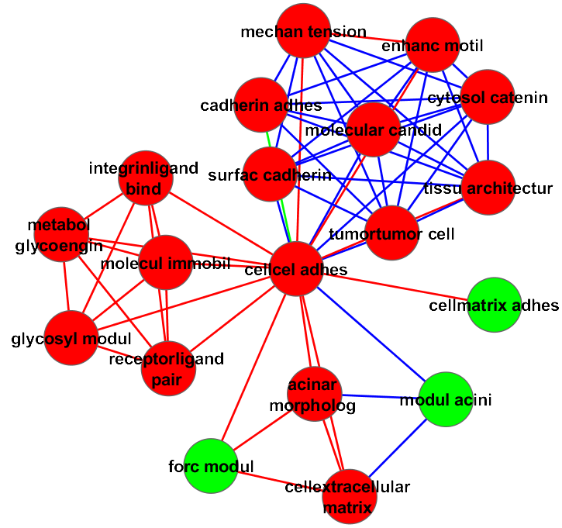
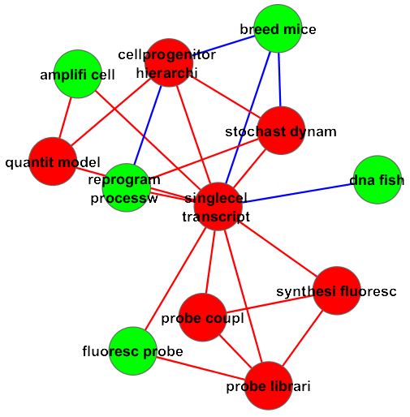
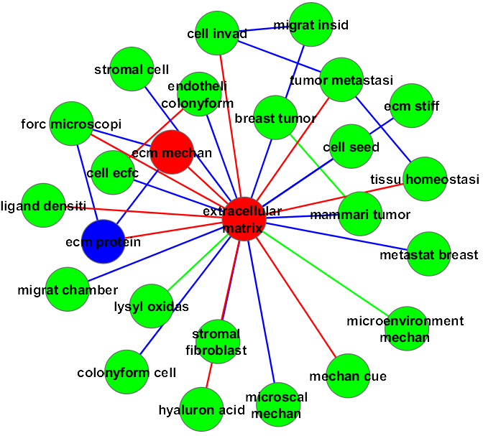
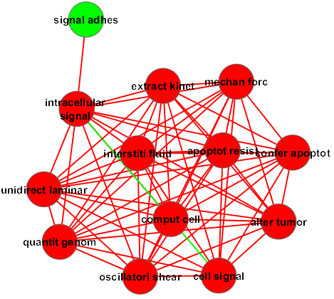
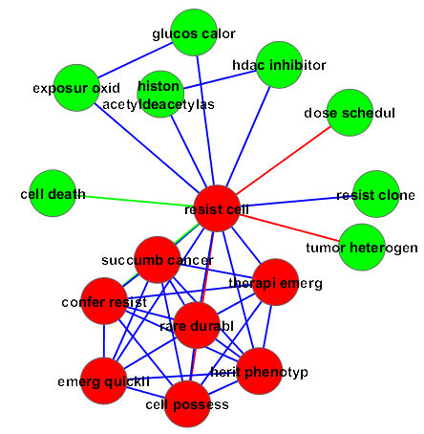
2. Content Mapping of Research Topics PS-OC Grant Years “Bursty” Topic Clusters
8 interesting clusters were selected by a combination of overall burst weight relative to baseline years and content

Slide 20
2. Content Mapping of Research Topics Grant Year Burst Activity
Above median
Around median
Below median
Cell Migration Cluster
Oscillatory Shear Cluster

Slide 21
Conclusions
Publication Authorship Collaboration analysis has demonstrated a 3 fold increase in “network-level collaboration formation”
Content Mapping Burstiness analysis has identified “network-level development of innovative research concepts”
Future Work: Outside network disciplinary authorship collaborations, adding comparison groups, include five years for baseline and grant years.

Slide 22
References
Node excel (Smith, M., Milic-Frayling, N., Shneiderman, B., Mendes Rodrigues, E., Leskovec, J., Dunne, C., (2010). NodeXL: a free and open network overview, discovery and exploration add-in for Excel 2007/2010, http://nodexl.codeplex.com
B. J. Frey and D. Dueck (2007). Clustering by passing messages between data points. Science, 315:972-976.
U. Bodenhofer, A. Kothmeier, and S. Hochreiter (2011). APCluster: an R package for affinity propagation clustering. Bioinformatics 27:2463-2464
Bastian M., Heymann S., Jacomy M. (2009). Gephi: an open source software for exploring and manipulating networks. International AAAI Conference on Weblogs and Social Media.
M. Smoot, K. Ono, J. Ruscheinski, P. Wang, T. Idekar. Cytoscape 2.8: new features for data integration and network visualization. Bioinformatics. 2011 February 1; 27(3):431-432.

Slide 23
Resources
NCI CSSI: http://cssi.cancer.gov/
NCI PS-OC Program: http://opso.cancer.gov/
STPI: https://www.ida.org/stpi.php
Thomson Reuters: http://researchanalytics.thomsonreuters.com/
Questions and feedback: unni.jensen@thomsonreuters.com
Thank you!

