Slide 1
Network Analysis Based Methods for Assessing Coordination in Exercises
Yee San Su
CNA, Safety & Security
November 3, 2011

Slide 2
Questions
National preparedness
How do we assess the state of national preparedness for all hazards?
“Large”
Measuring coordination
Can we utilize concepts from social network analysis to help us define quantitative metrics for coordination?
“Medium”
Top Officials 4 case study
Can network analysis shed new light on existing data?
“Small”
Notes:
The core capabilities in the newly released National Preparedness Goal include Operational Coordination as a core capability common to all mission areas.
Explore two particular types of techniques: (1) Centrality (importance) of agencies; and (2) Sub-group (“clique”) formation

Slide 3
National Level Exercises: A Rare Opportunity
National Level Exercises (NLEs) provide several unique opportunities for assessment:
Catastrophic: Infrequency of catastrophic real world events
Number/type of players: Multiple levels of government; multi-regional; and public and private players
Duration: Ability to examine how response develops over multiple days
“Laboratory”: Pre-plan data collection opportunities
TOPOFF 4 (2007)
Radiological dispersal device attack
15,000 participants representing international, federal, state, territorial and local entities

Slide 4
Network Analysis Metrics: Player Centrality
Key Player Problem, Negative (KPP-Neg)
Borgatti (2006)
Measures of degree of network fragmentation
Ranges from 0 to 1
Higher values indicate less cohesion
Benefits
Quantify player importance as a communication (coordination) node—e.g., emergency operation centers)
Allows for uniform comparison (across exercises, over time)
Identify factors influencing coordination performance
Where:
d_{ij} = distance between nodes i and j
D_{min} = normalization constant (weighted edges)
n = number of nodes
Notes:
Advantages:
Deals gracefully with fragmented networks
Accounts for the size/shape of the fragments created

Slide 5
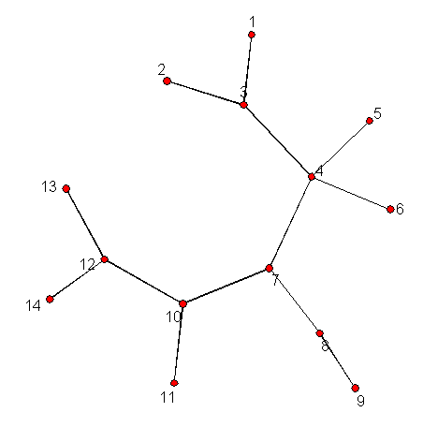
Network Analysis Metrics: Community Detection
G&N Method
Girvan & Newman (2002)
Identification of community structure in networks
Edge betweenness to identify “bottlenecks”
“Bottleneck” edges = intercommunity edges
Successive removal of the edge with the highest edge-betweenness score
Benefits
Which agencies are closer to each other?
Do cliques exist? Identify “stove-piping” of information exchange
1
3
2
5
4
6
7
8
9
10
11
13
12
14

Slide 6
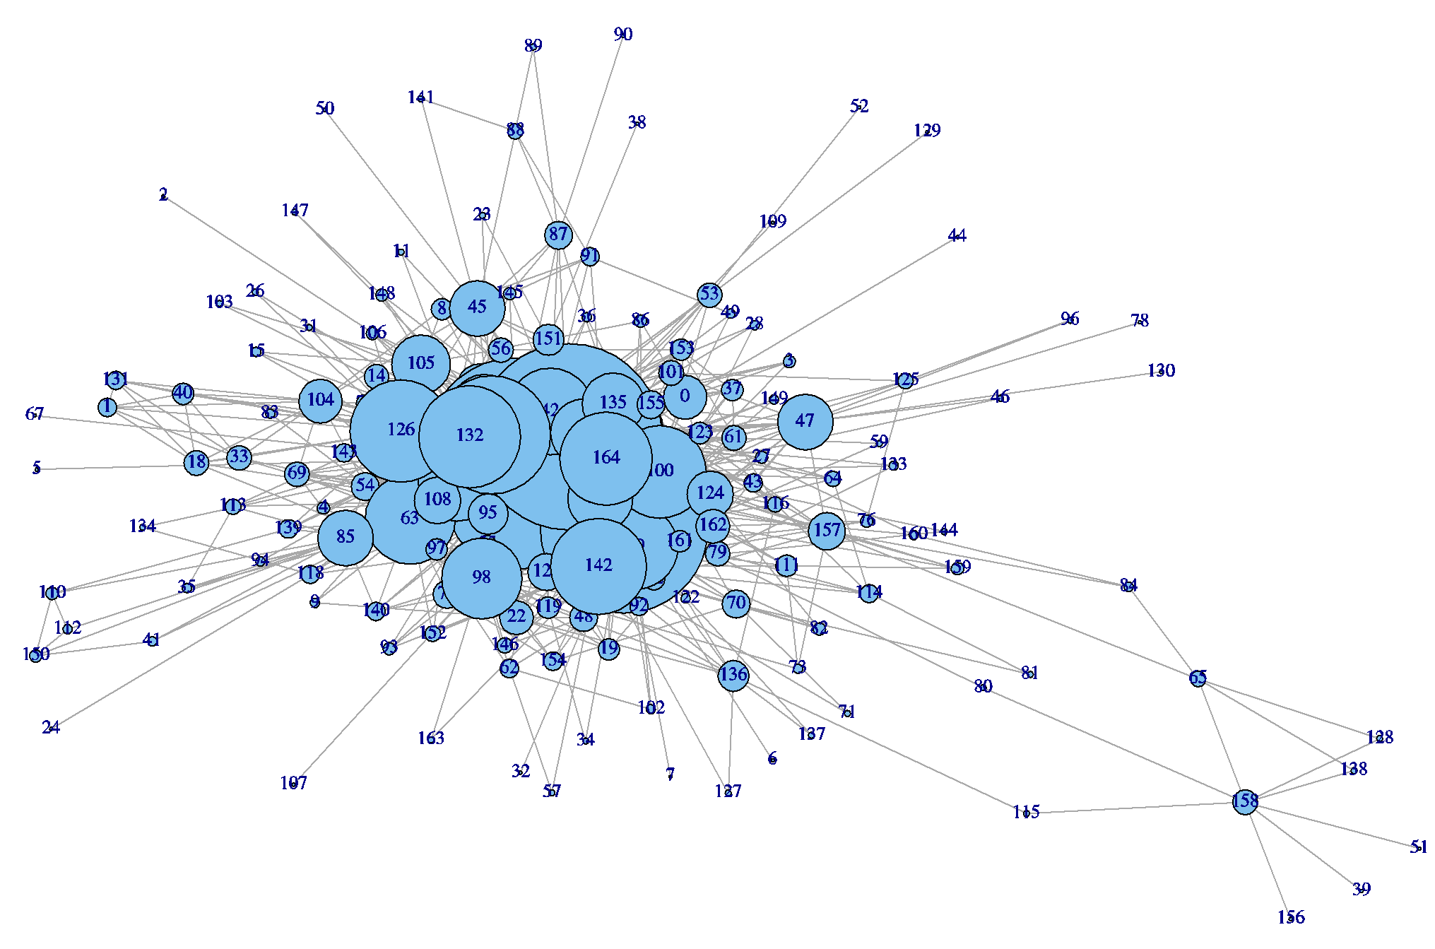
TOPOFF 4 Network Visualization
Constructed communication network from database of evaluator log entries (Portland, OR site)
Portland, OR site; 165 players identified
Size of radius indicates number of players connected to node
Raw Line Entries | 3,681
Total Entries After Coding | 4,241
Communication Entries | 2,128
Communication “Failures” | 64
Notes:
Three stage review of dataset:
The first review was done as broken down by site (the Portland, OR location included multiple sites of exercise play).
The second review was performed with all entries listed in chronological order; this was done to enforce consistency in coding and remove duplicate entries recorded by multiple evaluators.
The third review was done for those players with small numbers of communication counts. In this case, targeted keyword queries of the Access database were used to ensure counts were as accurate as possible.
The adjacency matrix of communication between players is highly sparse—only 5.5% of possible player pairs exhibited a non-zero frequency of communication. Moreover, 76% of edges valued at less than 0.2 instances of communication per hour.

Slide 7
Network Communications: By the Numbers
Percentage of communication by type
 | Local | County | State | Federal | Private | Volunteer | Media
Local | 9.9% | 9.1% | 4.4% | 7.0% | 0.7% | 1.8% | 1.0%
County |  | 10.5% | 5.5% | 4.3% | 1.1% | 2.3% | 2.3%
State |  |  | 14.4% | 9.4% | 1.6% | 1.3% | 0.7%
Federal |  |  |  | 9.8% | 1.0% | 0.1% | 1.7%
Private |  |  |  |  | 0.1% | 0.0% | 0.0%
Volunteer |  |  |  |  |  | 0.0% | 0.1%
Media |  |  |  |  |  |  | 0.0%
Communication highest among agencies at the same level of government
Communication barriers were not significant at Local/County interface
Drop-off in communication frequency occurs more than one level of government away
Involvement of non-governmental and volunteer groups is still limited

Slide 8
TOPOFF 4: KPP-Neg Analysis
Player | % Change in F
Oregon ECC | 0.49
Multnomah County EOC | 0.29
City of Portland ECC | 0.16
JFO | 0.15
CBP Port Office | 0.14
Larger percent change in F = Greater importance of player to network communications
Results:
Of top five players, four are coordination centers
No emergent behavior observed
While significant players, dispatch (17th), police (45th), and fire (54th) did play significant communication brokerage roles external to their agencies

Slide 9
TOPOFF 4: Community Breakdown
“Onion”
Network falls apart layer-by-layer
“Grape”
Network breaks down into clusters
TOPOFF 4 after-action report
Six groups working largely independent of one another → “Grape”
What does social network analysis say?

Slide 10
TOPOFF 4: Community Breakdown
Results:
12 sub-groups of three or more players identified
“Exercises within an exercise”
Evidence of information “stove-piping”; sub-groupings differed in some cases from after-action report findings
Notes:
How many communities should a network be split into?
Modularity: Difference in the fraction of edges falling within communities versus that if edges were assigned at random
Values 0.3 or higher indicate good divisions

Slide 11
Ongoing Research: Communication vs. Coordination
What is the best manner in which to define edges?
Frequencies instead of counts of communication
Going from frequency based weighting to utility based weighting
Different levels of communication needed between different agencies
Penalties for failure to communicate
Data quality

Slide 12
Thank You
Y. Su. 2011. “Application of Network Analysis Methods to Quantitatively Assess Exercise Coordination.” Homeland Security Affairs, in press.
Contact Information
Yee San Su
suy@cna.org

