Slide 1
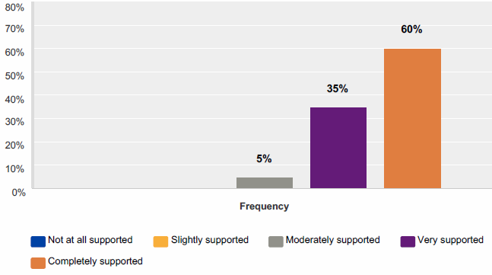
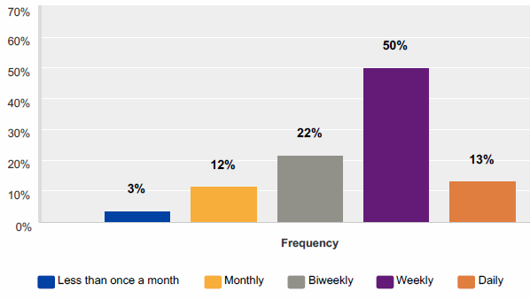
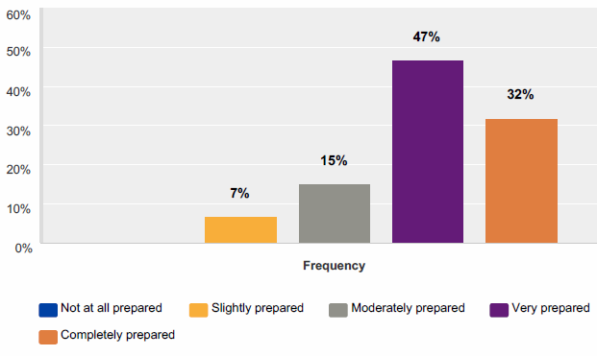
AN EXERCISE IN MAKING SENSE OF DATA
Team members: ________________ ________________ ________________ ________________
Phase 1, Week 9
Retention
________%
(fill in)
Phase 2, Week 13
Retention
________%
(fill in)
Phase 3, Week 19
Retention
________%
(fill in)
Phase 4, Week 25
Retention
________%
(fill in)
YUtopia Internship phases…
Jan16 Cycle Summary
L&D Retention | 89%
Graduation Retention | 77%
FT, YU-related jobs | 78%
Intern-to-hire | 58%
Wage | $17.20
Higher education | 50%
Total placed | 90%
Manager Satisfaction (NPS) | 94%
Student Satisfaction (NPS) | 89%
Phase 1 Objectives
-Review last cycle and L&D data in left margin
-Choose, cut, and paste one KPI of interest from both the IX and PR1 surveys
-Answer the questions provided and record notes below
Phase 2 Objectives
-Consider observations and hypotheses from Phase 1
-Choose up to two additional data sources for review
-Answer the questions provided and record notes below
Phase 3 Objectives
-Identify priority areas for data inquiry given what you know so far
-Choose, cut, and paste one KPI of interest from the PR2 survey
-Field a “Skype Call” with Program or CE for qualitative insight
Phase 4 Objectives
-Choose, cut, and paste one KPI of interest from the Pre-Graduation survey
-At end of Phase 4, review final YUtopia outputs/outcomes
-Prepare brief notes and summary responses to processing/debrief questions
Internship Experience (IX) Survey KPI (Choose one)
1. How satisfied are interns with their internship?
2. How well supported do our interns feel by their supervisors?
3. How much of internship includes concepts covered at Year Up?
4. How much downtime do interns typically have?
5. How supported have our interns felt by Year Up staff?
6. Would they recommend their internship to a future intern?
Additional Data (Choose up to two)
Infractions during internship weeks 1-13
Mirror Exercise admissions data (demographic composition of class)
Readiness Assessment scores summarized by factor
Last cycle’s IX and PR1 survey KPI
More IX survey data: “Since the beginning of internship how much have you felt supported by the following YU staff?” (Coach, Mentor, PM, SS, IS, Other)
More PR1 survey data: “How frequently does your intern demonstrate the following professional skills on the job?” (Communicates well, works well with others, applies feedback effectively, produces quality work, organizes tasks/projects, takes initiative, strives to learn new skills, follows instructions, asks questions, demonstrates a positive attitude, adapts well to challenges, thinks critically when solving problems)
Performance Review 2 (PR2) Survey KPI (Choose one)
1. How often does interns’ overall performance meet job requirements?
2. How often does interns’ pro skills meet job requirements?
3. How often do interns’ tech skills meet job requirements?
4. How satisfied are managers with Year Up’s support?
5. Are interns being considered for a position within the manager’s department?
6. How likely is it that managers would recommend Year Up? (NPS satisfaction)
Pre-Graduation Survey KPI (Choose one)
1. How well supported do our interns feel?
2. How satisfied are interns with their internship?
3. How satisfied are interns with the level of communication from the IS team?
4. How satisfied are interns with the level of communication from coaches?
5. How did the overall Year Up experience compare to their expectations?
6. How likely is it that interns would recommend Year Up? (NPS satisfaction)
Cut and paste corresponding KPI graphic here
Cut and paste corresponding KPI graphic here
Cut and paste corresponding KPI graphic here
Jul16 L&D Summary
L&D Retention | 85%
Students <100 L&D points | 14%
Avg. Sum of Readiness | 6.7
Briefly explain why you initially chose these additional data and if/how what you observed in Phase 1 influenced your choices. You’ll have the chance to explain what you’re observing in the new data further below.
Jul16 Pre-internship Survey KPIs
How well supported do students feel?
Frequency of coach communication
Preparedness for Internship Transition
L&D Experience vs. Expectations
97% Overall Satisfaction @ end of L&D (NPS)
Hypothesize why this data point matters: If interns are reporting _________________________________________________ ______________________, then they might be experiencing __________________ __________________________________________________ and this could specifically affect ______________________________________________________
How would you flag this data point for response? □ Red (immediate triage) □ Yellow (adjust now to boost performance) □ Green (reinforce practice) □ Delayed (hold for post-cycle lookback/adjustment)
Briefly recommend what you would do to respond: ____________________________________________________________________ ____________________________________________________________________
Who would be involved in your response? (select all that apply) □SLT □ED □PL □PM □Admissions/Recruitment □ISMs □Coaches □SS □Instructors □PRM/EP □NPT □Other___________________________________
Hypothesize why this data point matters: If managers are reporting _______________________________________________ ______________________, then they might be experiencing __________________ __________________________________________________ and this could specifically affect ______________________________________________________
How would you flag this data point for response? □ Red (immediate triage) □ Yellow (adjust now to boost performance) □ Green (reinforce practice) □ Delayed (hold for post-cycle lookback/adjustment)
Briefly recommend what you would do to respond: ____________________________________________________________________ ____________________________________________________________________
Who would be involved in your response? (select all that apply) □SLT □ED □PL □PM □Admissions/Recruitment □ISMs □Coaches □SS □Instructors □PRM/EP □NPT □Other___________________________________
Hypothesize why this data point matters: If interns are reporting _________________________________________________ ______________________, then they might be experiencing __________________ __________________________________________________ and this could specifically affect ______________________________________________________
How would you flag this data point for response? □ Red (immediate triage) □ Yellow (adjust now to boost performance) □ Green (reinforce practice) □ Delayed (hold for post-cycle lookback/adjustment)
Briefly recommend what you would do to respond: ____________________________________________________________________ ____________________________________________________________________
Who would be involved in your response? (select all that apply) □SLT □ED □PL □PM □Admissions/Recruitment □ISMs □Coaches □SS □Instructors □PRM/EP □NPT □Other___________________________________
Cut and paste your chosen data graphics here and consider some guiding questions. If your graphics do not fit, record brief notes below.
Guiding questions:
Do you observe any unique outliers (peaks/plummets) or patterns in the new data?
Do your new data support or run counter to your hypotheses in Phase 1?
After reviewing the new data, do they still feel relevant?
Where are there still gaps in the information available to you at this point in time?
Performance Review 1 (PR1) Survey KPI (Choose one)
1. How often do interns’ overall performance meet job requirements?
2. How often do interns’ pro skills meet job requirements?
3. How often do interns’ tech skills meet job requirements?
4. How satisfied are managers with Year Up’s support?
5. Would managers recommend their intern for hire?
“Skype Call” (Choose one)
You now have the opportunity to get on a Skype call with a key member of the Program or CE team who can give you further qualitative insight into interns’ experiences or managers’ observations of interns’ skills and job performance.
Program team (for intern feedback re: intern experience and needed supports)
Corporate Engagement team (for manager feedback re: interns’ tech skills)
Guiding questions:
Were you able to identify and code feedback into relevant categories and valences, sorting responses into positive/negative/neutral attitudes? If not, were there any challenges about deriving value from the comments?
Did the qualitative information provide helpful context or make things more confusing? Was it relevant information?
Have your original hypotheses from Phase 1 shifted or changed as a result of this additional context?
Did you learn anything from the comments that, while not directly applicable to your initial hypotheses and questions, were nonetheless helpful for other reasons?
Based upon all the data you have considered through the end of internship phase, briefly describe what you anticipate about post-program positive outcomes? Do you expect YUtopia to fall short, meet, or exceed goals? Which data points, if any, do you have top of mind when making this prediction?
Cut and paste corresponding KPI graphic here
Debrief After Reviewing YUTopia’s Final Outputs/Outcomes Guiding questions: Were any of your hypotheses confirmed by the outputs/outcomes? Did any remain untested (i.e., won’t know until a future cycle)? Did your team find itself wanting even more data? What information do you wish you had that you weren’t provided? The “Skype Call” aside, were there any points in time you wish you could talk directly to a stakeholder? Who? What would you have asked them? What data or information reviewed here would you absolutely include in a post-cycle lookback? Is there anything you would exclude because it could create too much “noise over the signal?”
Hypothesize why this data point matters: If managers are reporting _______________________________________________ ______________________, then they might be experiencing __________________ __________________________________________________ and this could specifically affect ______________________________________________________
How would you flag this data point for response? □ Red (immediate triage) □ Yellow (adjust now to boost performance) □ Green (reinforce practice) □ Delayed (hold for post-cycle lookback/adjustment)
Briefly recommend what you would do to respond: ____________________________________________________________________ ____________________________________________________________________
Who would be involved in your response? (select all that apply) □SLT □ED □PL □PM □Admissions/Recruitment □ISMs □Coaches □SS □Instructors □PRM/EP □NPT □Other___________________________________
Given what you have observed to this point, where do you plan to focus attention in the next two phases of the internship? On a specific function, role, or program activity? Will you reprioritize your focus from Phase 1 (e.g., moving from “immediate triage” to “delayed for post-cycle adjustment”)?

