Slide 1
The SHP Framework: A New Framework for the Evaluation of Complex Projects
Barbara Heath, Ph.D.
Aruna Lakshmanan, Ph.D.
Catherine Freeman, MPA
East Main Evaluation & Consulting, LLC

Slide 2
Context
The iPlant Collaborative
Multi-institutional
Multi-disciplinary
Virtual
Distributed
Create a cyberinfrastructure (CI) for plant science that will enable new conceptual advances through integrative, computational thinking

Slide 3
A new type of organization that will…
Foster computational thinking in biology
Be by, for, and of the community
Remain on the leading edge of plant science
Constantly reinvent itself and its capabilities

Slide 4
The SHP Framework
Systems
Iterative process that developed organically alongside the evaluand
Patterns of Action
Appropriate for dynamical situations with high uncertainty and high social conflict
Highlights

Slide 5
Systems: CDE Model
Context is complex, dynamical, and includes humans
CDE*
Three conditions for self-organizing behavior
Containers, Differences, Exchanges
Container 1
Container 2

Slide 6
Systems: CDE Model
Data sources: documents, interviews, meeting minutes/attendance, surveys, formal reports
Disaggregate the data into units
Units are analyzed as a set and clustered
Containers (C)

Slide 7
Systems: CDE Model
Core
Services
iPToL Working Group
Board of Directors
Determine what drives the action within each container (D) and how containers interact (E) to form the system
Core Software
iPG2P Working Group
Target Community
Engagement Team
Executive Committee
Admin. Support

Slide 8
Systems: CDE Model
Core Services
Core Software
Executive Team
System at a specific time point

Slide 9
System Diagram

Slide 10
System Diagrams
January 2009
April 2009

Slide 11
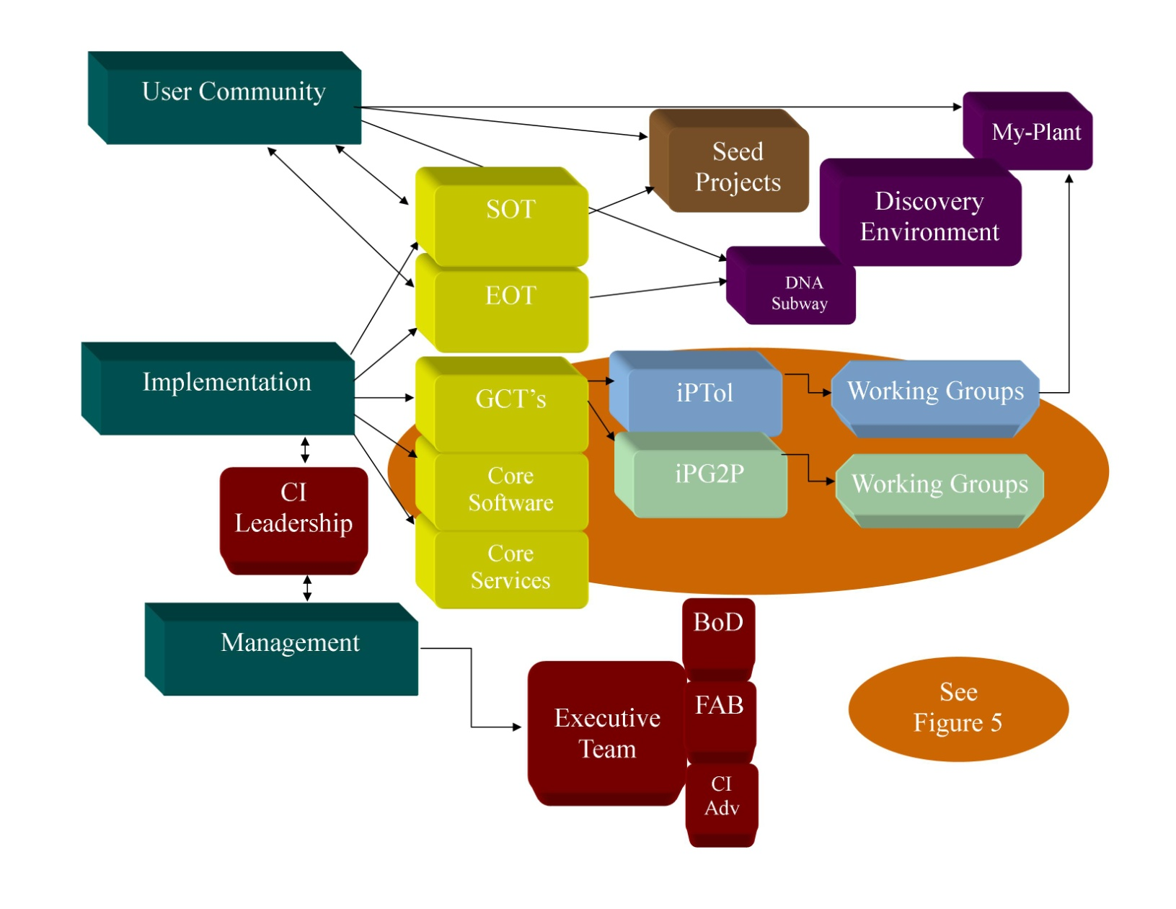
System Diagram

Slide 12
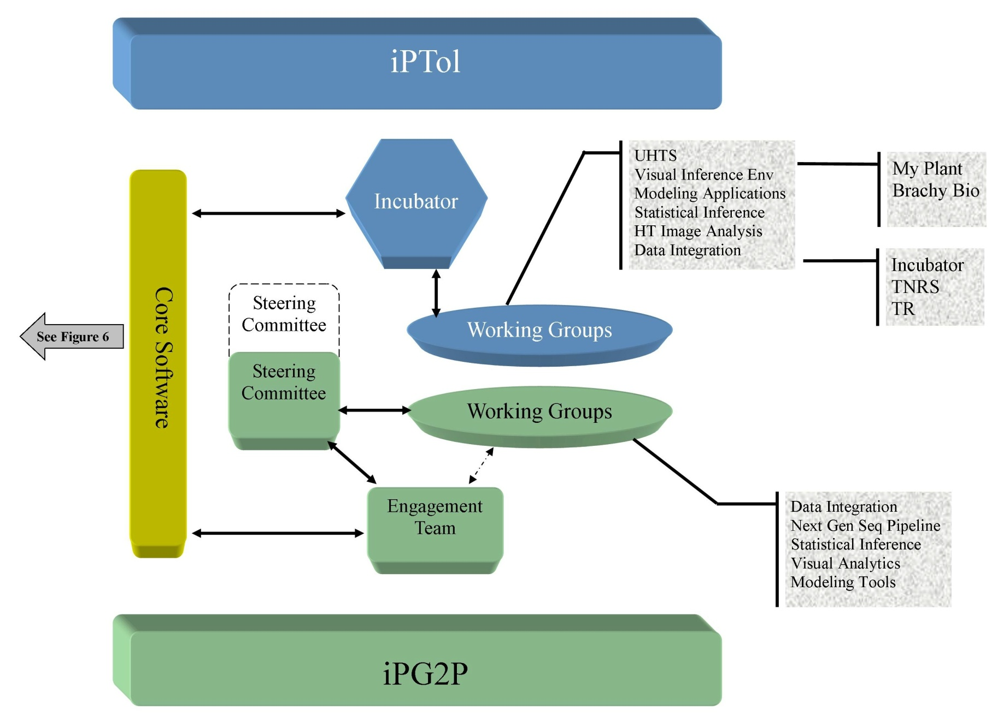
System Diagram

Slide 13
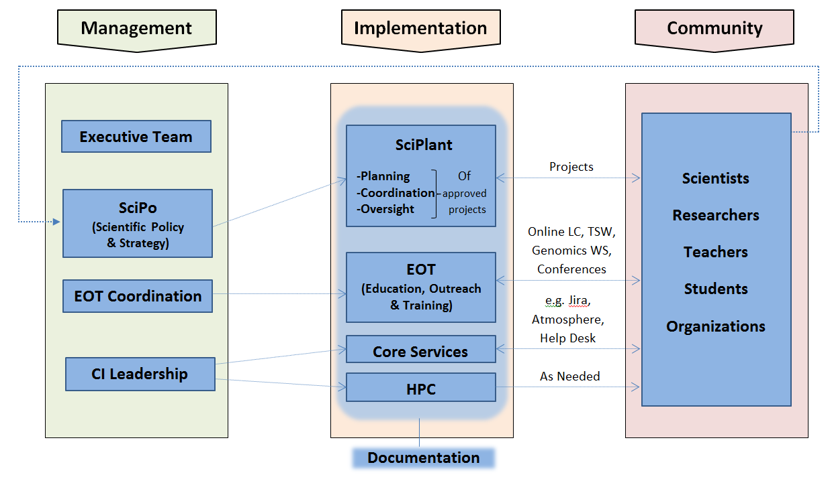
Systems Analysis Outcome

Slide 14
Highlights
Continued applying systems methods to iPlant
Generated a significant amount of data and related analysis
Selected to present a list of highlights for each quarter of project implementation
Further identified highlights as deliberate events and emergent ideas
Notes:
-To give a quick overview of where the “H” came from….
-During this time while applying systems methods to the project, we were generating a great deal of data and related analysis.
-As we were collecting data from all of those mentioned places like the wiki, meeting notes, staff interviews, and formal reports the project was moving at such a rapid pace we needed a way to organize the information to better understand and track.
-One particularly helpful practice was to present a list of highlights for each quarter of project implementation
-So this is how the “H” or “Highlights” developed.
-The items are described as deliberate event/activities and emergent ideas
-This tracking longitudinally provided us with a broad view of the progress and shifting focus of the project

Slide 15
Highlights Excerpt, 2009
Q:Y | Deliberate Events/Activities | Emergent Ideas
Q1:09 | GCT Selected BOD Meeting to review GCPs Recommendations for GC engagement Leaflet launched
Q2:09 | NSF Retreat Management structure reorganization: SOT, FAT, CA Advisory Genomics in Education Workshop iPToL kickoff meeting – 6 groups formed | Shift from consensus-based management to team-based management Engagement Team and Steering Committee concepts Compensation avenues for GCTs DNA Subway discussion initiated
Q3:09 | iPG2P kickoff meeting-5 groups formed CI Team meeting at TACC New Board Members inducted Board Chair change EOT Advisory Meeting in Chicago Website redesign | Stanzione to TACC – leverage human and computing capital at TACC Shift from management focus to implementation focus Tech talks begin
Q4:09 | SOT kickoff meeting iPlant/NESCent joint meeting VA Mutual Understanding Meeting | PI resigns My-Plant Workflows integrating data constructed via web-based services 1KP Consortium Atmosphere discussion initiated
Notes:
Now to describe how to actually do the Highlights piece of the Framework I will show you how we did it for iPlant:
Here, an excerpt of our highlights table is shown from one of the earlier years of the project
It is organized appropriately by our selected time increments
Now this might be different for other projects: But we selected quarter and year to track the major events and activities longitudinally
The events and activities are labeled as deliberate or emergent
-For example: The project deliberately schedule an EOT Advisory team meeting in Chicago in Q3 (CLICK) - from this meeting the idea of tech talks emerged. (CLICK)
-These Tech Talks eventually became a regular part of project activity and are still taking place today with the most recent series of Tech Talks beginning again this month.
4. Now, the way that these items are selected as highlights is through a team decision – our evaluation team together selects items that are most relevant and significant together
5. This relevance and significance is based on how that event/activity impacts the entire system that was defined in the systems analysis that Dr. Heath just described for you
6. This process is time intensive and requires that project staff to be constantly going back and checking events while following their lifespan such as their success, failure, growth, change patterns, and so forth
-During this process events may be added or removed for each quarter and year
-In order to do this part of the framework successfully, there must be an active participant evaluation occurring simultaneously while applying systems methods and concepts to the project
7. BUT-- the work doesn’t stop here:
-We also look at this information for any patterns and also for feedback we can provide to the client
-From these highlights tables we are able to recognize different patterns

Slide 16
Patterns Recognized, 2009
Q:Y | Deliberate Events/Activities
 | Community | Implementation | Management
Q1:09 | Leaflet launched | GCT Selected | BOD Meeting to review GCPs Recommendations for GC engagement
Q2:09 | Genomics in Education Workshop | iPToL kickoff meeting – 6 groups formed | NSF Retreat Management structure reorganization: SOT, FAT, CA Advisory iPToL kickoff meeting – 6 groups formed
Q3:09 | Website redesign | iPG2P kickoff meeting – 5 groups formed | iPG2P kickoff meeting – 5 groups formed CI Team meeting at TACC New Board Members inducted Board Chair change EOT Advisory Meeting in Chicago
Q4:09 | iPlant/NESCent joint meeting VA Mutual Understanding Meeting |  | SOT kickoff meeting
Notes:
-Now in order to further illustrate how we did this for iPlant we used the same excerpt from the previous slide
But now you can see how the highlights table allows for the evaluation team to recognized hidden themes and patterns within project activities that may have otherwise been missed
First notice it is still organized appropriately by the selected time increments (Q, Y) to stay with tracking over time
2. But in this excerpt we show you an example of one of the recognized patterns
3. We realized that different pieces of the project were responsible for different highlights that were showing up in our data collection
-This could have been any group within the project such as the PIs or the EOT team
-When we began identifying the group responsible we realized that each group fell into one of the three tiers identified in the CDE model that Dr. Heath just described for you– including Management, Implementation, and Community
-Now, keep in mind more than one group is often involved in different activities and events - but we selected the primary one responsible
4. As you can see on this slide we have organized by color the different highlights into their category
Purple: Community
Blue: implementation
Red: management
-As mentioned before, this process is still time intensive and still requires also requires to constantly be reviewing the events and going back through the history of the project
-And now this information can then be looked at over time throughout the project….

Slide 17
Increase in workshops, training and outreach
Period of organization
Heavy tool and application development
Renewal period
Notes:
So here the information from the highlights table is put into a graph by Community (Community), Implementation (Blue) and Management (Red)
To point out some major points that we were able visualize here:
-As you can see (CLICK) there is a spike in management activity at the beginning of the project in 2009 as groups were forming and the project was becoming organized
- (CLICK) Then there is another spike in management activity in 2013 because the project was invited for a non competitive renewal at the time
-Implementation and community were lower at the beginning when tools and applications had not been fully developed
-Once the project was moving along tools and applications were developing at a very rapid pace (CLICK) and more collaborations were forming – So as a result (CLICK) the implementation and community activities jumped significantly
It is easy to visualize and identify project phase changes over time this way
As seen through this graph, patterns of activity in each tier align with specific project events
5. No these examples are very general pattern recognitions but from this information the evaluation team is then able to further break it down to see the project through different lenses
-So to show an example how we did this for iPlant I will take the community tier and further break it down to show you…

Slide 18
Spread awareness
Rapid tool and application development
Adoption increasing
Notes:
1. So here taking the Community Tier from the previous table - we can further break it down to visualize its own patterns
2. You can see we have split Community by E, O, & T as defined by the project - Education, Outreach and Training
3. It is important to note that Community as E, O, & T is not only referring to activities carried out by the EOT group – as EOT is a project wide effort
4. So again the community patterns align with specific project activities
-this occurs certain tools and services were developed and the project hit certain milestones and major points
-For example, in the early years of the project before there were tools and services developed, (CLICK) the project worked to spread awareness of iPlant
-Then you see training frequency increases (CLICK) at the end of 2010 and beginning 2011
-this is when the tools and services were being rapidly developed and the project was becoming more established
- It is also noticed there was very little happening in classroom education while most efforts were focused on training and outreach
-but then in 2013 (CLICK) there is a small uptick in education – because as iPlant was more established and had reached a portion of their target population it was being adopted by users for education in a classroom setting
5. So over all, this whole process allows the evaluation team to recognize any disturbances to the project system as well as any further patterns
6. Additionally, as the project continues to develop …streams of behavior and consistencies or inconsistencies with goals can be recognized

Slide 19
The SHP Framework
Systems
Patterns of Action
Highlights
Notes:
So the Highlights table information is provided to the client to use as they want
2. It can often help them recognize strengths and weaknesses, and gain ideas for improvement
3. And also to better understand the characteristics of the organization, in turn leading to more informed decision-making, particularly if they would like to enact change.
I will now pass it over to Aruna and she will describe the “P” of the SHP Framework and Patterns of Action

Slide 20
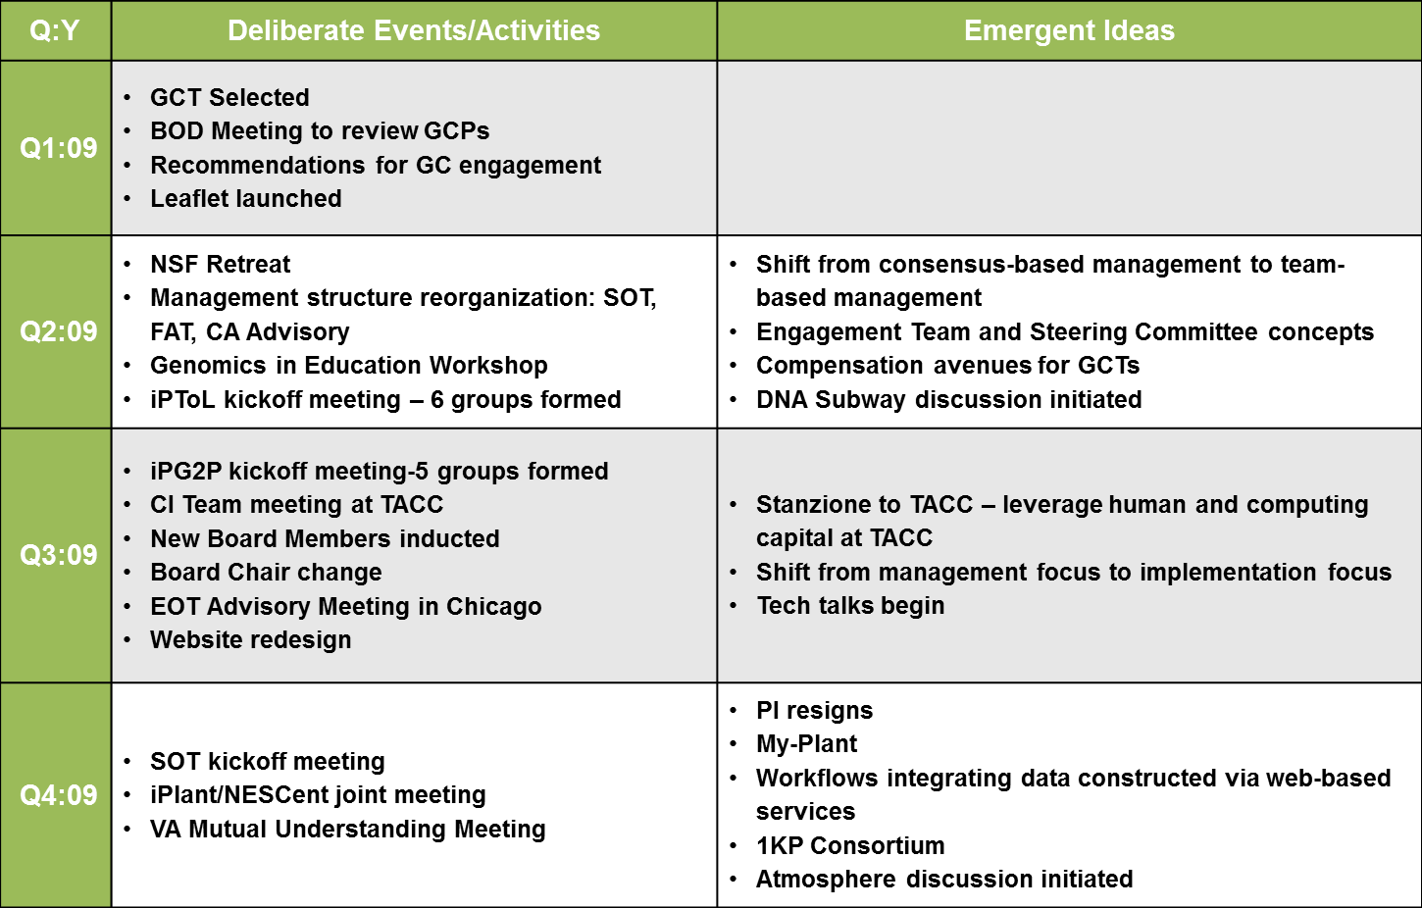
SHP: Patterns of Action

Slide 21
Patterns of Action
Patterns
Examine actions over time
Provide a visual representation
Theme selection
Understand project goals
Examine value to client

Slide 22
Patterns of Action
Personnel are concerned
PI Resigns
Project Initiated
Restructuring Step
SciPlant
BOD
CIAT
IAB
BOD
CIAT
IAB
CI-Lead
FAB
BOD
Direct Supervision
Executive Management
2008
2009
2010
2011
Management
Notes:
When creating the patterns of action diagrams, we outline the activities on a timeline– then look for patterns of action within the selected theme. In this case, we noticed the difference in the type of management, thus labeling the diagram in two phases: direct supervision and executive management.

Slide 23
Patterns of Action
Team Based
Chaos
Project Based
Reorganization
DNA Subway
Atmosphere
BrachyBio!
IBP
MyPlant
1KP
Trait Evolution
SOT
Seed
BSA-GWP
GCT2
WG
WG
WG
Peak Ranger
GCW
GCT1
WG
WG
WG
WG
TNRS
2008
2009
2010
2011
Scientific Portfolio Development
Notes:
In the next example, the focus/theme is the development of the scientific portfolio. In this case, the pattern of action centered on the type of team organization. Initially, there was a team-based effort, followed by a period of high growth and chaos that was rectified through a reorganization step resulting moving to a project-based model.

Slide 24
Patterns of Action
Personnel are concerned
Restructuring Step
PI Resigns
Project Initiated
SciPlant
BOD
CIAT
IAB
BOD
CIAT
IAB
CI-Lead
FAB
BOD
2008
2009
2010
2011
Management
Chaos
Reorganization
DNA Subway
Atmosphere
BrachyBio!
IBP
1KP
MyPlant
SOT
Seed
Trait Evolution
BSA-GWP
GCT2
WG
WG
WG
Peak Ranger
GCW
GCT1
WG
WG
WG
WG
TNRS
2008
2009
2010
2011
Scientific Portfolio Development
Notes:
Can compare themed-based patterns of action to investigate even larger patterns or correlations between themes. In this example, the reorganization within the scientific portfolio development aligns with the creation and implementation of SciPlant in the Management diagram. One may also, notice that the resignation of the original PI appears a precursor to the Chaos phase of the SPD diagram. However, this is not the correct cause and effect relationship. You must know your data and be able to find evidence to support any patterns or patterns of action.

Slide 25
Why SHP?
Captures the dynamic nature of the system
For the Evaluator
Identify and understand emergent themes
Adjust data collection and focus
Frame appropriate recommendations
For the Client
Helps visualize history of behavior, actions, and decisions
Helps identify what worked and why
Encourages proactivity

Slide 26
The SHP Framework
Systems
Patterns of Action
Highlights

Slide 27
References
Eoyang, G. H. (2007). Human systems dynamics: Complexity-based approach to a complex evaluation. In B. Williams, and I. Imam (Eds.) Systems concepts in evaluation: An expert anthology (pp. 123-140). Point Reyes, CA: EdgePress of Inverness.
Mintzberg, H. (2007). Tracking strategies: Toward a general theory of strategy formation. New York, NY: Oxford University Press.

Slide 28
Acknowledgements
The iPlant Collaborative (NSF Award: DBI-1265383)
Courtney Humphreys, EMEC
Contact Information
Barbara P. Heath, Ph.D. bheath@emeconline.com
Aruna Lakshmanan, Ph.D. alakshmanan@emeconline.com
Catherine M. Freeman, MPA cfreeman@emeconline.com
www.emeconline.com
East Main Evaluation & Consulting, LLC
Wilmington, North Carolina

