Slide 1
Recruiting participants for education studies: Practical strategies and advice
Elizabeth Autio, M.A.
Jason Greenberg-Motamedi, Ph.D.
Annual Meeting of the American Evaluation Association
November 3, 2011, Anaheim, CA

Slide 2
Based on our experience recruiting 5th grade teacher teams for an RCT
10 key lessons learned

Slide 3
Importance of recruitment
Sample size
Representativeness
Commitment

Slide 4
Challenges
Time
Money
Relation-ships
Multiple stake-holders
Buy-in
Many programs
Random assgmt

Slide 5
1. Develop a system
Approach
Materials
Tracking mechanism

Slide 6
Organization contacts
Districts
Conference presentations
Conf. calls, webinars
State Dept. of Ed support
Principals
Press releases
In-person visits, recruitment sessions
Teachers

Slide 7
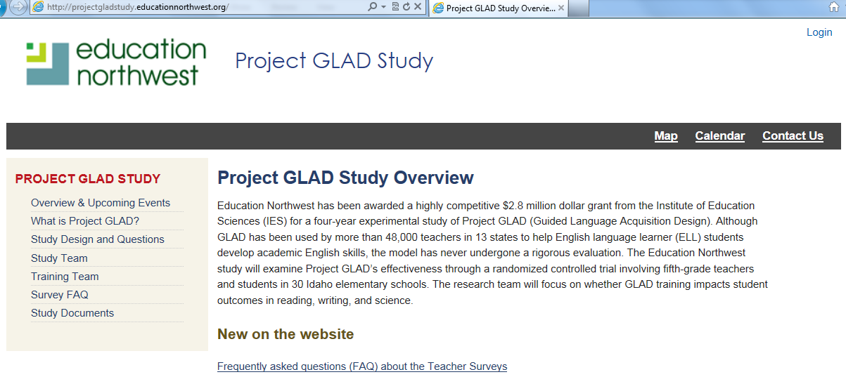
Consistent look, content, and contact

Slide 8
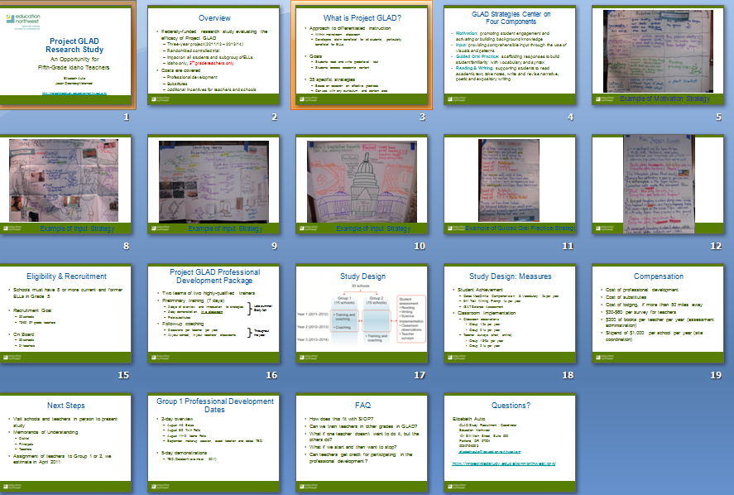

Slide 9
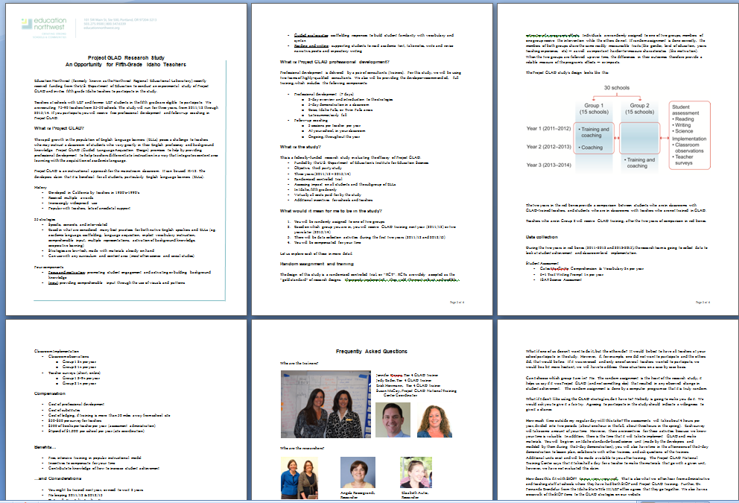

Slide 10
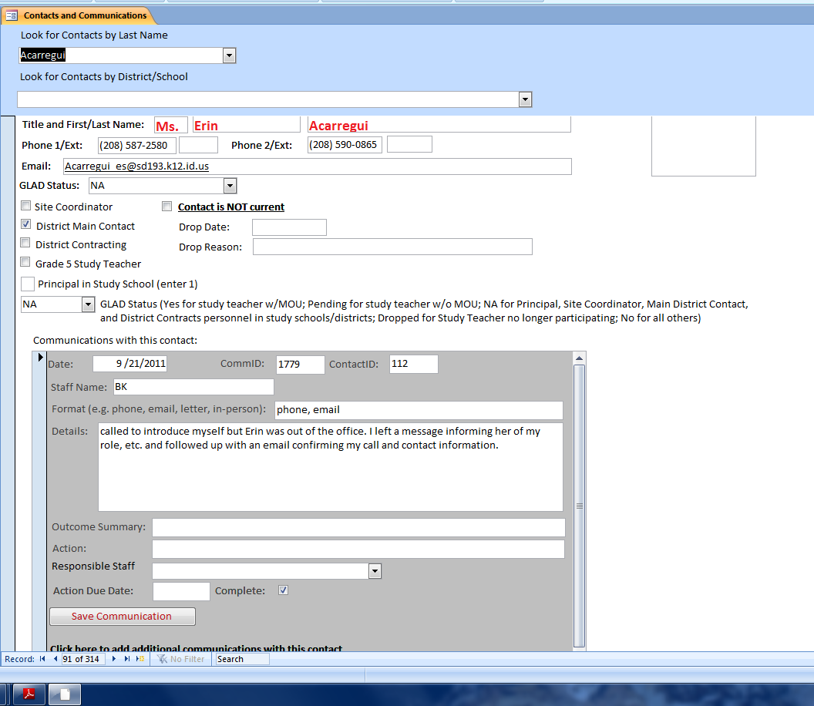

Slide 11
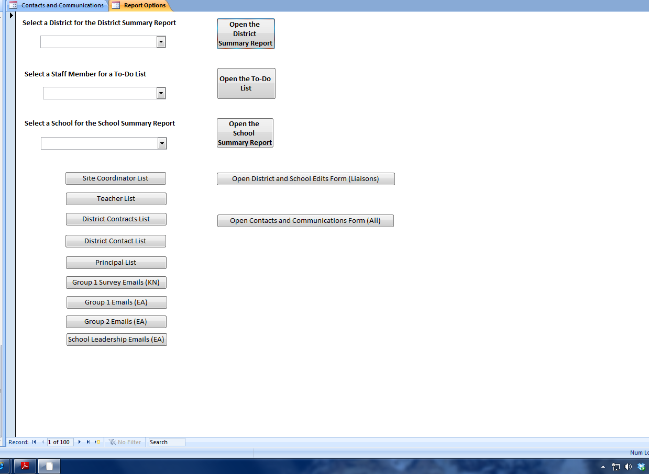

Slide 12
2. Make participation attractive
Needs
Wants
Incentives
Share data
RCTs: Delayed tx
Helping via research

Slide 13
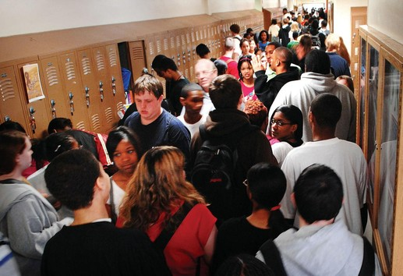
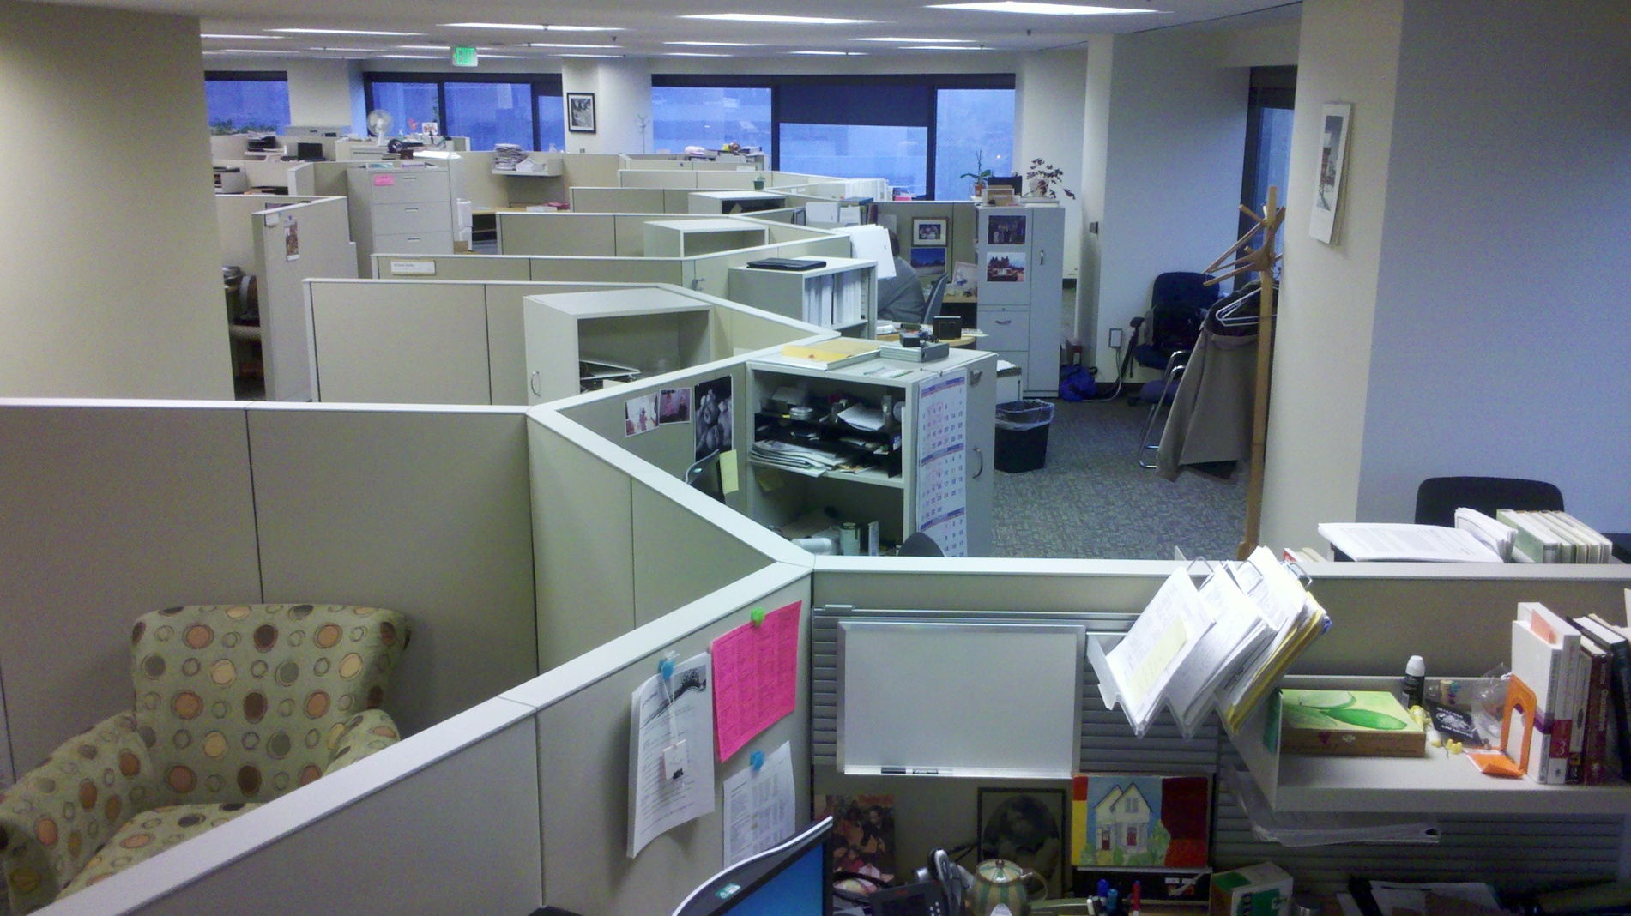

Slide 14
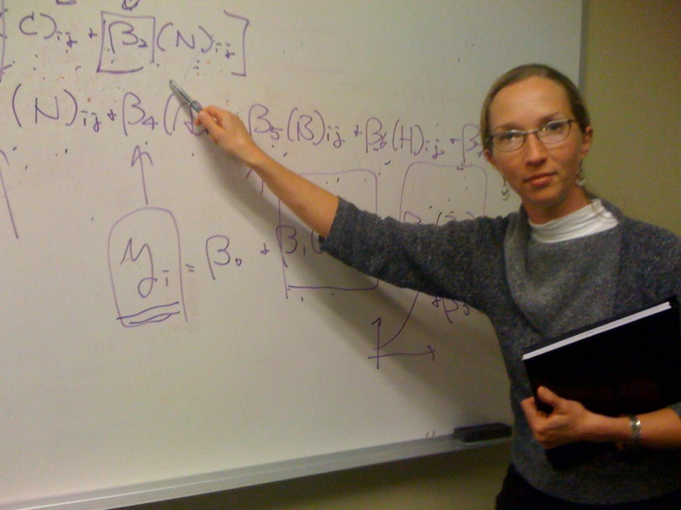
3. Don’t think like a researcher

Slide 15
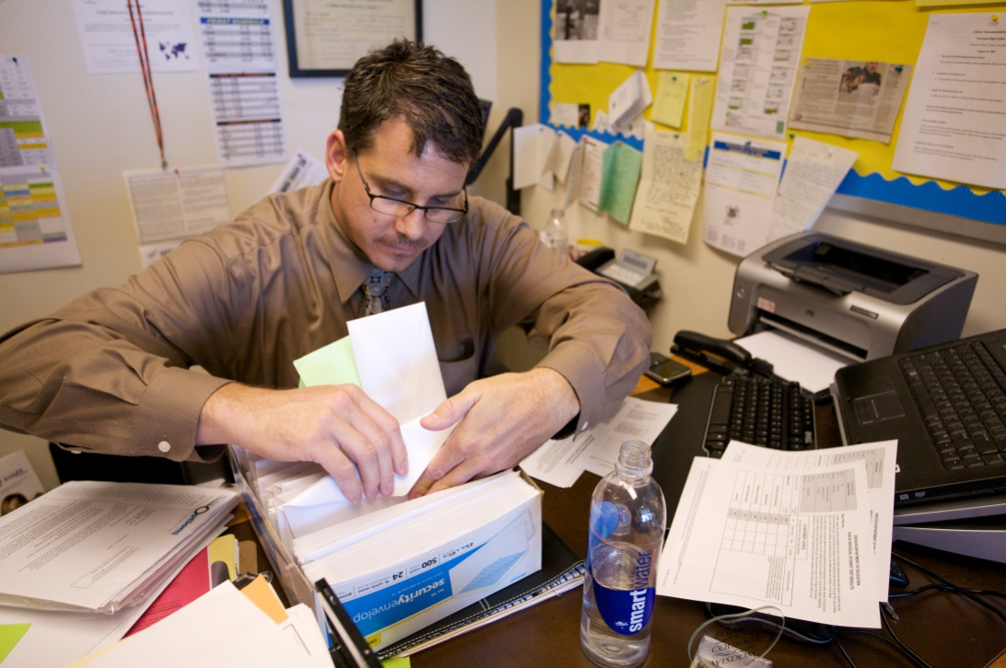
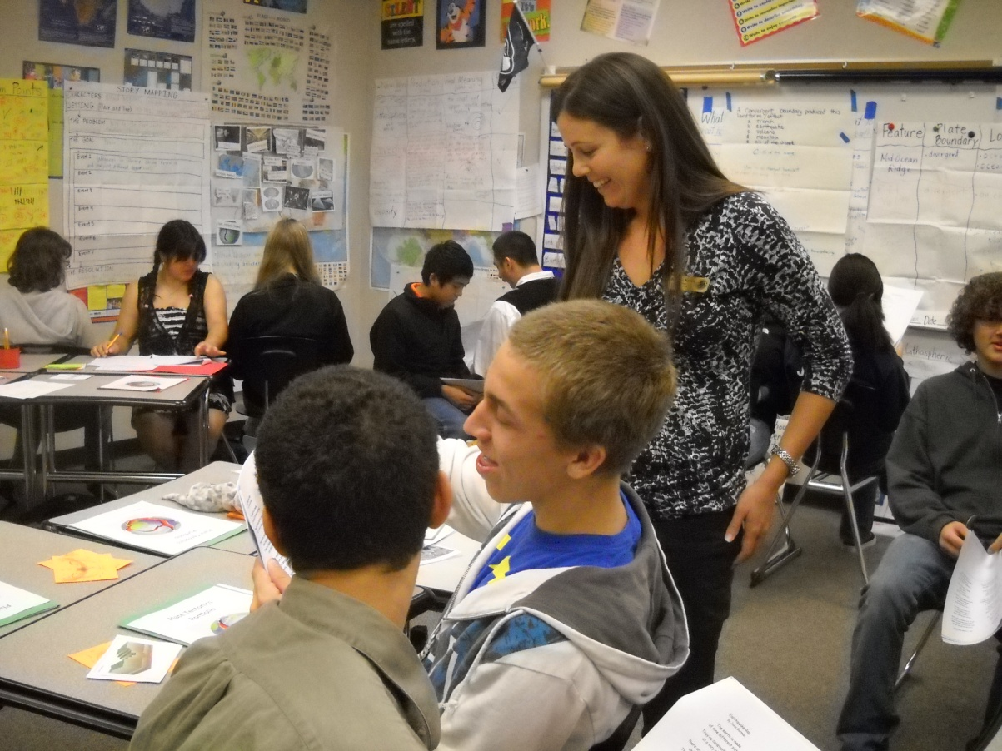
What will we get?
What do we have to do?
Why would we want to do that?
How much additional time will this take?
Will it help my kids?
Does it mesh with what we are already doing?

Slide 16
4. Match the medium to the message
Email
Telephone
Webinars
In-person

Slide 17
5. Find a champion

Slide 18
6. Get the teachers on board
Appropriate medium
Increased buy-in
Personal connection
Control message
$

Slide 19
Tips for teacher recruitment sessions
Be on time (add extra travel time)
Confirm address and directions
Take snacks
50-60 minutes
Be flexible about scheduling
If possible, pool teachers across a district
Be clear about who you are and who is funding the study
Show the intervention/program

Slide 20
Tips, cont.
If you don’t know that it “works”, be honest
Layperson explanation of design, methods
Be aware of their community

Slide 21
7. Know when to hold ‘em and when to fold ‘em
Early supporters
Middle, “as planned”
Challenges, less responsive

Slide 22
8. Put a signature on it
Memoranda of Understanding
Teachers
Districts
Principals
Legal review
Non-binding
Have a follow-up procedure

Slide 23
GLAD Teacher MOU Collection Steps
AFTER AN INFORMATION SESSION
(1) Database: Under “Districts and Schools”, enter recruitment session date.
(2) Database: Enter teacher name as “contact” and information session attendance as “communication”
Indicate that a follow-up email about the MOU is needed by DB 2 weeks after the session attendance date.
RUN REPORT
Database: Run “Summary of NWED Actions” report every Mon
RECEIVE T MOU before follow-up
Enter MOU as received into database
Send T a photocopy of MOU and thank you note
Scan MOU and electonically file at H:/Evaluation/GLAD/MOUs/Teacher copies
File hard copy of MOU
Mark follow-up as complete
Add to thermometer
DONE
DO NOT RECEIVE T MOU before follow-up
Send Follow-up email #1
Database: Under “communications”, mark follow-up as complete
Database: Under “communications”, enter email follow-up conducted by DB and indicate a second follow-up needed by DB 1 week later
T responds YES I’M INTERESTED
Respond with Follow-up email #2 asking when they are sending the MOU and if we can follow-up with them again
Database: Enter email as “communication” and indicate follow-up needed by DB 1 week later
T responds NO THANK YOU
Send No thanks email
Database: Under “Contacts” mark as “not interested”
Database: Under “Communications:, mark follow-up as complete
DONE
T DOES NOT RESPOND
Call to follow-up [see script]
RECEIVE T MOU
Enter MOU as received into database
Mark follow-up as complete
Send T a photocopy of MOU and thank you note
Scan MOU and electonically file at H:/Evaluation/GLAD/MOUs/Teacher copies
File hard copy of MOU
Add to thermometer
DONE
DO NOT RECEIVE T MOU
Send follow-up email #3 and repeat follow-up steps 1x

Slide 24
GLAD District and Principal MOU Collection Steps
Database: Under each principal and district rep (which all already exist) in “Contacts and Communications”, enter as a “communication” that the MOU and cover letter were sent on 6-15 by DB. Indicate that a follow-up about the MOU is needed by DB in 2 weeks.
RUN REPORT
Database: Run “Summary of NWED Actions” report every Mon
RECEIVE MOU before follow-up
Enter MOU as received into database
Scan MOU and electronically file at H:/Evaluation/GLAD/MOUs/District copies or
H:/Evaluation/GLAD/MOUs/School copies
File hard copy of MOU
Mark follow-up as complete
DONE
DO NOT RECEIVE MOU before follow-up
Call (all phone numbers are in database)
Database: Under “communications”, mark follow-up as complete
Database: Under “communications”, enter call follow-up conducted by DB and indicate a second follow-up needed by DB 1 week later

Slide 25
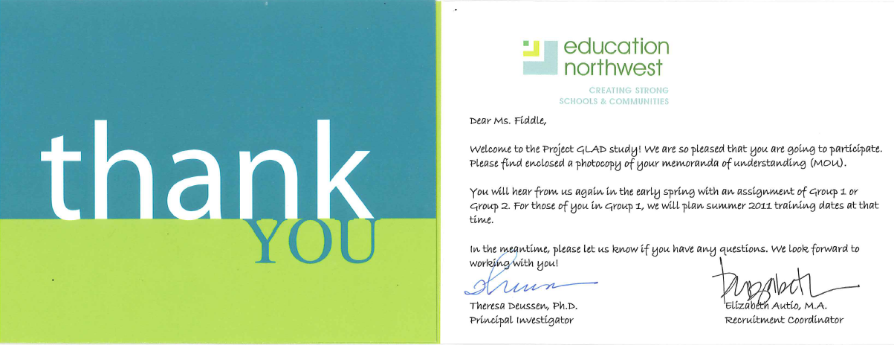
9. Keep in touch

Slide 26
Ongoing contact and information sharing
Email distribution lists
Website
Webinars
Post random assignment
At start of school year
Study team liaisons

Slide 27
10. Time, Time, Time (Money, Money, Money)
It will take more than you think!
9 months active recruitment
11 months including planning time/waiting for school year to start

Slide 28
Budget Iterations
Proposal ~$25,000 Oct 09
Revision 1 $34,000 Jul 10
Revision 2 $58,000 Sep 10
Revision 3 “It will cost what it will cost.”

Slide 29
Final Costs
Professional staff | 1,223 hrs | $113,456
Support staff | 80 hrs | 5,178
Travel | 8 trips | 9,525
SUBTOTAL |  | $128,159
Database | 120 hrs | $11,217
TOTAL |  | $139,376

Slide 30
Buy-In
Implementation
Attrition

Slide 31
Wrap-up
Elizabeth Autio
elizabeth.autio@educationnorthwest.org
503-275-9593
projectgladstudy.educationnorthwest.org

